Slide 1
Section 6.10
Square Roots and the Pythagorean Theorem

Slide 2
Square Roots
Table 1: Squares of Whole Numbers from 1 to 20
1² = 1 | 6² = 36 | 11² = 121 | 16² = 256
2² = 4 | 7² = 49 | 12² = 144 | 17² = 289
3² = 9 | 8² = 64 | 13² = 169 | 18² = 324
4² = 16 | 9² = 81 | 14² = 196 | 19² = 361
5² = 25 | 10² = 100 | 15² = 225 | 20² = 400

Slide 3
Definition: Terminology of Radicals
The symbol is called a radical sign.
The number under the radical sign is called the radicand.
The complete expression, such as is called a radical or radical expression.

Slide 4
Square Roots (cont.)
Table 2: Square Roots of Perfect Squares from 1 to 400

Slide 5
Example 1: Evaluating Perfect Squares
Use your memory of the values in Table 1 to evaluate each expression.
Solution

Slide 6
Example 2: Evaluating Square Roots
Use your memory of the values in Table 2 to evaluate each expression.
Solution
c.
d.
c.
d.

Slide 7
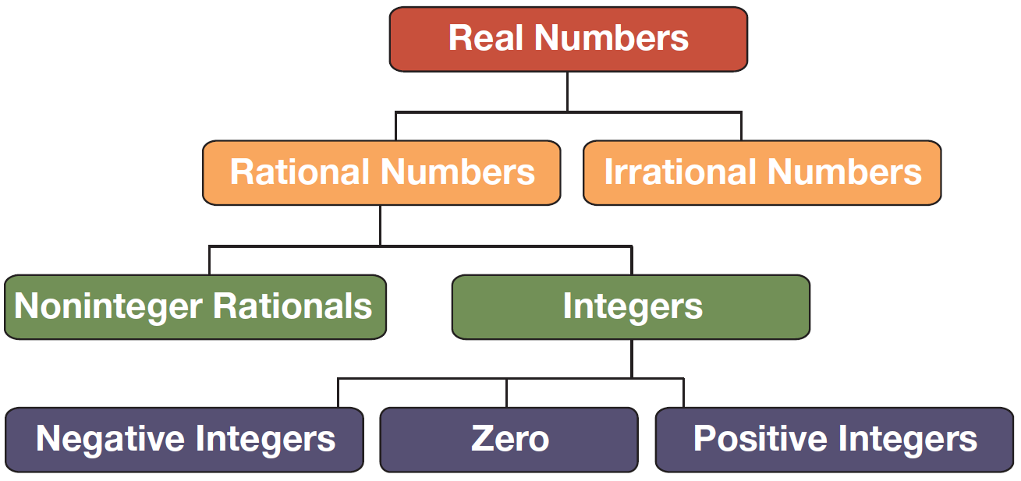
Square Roots (cont.)
Figure 1

Slide 8
Definition: Square Root
For any real number a and any nonnegative real number b, a is a square root of b if a² = b. If a is positive, then we write Thus,

Slide 9
Example 3: Evaluating Expressions Containing Square Roots
Evaluate each expression.
Solution
Even though we do not know the exact decimal value of its square must be 3. Thus,
b.
c.

Slide 10

Example 4: Calculating Square Roots Using a Calculator
Use a calculator to approximate each square root to the nearest ten-thousandth.
Solution

Slide 11
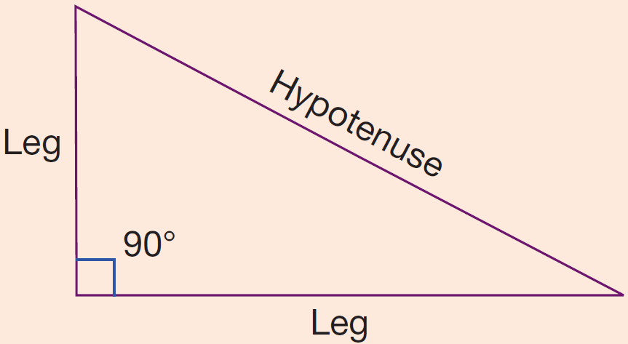
Definition: Terms Related to Right Triangles
Right triangle: A triangle containing a right (90°) angle
Hypotenuse: The longest side of a right triangle; the side opposite the right angle
Leg: Each of the other two sides of a right triangle (the sides that are not the hypotenuse)

Slide 12
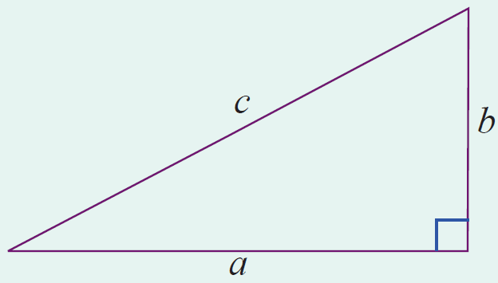
Theorem: The Pythagorean Theorem
In a right triangle, the square of the length of the hypotenuse is equal to the sum of the squares of the lengths of the two legs.

Slide 13
Example 5: Verifying Right Triangles
Show that a triangle with sides of lengths 3 inches, 4 inches, and 5 inches must be a right triangle.
Solution
If the triangle is a right triangle, then its three sides must satisfy the property stated in the Pythagorean Theorem: c² = a² + b². Or, in this case, 5² = 3² + 4². Since 25 = 9 + 16 is a true statement, the triangle is a right triangle.

Slide 14
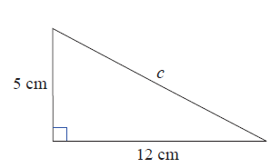
Example 6: Finding the Length of the Hypotenuse
Find the length of the hypotenuse of a right triangle with legs of length 12 cm and 5 cm.
Solution
Let c = the length of the hypotenuse.
Now, by the Pythagorean Theorem:
The length of the hypotenuse is 13 cm.

Slide 15
Example 7: Finding the Length of a Leg
Use a calculator and the Pythagorean Theorem to find the length of a leg (to the nearest hundredth) of a right triangle with hypotenuse 20 inches long and the other leg 13 inches long.
Solution
In this case, the length of the hypotenuse is known and the unknown is one of the legs.
Let x = the length of the unknown leg.

Slide 16
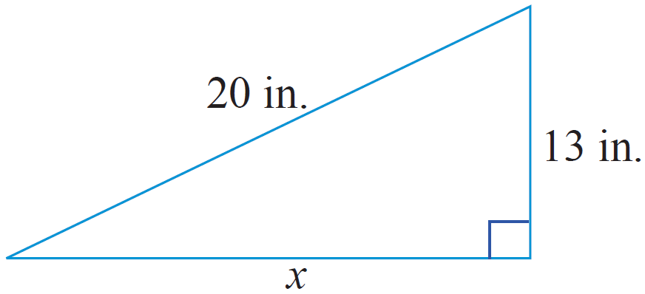
Example 7: Finding the Length of a Leg (cont.)
Then, by the Pythagorean Theorem, we have the following.
So the leg is 15.20 inches long (accurate to the nearest hundredth).

Slide 17
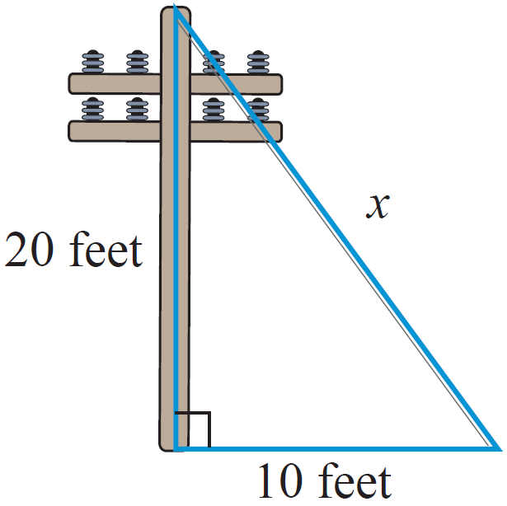
Example 8: Application: Finding the Length of the Hypotenuse
A guy wire is attached to the top of a telephone pole and anchored to the ground 10 feet from the base of the pole. If the pole is 20 feet high, what is the length of the guy wire to the nearest hundredth?
Solution
Let x = the length of the guy wire.

Slide 18
Example 8: Application: Finding the Length of the Hypotenuse (cont.)
The guy wire is about 22.36 feet long.
Then, by the Pythagorean Theorem:

