Slide 1
Section 4.1
Introduction to Decimal Numbers

Slide 2
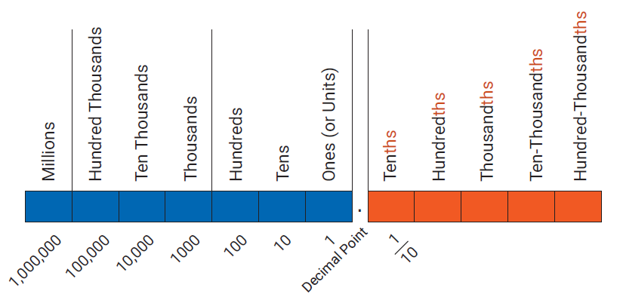
Reading and Writing Decimal Numbers
Figure 1

Slide 3
Procedure: Reading or Writing a Decimal Number
Read (or write) the whole number.
Read (or write) the word “and” in place of the decimal point.
Read (or write) the fraction part as a whole number. Then, name the fraction part with the name of the place value of the last digit on the right.

Slide 4
Note
If there is no whole number part, then 0 can be written to the left of the decimal point.
For example, .6 can be written as 0.6 and in most cases 0.6 is preferred.

Slide 5
Example 1: Reading and Writing Decimal Numbers
Write the mixed number in decimal notation and in words.
Solution
And indicates the decimal point; the digit 6 is in the tenths position.
48
.
6
In decimal notation
forty-eight
and
six tenths
In words

Slide 6
Example 2: Reading and Writing Decimal Numbers
Write the mixed number in decimal notation and in words.
Solution
And indicates the decimal point; the digit 5 is in the ten-thousandths position.
Two 0s must be inserted as placeholders so the digits 7 and 5 will be in the right places.
12
.
0075
In decimal notation
twelve
and
seventy‑five ten thousandths
In words

Slide 7
Attention!
The letters ths (or th) at the end of a word indicate a fraction part (a part to the right of the decimal point).
six hundred = 600 two hundred thousand = 200,000
six hundredths = 0.06 two hundred-thousandths = 0.00002

Slide 8
Example 3: Reading and Writing Decimal Numbers
Write each number in decimal notation. Note how and indicates the decimal point.
four hundred and two thousandths
four hundred two thousandths
Solution
four hundred and two thousandths
400
.
002
The digit 2 is in the thousandths position.
Two 0s must be inserted as placeholders

Slide 9
Example 3: Reading and Writing Decimal Numbers (cont.)
b. four hundred two thousandths
0 .
402

Slide 10
Procedure: Comparing Two Positive Decimal Numbers
Moving left to right, compare digits with the same place value. Insert 0s to the right to continue comparison, if necessary.
When one compared digit is larger, then the corresponding number is larger.

Slide 11
Example 4: Comparing Positive Decimal Numbers
Which number is larger: 3.126 or 3.14?
Solution
Comparing digits with the same place value from left to right (until we find a mismatch) gives the following.
3. 1 2 6
3. 1 4 0
Because 4 > 2, the number 3.14 is greater than 3.126. That is, 3.14 > 3.126.
Mismatch

Slide 12
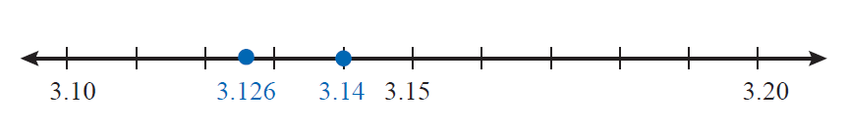
Example 4: Comparing Positive Decimal Numbers (cont.)
Graphing these values on a number line,
we have 3.14 > 3.126 and 3.14 lies to the right of 3.126.

Slide 13
Example 5: Comparing Positive Decimal Numbers
Which number is larger: 0.08 or 0.085?
Solution
Comparing digits with the same place value from left to right (until we find a mismatch) gives the following.
0.0 8 0
Mismatch
0.0 8 5
Because 5 > 0, we know that 0.085 > 0.08.

Slide 14
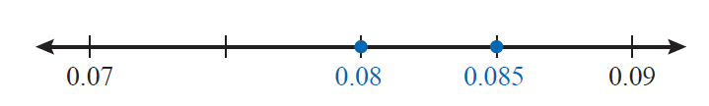
Example 5: Comparing Positive Decimal Numbers (cont.)
Graphing these values on a number line,
we have 0.085 > 0.08 and 0.085 lies to the right of 0.08.

Slide 15
Procedure: Comparing Two Negative Decimal Numbers
Moving left to right, compare digits with the same place value. Insert 0s to the right to continue comparison, if necessary.
When one compared digit is smaller, then the corresponding number is larger.

Slide 16
Example 6: Comparing Negative Decimal Numbers
Which number is larger: −4.7 or −4.78?
Solution
Comparing digits in −4.7 and −4.78 from left to right (until we find a mismatch) gives the following.
−4. 7 0
Mismatch
−4. 7 8
Because 0 < 8, the number −4.7 is greater than −4.78. That is, −4.7 > −4.78.

Slide 17
Example 6: Comparing Negative Decimal Numbers (cont.)
Graphing these values on a number line, we have −4.7 > −4.78 and −4.7 lies to the right of −4.78. (Remember, on a number line larger numbers are always on the right.)

Slide 18
Procedure: Rounding Rule for Decimal Numbers
Look at the single digit one place value to the right of the digit in the place of desired accuracy.
͏If this digit is less than 5, leave the digit in the desired place of accuracy as it is and replace all digits to the right with zeros. All digits to the left remain unchanged.
͏If this digit is 5 or greater, increase the digit in the desired place of accuracy by one and replace all digits to the right with zeros. All digits to the left remain unchanged unless a 9 is made one larger. Then, the 9 is replaced by 0 and the next digit to the left is increased by 1.

Slide 19
Procedure: Rounding Rule for Decimal Numbers (cont.)
Zeros to the right of the place of accuracy that are also to the right of the decimal point must be dropped. In this way, the place of accuracy is clearly understood. If a rounded number has a 0 in the desired place of accuracy, then that 0 remains.

Slide 20
Example 7: Rounding Decimal Numbers
Round 18.649 to the nearest tenth.
Solution
Since 4 is less than 5, leave the 6 and replace 4 and 9 with 0s.
Now, the 6 is to the right of the decimal point and the 0s to the right of the 6 in 18.600 are dropped so that the place of accuracy is indicated by the 6.
Thus, 18.649 rounds to 18.6 to the nearest tenth.
6 is in the tenths place.
18.649
The next digit to the right is 4.

Slide 21
Example 8: Rounding Decimal Numbers
Round 5.83971 to the nearest thousandth.
Solution
Thus, 5.83971 rounds to 5.840 to the nearest thousandth, and only two 0s are dropped.
Notice that the digit 3 changed to a 4 since the 9 was made one larger during rounding.
Since 7 is greater than 5, increase 9 by one and replace 7 and 1 with 0s. (Increasing 9 by one gives 10, which affects the digit 3 as well.)
9 is in the thousandths place.
5.83971
The next digit to the right is 7.

Slide 22
Completion Example 9: Rounding Decimal Numbers
Round 0.6753 to the nearest hundredth.
Solution
The digit in the hundredths position is ____.
The next digit to the right is ____.
Since ____ is equal to 5, change the ____ to ____ and replace ____ and ____ with 0s.
So, 0.6753 rounds to ______ to the nearest hundredth (with two 0s dropped).

