Slide 1
Section 3.5
Least Common Multiple (LCM)

Slide 2
Definition: Least Common Multiple (LCM)
The least common multiple (LCM) of two (or more) counting numbers is the smallest number that is a multiple of each of these numbers.

Slide 3
Procedure: Finding the LCM of a Set of Counting Numbers
1. Find the prime factorization of each number.
2. List the prime factors that appear in any one of the prime factorizations.
3. Find the product of these primes using each prime the most number of times it appears in any one of the prime factorizations.

Slide 4
Example 1: Finding the Least Common Multiple (LCM)
Find the LCM of 20 and 45.
Solution
Step 1: Prime factorizations:
Step 2: 2, 3 and 5 are the only prime factors.

Slide 5
Example 1: Finding the Least Common Multiple (LCM) (cont.)
Step 3: The most number of times each prime factor appears in any one factorization:
Two 2s (In 20)
Two 3s (In 45)
One 5 (one in 20 and one in 45)
180 is the smallest number divisible by both 20 and 45. (Note also that the LCM, 180, contains all the factors of the numbers 20 and 45.)

Slide 6
Example 2: Finding the Least Common Multiple (LCM)
Find the LCM of 12, 18, and 48.
Solution
Step 1: Prime factorizations:
Step 2: 2 and 3 are the only prime factors.

Slide 7
Example 2: Finding the Least Common Multiple (LCM) (cont.)
Step 3: The most number of times each prime factor appears in any one factorization:
Four 2s (In 48)
Two 3s (In 18)
144 is the smallest number divisible by 12, 18, and 48.

Slide 8
Completion Example 3: Finding the Least Common Multiple (LCM)
Find the LCM of 36, 24, and 48.
Solution
Step 1: Prime factorizations:
Step 2: _____ and _____ are the only prime factors.
2
3

Slide 9
Completion Example 3: Finding the Least Common Multiple (LCM) (cont.)
Step 3: The most number of times each prime factor appears in any one factorization:
_______ 2s (in 48)
_______ 3s (in 36)
So, LCM = _______________ = ____.
_______ is the smallest number divisible by 36, 24, and 48.
Four
Two
2 · 2 · 2 · 2 · 3 · 3
144
144

Slide 10
Example 4: Finding the Least Common Multiple (LCM)
Find the LCM of 27, 30, and 42.
Solution

Slide 11
Example 5: Finding the Least Common Multiple (LCM)
Find the LCM of 8 and 25.
Solution
In this case, where the two numbers have no common prime factors, the LCM is the product of the two numbers.

Slide 12
Example 6: Finding the Least Common Multiple (LCM)
Find the LCM for 27, 30, and 42; then state how many times each number divides into the LCM.
Solution
Recall from Example 4,
Now determine how many times each number divides into the LCM.
So, 27 divides into 1890 70 times.

Slide 13
Example 6: Finding the Least Common Multiple (LCM) (cont.)
So, 30 divides into 1890 63 times.
So, 42 divides into 1890 45 times.

Slide 14
Example 7: Finding the Least Common Multiple (LCM)
Find the LCM for 12, 18, and 66; then state how many times each number divides into the LCM.
Solution
Begin by finding the LCM.

Slide 15
Example 7: Finding the Least Common Multiple (LCM) (cont.)
Now determine how many times each number divides into the LCM.
So, 12 divides into 396 33 times.
So, 18 divides into 396 22 times.

Slide 16
Example 7: Finding the Least Common Multiple (LCM) (cont.)
So, 66 divides into 396 6 times.

Slide 17
Completion Example 8: Finding the Least Common Multiple (LCM)
Find the LCM of 30, 50, and 63; then state how many times each number divides into the LCM.
Solution
Begin by finding the LCM.
30 = ________
50 = ________
63 = ________
2 ∙ 3 ∙ 5
2 ∙ 3 ∙ 3 ∙ 5 ∙ 5 ∙ 7
2 ∙ 5 ∙ 5
LCM = ______________ = 3150
3 ∙ 3 ∙ 7

Slide 18
Completion Example 8: Finding the Least Common Multiple (LCM) (cont.)
Now determine how many times each number divides into the LCM:
3150 =______________ = (2 ∙ 3 ∙ 5) ⋅ ( ______ )
= 30 ⋅ ___
2 ∙ 3 ∙ 3 ∙ 5 ∙ 5 ∙ 7
3 ∙ 5 ∙ 7
105
105
So, 30 divides into 3150 ______times.

Slide 19
Completion Example 8: Finding the Least Common Multiple (LCM) (cont.)
3150 =______________ = (2 ∙ 5 ∙ 5) ⋅ ( ______ )
= 50 ⋅ ______
3150 =______________ = (3 ∙ 3 ∙ 7) ⋅ ( ______ )
= 63 ⋅ ____
2 ∙ 3 ∙ 3 ∙ 5 ∙ 5 ∙ 7
3 ∙ 3 ∙ 7
63
63
So, 50 divides into 3150 ______times.
2 ∙ 3 ∙ 3 ∙ 5 ∙ 5 ∙ 7
2 ∙ 5 ∙ 5
50
50
So, 63 divides into 3150 ______times.

Slide 20
Example 9: Application: Finding the LCM
Suppose it takes three weather satellites—A, B, and C— different lengths of time to orbit the earth. Satellite A takes 24 hours, B takes 18 hours, and C takes 12 hours. If they are directly above each other now, as shown in Part a. of the given figure, in how many hours will they again be directly above each other in the position shown in Part a.? How many orbits will each satellite have made in that time?

Slide 21
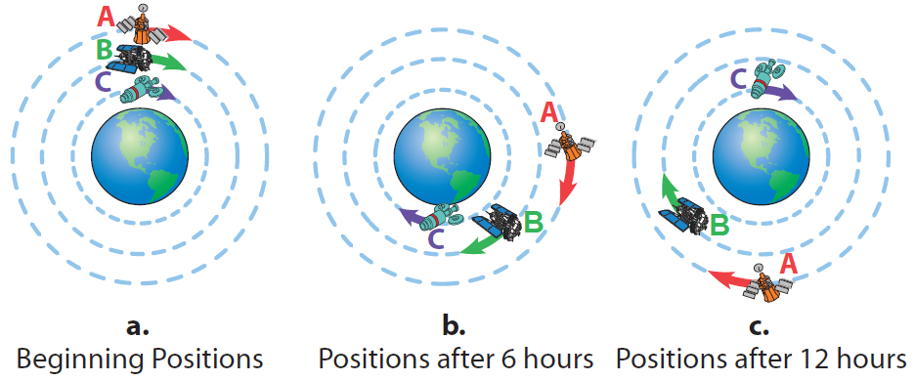
Example 9: Application: Finding the LCM (cont.)

Slide 22
Example 9: Application: Finding the LCM (cont.)
Solution
Step 1: READ: Read the problem carefully and, in this situation, study the figures. Note that there are two questions to be answered. The answer to the number of orbits depends on the number of hours it takes for the satellites to align again.
Step 2: SET UP: Since A takes 24 hours to make one complete orbit, the solution must be a multiple of 24. Similarly, the solution must be a multiple of 18 and a multiple of 12 to allow for complete orbits of satellites B and C.

Slide 23
Example 9: Application: Finding the LCM (cont.)
Step 3: SOLVE: The solution is the LCM of 24, 18, and 12.
Thus, the satellites will align again at the position shown in Part a. in 72 hours (or 3 days).

Slide 24
Example 9: Application: Finding the LCM (cont.)
Note the following.
Satellite A will have made 3 orbits: 24⋅3 = 72
Satellite B will have made 4 orbits: 18⋅4 = 72
Satellite C will have made 6 orbits: 12⋅6 = 72
Step 4: CHECK: Because C goes faster than either A or B, it is reasonable that C makes more orbits in 72 hours than the other two satellites. Since B goes faster than A, it is also reasonable that B makes more orbits than A in 72 hours.

Slide 25
Example 10: Finding the LCM of a Set of Algebraic Terms
Find the LCM of the terms 8x, 25xy³, and 30x²y.
Solution
Write each prime factorization in exponential form (including variables) and multiply the largest powers of each prime factor, including variables.

Slide 26
Example 11: Finding the LCM of a Set of Algebraic Terms
Find the LCM of the terms 6a, a²b, 4a², and 18b³.
Solution
Write each prime factorization in exponential form (including variables) and multiply the largest powers of each prime factor, including variables.

Slide 27
Completion Example 12: Finding the LCM of a Set of Algebraic Terms
Find the LCM of the terms 8xy, 10x², and 20y.
Solution

Slide 28
Procedure: Finding Equivalent Fractions
To find a fraction equivalent to , multiply the
numerator and denominator by the same nonzero whole number.
where
Example:

Slide 29
Example 13: Finding Equivalent Fractions
Find the missing numerator that will make the fractions equivalent.
Solution
Because multiply by
Thus,

Slide 30
Example 14: Finding Equivalent Fractions
Find the missing numerator that will make the fractions equivalent.
Solution
Because multiply by
Thus,

Slide 31
Completion Example 15: Finding Equivalent Fractions
Find the missing numerator that will make the fractions equivalent.
Solution
Because we have
Thus,

