Slide 1
Section 3.10
Ratios and Unit Rates

Slide 2
Definition: Ratios
A ratio is a comparison of two quantities by division. The ratio of a to b can be written as

Slide 3
Attention!
The most common notation for ratios is fraction notation, and that is the notation we will use in this section.

Slide 4
Example 1: Application: Writing Ratios
The floor of a room measures 14 feet long and 10 feet wide. An architect drawing a scale model of the room needs to determine the ratio of the room’s length to its width. Write this ratio as a fraction in lowest terms.
Solution
The ratio of length to width (in that order) in fraction form is
Note that, in addition to reducing the fraction to lowest terms, the common units (feet) were canceled.

Slide 5
Example 2: Writing Ratios that Compare Mixed Numbers
Write each ratio as a fraction in lowest terms.
Solution
a.

Slide 6
Example 2: Writing Ratios that Compare Mixed Numbers (cont.)
Note that in ratios, two numbers are being compared, so the ratio is 2 to 1, not just 2.

Slide 7
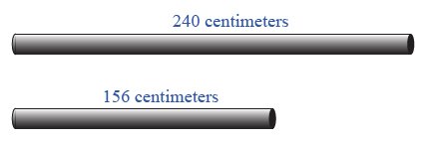
Example 3: Writing Ratios that Compare Decimal Numbers
Two lengths of pipe are shown. Write the ratio of the length of the longer pipe to the length of the shorter pipe by comparing the lengths in centimeters.
Solution
The ratio is

Slide 8
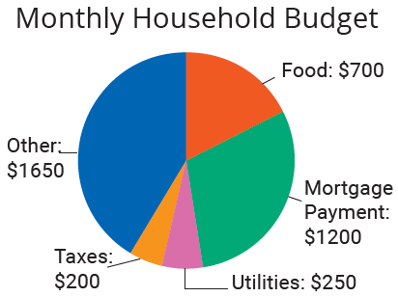
Example 4: Application: Writing Ratios from Graphs
The circle graph shown here illustrates a monthly budget with categories for food, mortgage payment, utilities, taxes, and other.
Use the information from the graph to
find the ratio of money
budgeted for food to money
budgeted for taxes and
find the ratio of the mortgage
payment to the total budget.

Slide 9
Example 4: Application: Writing Ratios from Graphs (cont.)
Solution
The ratio of money budgeted for food to money budgeted for taxes is
The total budget is found by summing the amount spent in each category.

Slide 10
Example 4: Application: Writing Ratios from Graphs (cont.)
So, the ratio of the mortgage payment to the total budget is

Slide 11
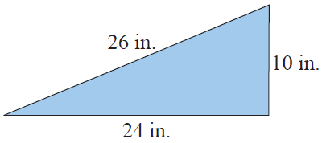
Example 5: Writing Ratios in Geometry
The lengths of the sides of a triangle are 10 in., 24 in., and 26 in.
Find the ratio of the length of the longest side to the length of the shortest side.
Find the ratio of the length of the shortest side to the length of the longest side.

Slide 12
Example 5: Writing Ratios in Geometry (cont.)
Solution
The ratio of the length of the longest side to the length of the shortest side is
The ratio of the length of the shortest side to the length of the longest side is

Slide 13
Note
Notice that the answers to parts a. and b. in Example 5
illustrate how the order of the comparison in the ratio is critical.

Slide 14
Example 6: Writing Ratios that Compare Measurements
Write the ratio of 30 minutes to 2 hours as a fraction in lowest terms.
Solution
The smaller unit is minutes. Because 1 hour = 60 minutes, we have 2 hours = 120 minutes. The ratio can be written as

Slide 15
Example 7: Writing a Rate
Write the following rate as a fraction in lowest terms: 150 kilometers (km) to 8 gallons (gal) of gas.
Solution

Slide 16
Example 8: Application: Interpreting Rates
David made of the baskets he shot in last night’s basketball game. What does this indicate?
Solution
Making of the baskets means that David made 3 baskets for every 4 shots he attempted.
Note: This doesn’t mean that David only attempted 4 shots during the game. It means that he made 6 shots if he attempted 8, made 9 shots if he attempted 12, and so on.)

Slide 17
Procedure: Changing Rates to Unit Rates
To make a rate a unit rate, divide the numerator by the denominator so the denominator is 1 unit.

Slide 18
Example 9: Application: Writing a Unit Rate
A bicyclist rides over level ground at a steady speed of 27 miles (mi) in 3 hours (hr). Find her speed in miles per hour.
Solution
The rate is indicated by the ratio
To find the unit rate, divide the numerator by the denominator.
Thus, her speed is 9 miles per hour, or 9 mph.

Slide 19
Example 10: Application: Writing a Unit Rate
Find the rate of a frog hopping across a road if the road is 20 ft wide and the frog hops 10 times to get across the road. (Assume each hop is the same distance.)
Solution
The rate can be found by comparing the number of feet covered to the number of hops needed.
Thus, the frog’s rate is 2 feet per hop, or 2 ft/hop.

Slide 20
Example 11: Application: Writing a Unit Rate
You find yourself reading a particularly exciting detective thriller novel. In one afternoon in the library, you read 320 pages of this book in 4 hours. What was your reading rate? That is, how many pages did you read in one hour?
Solution
Thus, your reading rate was 80 pages per hour, or 80 pages/hour.

Slide 21
Note
In the past, many consumers did not understand the concept of unit price or know how to determine such a number. Now, most states have a law that grocery stores must display the unit price for certain goods they sell so that consumers can be fully informed.

Slide 22
Example 12: Application: Comparing Unit Prices
An 8-ounce block of Jersey Blue cheese costs $24 and a 16-ounce block of the same cheese at a different store costs $32. Which is the better buy?
Solution
To solve this problem, we must divide to find the price per ounce of each block of cheese. Then we will compare the results to decide which is the better buy.

Slide 23
Example 12: Application: Comparing Unit Prices (cont.)
8-ounce block
The 8-ounce block of Jersey Blue cheese costs $3 per ounce. 16-ounce block
16-ounce block
The 16-ounce block of Jersey Blue cheese costs $2 per ounce.
Thus, the larger block (16 ounces for $32) is the better buy because the price per ounce is less.

Slide 24
Example 13: Application: Comparing Unit Prices
At a Home and Garden show, an artist is selling 8-inch by 10-inch prints of their work in three different bundle sizes.
2 prints for $30
4 prints for $52
6 prints for $72
Find the price per print for each bundle of prints and tell which is the best buy.

Slide 25
Example 13: Application: Comparing Unit Prices (cont.)
Solution
Calculate the unit price for each bundle and then compare.
2 prints for $30
Therefore, the small bundle of prints costs $15 per print.

Slide 26
Example 13: Application: Comparing Unit Prices (cont.)
4 prints for $52
The medium bundle of print costs $13 per print.
6 prints for $72
The largest bundle of prints costs $12 per print.

Slide 27
Example 13: Application: Comparing Unit Prices (cont.)
Looking at the price per print of each bundle, the largest bundle (6 prints) has the lowest price per print and is therefore the best buy.

Slide 28
Special Comment on the Term per
Be aware that the term per can be interpreted to mean divided by.
For example,
cents per ounce means cents divided by ounces
dollars per pound means dollars divided by pounds
miles per hour means miles divided by hours
miles per gallon means miles divided by gallons

