Slide 1
Section 2.3
Subtraction with Integers

Slide 2
Definition: Subtraction with Integers
For any integers a and b,
a − b = a + (−b).
In words, to subtract b from a, add the opposite of b to a.

Slide 3
Example 1: Subtracting Integers
Subtract. Remember, to subtract an integer, you add its opposite.
–1 – (–5)
–10 – 3
–2 – (–7)
4 – 5
–6 – (–6)

Slide 4
Example 1: Subtracting Integers (cont.)
Solution

Slide 5
Example 1: Subtracting Integers (cont.)

Slide 6
Example 2: Subtracting Integers
Subtract.
Think: 7 + (–13)
Think: –7 + (–13)
Think: –16 + (–3)
Think: 25 + (–20)
Think: 32 + (–33)

Slide 7
Example 3: Addition and Subtraction with Integers
Perform the indicated operations.
–3 + 5 – 2
5 – (–7) + (–4)
–9 + (–2) + 6 – (–8)
Solution

Slide 8
Example 3: Addition and Subtraction with Integers (cont.)

Slide 9
Example 4: Application: Calculating Change in Value
On a cold day at a ski resort, the temperature dropped from a high of 25 °F at 1 p.m. to a low of –10 °F at 2 a.m. What was the change in temperature?
Solution
The temperature dropped 35 °F, so the change in temperature was –35 °F.
–10 °F
–
25 °F
=
–35 °F
End temperature
–
Beginning temperature
=
Change in temperature

Slide 10
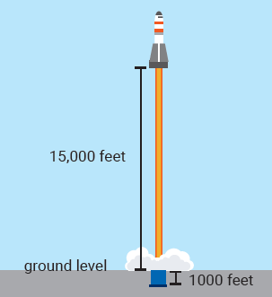
Example 5: Application: Calculating Change in Value
A rocket was fired from a silo 1000 feet below ground level. If the rocket attained a height of 15,000 feet, what was its change in altitude?

Slide 11
Example 5: Application: Calculating Change in Value (cont.)
Solution
The end value was 15,000 feet.
The beginning value was −1000 feet since the rocket was below ground level.
Change in altitude
The change in altitude was 16,000 feet.

Slide 12
Example 6: Application: Calculating Net Change
Trevor started the week with $2500 in his checking account. On Monday he deposited $500, on Tuesday he spent $950, on Wednesday he spent $155, on Thursday he spent $820, and on Friday he deposited $1200. What was the net change in Trevor's bank account over the course of the week?
Solution
By using positive numbers for deposits and negative numbers for withdrawals, we can find the net change as follows.

Slide 13
Example 6: Application: Calculating Net Change (cont.)
500 − 950 − 155 − 820 + 1200 = −225
At the end of the week, the balance in Trevor's checking account had gone down $225.

Slide 14
Example 7: Checking Solutions in Equations
Determine whether the given integer is a solution to the given equation by substituting for the variable and then subtracting.
x – (–6) = –10; x = –14
7 – y = –1; y = 8
a – 12 = –2; a = –10

Slide 15
Example 7: Checking Solutions in Equations (cont.)
Solution
–14 is not a solution.

Slide 16
Example 7: Checking Solutions in Equations (cont.)
8 is a solution.
–10 is not a solution.

