Slide 1
Section 2.2
Addition with Integers

Slide 2
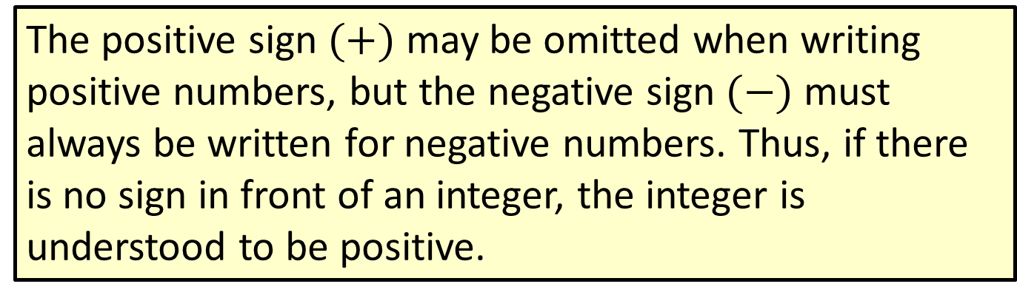
Note
The positive sign $(+)$ may be omitted when writing positive numbers, but the negative sign $(−)$ must always be written for negative numbers. Thus, if there is no sign in front of an integer, the integer is understood to be positive.

Slide 3
Example 1: Adding Integers
Add.
–15 + (–5)
10 + (–2)
4 + 11
–12 + 5
–90 + 90
= –20
= 8
= 15
= –7
= 0

Slide 4
Procedure: Rules for Addition with Integers
To add two integers with like signs,
add their absolute values and
use the common sign.
To add two integers with unlike signs,
subtract their absolute values (the smaller from the larger) and
use the sign of the integer with the larger absolute value.

Slide 5
Example 2: Adding Integers
Add.
10 + 3
(–10) + (–3)
Add the absolute values; + is the common sign.
Add the absolute values; – is the common sign.

Slide 6
Example 2: Adding Integers (cont.)
10 + (–3)
–10 + 3
Subtract the absolute values. Use + because
|+10| > |–3|.
Subtract the absolute values. Use – because
|–10| > |+3|.

Slide 7
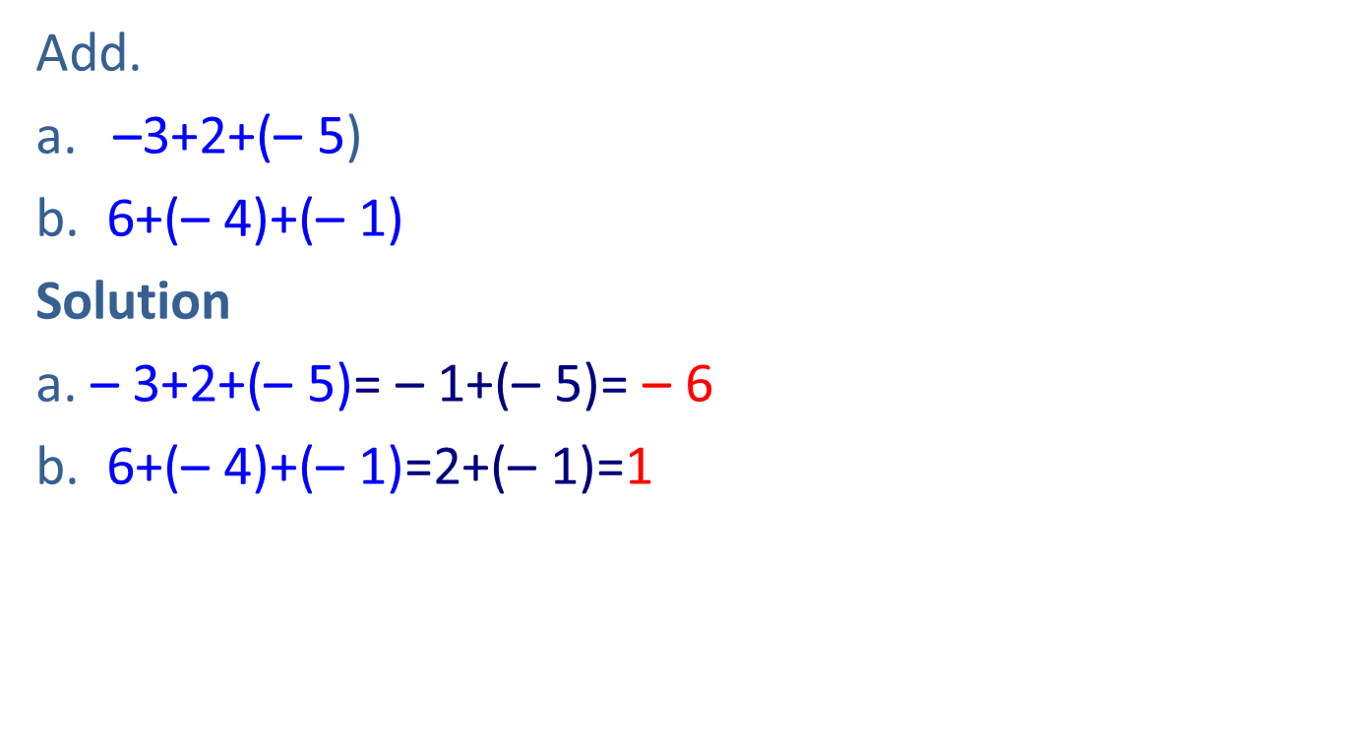
Example 3: Adding Three or More Integers
Add.
–3+2+(– 5)
b. 6+(– 4)+(– 1)
Solution
a. – 3+2+(– 5)= – 1+(– 5)= – 6
b. 6+(– 4)+(– 1)=2+(– 1)=1

Slide 8
Example 4: Adding Three or More Integers
Add.
– 9+13+(– 11) b. 7+(– 20)+(– 30)+8
Solution
– 9+13+(– 11)= – 9+(– 11)+13= – 20+13= – 7
b. 7+(– 20)+(– 30)+8

Slide 9
Definition: Additive Inverse
The opposite of an integer is called its additive inverse.
The sum of any integer and its additive inverse is 0.
Symbolically, for any integer a,
a + (−a) = 0.
As an example,
20 + (–20) = +(|20|–|–20|) = +(20 – 20) = 0.

Slide 10
Example 5: Finding Additive Inverses
Find the additive inverse (opposite) of each number.
5
–2
–15
Solution
The additive inverse of 5 is –5, and 5 + (–5) = 0.
The additive inverse of −2 is 2, and −2 + 2 = 0.
The additive inverse of −15 is 15, and −15 + 15 = 0.

Slide 11
Example 6: Checking Solutions in Equations
Determine whether the given integer is a solution to the given equation by substituting for the variable and adding.
x + 8 = –2; x = –10
x + (–5) = –6; x = 1
17 + y = 0; y = –17

Slide 12
Example 6: Checking Solutions in Equations (cont.)
Solution
–10 is a solution.
1 is not a solution.
≠ is read “not equal to.”

Slide 13
Example 6: Checking Solutions in Equations (cont.)
–17 is a solution.

