Slide 1
Section 16.5
Nonlinear Systems of Equations

Slide 2
Procedure: Solving a System of One Nonlinear Equation and One Linear Equation
To solve a system of two equations that has one nonlinear equation and one linear equation, perform the following steps.
Solve the linear equation for one of the variables and substitute for this variable in the nonlinear equation.
Solve the resulting equation and analyze the results.
Graph the curves on the same set of axes to visualize the number of solutions and check that the solutions are reasonable and satisfy both equations.

Slide 3
Example 1: Solving a System of One Nonlinear and One Linear Equation
Solve the following system of equations and graph both curves on the same set of axes.
A circle and a line:
Solution
Solve x + y = 5 for y (or x). Then substitute into the other equation.

Slide 4
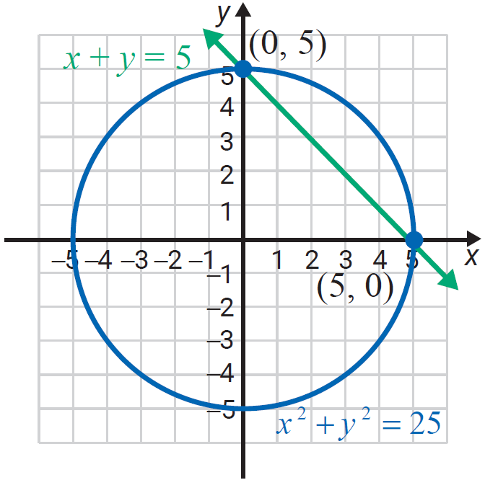
Example 1: Solving a System of One Nonlinear and One Linear Equation (cont.)
Now, solve for x.
The solutions (points of intersection) are (0,5) and (5,0).

Slide 5
Example 2: Solving a System of One Nonlinear and One Linear Equation
Solve the following system of equations and graph both curves on the same set of axes.
A line and a parabola:
Solution
Solve the linear equation for y (or x), then substitute into the quadratic equation. (In this case, the quadratic equation is already solved for y, so we could have chosen to make the substitution into the linear equation instead.)

Slide 6
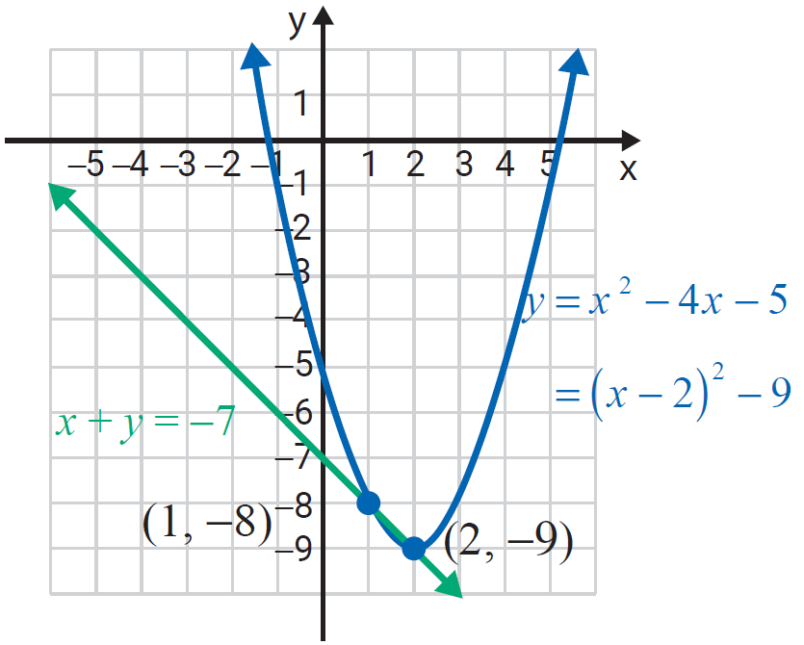
Example 2: Solving a System of One Nonlinear and One Linear Equation (cont.)
The solutions are (2,−9) and (1, −8).

Slide 7
Procedure: Solving a System of Two Nonlinear Equations
To solve a system of two equations that has two nonlinear equations:
The method used depends on the form of the equations.
Substitution may work or addition may work.
Graph the curves on the same set of axes to visualize the number of solutions and check that the solutions are reasonable and satisfy both equations.

Slide 8
Example 3: Solving A System of Two Nonlinear Equations
Solve the following system of equations and graph both curves on the same set of axes.
A hyperbola and a circle:
Solution
Here the method of addition will eliminate y².

Slide 9
Example 3: Solving A System of Two Nonlinear Equations (cont.)

Slide 10
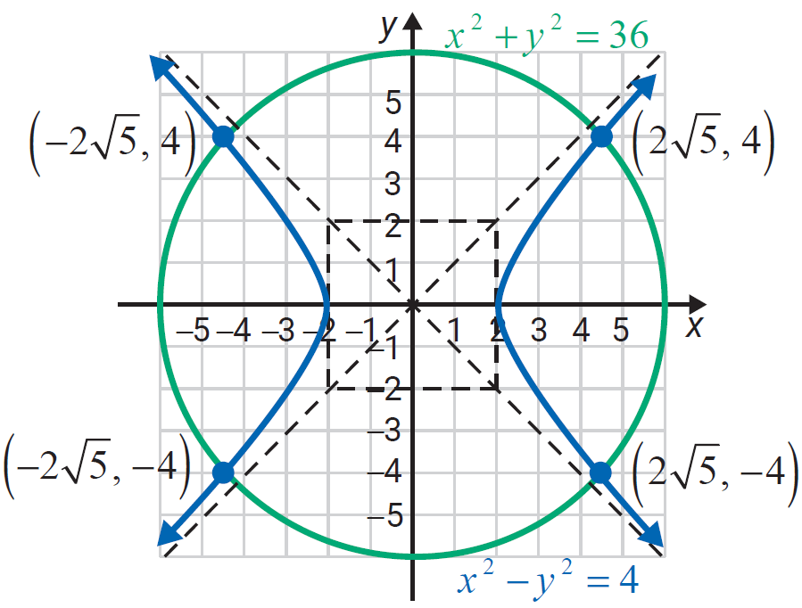
Example 3: Solving A System of Two Nonlinear Equations (cont.)
There are four points of intersection:

Slide 11
Attention!
In the examples and the exercises, the curves intersect. However, there are many situations where the curves do not intersect. This can be confirmed both algebraically and graphically.

