Slide 1
Section 16.2
Parabolas as Conic Sections

Slide 2
Note
The study of geometry with algebraic equations is called analytic geometry. If you continue your studies in mathematics, you will find that analytic geometry can be applied in three dimensions as well as in two dimensions. Related figures would be spheres, ellipsoids (football shapes), and paraboloids (the reflective surfaces of telescopes).

Slide 3
Definition: Equations of Horizontal Parabolas
Equations of horizontal parabolas (parabolas that open to the left or right) can be written in the form
The parabola opens to the left if a < 0 and to the right if a > 0.
The vertex is at (h, k).
The line y = k is the line of symmetry.

Slide 4
Example 1: Sketching Horizontal Parabolas
For find the vertex, the y-intercepts, and the line of symmetry. Then sketch the graph.
Solution
To find the vertex, complete the square.
Therefore, add 0 = 9 – 9.
The vertex is at

Slide 5
Example 1: Sketching Horizontal Parabolas (cont.)
To find the y-intercepts, let x = 0 and use the square root method as follows.
Since a = 1, the parabola has the same shape as x = y².
Vertex:

Slide 6
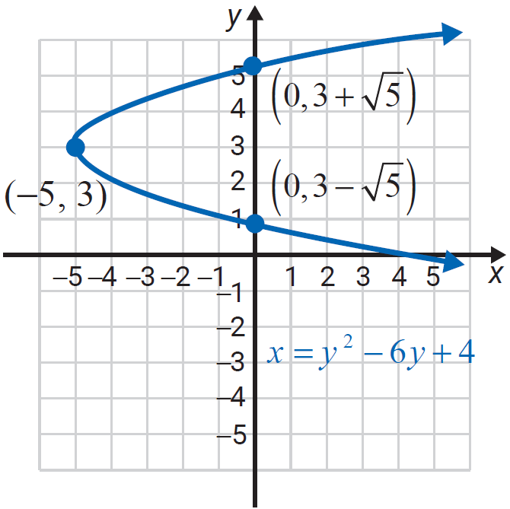
Example 1: Sketching Horizontal Parabolas (cont.)
y-intercepts:
Line of symmetry: y = 3

Slide 7
Example 2: Sketching Horizontal Parabolas
For find the vertex, the y-intercepts, and the line of symmetry. Then sketch the graph.
Solution
To find the vertex, complete the square.

Slide 8
Example 2: Sketching Horizontal Parabolas (cont.)
Therefore, add 0 = 1 – 1 inside the parentheses.
Multiply −2(− 1) = 2 and write this term outside the parentheses
The vertex is at

Slide 9
Example 2: Sketching Horizontal Parabolas (cont.)
To find the y-intercepts, let x = 0 and factor.

Slide 10
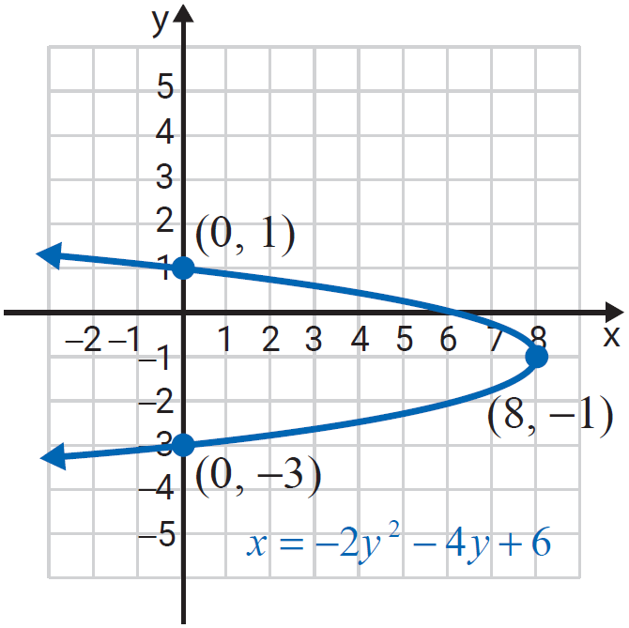
Example 2: Sketching Horizontal Parabolas (cont.)
Since a = −2 , the graph opens to the left and is slightly narrower than x = y² .
Vertex: (8,−1)
y-intercepts: (0, −3) and (0, 1)
Line of symmetry: y = −1

Slide 11
Example 3: Using a Graphing Calculator to Graph Horizontal Parabolas
Use a graphing calculator to graph the horizontal parabola Estimate the y-intercepts using the zoom and trace features of the calculator.
Solution
To solve for y, complete the square and use the square root property as follows.

Slide 12
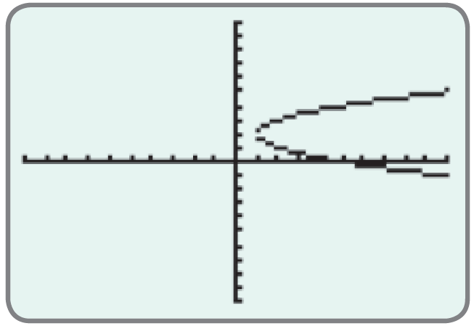
Example 3: Using a Graphing Calculator to Graph Horizontal Parabolas (cont.)
Therefore, add 4 to both sides.
Use the square root property.
Graph both of these equations.
From this graph, we can determine that there are no y-intercepts.

