Slide 1

Section 15.6
Common Logarithms and Natural Logarithms

Slide 2
Example 1: Translating between Exponential Form and Common Logarithms
Exponential Logarithmic
Form Form
This is a common logarithm that equals 4.
This is a common logarithm that equals −2.
This is a common logarithm that equals x.

Slide 3
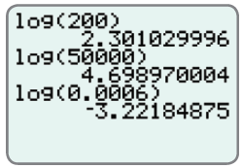
Example 2: Evaluating Common Logarithms Using a Calculator
Use a TI-84 Plus graphing calculator to find the approximate values of the following common logarithms.
a. log 200 b. log 50,000 c. log 0.0006
Solution
From the display, we see the results (accurate to 9 decimal places).
log 200
log 50,000
log 0.0006
≈ 2.301029996
≈ 4.698970004
≈ –3.22184875

Slide 4
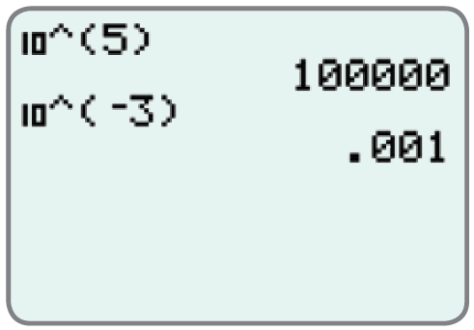
Example 3: Using a Calculator to Find the Inverse Log of N
Use a TI-84 Plus graphing calculator to find the inverse log of N for each expression. (That is, find the value of x.)
log x = 5 c. log x = 2.4142
log x = −3 d. log x = 16.5
Solution
The calculator gives the following
results
x = 10⁵
x = 10⁻³
= 100,000
= 0.001

Slide 5
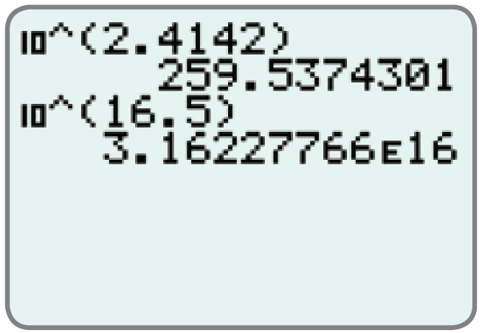
Example 3: Using a Calculator to Find the Inverse Log of N (cont.)
≈ 259.5374301
x = 10^{2.4142}
x = 10^{16.5}
The letter E in the solution is
the calculator version of
scientific notation.
Thus, 3.16227766E16
≈ 3.16227766E16
= 3.16227766 × 10¹⁶.

Slide 6
Example 4: Translating between Exponential Form and Natural Logarithms
Exponential Logarithmic
Form Form
This is a natural logarithm that equals t.
This is a natural logarithm that equals 0.
This is a natural logarithm that equals 2.

Slide 7
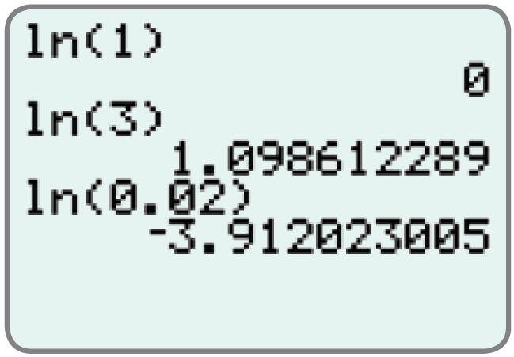
Example 5: Evaluating Natural Logarithms Using a Calculator
Use a TI-84 Plus graphing calculator to find the approximate values of the following natural logarithms.
ln 1 b. ln 3 c. ln 0.02
Solution
From the display, we see the results
(accurate to 9 decimal places).
ln 1
ln 3
ln 0.02
= 0
≈ 1.098612289
≈ −3.912023005

Slide 8
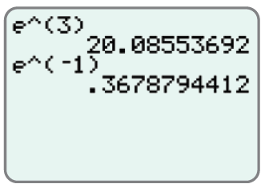
Example 6: Using a Calculator to Find the Inverse ln of N
Use a TI-84 Plus graphing calculator to find the inverse ln of N for each expression. (That is, find the value of x.)
a. ln x = 3 c. ln x = −0.1
b. ln x = −1 d. ln x = 50
Solution
The calculator gives the
following results.

Slide 9
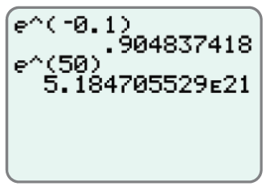
Example 6: Using a Calculator to Find the Inverse ln of N (cont.)

