Slide 1

Section 13.1
Evaluating Radicals

Slide 2
Definition: Radical Terminology
The symbol is called a radical sign.
The number under the radical sign is called the radicand.
The complete expression, such as is called a radical or radical expression.

Slide 3
Definition: Square Root
If a is a nonnegative real number, then
is the principal square root of a,
and
is the negative square root of a.

Slide 4
Note
Square roots of negative numbers are not real numbers. For example, is not a real number because there is no number times itself that results in the negative number Consider how and these both result in a positive number. Later, we will discuss a special type of number called a complex number that can result in a negative number when multiplies by itself.

Slide 5
Example 1: Evaluating Square Roots
Because
we have
and

Slide 6
Example 2: Evaluating Square Roots

Slide 7
Example 3: Estimating Square Roots
A calculator will give rounded to the
nearest ten-thousandth. Check that this is a reasonable
estimate.
Solution
Because 25 < 30 < 36, we have and
The approximation 5.4772 is between 5
and 6 and is reasonable.
Another approach is to square as follows.

Slide 8
Definition: Cube Root
If a is a real number, then is the cube root of a.

Slide 9
Example 4: Evaluating Cube Roots
The cube root of a negative number is a real number and is negative.

Slide 10
Attention!
In the cube root expression , the number 3 is called the index. In a square root expression such as , the index is understood to be 2 and is not written. Expressions with square roots and cube roots (as well as other roots) are called radical expressions.

Slide 11

Example 5: Evaluating Radical Expressions with a Calculator
The following radical expressions are evaluated by
using a TI-84 Plus graphing calculator. In each example,
the steps (or keys to press) are shown. The TI-84 Plus
gives answers rounded to at most ten decimal places. You may choose (through the key) to have answers rounded to fewer places.
a. b. c.

Slide 12


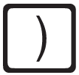

Example 5: Evaluating Radical Expressions with a Calculator (cont.)
Solution
a.
Step 1: Press to get the square root symbol
Step 2: Enter and the right-hand parenthesis .
(Note: When symbol appears, it will appear with a left-hand parenthesis. You should press the right-hand parenthesis to close the square root operation.)
Step 3: Press .

Slide 13
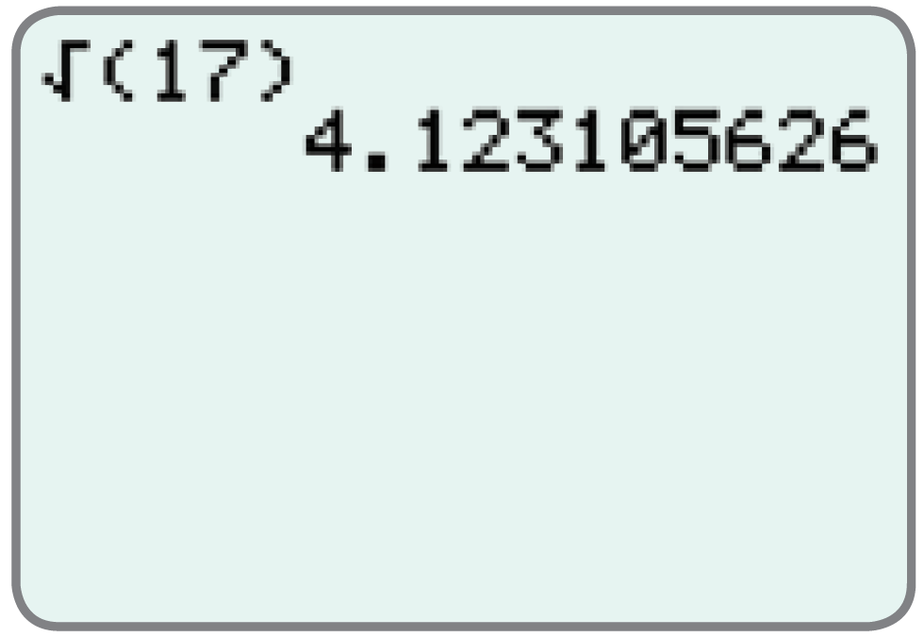
Example 5: Evaluating Radical Expressions with a Calculator (cont.)
The display will appear as follows.

Slide 14





Example 5: Evaluating Radical Expressions with a Calculator (cont.)
Step 1: Press . (Note: The followed by indicates the cube root to the calculator. That is, the 3 takes the place of x in the expression )
Step 2: Enter the left-hand parenthesis , then
, and then finally the right hand parenthesis .
Step 3: Press .

Slide 15
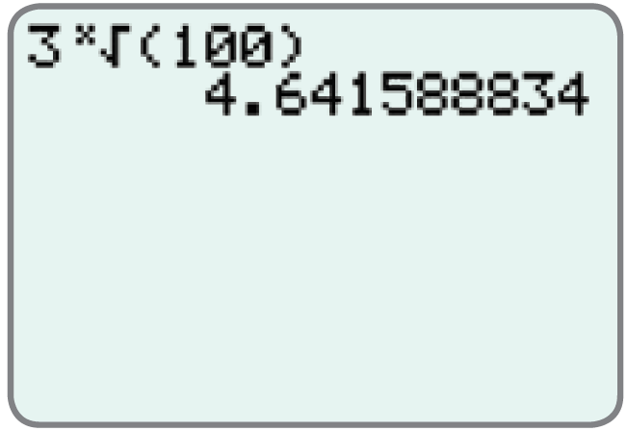
Example 5: Evaluating Radical Expressions with a Calculator (cont.)
The display will appear as follows.

Slide 16

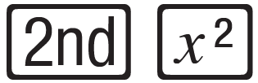

Example 5: Evaluating Radical Expressions with a Calculator (cont.)
Note: This expression represents 3 times
Step 1: Enter .
Step 2: Press . (This gives the symbol.)
Step 3: Enter and the right-hand parenthesis .
Step 4: Press .

Slide 17
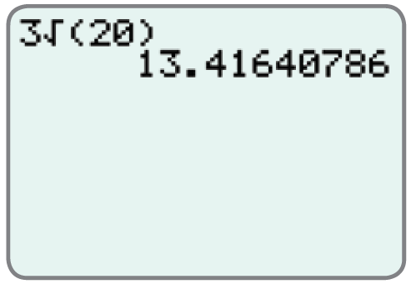
Example 5: Evaluating Radical Expressions with a Calculator (cont.)
The display will appear as follows.

