Slide 1
Section 9.1
Systems of Linear Equations: Solutions by Graphing

Slide 2
Objectives
Determine whether a given ordered pair is a solution to a specified system of linear equations.
Solve systems of linear equations by graphing.
Use a graphing calculator to solve systems of linear equations.

Slide 3
Example 1: Checking Solutions to Systems (Solution)
Show that (2, 1) is a solution to the system
Solution
Substitute x = 2 and y = 1 into both equations.
In the first equation:
True statement

Slide 4
Example 1: Checking Solutions to Systems (Solution) (cont.)
In the second equation:
True statement
Because (2, 1) satisfies both equations, (2, 1) is a solution to the system.

Slide 5
Example 2: Checking Solutions to Systems
(Not a Solution)
Show that (0, 4) is not a solution to the system
Solution
Substitute x = 0 and y = 4 into both equations.
In the first equation:
True statement

Slide 6
Example 2: Checking Solutions to Systems
(Not a Solution) (cont.)
In the second equation:
False statement
Because (0, 4) does not satisfy both equations, (0, 4) is NOT a solution to the system.

Slide 7
To Solve a System of Linear Equations by Graphing
Procedure
Graph both linear equations on the same set of axes.
Observe the point of intersection (if there is one).
If the slopes of the two lines are different, then the lines intersect in one and only one point. The system has a single point as its solution.
If the lines have the same slope and different
y-intercepts, then the lines are parallel. The system has no solution.

Slide 8
To Solve a System of Linear Equations by Graphing
Procedure (cont.)
If the lines are the same line, then all the points on the line constitute the solution. There are an infinite number of solutions.
Check the solution (if there is one) in both of the original equations.

Slide 9
Consistent and Inconsistent Systems of Linear Equations
Definition
A system is consistent if it has one or more solutions.
A system is inconsistent if it has no solutions.

Slide 10
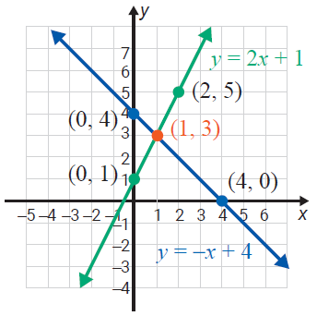
Example 3: Solving Systems (One Solution/
A Consistent System)
Solve the system of equations by graphing.
Solution
In Example 2, we showed that (0, 4) is not a solution to the given system.
However, by graphing both equations, we see that the two lines appear to intersect at the point (1, 3).

Slide 11
Example 3: Solving Systems (One Solution/
A Consistent System) (cont.)
We can check that (1, 3) satisfies both equations by substituting x = 1 and y = 3 into both equations.
Since both substitutions give true statements, the point (1, 3) is the solution to the system and the system is consistent.

Slide 12
Solving Systems of Linear Equations by Graphing
Notes
Before working the examples in this section, you might want to review graphing lines in Chapter 10. Recall that lines can be graphed by plotting intercepts, finding a point on the line and using the slope to find another point, or finding two points.

Slide 13
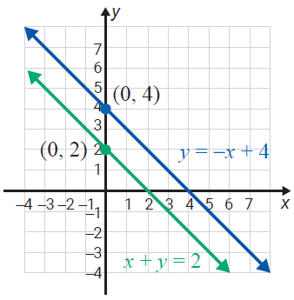
Example 4: Solving Systems (No Solution/
An Inconsistent System)
Solve the system of equations by graphing.
Solution
The graphs of the lines of the equations in the system are shown to the right.

Slide 14
Example 4: Solving Systems (No Solution/
An Inconsistent System)
The lines are parallel. This can be shown by writing the equations in slope-intercept form and noting that they have the same slope and different y-intercepts.
first equation: y = –x + 4 with m = –1 and y-intercept 4
second equation: y = –x + 2 with m = –1 and
y-intercept 2
Thus the lines are parallel and do not intersect, and there is no solution to the system. The system is inconsistent.

Slide 15
Consistent and Inconsistent Systems of Linear Equations
Definition
If the graphs of two linear equations are
the same line, then the equations are dependent.
different lines, then the equations are independent.

Slide 16
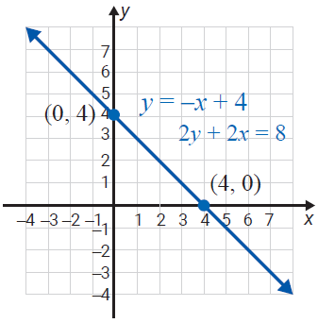
Example 5: Solving Systems (Infinite Solutions/
A Dependent System)
Solve the system of equations by graphing.
Solution
The graphs of both equations
are as follows.
There is just one line because
both equations represent the
same line. That is, they coincide.
Any point that satisfies one of
the equations will also satisfy

Slide 17
Example 5: Solving Systems (Infinite Solutions/
A Dependent System) (cont.)
the other. The system has an infinite number of solutions and the equations are dependent. Putting both equations in the slope-intercept form shows that they are identical.
Solving 2y + 2x = 8 for y gives the following.

Slide 18
Example 5: Solving Systems (Infinite Solutions/
A Dependent System) (cont.)
This is the same as the first equation: y = –x + 4.
Since y = –x + 4 for all points on the line, we can write the set of all solutions in the form (x, –x + 4).

Slide 19
Solving Systems of Linear Equations by Graphing
Attention!
To use the graphing method
Graph the lines as accurately as you can.
Be sure to check your solution by substituting it back into both of the original equations. (Of course,
fractional estimates may not check exactly.)

Slide 20
Example 6: Solving a System that Requires Estimation
Solve the system of equations by graphing.
Solution
The two lines intersect at one point. However, we can
only estimate the point of intersection as
In this situation be aware that, although graphing gives
a good “estimate,” finding exact solutions to the system
is not likely.

Slide 21
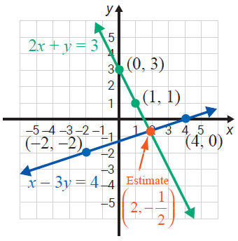
Example 6: Solving a System that Requires Estimation (cont.)

Slide 22
Example 6: Solving a System that Requires Estimation (cont.)
Check:
Substitute x = 2 and
and

Slide 23
Example 6: Solving a System that Requires Estimation (cont.)
Thus checking shows that the estimated solution
does not satisfy either equation. The estimated point of intersection is just that, an estimate. The following sections will provide algebraic techniques for solving systems of equations that would give the exact solution
as

Slide 24
Example 7: Using a Graphing Calculator To Solve a System
Use a graphing calculator’s intersect function
to solve the system of equations.
Solution
Step 1: Solve each equation for y. For this system,

Slide 25


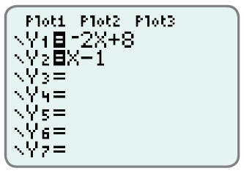


Example 7: Using a Graphing Calculator To Solve a System (cont.)
Solution
Step 2: Press and enter the two expressions for y. To get the variable X, press . The display screen will appear as follows:
Step 3: Press . (Both lines should appear. If not, you may need to adjust the .)

Slide 26


Example 7: Using a Graphing Calculator To Solve a System (cont.)
Step 4: Press and CALC. Select 5: intersect. The cursor will appear on one of the lines. Use the right or left arrow to get near the point of intersection and press . Then move the up or down arrow to get to the other line. Now use the right or left arrow to move closer to the point of intersection on this line and press . Follow the directions for Guess? by moving the cursor to the point of intersection and pressing .

Slide 27
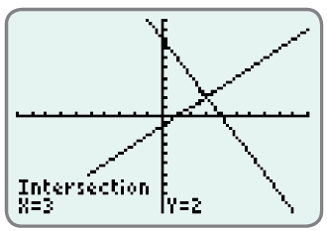
Example 7: Using a Graphing Calculator To Solve a System (cont.)
Step 5: The answer x = 3 and y = 2 will appear at the bottom of the display screen.
Note: Step 4 may seem somewhat complicated, but TRY IT. It is fun and accurate! (If the lines are parallel (an inconsistent system) the calculator will give an error message.)

