Slide 1
Section 6.7
Area

Slide 2
Objectives
Calculate the areas of polygons.

Slide 3
Finding the Area of a Polygon
From the Metric System From the US Customary System
square millimeters (mm²) | square inches (in.²)
square centimeters (cm²) | square feet (ft²)
square meters (m²) | square yards (yd²)
square kilometers (km²) | square miles (mi²)
Table 1

Slide 4
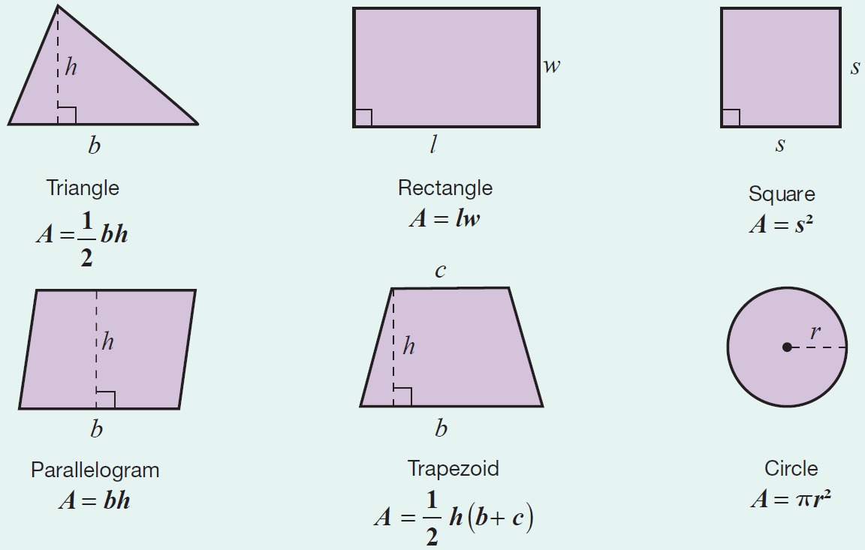
Area Formulas for Five Polygons
Formula

Slide 5
Area Formulas for Five Polygons
Notes
The letter h is used to represent the height of the figure. The height is also called the altitude and is perpendicular to the base.

Slide 6
Example 1: Calculating the Area of a Triangle Using a Formula
Calculate the area of a triangle with height 4 in. and base 10 in. (Be sure to label the answer in square inches.)
Solution
Now, using the formula for the area of a triangle, we have the following.
The area of the triangle is 20 in.²

Slide 7
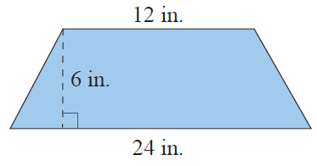
Example 2: Calculating the Area of a Trapezoid Using a Formula
Calculate the area of a trapezoid with altitude 6 in. and parallel sides of length 12 in. and 24 in.
Solution
First draw a figure and label the lengths of the known parts.

Slide 8
Example 2: Calculating the Area of a Trapezoid Using a Formula (cont.)
Now, using the formula for the area of a
trapezoid, we have the following.
The area of the trapezoid is 108 in.²

Slide 9
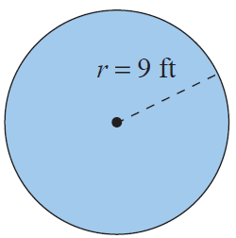
Example 3: Calculating the Area of a Circle
Calculate the area of a circle with a radius of 9 ft.
Using the formula for area:
The area is 254.34 ft².

Slide 10
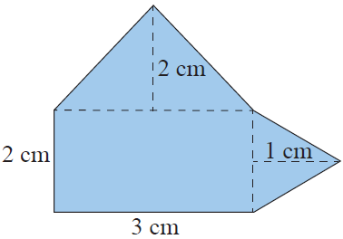
Example 4: Calculating the Area of a Composite Figure
Calculate the area of the composite figure made up of a rectangle and two triangles.
Solution
To find the area of this figure, calculate the area of each part and then add the three areas. The figure is made up of two triangles and one rectangle.

Slide 11
Example 4: Calculating the Area of a Composite Figure (cont.)
Rectangle
Larger Triangle
Smaller Triangle
The area of the composite figure is

Slide 12
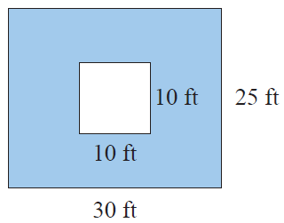
Example 5: Calculating Area
A square is cut out of a rectangle as shown. Calculate the area of the blue shaded region.
Solution
There are three steps in calculating the area of the shaded region. First, calculate the area of the outer figure. Then, calculate the area of the inner figure. Finally,
calculate the difference between the areas.

Slide 13
Example 5: Calculating Area (cont.)
Step 1: Calculate the area of the rectangle.
Step 2: Calculate the area of the square.
Step 3: Calculate the difference between the two areas.
The area of the shaded region is 650 ft².

Slide 14
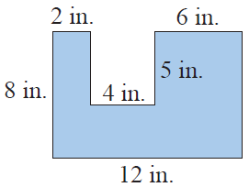
Example 6: Calculating Area
The polygon shown here is a rectangle with a rectangular piece missing. Calculate the area of the polygon.
Solution
There are several ways of finding the area of this figure. One way is to find the area of each of the three parts as illustrated here and then adding the three areas.

Slide 15
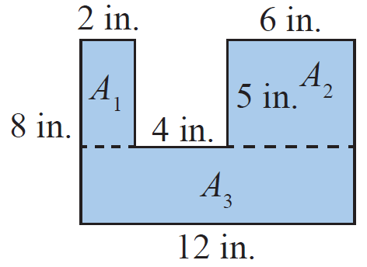
Example 6: Calculating Area (cont.)
The area of the polygon is

Slide 16
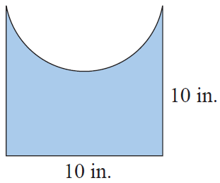
Example 7: Calculating Area
Calculate the area of the figure shown here with a square base and a semicircle cut out of one side. One side of the square is 10 in. long.
Solution
Calculate the area of the square
then subtract the area of the
semicircle.
Area of square = s² = (10 in.)² = 100 in.²

Slide 17
Example 7: Calculating Area (cont.)
Area of semicircle
Area of the figure = 100 in.² – 39.25 in.² = 60.75 in.²
The area of the figure is 60.75 in.²

Slide 18
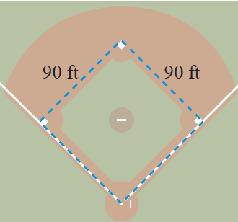
Example 8 Application: Calculating Perimeter and Area
A baseball infield is in the shape of a square 90 ft on each side.
What is the perimeter of the infield?
What is the area of the infield?

Slide 19
Example 8 Application: Calculating Perimeter and Area (cont.)
Solutions
The perimeter of the infield is 360 feet and the area is .

