Slide 1
Section 6.6
Perimeter

Slide 2
Objectives
Recognize various types of polygons.
Calculate the perimeters of polygons.
Calculate the circumference of a circle.

Slide 3
Polygon
Definition
A polygon is a closed plane figure, with three or more sides, in which each side is a line segment.
Each point where two sides meet is called a vertex.
Note: A closed figure begins and ends at the same point.

Slide 4
Perimeter
Definition
The perimeter P of a polygon is the sum of the lengths of its sides.

Slide 5
Finding the Perimeter of a Polygon
From the Metric System | From the US Customary System
millimeter (mm) | inch (in.)
centimeter (cm) | foot (ft)
meter (m) | yard (yd)
kilometer (km) | mile (mi)
Table 1

Slide 6
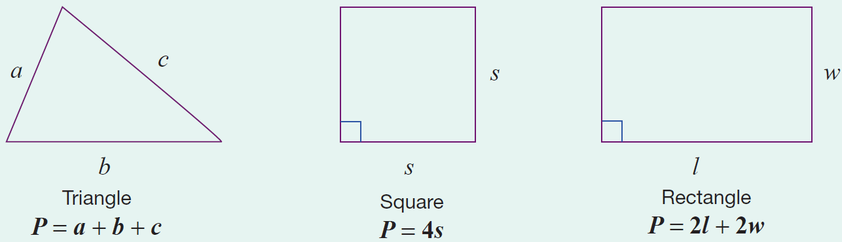
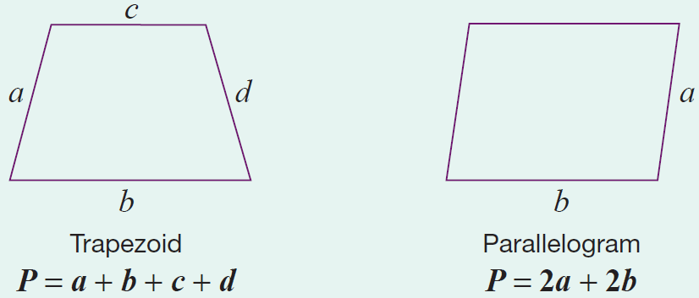
Perimeter Formulas for Five Polygons
Formula
Note that each formula represents the sum of the lengths of the sides.

Slide 7
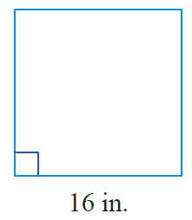
Example 1: Calculating the Perimeter of a Square
Calculate the perimeter of a square with sides of length 16 in.
Solution
Using the formula for the perimeter of a square, we have the following.
The perimeter of the square is 64 in.

Slide 8
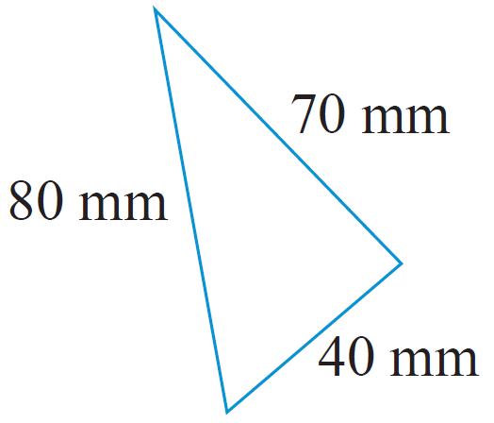
Example 2: Calculating the Perimeter of a Triangle
Calculate the perimeter of a triangle with sides of length 40 mm, 70 mm, and 80 mm.
Solution
First draw a figure and label the lengths
of the sides.
Now, using the formula for the perimeter of a triangle, we have the following.
The perimeter of the triangle is 190 mm.

Slide 9
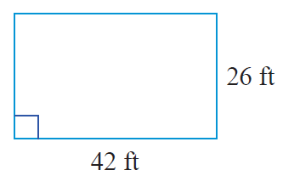
Example 3: Calculating the Perimeter of a Rectangle
Calculate the perimeter of the rectangle.
Solution
Using the formula for the perimeter of a rectangle, we have the following.
The perimeter of the rectangle is 136 ft.

Slide 10
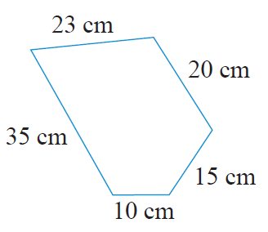
Example 4: Calculating the Perimeter of a Polygon
Calculate the perimeter of the polygon.
(Note: A 5-sided polygon is called a pentagon.)

Slide 11
Example 4: Calculating the Perimeter of a Polygon (cont.)
Solution
The perimeter of any polygon is found by adding the lengths of the sides. Thus, for this pentagon we have the following.
The perimeter of the polygon is 103 cm.

Slide 12
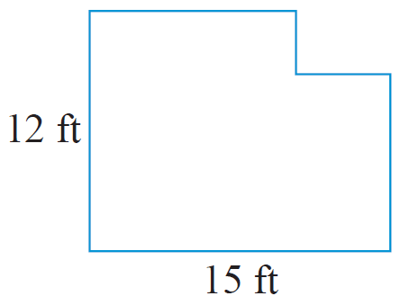
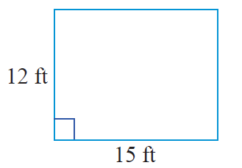
Example 5: Calculating the Perimeter of a Polygon
Calculate the perimeter of the polygon.
Solution
If a rectangle has length 15 ft and width 12 ft, then its perimeter is:

Slide 13
Example 5: Calculating the Perimeter of a Polygon (cont.)
Now, if a small rectangle is cut from one corner of the original rectangle, then a new shape is formed. An interesting fact is that, regardless of the size of the cut out rectangle, this new shape will have the same perimeter as the original rectangle. This is because the length and width of the segments of the indented corner are the same as those of the cut out.

Slide 14
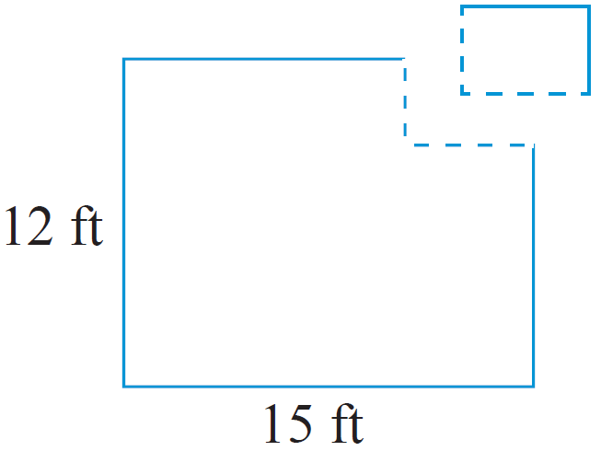
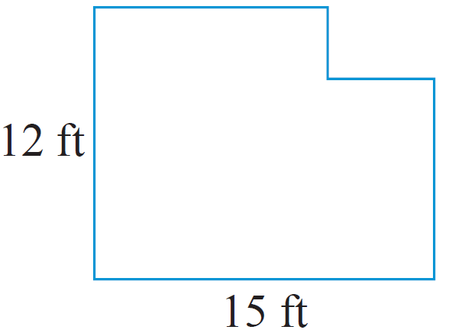
Example 5: Calculating the Perimeter of a Polygon (cont.)
Thus, the perimeter of the polygon is 54 ft.

Slide 15
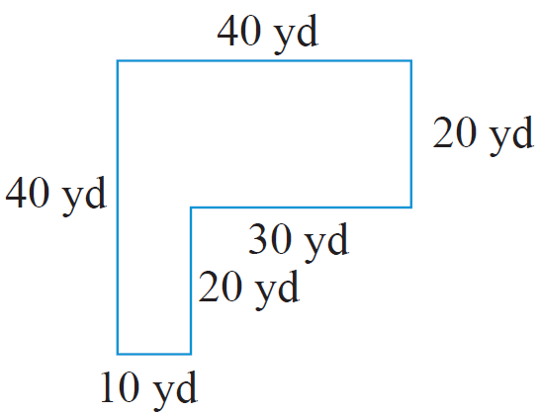
Example 6 Application: Calculating the Perimeter of a Polygon
For security, a chain link fence is to be built on the edge of a property surrounding a new warehouse. The property is L-shaped as shown.
How many yards of fencing will be needed?
What will be the cost of the entire fencing project if the price is $12.50 per yard?

Slide 16
Example 6 Application: Calculating the Perimeter of a Polygon (cont.)
Solution
As the fence is to be put up along the edge of the property, the amount of fencing needed is equivalent to the perimeter of the property.
They will need 160 yd of fencing.

Slide 17
Example 6 Application: Calculating the Perimeter of a Polygon (cont.)
The cost of the fencing will be $2000.

Slide 18
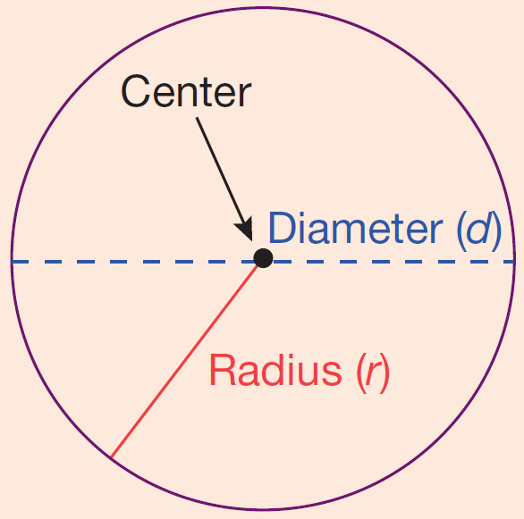
Circles
Definition
Circle: The set of all points in a plane that are
some fixed distance from a fixed point called
the center of the circle.
Radius: The distance from the center of a circle
to any point on the circle. (The letter r is used to
represent the radius of a circle.)
Diameter: The distance from one point on a circle to another point on the circle measured through the center. (The letter d is used to represent the diameter of a circle and d = 2r.)
Circumference: Perimeter of (or distance around) a circle.

Slide 19
The Circumference of a Circle
Formula
To find the circumference C of a circle, use one of the following formulas,
and
where r is the radius and d is the diameter of the circle.

Slide 20
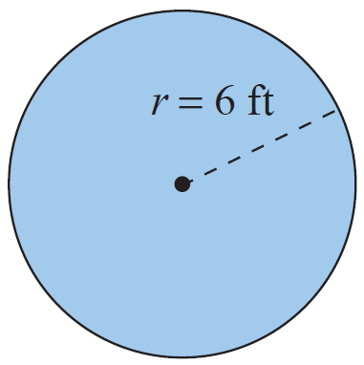
Example 7: Calculating the Circumference of a Circle
Calculate the circumference of a circle with a radius of 6 ft.
Solution
Using the formula for circumference:
The circumference is 37.68 ft.

Slide 21
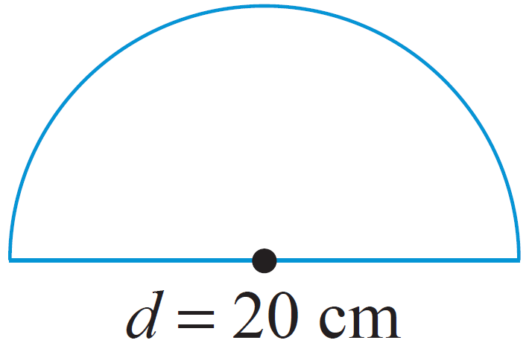
Example 8: Calculating the Perimeter
Calculate the perimeter of the figure shown: a semicircle (half of a circle) and a diameter. The diameter is 20 cm long.
Solution
In order to find the perimeter of the figure,
find the perimeter of the semicircle and then add the diameter.
Length of semicircle

Slide 22
Example 8: Calculating the Perimeter (cont.)
Perimeter = semicircle + diameter
= 31.4 cm + 20 cm = 51.4 cm
The perimeter is 51.4 cm.

Slide 23
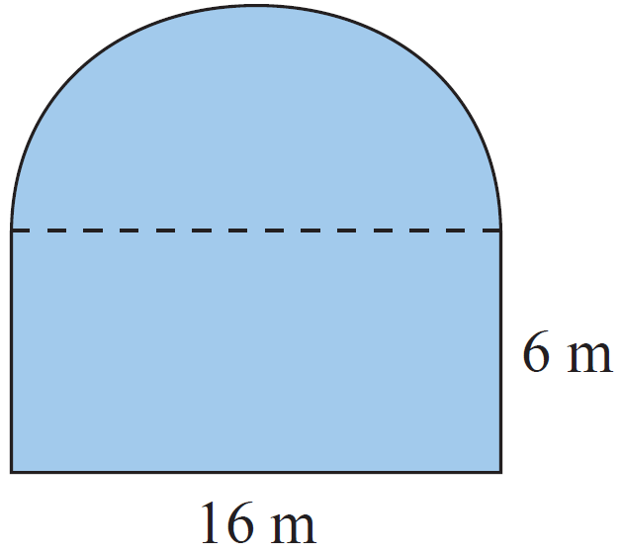
Example 9: Calculating Perimeter
Calculate the perimeter of the figure
shown here with a rectangular base
and a semicircle attached to the top.
The rectangle has a length of 16 m
and a width of 6 m.
Solution
The perimeter of the figure is the sum of the lengths of three sides of the rectangle and the length of the semicircle. (Note: The diameter of the semicircle is
16 m.)

Slide 24
Example 9: Calculating Perimeter (cont.)
Sum of the lengths of three sides of the rectangle
= 6 m + 16 m + 6 m
Length of semicircle
Perimeter of the figure
= 28 m
= 28 + 25.12
= 53.12 m

