Slide 1
Section 16.5
Nonlinear Systems of Equations

Slide 2
Objectives
Solve systems of equations where one or both equations are nonlinear.

Slide 3
Solving a System of One Quadratic Equation and One Linear Equation
Procedure
If a system of two equations has one quadratic equation and one linear equation, then:
Solve the linear equation for one of the variables and substitute for this variable in the quadratic equation.
Solve the resulting second-degree equation and analyze the results.
Graph the curves on the same set of axes to visualize the number of solutions and check that the solutions are reasonable and satisfy both equations.

Slide 4
Example 1: Solving a System of One Quadratic and One Linear Equation
Solve the following system of equations and graph both curves on the same set of axes.
A circle and a line:
Solution
Solve x + y = 5 for y (or x). Then substitute into the other equation.

Slide 5
Example 1: Solving a System of One Quadratic and One Linear Equation (cont.)
Now solve for x.
Now substitute and solve for y.
The solutions (points of intersection) are (0,5) and (5,0).

Slide 6
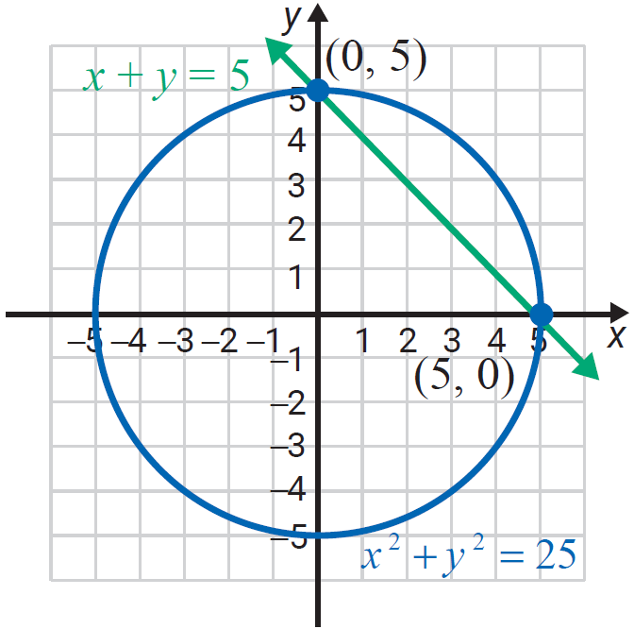
Example 1: Solving a System of One Quadratic and One Linear Equation (cont.)

Slide 7
Example 2: Solving a System of One Quadratic and One Linear Equation
Solve the following system of equations and graph both curves on the same set of axes.
A line and a parabola:
Solution
Solve the linear equation for y (or x), then substitute into the quadratic equation. (In this case, the quadratic equation is already solved for y, so we could have chosen to make the substitution into the linear equation instead.)

Slide 8
Example 2: Solving a System of One Quadratic and One Linear Equation (cont.)
The solutions are and (2,−9) and (1, −8).

Slide 9
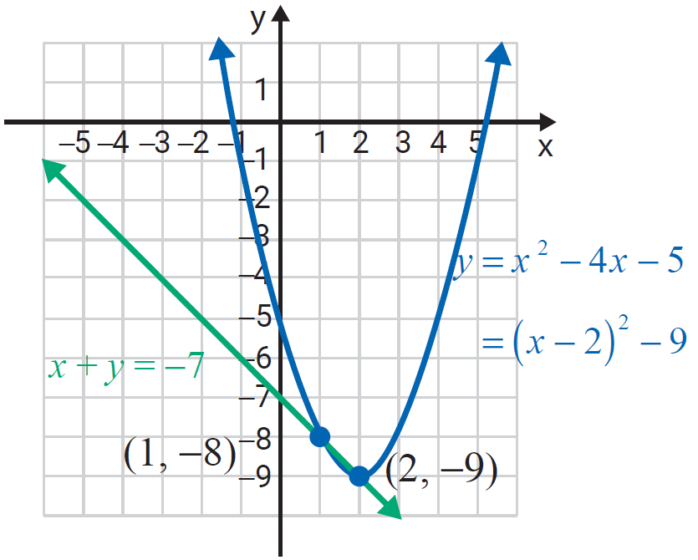
Example 2: Solving a System of One Quadratic and One Linear Equation (cont.)

Slide 10
Solving a System of Two Quadratic Equations
Procedure
If a system of two equations has two quadratic equations, then:
The method used depends on the form of the equations.
Substitution may work or addition may work.
Graph the curves on the same set of axes to visualize the number of solutions and check that the solutions are reasonable and satisfy both equations.

Slide 11
Example 3: A System of Two Quadratic Equations
Solve the following system of equations and graph both curves on the same set of axes.
A hyperbola and a circle:
Solution
Here addition will eliminate y².

Slide 12
Example 3: A System of Two Quadratic Equations (cont.)

Slide 13
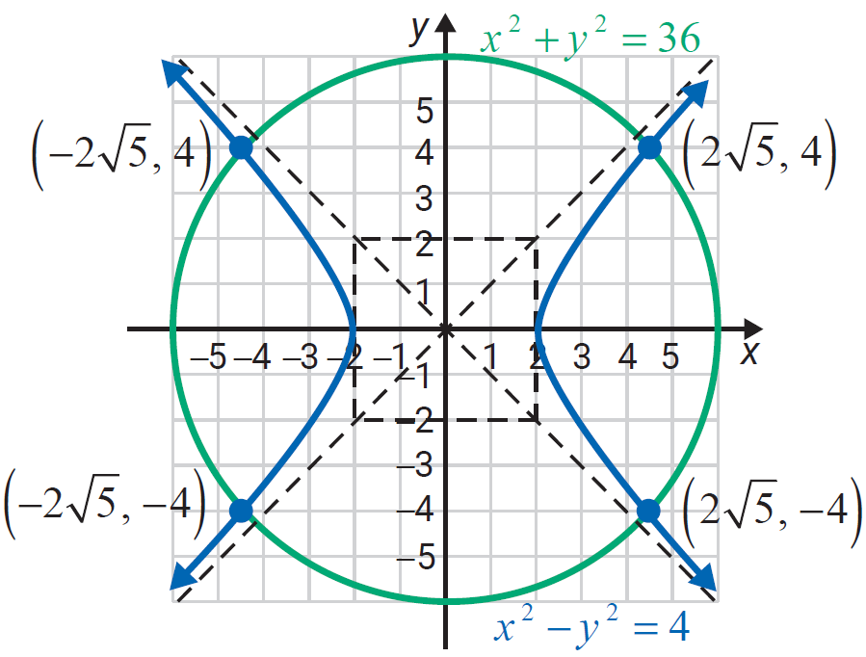
Example 3: A System of Two Quadratic Equations (cont.)
There are four points of intersection:

Slide 14
Note
Attention!
In the examples and the exercises the curves intersect. However, there are many situations where the curves do not intersect. This can be confirmed both algebraically and graphically.

