Slide 1
Section 15.2
Composition of Functions and Inverse Functions

Slide 2
Objectives
Evaluate a function at a given algebraic expression.
Form the composition of two functions.
Use the horizontal line test to determine if a function is one-to-one.
Determine whether or not two functions are inverses of each other.
Find and graph the inverse of a one-to-one function.

Slide 3
Example 1: Evaluating a Function at an Algebraic Expression
Find the following function values when
Solution
Substitute 2a in for x everywhere x appears and simplify.

Slide 4
Example 1: Evaluating a Function at an Algebraic Expression (cont.)
Find the following function values when
Solution
Substitute g + 3 in for x everywhere x appears and simplify.

Slide 5
Composite Function
Definition
For two functions f and g, the composite function is defined as follows.
The domain of consists of those values of x in the domain of g for which g(x) is in the domain of f.

Slide 6
Example 2: Compositions
Form the compositions
if and
Solution
Note: Both and are defined for all real numbers.

Slide 7
Example 3: Compositions
Form the compositions
if and
Solution
Note: For the expression under the radical to be defined, we must have g(x) ≥ 3. Because x² + 4 ≥ 3 for all real numbers, the domain of is all real numbers.

Slide 8
Example 3: Compositions (cont.)
Form the compositions
if and
Solution
Now, for the domain is restricted by
That is, the domain is restricted to
x ≥ 3 regardless of the simplified result.

Slide 9
Example 4: Compositions
Find if and
Solution
Note: is defined only for

Slide 10
Example 4: Compositions (cont.)
Find if and
Solution
Note: is defined only for

Slide 11
One-to-One Functions
Definition
A function is a one-to-one function (or 1-1 function) if for each value of y in the range there is only one corresponding value of x in the domain.

Slide 12
Horizontal Line Test
Definition
A function is one-to-one if no horizontal line intersects the graph of the function at more than one point.

Slide 13
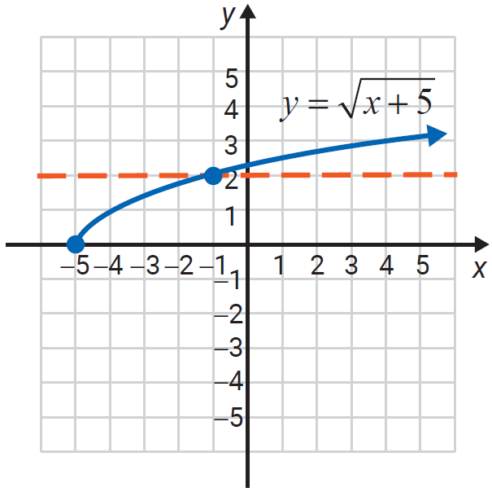
Example 5: One-to-One Functions
Determine whether each function is one-to-one.
Solution
The horizontal line test shows
that this function is one-to-one.

Slide 14
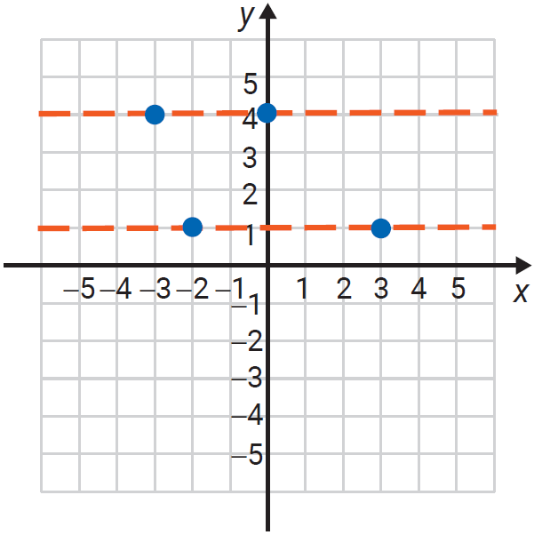
Example 5: One-to-One Functions (cont.)
Solution
This function is not one-to-one.
Both y-values, 4 and 1, have more
than one corresponding x-value.

Slide 15
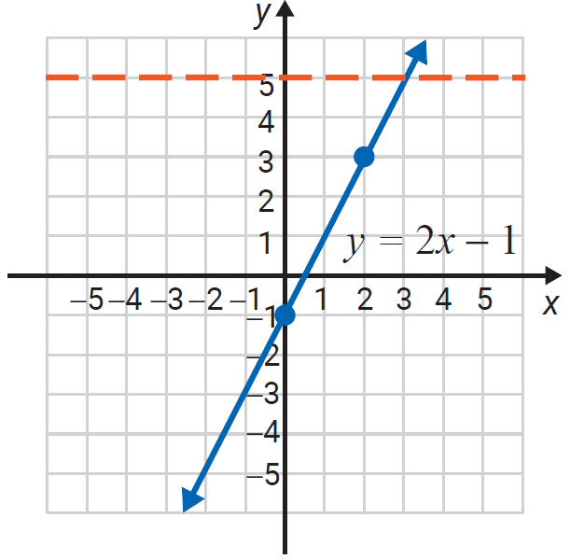
Example 5: One-to-One Functions (cont.)
Solution
The graph of the function
y = 2x − 1 is a straight line. Straight lines that are not vertical and not horizontal represent one-to-one functions. (Vertical lines are not functions in the first place and horizontal lines fail the horizontal line test.)

Slide 16
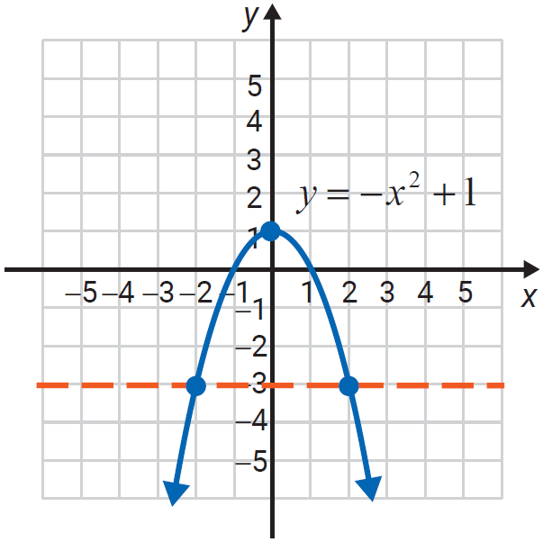
Example 5: One-to-One Functions (cont.)
Solution
The graph of the function
is a parabola and
the horizontal line test shows
that the function is not
one-to-one.

Slide 17
Inverse Functions
Definition
If f is a one-to-one function with ordered pairs of the form (x, y) then its inverse function, denoted as f ⁻¹, is also a one-to-one function with ordered pairs of the form (y, x).

Slide 18
Inverse Functions
Note
The notation f ⁻¹(x) represents the inverse of a one-to-one function. This inverse is a new function in which the x- and y-values have been interchanged. f ⁻¹(x) does
NOT mean because the −1 is NOT an exponent.

Slide 19
To Determine whether Two Functions are Inverses
Procedure
If f and g are one-to-one functions and
then f and g are inverse functions.
That is, g = f ⁻¹ and f = g ⁻¹.

Slide 20
Example 6: Inverse Functions
Use the definition of inverse functions to show that f and g are inverse functions.
Solution
The domain of both
functions is the set of all real numbers.

Slide 21
Example 6: Inverse Functions (cont.)
We have
Replace the x in f(x) with g(x) and simplify.
Also,
Replace the x in g(x) with f(x) and simplify.

Slide 22
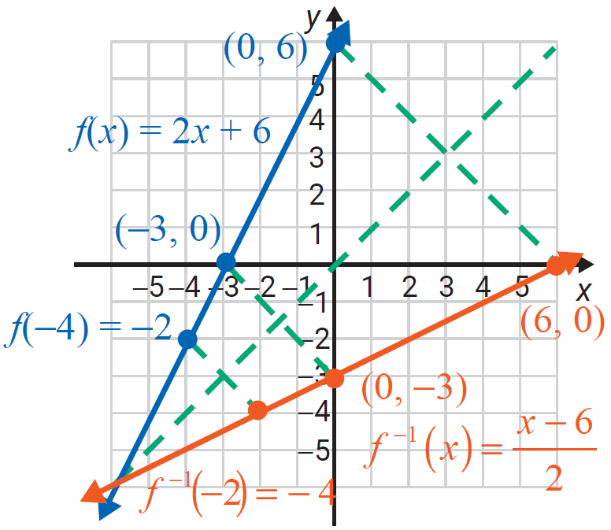
Example 6: Inverse Functions (cont.)
Therefore, g = f ⁻¹ and g = f ⁻¹.
The graph shows that the line y = x is a line of symmetry for the graphs of the inverse functions.

Slide 23
Example 7: Inverse Functions
Use the definition of inverse functions to show that f and g are inverse functions.
Solution
The domain of f is the interval [3, ∞) and the domain of g is the interval [0, ∞).

Slide 24
Example 7: Inverse Functions (cont.)
We have,
Replace the x in f(x) with g(x) and simplify.
Also,
Replace the x in g(x) with f(x) and simplify.
Therefore, g = f ⁻¹ and f = g ⁻¹.

Slide 25
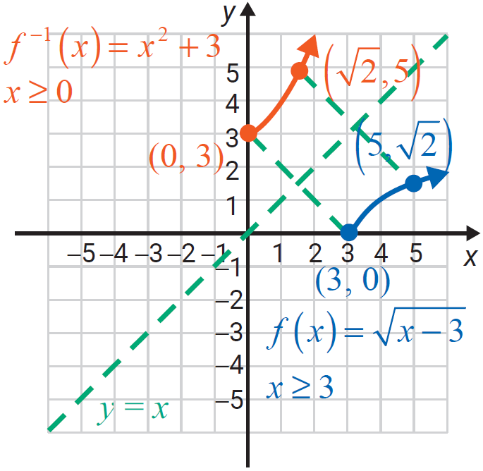
Example 7: Inverse Functions (cont.)
The graph shows that the line y = x is a line of symmetry for the graphs of the inverse functions. Note that these graphs are only
parts of parabolas and the
domains have been restricted
accordingly.

Slide 26
Example 8: Evaluating Compositions of Inverses
Given for x ≥ −4 and for
x ≥ 0, evaluate the indicated compositions.
Solution
so

Slide 27
Example 8: Evaluating Compositions of Inverses (cont.)
Given for x ≥ −4 and for
x ≥ 0, evaluate the indicated compositions.
Solution
so

Slide 28
Example 8: Evaluating Compositions of Inverses (cont.)
Given for x ≥ −4 and for
x ≥ 0, evaluate the indicated compositions.
Solution
so

Slide 29
Example 8: Evaluating Compositions of Inverses (cont.)
Given for x ≥ −4 and for
x ≥ 0, evaluate the indicated compositions.
Solution
does not exist because −5 is not in the domain of f. Therefore, does not exist.

Slide 30
To Find the Inverse of a One-to-One Function
Procedure
Let y = f(x). (In effect, substitute y for f(x).)
Interchange x and y.
In the new equation, solve for y in terms of x.
Substitute f ⁻¹ (x) for y. (This new function is the inverse of f.)

Slide 31
Example 9: Finding the Inverse
Find
Solution
Substitute y for f(x).
Interchange x and y.
Solve for y in terms of x.
Substitute f ⁻¹ (x) for y.

Slide 32
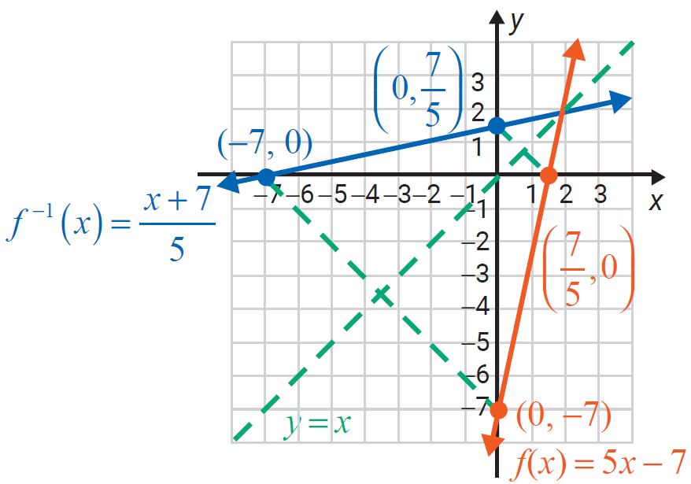
Example 9: Finding the Inverse (cont.)

Slide 33
Example 10: Finding the Inverse
Find g⁻¹ (x) if g(x) = x² − 2 for x ≥ 0.
Solution
For x ≥ 0 (Note that g is one-to-one for x ≥ 0.)
Substitute y for g(x).
Interchange y and x.
Solve for y in terms of x.
Take the positive square root because we must have y ≥ 0 (The domain of g is x ≥ 0, so the range of g ⁻¹ is y ≥ 0.)

Slide 34
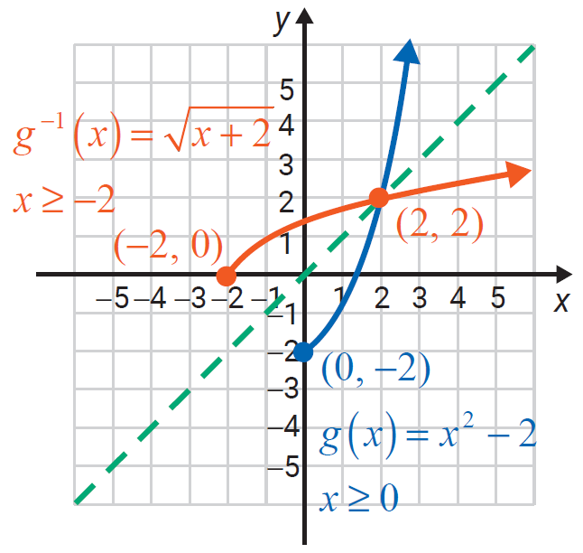
Example 10: Finding the Inverse (cont.)

