Slide 1
Section 14.4
More Applications of Quadratic Equations

Slide 2
Objectives
Use quadratic equations to solve applications involving
The Pythagorean Theorem,
Work,
Distance-Rate-Time,
Projectiles,
Geometry, and
Cost per Person.

Slide 3
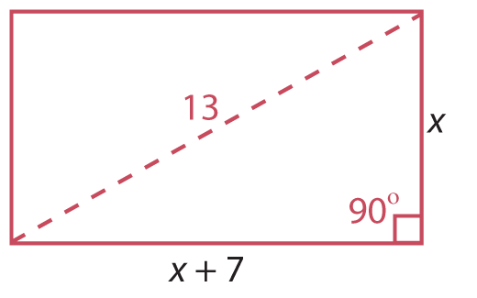
Example 1: Using The Pythagorean Theorem
The length of a rectangle is 7 feet longer than the width. If one diagonal measures 13 feet, what are the dimensions of the rectangle?
Solution
Draw a diagram for problems involving geometric figures whenever possible.
Let x = width of the rectangle
and x + 7 = length of the rectangle.

Slide 4
Example 1: Using The Pythagorean Theorem (cont.)
Then, by the Pythagorean Theorem:

Slide 5
Example 1: Using The Pythagorean Theorem (cont.)
Check
The width is 5 feet and the length is 12 feet.
A negative number does not fit the conditions of the problem.
True statement

Slide 6
Example 2: Application: Work
Working for a janitorial service, a woman and her daughter can clean a building in 5 hours. If the daughter were to do the job by herself, she would take 24 hours longer than her mother would take. How long would it take her mother to clean the building without the daughter’s help?
(Note: For reference, this problem is similar to those discussed in Section 14.7 on work. The difference is that, in this section, the resulting equations are quadratic.)

Slide 7
Example 2: Application: Work (cont.)
Solution
Let x = time for mother to do the job alone
and x + 24 = time for daughter to do the job alone.
 | Hours to Complete | Part Completed in 1 Hour
Mother
x
Daughter
x + 24
Together
5

Slide 8
Example 2: Application: Work (cont.)

Slide 9
Example 2: Application: Work (cont.)
The mother could do the job alone in 6 hours.

Slide 10
Example 3: Application: Distance-Rate-Time
A small plane travels at a speed of 200 mph in still air. Flying with a tailwind, the plane is clocked over a distance of 960 miles. Flying against a headwind, it takes 2 hours more time to complete the return trip. What was the wind velocity?
Solution
The basic formula is d = rt (distance = rate · time).
Also,

Slide 11
Example 3: Application: Distance-Rate-Time (cont.)
Let x = wind velocity.
Then 200 + x = speed of airplane going with the wind (tailwind),
200 − x = speed of airplane returning against the wind (headwind),
and 960 = distance each way.
We know the distance and can represent the rate (or speed), so the formula is used for representing time.

Slide 12
Example 3: Application: Distance-Rate-Time (cont.)
 | Distance | Rate | Time
Going | 960 | 200 + x
Returning | 960 | 200 − x

Slide 13
Example 3: Application: Distance-Rate-Time (cont.)

Slide 14
Example 3: Application: Distance-Rate-Time (cont.)
The wind velocity was 40 mph.

Slide 15
Example 3: Application: Distance-Rate-Time (cont.)
Check

Slide 16
Example 4: Application: Projectiles
A bullet is fired straight up from ground level with a muzzle velocity of 320 feet per second.
When will the bullet hit the ground?
Solution
In this problem, v₀ = 320 feet per second and
h₀ = 0 feet.
The bullet hits the ground when its height h equals 0.

Slide 17
Example 4: Application: Projectiles (cont.)
Divide both sides by −16.
Factor.
The bullet hits the ground in 20 seconds. The solution
t = 0 confirms the fact that the bullet was fired from the ground.

Slide 18
Example 4: Application: Projectiles (cont.)
When will the bullet be 1200 feet above the ground?
Solution
Let h = 1200.
Divide both sides by −16.
Factor.

Slide 19
Example 4: Application: Projectiles (cont.)
Both solutions are meaningful. The bullet is at a height of 1200 feet twice; once at 5 seconds while going up and once at 15 seconds while coming down.

Slide 20
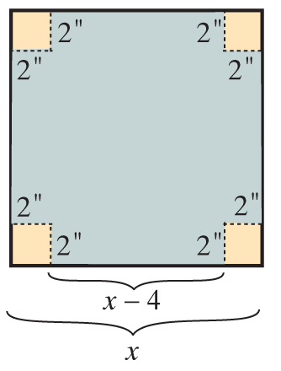
Example 5: Finding the Dimensions of a Box
A square piece of cardboard has a small square,
2 in. by 2 in., cut from each corner. The edges are then folded up to form a box with a volume of 512 in.³ What are the dimensions of the box?
(Hint: The volume is the product of the length, width, and height: V = lwh.)
Solution
Draw a diagram illustrating the information.
Let x = length of one side of the square
piece of cardboard.
Then l = x − 4, w = x − 4, and h = 2.

Slide 21
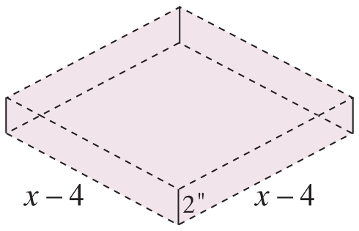
Example 5: Finding the Dimensions of a Box (cont.)
The dimensions of the box are 16 in. by 16 in. by 2 in.

Slide 22
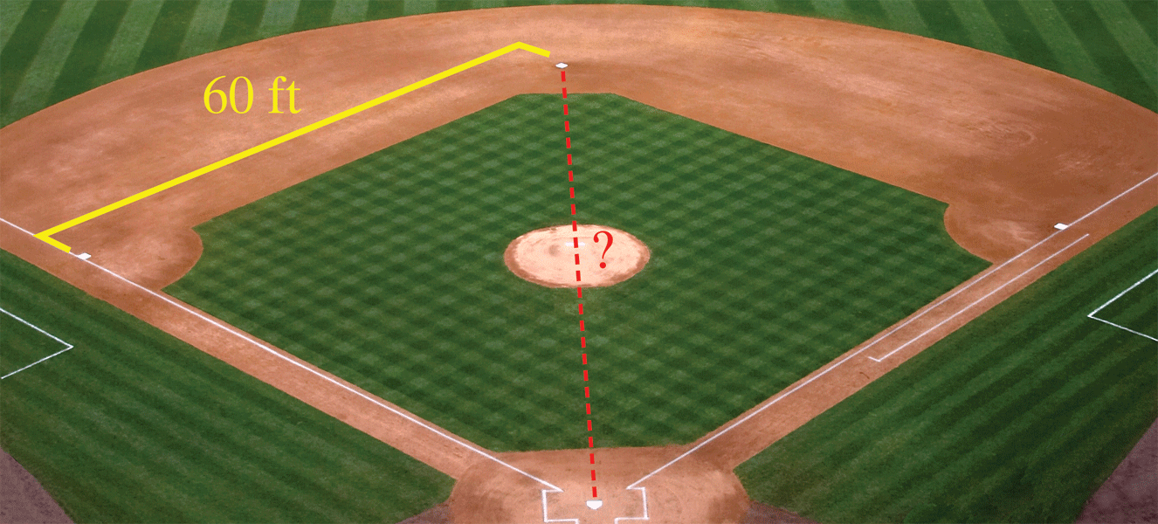
Example 6: Finding the Dimensions of a Baseball Field
A little league baseball field is in the shape of a square with sides of 60 feet. What is the distance (to the nearest tenth of a foot) the catcher must throw from home plate to second base?
Solution
The distance from home plate to second base is the hypotenuse of a right triangle with sides of length 60 feet.

Slide 23
Example 6: Finding the Dimensions of a Baseball Field (cont.)
We can use the Pythagorean Theorem as follows.
The catcher must throw about 84.9 feet.

Slide 24
Example 7: Application: Finding the Cost per Person
The members of a bowling club were going to rent a bus to drive them to a tournament at a total cost of $2420, which was to be divided equally among the members. At the last minute, two of the members decided to drive their own cars. The cost to the remaining members increased $11 each. How many members rode the bus?
Solution
Let x = number of club members and
x − 2 = number of club members who rode the bus.

Slide 25
Example 7: Application: Finding the Cost per Person (cont.)
LCD = x(x – 2)
Divide both sides by 11.

Slide 26
Example 7: Application: Finding the Cost per Person (cont.)
−20 does not fit the conditions. That is, the number of people in a club is a positive number.
Check
$121 − $110 = $11
Twenty members rode the bus.
Difference in cost per member

