Slide 1
Section 13.7
Functions with Radicals

Slide 2
Objectives
Review the concepts of functions and function notation.
Find the domain and range of radical functions.
Evaluate radical functions.
Graph radical functions.
Use a graphing calculator to graph radical functions.

Slide 3
Relation, Domain, and Range
Definition
A relation is a set of ordered pairs of real numbers.
The domain D of a relation is the set of all first coordinates in the relation.
The range R of a relation is the set of all second coordinates in the relation.

Slide 4
Function
Definition
A function is a relation in which each domain element has exactly one corresponding range element.

Slide 5
Vertical Line Test
Definition
If any vertical line intersects the graph of a relation at more than one point, then the relation is not a function.

Slide 6
Radical Function
Definition
A radical function is a function of the form in which the radicand contains a variable expression.
The domain of such a function depends on the index, n:
If n is an even number, the domain is the set of all x such that
If n is an odd number, the domain is the set of all real numbers,

Slide 7
Radical Function
Definition (cont.)
The range of the function depends on the index, n:
If n is an even number, the range is the set of all real numbers greater than or equal to 0, [0, ∞).
If n is an odd number, the range is the set of all real numbers, (−∞, ∞).

Slide 8
Example 1: Finding the Domain of a Radical Function
Determine the domain of each radical function.
a.
Solution
Because the index is 2, the radicand must be nonnegative. (That is, the expression under the radical sign cannot be negative.)

Slide 9
Example 1: Finding the Domain of a Radical Function (cont.)
Thus, we must have
and the domain is the interval of real numbers

Slide 10
Example 1: Finding the Domain of a Radical Function (cont.)
b.
Solution
Because the index is 3, an odd number, the radicand may be any real number.
Thus the domain is the set of all real numbers

Slide 11
Example 2: Evaluating Radical Functions
Complete each table by finding the corresponding f(x) values for the given values of x.
Solution
x | f (x)
7 | ?
6 | ?
−1 | ?
x | f (x)
7
6
−1

Slide 12
Example 2: Evaluating Radical Functions (cont.)
x | f (x)
0 | ?
4 | ?
6 | ?
Solution
x | f (x)
0
4
6

Slide 13
Example 3: Graphing a Radical Function
Graph the function
Solution
For the domain we have x + 5 ≥ 0, so x ≥ −5.
To see the nature of the graph we select a few values for x in the domain and find the corresponding values of y. Then we plot the points on a graph.

Slide 14
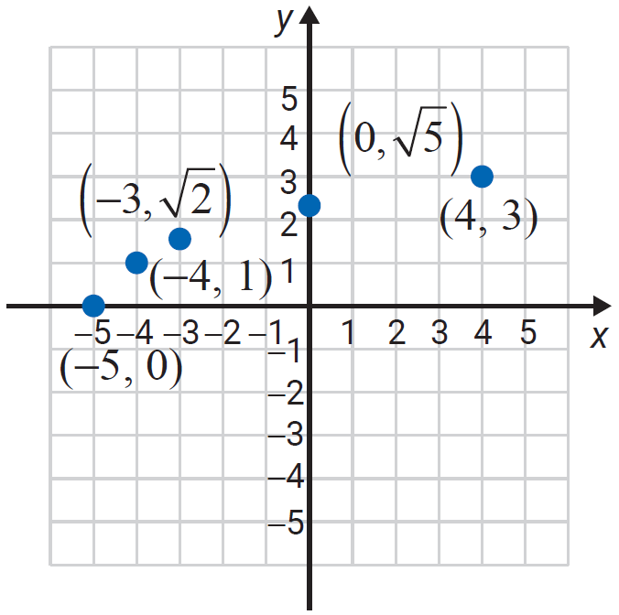
Example 3: Graphing a Radical Function (cont.)
x | y
−5
0
−4
1
−3
0
4
3

Slide 15
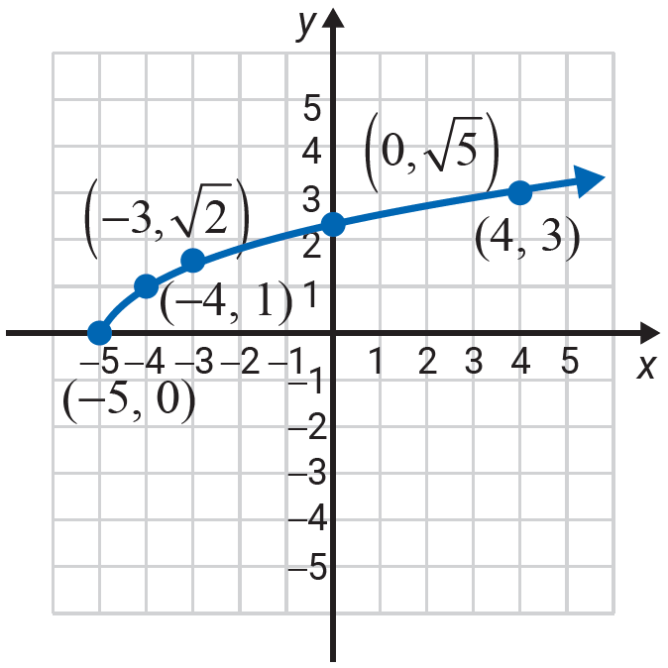
Example 3: Graphing a Radical Function (cont.)
Note that is the principal square root. This means that y ≥ 0. Thus the point (−5, 0) is on the x-­axis and the remaining points on the graph are above the x-axis. So, we can complete the graph by drawing a smooth curve that passes through the selected points.
We see that the domain is and the range is

Slide 16



Example 4: Using a TI-84 Plus to Graph a
Radical Functions
Use the TABLE feature of a TI-84 Plus graphing calculator to locate many points on the graph of the function
Solution
Using the TABLE feature of a TI-84 Plus:
Step 1: Press and enter the function as follows:
Press .
Choose 4:
Enter 2x − 3) and press .

Slide 17


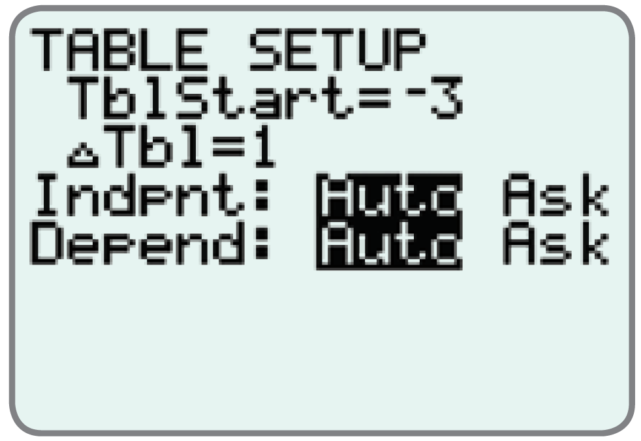
Example 4: Using a TI-84 Plus to Graph a
Radical Functions (cont.)
Step 2: Press TBLSET, which is , and set the display as shown here:

Slide 18

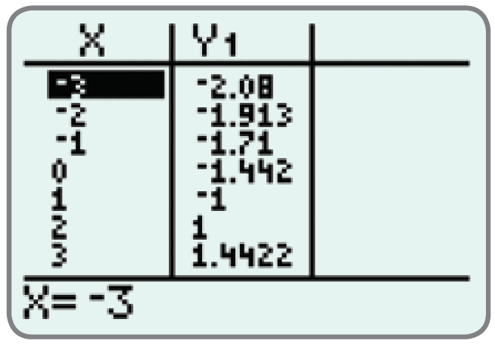
Example 4: Using a TI-84 Plus to Graph a
Radical Functions (cont.)
Step 3: Press TABLE, which is , and the display will appear as follows:

Slide 19
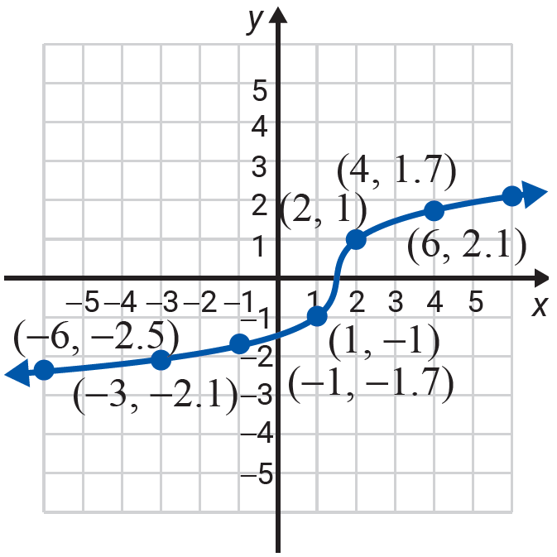
Example 4: Using a TI-84 Plus to Graph a
Radical Functions (cont.)
Plot several points (approximately) on a graph and then connect them with a smooth curve.
Solution
Once your calculator is displaying the table, you may scroll up and down the display to find as many points as you like. A few are shown here to see the nature of the graph.

Slide 20
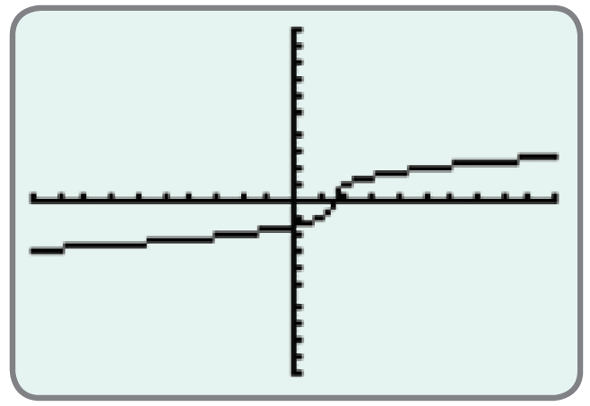
Example 4: Using a TI-84 Plus to Graph a
Radical Functions (cont.)
c. Use a TI-84 Plus graphing calculator to graph the function.
Solution
Press and the display will appear with the curve as follows:

