Slide 1
Section 12.6
Solving Rational Equations

Slide 2
Objectives
Solve proportions
Solve equations that involve rational expressions.
Use the process of solving equations to manipulate formulas.
Use proportions to relate similar triangles.

Slide 3
Proportion
Definition
A proportion is an equation stating that two ratios are equal.
In symbols, is a proportion.

Slide 4
Example 1: Proportions
State any restrictions on the variable, and then solve the equation.
Solution LCD = 6x

Slide 5
Example 1: Proportions (cont.)
Check

Slide 6
Example 1: Proportions (cont.)
Solution

Slide 7
Example 1: Proportions (cont.)
Check

Slide 8
Example 2 Application: Solving Proportions
On an architect’s scale drawing of a home, inch
represents 10 feet. What length does a measure of inches represent?
Solution
Set up a proportion representing the information. In this example the numerators are the same type (inches) and the denominators are the same type (feet).

Slide 9
Example 2: Application: Solving Proportions (cont.)
On this drawing, inches represent 50 feet.

Slide 10
Example 2: Application: Solving Proportions (cont.)
Note
Any of the following four equations could have been used to solve the problem in Example 2.
Agree in Type:

Slide 11
Example 2: Application: Solving Proportions (cont.)
Note (cont.)
Any of the following four equations could have been used to solve the problem in Example 2.
Agree in Type:

Slide 12
To Solve an Equation Containing Rational Expressions
Procedure
Find the LCD of the fractions.
List any restrictions on the variables. If one of these values appears to be a solution, it must be rejected.
Multiply both sides of the equation by this LCD and simplify.
Solve the resulting equation. (This equation will have only polynomials on both sides.)
Check each solution in the original equation. (Remember that no denominator can be 0.)

Slide 13
Example 3: Solving Rational Equations
State any restrictions on the variable, and then solve the equation.
Solution
First, find the LCD of the fractions, and then multiply both sides of the equation by the LCD.

Slide 14
Example 3: Solving Rational Equations (cont.)

Slide 15
Example 4: Solving Rational Equations
State any restrictions on the variable, and then solve the equation.
Solution
First find the LCD of the fractions and then multiply each term on both sides of the equation by the LCD.

Slide 16
Example 4: Solving Rational Equations (cont.)

Slide 17
Example 4: Solving Rational Equations (cont.)
The only solution is since 2 is a restricted value
(x ≠ 0, 2) and thus not a solution. No denominator can be 0.

Slide 18
Example 5: Solving Rational Equations
State any restrictions on the variable, and then solve the equation.
Solution
First find the LCD of the fractions and then multiply each term on both sides of the equation by the LCD.

Slide 19
Example 5: Solving Rational Equations (cont.)

Slide 20
Example 5: Solving Rational Equations (cont.)
There is no solution. The solution set is the empty set, ∅. The original equation is a contradiction.

Slide 21
Completion Example 6: Solving Rational Equations
State any restrictions on the variable then solve the equation:
Solution
−5
1

Slide 22
Completion Example 6: Solving Rational Equations (cont.)
x − 1
x − 1
x − 1
3x + 1
x − 1
3x
1
x² + x −2
2x − 1
x − 2
−1

Slide 23
Example 7: Solving a Formula for a Specified Variable
The formula is used to find the surface area (S) of a right circular cylinder, where r is the radius of the cylinder and h is the height of the cylinder. Solve the formula for h.
Solution
Thus, the formula solved for h is

Slide 24
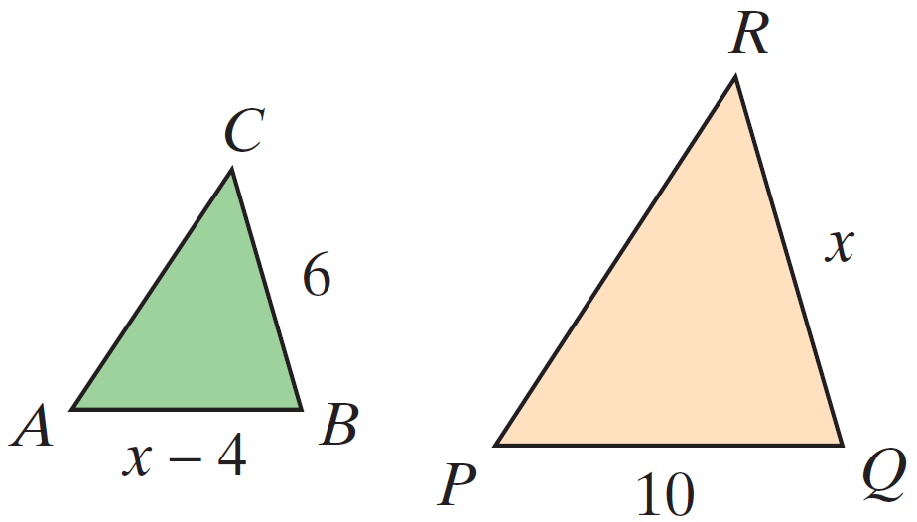
Example 8: Similar Triangles
In the figure shown, . Find the lengths of the sides AB and QR.

Slide 25
Example 8: Similar Triangles (cont.)
Solution
Set up a proportion involving corresponding sides and solve for x.

Slide 26
Example 8: Similar Triangles (cont.)
Because the length of a side cannot be negative, the only acceptable solution is x = 10. Thus QR = 10. Substituting 10 for x gives AB = 10 − 4 = 6.

