Slide 1
Entry and Exit Decisions in the Long Run
HAWKES LEARNING
Notes:
By the end of this lesson, you will be able to explain how entry and exit lead to zero profits in the long run, discuss the long-run adjustment process, and identify industry types.

Slide 2
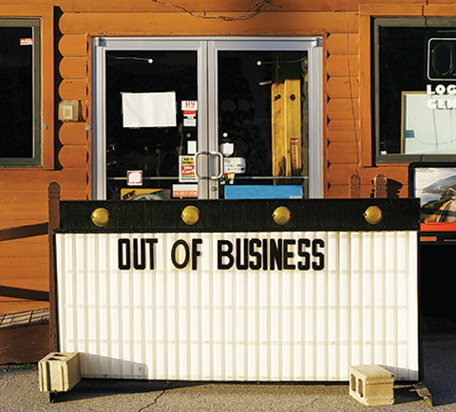
Entry and Exit Decisions
Profit is the measurement that determines whether a firm stays in business or not. Firms will close if they are making losses in the long run.
Notes:
Can we say anything about what causes a firm to exit an industry? Profit is the measurement that determines whether a firm stays in business or not. Firms will close if they are making losses in the long run.

Slide 3
Short Run and Long Run
The difference between the long run and the short run is not a specific period of time; it depends on the firms in an industry.
The distinction between the short run and the long run is more technical.
In the short run, firms cannot change the amount of one or more (fixed) inputs.
In the long run, a firm can adjust all factors of production.
Notes:
The difference between the long run and the short run is not a specific period of time; it depends on the firms in an industry. Therefore, the distinction between the short run and the long run is more technical. In the short run, firms cannot change the amount of one or more (fixed) inputs. In the long run, a firm can adjust all factors of production.

Slide 4
Entry & Exit
In a competitive market, profits incite businesses to charge, while losses incite businesses to flee.
When new firms enter the industry in response to increased industry profits, it is called entry into the market.
The long-run process of leaving industries in response to a sustained pattern of losses is called exit.
Notes:
In a competitive market, profits incite businesses to charge, while losses incite businesses to flee. When new firms enter the industry in response to increased industry profits, it is called entry into the market. The long-run process of leaving industries in response to a sustained pattern of losses is called exit.

Slide 5
How Entry and Exit Lead to Zero Profits in the Long Run
No perfectly competitive firm acting alone can affect the market price.
However, the combination of many firms entering or exiting the market will affect overall supply in the market.
In turn, a shift in supply for the market as a whole will affect the market price.
Entry and exit in the market results in a process that, in the long run, pushes the price down to minimum average total costs.
When price is pushed to minimum average total costs, all firms are earning zero profits.
Notes:
No perfectly competitive firm acting alone can affect the market price. However, the combination of many firms entering or exiting the market will affect overall supply in the market. In turn, a shift in supply for the market as a whole will affect the market price. Entry and exit in the market results in a process that, in the long run, pushes the price down to minimum average total costs. When price is pushed to to minimum average total costs, all firms are earning zero profits.

Slide 6
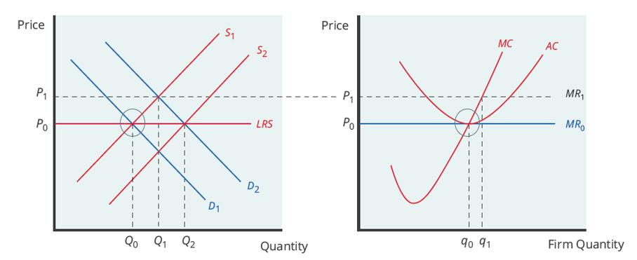
Initial Long-Run Equilibrium
Assume the market is in long-run equilibrium, where firms earn zero economic profits at the output level where P = MR = MC and P = AC.
Notes:
Assume the market is in long-run equilibrium, where firms earn zero economic profits at the output level where P=MR=MC and P=AC.

Slide 7
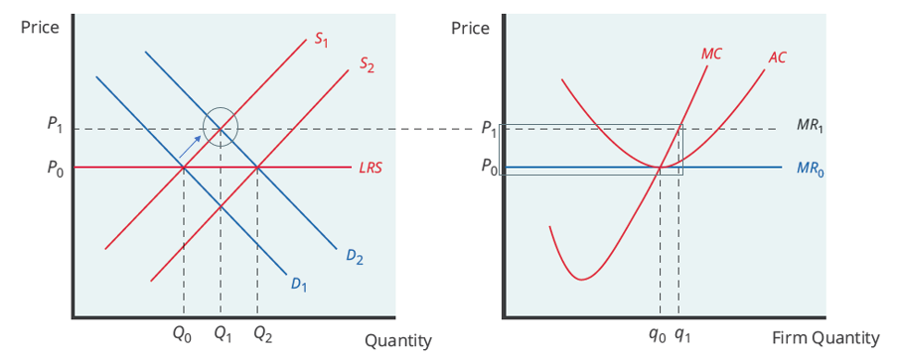
Increased Demand
Increased demand for the market’s product causes price to rise, meaning the firms in the market will be earning economic profit.
Notes:
Increased demand for the market’s product causes price to rise, meaning the firms in the market will be earning economic profit.

Slide 8
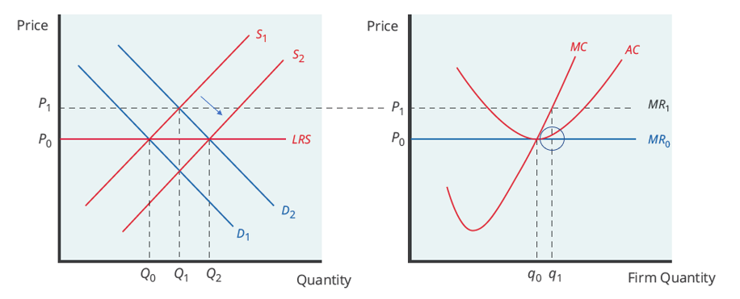
Entry
The higher price induces existing firms to increase output. Economic profits also attract other firms to enter the market, shifting the market supply curve to the right.
Notes:
Economic profits attract other firms to enter the market, shifting the market supply curve to the right.

Slide 9
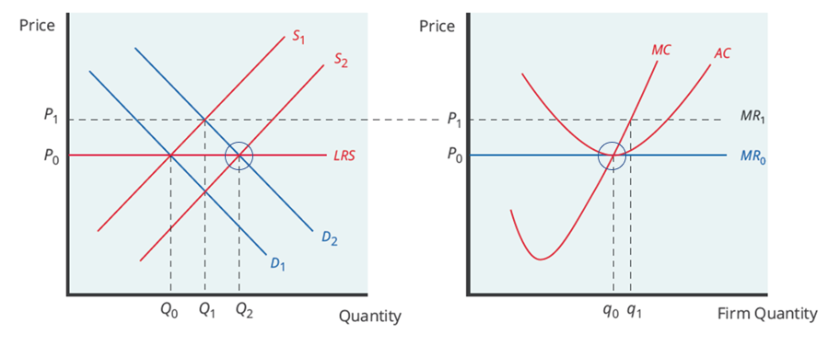
Zero-Profit Level
Firms eventually return to zero economic profit. The price returns to the original price, but there are more firms in the industry, so output is higher.
Notes:
Entry stops whenever the market price is driven down to the zero-profit level, where the market price is equal to minimum average cost and no firm is earning economic profits.

Slide 10
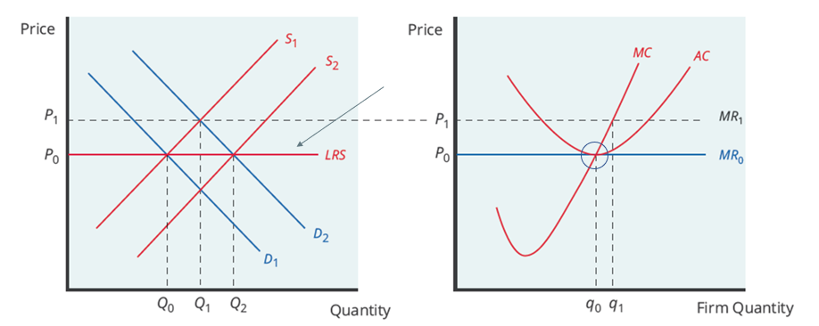
Long-Run Supply Curve
The long-run supply curve is found by connecting all price-quantity combinations where the potential firms in the industry break even.
Notes:
The long-run supply curve is found by connecting all price-quantity combinations where the potential firms in the industry break even.

Slide 11
Summary of Effects
The market is initially in long-run equilibrium, where firms earn zero economic profits at the output level where P = MR = MC and P = AC.
Demand for the product increases, the market price rises, and the existing firms in the market now earn economic profits.
Existing firms increase output and economic profits attract other firms to enter the market, shifting the market supply curve to the right.
As the supply curve shifts to the right, the market price starts decreasing, and economic profits fall for both new and existing firms.
Firms stop entry when the market price is driven down to the zero-profit level, where the market price equals minimum average cost.
Notes:
The market is initially in long-run equilibrium, where firms earn zero economic profits at the output level where P=MR=MC and P=AC. Demand for the product increases, the market price rises, and the existing firms in the market now earn economic profits. Economic profits attract other firms to enter the market, shifting the market supply curve to shift to the right. As the supply curve shifts to the right, the market price starts decreasing, and economic profits fall for both new and existing firms. Firms stop entry when the market price is driven down to the zero-profit level, where the market price equals minimum average cost.

Slide 12
Short-Run Losses
Short-run losses will fade away in the same way as short-run profits.
If demand were to decrease instead of increase, the market price would fall, meaning firms in the industry would face economic losses.
Firms that are unable to cover their average variable costs would exit the market, shifting the supply curve to the left.
This process ends when the market price rises to the zero-profit level, where the existing firms are no longer losing money.
Notes:
Short-run losses will fade away in the same way as short-run profits. If demand were to decrease instead of increase, the market price would fall, meaning firms in the industry would face economic losses. Firms that are unable to cover their average variable cost would exit the market, shifting the supply curve to the left. This process ends when the market price rises to the zero-profit level, where the existing firms are no longer losing money.

Slide 13
On Your Own₁
The price of a guitar is $100, and the average total cost is $80.
Based on this information, which of the following statements is true?
    a. Musical instrument firms will exit the market.
    b. The market is in equilibrium.
    c. Musical instrument firms will enter the market.
Notes:
The price of a guitar is $100, and the average total cost is $80. Based on this information, which of the following statements is true?
Musical instrument firms will exit the market.
The market is in equilibrium.
Musical instrument firms will enter the market.

Slide 14
On Your Own₂
The price of a guitar is $100, and the average total cost is $80.
Based on this information, which of the following statements is true?
    c. Musical instrument firms will enter the market.
When P > ATC, firms in the industry are earning a profit in the short run. Economic profits attract other firms to enter the market.
Notes:
The price of a guitar is $100, and the average total cost is $80. Based on this information, which of the following statements is true?
Musical instrument firms will enter the market.
When P>ATC, firms in the industry are earning a profit in the short run. Economic profits attract other firms to enter the market.

Slide 15
The Long-Run Adjustment and Industry Types
Whenever there are expansions in an industry, costs of production for the existing and new firms can stay the same, increase, or decrease.
In a constant-cost industry, as demand increases, the cost of production for firms stays the same.
In an increasing-cost industry, as demand increases, the cost of production for firms increases.
In a decreasing-cost industry, as demand increases, the cost of production for firms decreases.
Notes:
Whenever there are expansions in an industry, costs of production for the existing and new firms can stay the same, increase, or decrease. In a constant cost industry, as demand increases, the cost of production for firms stays the same. In an increasing cost industry, as demand increases, the cost of production for firms increases. In a decreasing cost industry, as demand increases, the cost of production for firms decreases.

Slide 16
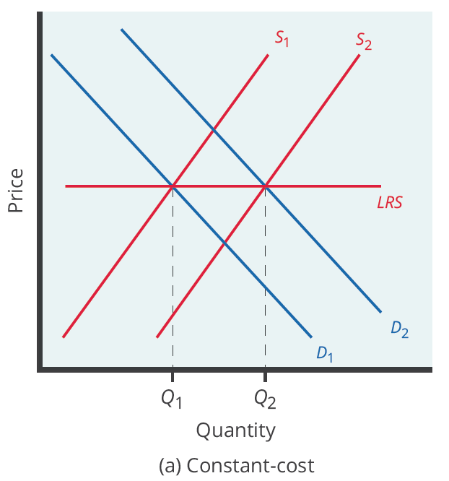
Constant-Cost Industry
With an increase in market demand and price, the supply curve shifts to the right with new firms' entry and stops at the point where the new long-run equilibrium intersects at the same market price as before.
The long-run supply curve is very elastic because there are many similar firms that can produce output, and there is a perfectly elastic supply of inputs.
Notes:
For a constant cost industry, whenever there is an increase in market demand and price, the supply curve shifts to the right with new firms' entry and stops at the point where the new long-run equilibrium intersects at the same market price as before. Why will costs remain the same? In this type of industry, the long-run supply curve is very elastic because there are many similar firms that can produce output, and there is a perfectly elastic supply of inputs—firms can easily increase their demand for employees, for example, with no increase to wages. Agricultural markets are often good examples of constant cost industries.

Slide 17
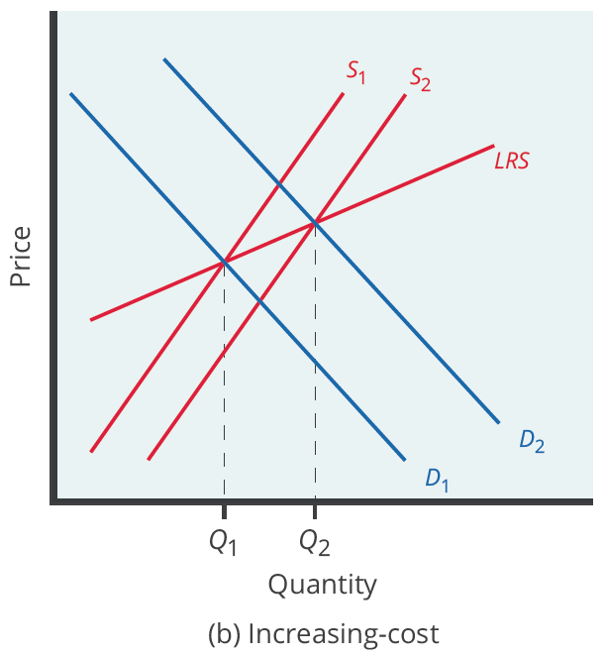
Increasing-Cost Industry
As the market expands, the old and new firms experience increases in their costs of production, which makes the new zero-profit level intersect at a higher price than before.
Companies may have to deal with limited inputs, such as skilled labor.
The industry supply curve is more inelastic than in a constant-cost industry.
Notes:
For an increasing cost industry, as the market expands, the old and new firms experience increases in their costs of production, which makes the new zero-profit level intersect at a higher price than before. Here, companies may have to deal with limited inputs, such as skilled labor. As the demand for these workers rises, wages rise, and this increases the cost of production for all firms. The industry supply curve in this type of industry is more inelastic. An example of this type of market is the housing industry. When more houses are built, the price of lumber and other scarce inputs rises, increasing costs for all firms.

Slide 18
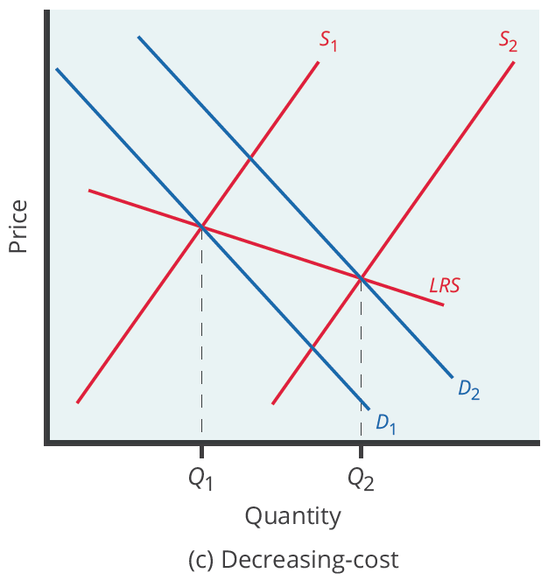
Decreasing-Cost Industry
As the market expands, the old and new firms experience lower costs of production, which makes the new zero-profit level intersect at a lower price than before.
In this case, the industry and all the firms in it are experiencing falling average total costs. This can be due to an improvement in technology in the entire industry or an increase in the availability of employees.
Notes:
For a decreasing cost industry, as the market expands, the old and new firms experience lower costs of production, which makes the new zero-profit level intersect at a lower price than before. In this case, the industry and all the firms in it are experiencing falling average total costs. This can be due to an improvement in technology in the entire industry or an increase in the availability of employees. High tech industries can be a good example of a decreasing cost market.

Slide 19
Real-World Discussion
Suppose you operate a small cleaning business, and the industry is currently in long-run equilibrium. However, the economy is in good shape, and more people decide that they would like to hire people to clean their houses. Because the economy is strong, as more people get into the cleaning business, there will be an increase in wages for house cleaners. Think about how you would demonstrate this situation. Determine what type of cost industry you are in and what the adjustment process back to equilibrium will be. Did you earn an economic profit? What will the long-run supply curve look like when equilibrium is restored?
Notes:
Suppose you operate a small cleaning business, and the industry is currently in long-run equilibrium. However, the economy is in good shape, and more people decide that they would like to hire people to clean their houses. Because the economy is strong, as more people get into the cleaning business, there will be an increase in wages for house cleaners. Think about how you would demonstrate this situation. Choose what type of cost industry you are in and what the adjustment process back to equilibrium will be. Did you earn an economic profit? What will the long-run supply curve look like when equilibrium is restored?

Slide 20
Summary
In the long run, firms will respond to profits through a process of entry, where existing firms expand output and new firms enter the market.
Conversely, firms will react to losses in the long run through a process of exit, in which existing firms cease production altogether.
Through the process of entry in response to profits and exit in response to losses, the price level in a perfectly competitive market will move toward the zero-profit point, where the marginal cost curve crosses the AC curve at the minimum of the average cost curve.
The long-run supply curve shows the long-run output supplied by firms in three different types of industries: constant-cost, increasing-cost, and decreasing-cost.

Slide 21




HAWKES LEARNING

