Slide 1
Costs in the Long Run
HAWKES LEARNING
Notes:
By the end of this lesson, you will be able to identify economies of scale, diseconomies of scale, and constant returns to scale; interpret graphs of short-run and long-run average cost curves; and analyze cost and production in the long run and short run.

Slide 2
Long Run
The long run is the period of time when all costs are variable.
The long run depends on the specifics of the firm in question; it is not a precise period of time.
No costs are fixed in the long run, as a firm can build new factories and purchase new machinery, or it can close existing facilities.
In planning for the long run, the firm will compare alternative production technologies and can substitute its labor for capital.
Notes:
The long run is the period of time when all costs are variable. The long run depends on the specifics of the firm in question—it is not a precise period of time. No costs are fixed in the long run, as a firm can build new factories and purchase new machinery, or it can close existing facilities. In planning for the long run, the firm will compare alternative production technologies and can substitute its labor for capital.

Slide 3
Choice of Production Technology₁
A firm can perform many tasks with a range of combinations of labor and capital.
For example, a firm can have employees (labor) answering phones, or it can invest in an automated voicemail system (capital).
In short, capital and labor can often substitute for each other in the long run.
A firm starts with an initial combination of labor and capital to produce its output.
If the price of labor rises, which can include changes in productivity, substitute capital for labor to minimize cost.
If the price of capital rises, which can include changes in productivity, substitute labor for capital to minimize cost.
Notes:
A firm can perform many tasks with a range of combinations of labor and capital. For example, a firm can have employees (labor) answering phones, or it can invest in an automated voicemail system (capital). In short, capital and labor can often substitute for each other in the long run.

Slide 4
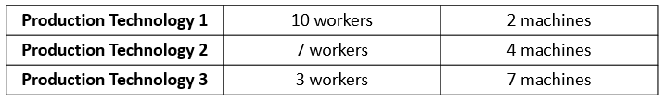
Choice of Production Technology₂
Consider the example of a local government hiring a private firm to clean up public parks. Three different combinations of labor and capital for cleaning up a single average-sized park are possible.
Since all three of these production methods produce the same thing—one cleaned-up park—a profit-seeking firm will choose the production technology that is least expensive, given the prices of labor and machines.
Notes:
Consider an example of a local government hiring a private firm to clean up public parks. Three different combinations of labor and capital for cleaning up a single average-sized park are possible. Since all three of these production methods produce the same thing—one cleaned-up park—a profit-seeking firm will choose the production technology that is least expensive, given the prices of labor and machines.

Slide 5
Economies of Scale₁
Once a firm has determined the least costly production technology, it can consider the optimal scale of production.
Economies of scale refers to the situation where, as the quantity of output goes up, the cost per unit (average total cost) goes down.
A larger factory can produce at a lower average cost than a smaller factory as the level of output increases.
Economies of scale exist when the long-run average total cost is declining across the associated range of output.
Notes:
Once a firm has determined the least costly production process, it can consider the optimal scale of production, or quantity of output to produce. Economies of scale refers to the situation where, as the quantity of output goes up, the cost per unit goes down. A larger factory can produce at a lower average cost than a smaller factory as the level of output increases. Economies of scale exist when the long-run average total cost is declining across the associated range of output.

Slide 6
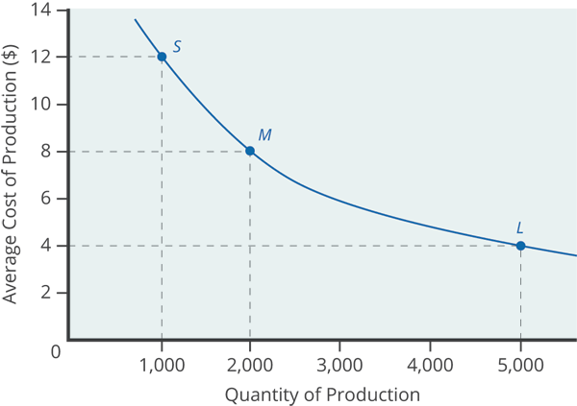
Economies of Scale₂
Consider the graph, which shows the average total cost of producing an alarm clock falling as the quantity of output rises.
A smaller factory can produce 1,000 alarm clocks at an average cost of $12 while a larger factory can produce 5,000 alarm clocks at an average price of $4.
Economies of scale exist when the larger scale of production leads to lower average costs.
Notes:
Consider the graph, which shows the average total cost of producing an alarm clock falling as the quantity of output rises. A smaller factory can produce 1,000 alarm clocks at an average cost of $12 while a larger factory can produce 5,000 alarm clocks at an average price of $4. Economies of scale exist when the larger scale of production leads to lower average costs.

Slide 7
Shapes of Long-Run Average Cost Curves₁
While in the short run, firms are limited to operating on a single average cost curve (corresponding to the level of fixed costs chosen).
In the long run, when all costs are variable, they can choose to operate on any average cost curve.
Thus, the long-run average cost (LRAC) curve is actually based on a group of short-run average cost (SRAC) curves.
The long-run average cost curve will be the least expensive average cost curve for any level of output.
Notes:
While in the short run, firms are limited to operating on a single average cost curve (corresponding to the level of fixed costs chosen). In the long run, when all costs are variable, they can choose to operate on any average cost curve. Thus, the long-run average cost (LRAC) curve is actually based on a group of short-run average cost (SRAC) curves. The long-run average cost curve will be the least expensive average cost curve for any level of output.

Slide 8
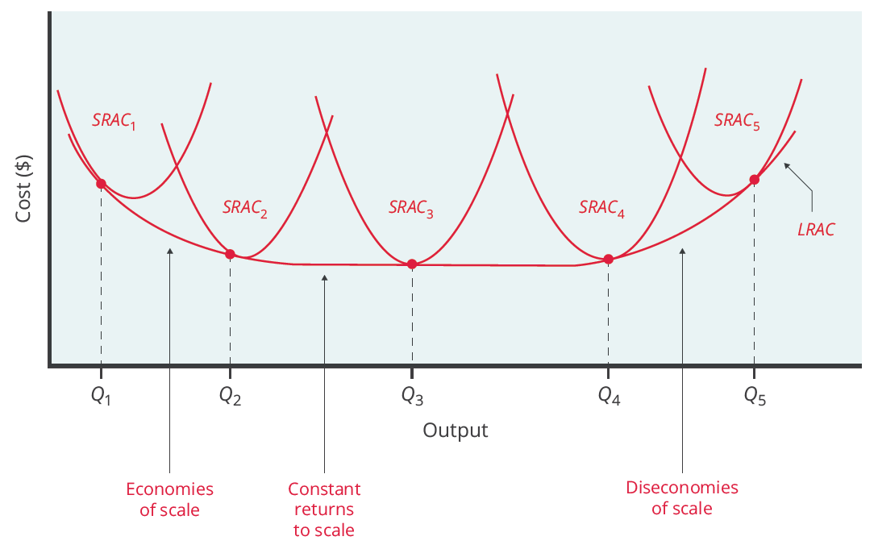
Shapes of Long-Run Average Cost Curves₂
The long-run average cost curve is built from a group of short-run average cost curves.
Although most diagrams show only a few SRAC curves, presumably there are an infinite number of other SRAC curves.
A group of short-run average cost curves represents different choices for a firm that is planning its level of investment in fixed cost physical capital.
Notes:
The long-run average cost curve is built from a group of short-run average cost curves. Although most diagrams shows only a few SRAC curves, presumably there are an infinite number of other SRAC curves. A group of short-run average cost curves represents different choices for a firm that is planning its level of investment in fixed cost physical capital.

Slide 9
Long-Run Average Cost Curve₁
The left-hand portion of the long-run average cost curve illustrates the case of economies of scale. In this portion of the long-run average cost curve, larger scale leads to lower average costs.
Notes:
The left-hand portion of the long-run average cost curve illustrates the case of economies of scale. In this portion of the long-run average cost curve, larger scale leads to lower average costs.

Slide 10
Long-Run Average Cost Curve₂
The middle portion of the long-run average cost curve shows that economies of scale have been exhausted. In this situation, allowing all inputs to expand does not change the average cost of production. This is called constant returns to scale because the average cost of production does not change as scale rises or falls.
Notes:
The middle portion of the long-run average cost curve shows that economies of scale have been exhausted. In this situation, allowing all inputs to expand does not change the average cost of production. This is called constant returns to scale because the average cost of production does not change as scale rises or falls.

Slide 11
Long-Run Average Cost Curve₃
The right-hand portion of the long-run average cost curve shows a situation where, as the level of output and the scale rises, average costs rise as well. This is called diseconomies of scale.
Notes:
The righthand portion of the long-run average cost curve shows a situation where, as the level of output and the scale rises, average costs rise as well. This is called diseconomies of scale.

Slide 12
Real-World Discussion
Suppose your firm is examining its cost structure and the level of output it hopes to produce. Given the ranges on the average cost curve, would it be best for your firm to produce where there are economies of scale, constant returns to scale, or diseconomies of scale? Explain your reasoning.
Notes:
Suppose your firm is examining its cost structure and the level of output it hopes to produce. Given the ranges on the average cost curve, would it be best for your firm to produce where there are economies of scale, constant returns to scale, or diseconomies of scale? Explain your reasoning.

Slide 13
The Size and Number of Firms in an Industry
The shape of the long-run average cost curve has implications for how many firms will compete in an industry.
It also has implications as to whether the firms in an industry have many different sizes or tend to be the same size.
Notes:
The shape of the long-run average cost curve has implications for how many firms will compete in an industry. It also has implications as to whether the firms in an industry have many different sizes or tend to be the same size.

Slide 14
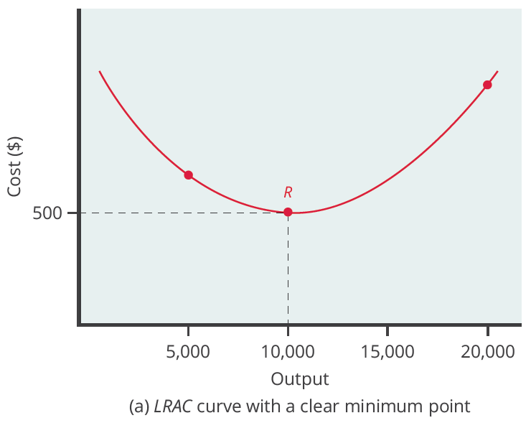
LRAC Curve₁
Low-cost firms will produce at output level R. When the LRAC curve has a clear minimum point, any firm producing a different quantity will have higher costs and be unable to compete. The level of output corresponding to the lowest point on the curve is the most cost-efficient production level.
Notes:
Low-cost firms will produce at output level R. When the LRAC curve has a clear minimum point, any firm producing a different quantity will have higher costs and be unable to compete. The level of output corresponding to the lowest point on the curve is the most cost-efficient production level.

Slide 15
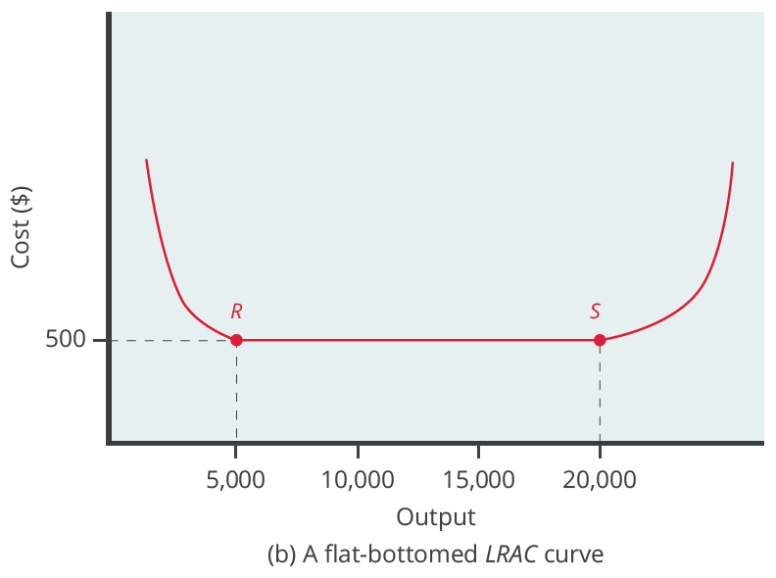
LRAC Curve₂
Low-cost firms will produce between output levels R and S. When the LRAC has a flat bottom, firms producing at any quantity along this flat bottom can compete, since they all face the same average costs.
Notes:
Low-cost firms will produce between output levels R and S. When the LRAC has a flat bottom, firms producing at any quantity along this flat bottom can compete, since they all face the same average costs.

Slide 16
Shifting Patterns of Long-Run Average Cost
Developments in production technology can shift the LRAC curve in ways that can alter the size distribution of firms in an industry.
For much of the twentieth century, the most common change was alterations in technology, like the assembly line or the large department store, where large-scale producers seemed to gain an advantage over smaller ones.
In the LRAC curve, the downward-sloping economies of scale portion of the curve stretched over a larger quantity of output.
Notes:
Developments in production technology can shift the LRAC curve in ways that can alter the size distribution of firms in an industry. For much of the twentieth century, the most common change was alterations in technology, like the assembly line or the large department store, where large-scale producers seemed to gain an advantage over smaller ones. In the LRAC curve, the downward-sloping economies of scale portion of the curve stretched over a larger quantity of output.

Slide 17
On Your Own₁
A long-run average cost curve has a clear minimum point at a quantity of 40,000 lamps. The current demand in the market is 800,000 lamps.
Calculate the number of firms in the lamp industry if demand increases and becomes twice as large.
Notes:
A long-run average cost curve has a clear minimum point at a quantity of 40,000 lamps. The current demand in the market is 800,000 lamps. Calculate the number of firms in the lamp industry if demand increases and becomes twice as large.

Slide 18



On Your Own₂
1. Given that the LRAC curve has a clear minimum point, any firm producing a different quantity will be unable to compete. Therefore, we can determine the initial number of firms in the industry by dividing the initial quantity demanded by the number of lamps produced at the minimum point:
2. If demand doubles, so too will the number of firms in the lamp industry:

Slide 19
Summary
A production technology refers to a specific combination of labor, physical capital, and technology that makes up a particular method of production.
In the long run, firms can choose their production technology, so all costs become variable costs.
Economies of scale refers to a situation where, as the level of output increases, the average cost decreases.
The long-run average cost curve shows the lowest possible average cost of production, allowing all inputs to vary so that the firm is choosing its production technology.
A downward-sloping LRAC shows economies of scale; a flat LRAC shows constant returns to scale; an upward-sloping LRAC shows diseconomies of scale.

Slide 20




HAWKES LEARNING

