Slide 1
Consumption Choices
HAWKES LEARNING
Notes:
By the end of this lesson, you will be able to calculate total utility; propose decisions that maximize utility; and explain marginal utility and the significance of diminishing marginal utility.

Slide 2

Consumption Choices₁
Microeconomics seeks to understand the behavior of individual economic agents such as individuals and businesses. If people base their decisions on their own tastes and personal preferences, how can economists hope to analyze the choices consumers make?
Notes:
Microeconomics seeks to understand the behavior of individual economic agents such as individuals and businesses. If people base their decisions on their own tastes and personal preferences, how can economists hope to analyze the choices consumers make?

Slide 3
Consumption Choices₂
Economists analyze individuals' decisions about what goods and services to buy as choices made within certain budget constraints.
Generally, consumers are trying to get the most happiness from their limited budget.
In economics, happiness or satisfaction is called utility.
Notes:
Economists analyze individuals' decisions about goods and services to buy as choices made within certain budget constraints. Generally, consumers are trying to get the most happiness from their limited budget. In economics, happiness or satisfaction is called utility. This lesson introduces the economic theory of how consumers make choices about what to buy given their limited incomes.

Slide 4
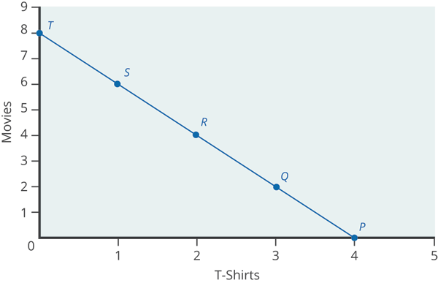
Consumption Choices₃
The budget constraint shows the various combinations of two goods that are affordable given a consumer’s limited income.
Total utility is the amount of satisfaction consumers receive from the choices they make given their budget constraint.
Notes:
The budget constraint shows the various combinations of two goods that are affordable given a consumer’s limited income. Total utility is the amount of satisfaction consumers receive from the choices they make given their budget constraint.

Slide 5
Marginal Utility
Consumers wish to choose the combination of goods on a budget constraint that will provide the greatest utility, or the most utils.
Marginal utility refers to the additional utility provided by one additional unit of consumption.
Typically, consuming additional units of a particular good leads to greater total utility, but at a decreasing rate.
The law of diminishing marginal utility holds that for most goods, the additional utility received decreases with each unit added.
Notes:
Consumers wish to choose the combination of goods on a budget constraint that will provide the greatest utility, or the most utils. Marginal utility refers to the additional utility provided by one additional unit of consumption. Typically, consuming additional units of a particular good leads to greater total utility, but at a decreasing rate. The law of diminishing marginal utility holds that for most goods, the additional utility received decreases with each unit added.

Slide 6
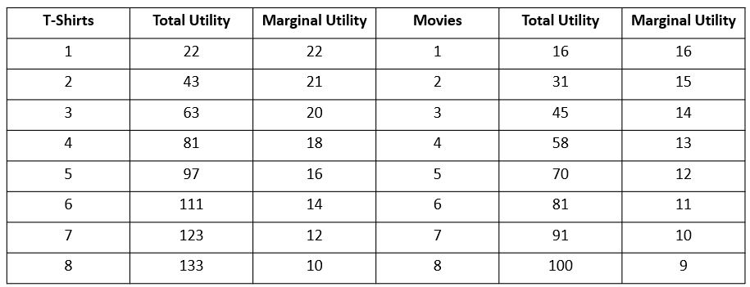
Total and Marginal Utility₁
Consider this table that shows levels of utility given different combinations of t-shirts and movies. Notice that marginal utility diminishes as additional units are consumed, which means that each subsequent unit of a good consumed provides less additional utility.
Notes:
Consider this table that corresponds to the budget constraint shown previously. Notice that marginal utility diminishes as additional units are consumed, which means that each subsequent unit of a good consumed provides less additional utility.

Slide 7
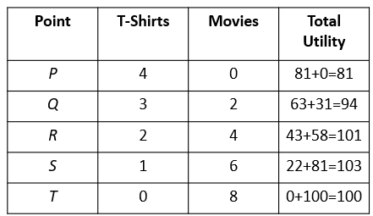
Total and Marginal Utility₂
Consumers wish to choose the combination of goods on a budget constraint that will provide the greatest utility. In this case, Point S will give the consumer the highest utility, 103 utils. Moving to Point T results in a marginal utility of -3 utils, making it less desirable than Point S.
Notes:
Consumers wish to choose the combination of goods on a budget constraint that will provide the greatest utility. In this case, Point S will give the consumer the highest utility, 103 utils. Moving to Point T results in a marginal utility of -3 utils, making it less desirable than Point S.

Slide 8
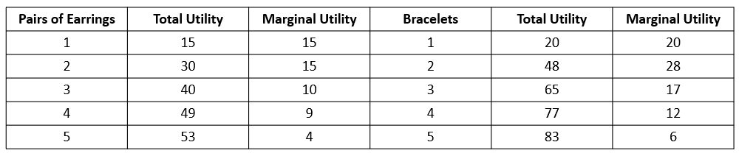
On Your Own₁
Susan loves jewelry, especially earrings and bracelets. The following table shows how many utils she derives from purchasing earrings and bracelets.
What is her total utility if she purchases 5 pairs of earrings and 1 bracelet?

Slide 9
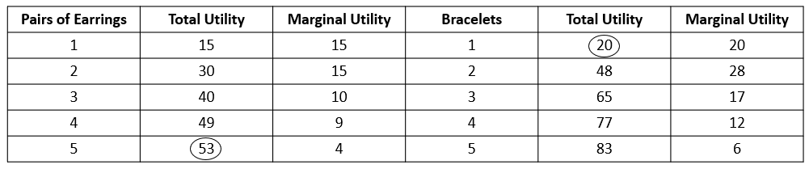
On Your Own₂
53 + 20 = 73 utils

Slide 10

Marginal Utility Per Dollar
Marginal utility per dollar is the additional satisfaction gained from purchasing a good given the price of the product.
To maximize utility given a budget, consumers will always purchase the item with the greatest marginal utility per dollar of expenditure.
Notes:
Marginal utility per dollar is the additional satisfaction gained from purchasing a good given the price of the product. To maximize utility given a budget, consumers will always purchase the item with the greatest marginal utility per dollar of expenditure.

Slide 11
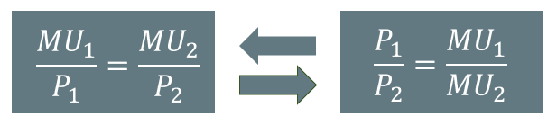
A Rule for Maximizing Utility
If you always choose the item with the greatest marginal utility per dollar spent, when your budget is exhausted, the utility-maximizing choice should occur where the marginal utility per dollar spent is the same for both goods.
Notes:
If you always choose the item with the greatest marginal utility per dollar spent, when your budget is exhausted, the utility-maximizing choice should occur where the marginal utility per dollar spent is the same for both goods.

Slide 12
Real-World Discussion
Think about how you make decisions about what you consume. You know that you have a limited budget, and you want to get the most satisfaction per dollar from what you consume. What process do you go through to make your consumption decisions to try to maximize utility and be as close as possible to consumer equilibrium?
Notes:
Think about how you make decisions about what you consume. You know that you have a limited budget, and you want to get the most satisfaction per dollar from what you consume. What process do you go through to make your consumption decisions to try to maximize utility and be as close as possible to consumer equilibrium?

Slide 13
Summary
Economic analysis of household behavior is based on the assumption that people seek the highest level of utility or satisfaction.
In general, greater consumption of a good brings higher total utility. However, the additional utility people receive from each unit of greater consumption tends to decline in a pattern of diminishing marginal utility.

Slide 14




HAWKES LEARNING

