Slide 1
Elasticity and Pricing
HAWKES LEARNING
Notes:
By the end of this lesson, you will be able to analyze how price elasticities impact revenue; evaluate how elasticity can cause shifts in demand and supply; explain how the elasticity of demand and supply determine the incidence of a tax on buyers and sellers; and predict how the long-run and short-run impacts of elasticity affect equilibrium.

Slide 2

Elasticity and Pricing₁
Studying elasticities is useful for a number of reasons, pricing being most important.
Elasticity relates to revenue and pricing, both in the long and short run.
Notes:
Studying elasticities is useful for a number of reasons, pricing being most important. Elasticity relates to revenue and pricing, both in the long and short run.

Slide 3
Elasticity and Pricing₂
$$price×quantity=revenue$$
Elastic
Unitary
Inelastic
Based on the elasticity of a good, a change in price will impact revenue in three different ways.
Notes:
Revenue is calculated as price times quantity. Based on the elasticity of a good, a change in price will impact revenue in three different ways.

Slide 4

Elasticity and Pricing₃
Consider a band trying to sell tickets for their concert; how should the band set the ticket price to generate the most total revenue? The key concept in thinking about collecting the most revenue is the price elasticity of demand. Imagine that the band starts off thinking about a certain price, which will result in the sale of a certain quantity of tickets.
Notes:
Consider a band trying to sell tickets for their concert; how should the band set the ticket price to generate the most total revenue? The key concept in thinking about collecting the most revenue is the price elasticity of demand. Imagine that the band starts off thinking about a certain price, which will result in the sale of a certain quantity of tickets.

Slide 5
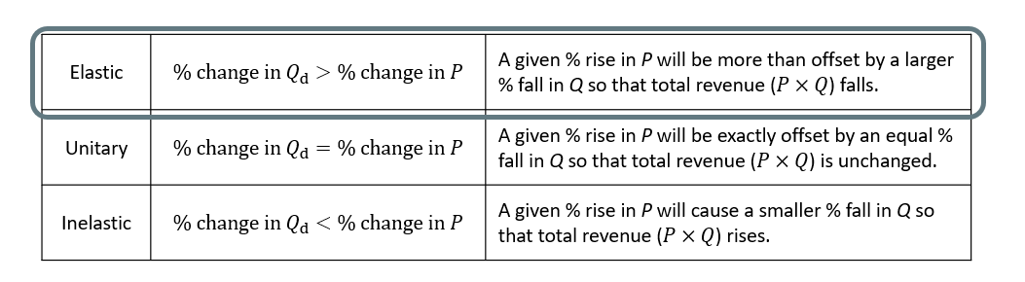
Elastic
If demand is elastic at that price level, the band should cut the price because the percentage drop in price will result in an even larger percentage increase in the quantity sold, increasing total revenue.
Notes:
If demand is elastic at that price level, the band should cut the price because the percentage drop in price will result in an even larger percentage increase in the quantity sold, increasing total revenue.

Slide 6
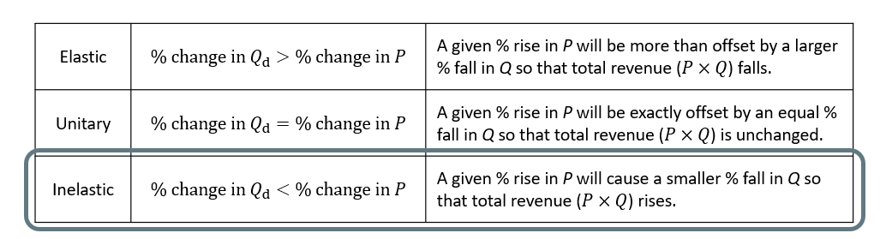
Inelastic
If demand is inelastic at that original quantity level, the band should raise the ticket price because a certain percentage increase in price will result in a smaller percentage decrease in the quantity sold, and total revenue will rise.
Notes:
If demand is inelastic at that original quantity level, the band should raise the ticket price because a certain percentage increase in price will result in a smaller percentage decrease in the quantity sold, and total revenue will rise.

Slide 7
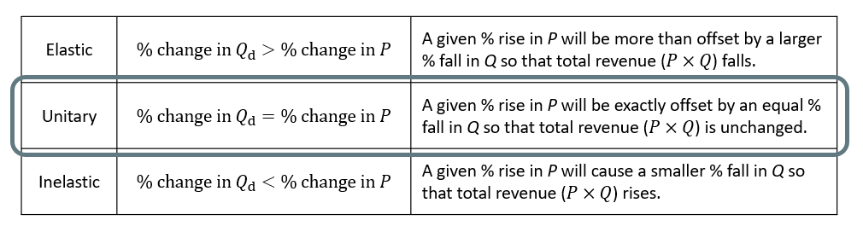
Unitary
If demand has a unitary elasticity at that quantity, an equal percentage change in quantity will offset a moderate percentage change in the price, so the band will earn the same revenue whether it (moderately) increases or decreases the ticket price. Hence, total revenue is maximized at the point of unit elasticity (corresponding to the midpoint of the linear demand curve).
Notes:
If demand has a unitary elasticity at that quantity, an equal percentage change in quantity will offset a moderate percentage change in the price, so the band will earn the same revenue whether it (moderately) increases or decreases the ticket price. Hence, total revenue is maximized at the point of unit elasticity (corresponding to the midpoint of the linear demand curve).

Slide 8
Maximizing Profits₁
There are two approaches to maximizing profits: cut costs or increase total revenue.
Most businesses face a day-to-day struggle to figure out ways to produce at a lower cost as a way to earn higher profits.
However, if the cost of a key input rises, can the firm pass those higher costs along to consumers in the form of higher prices?
Conversely, if new and less expensive ways of producing are invented, can the firm keep the benefits in the form of higher profits?
The price elasticity of demand plays a key role in answering these questions.
Notes:
There are two approaches to maximizing profits: cut costs or increase total revenue. Most businesses face a day-to-day struggle to figure out ways to produce at a lower cost as a way to earn higher profits. However, if the cost of a key input rises, can the firm pass those higher costs along to consumers in the form of higher prices? Conversely, if new and less expensive ways of producing are invented, can the firm keep the benefits in the form of higher profits? The price elasticity of demand plays a key role in answering these questions.

Slide 9
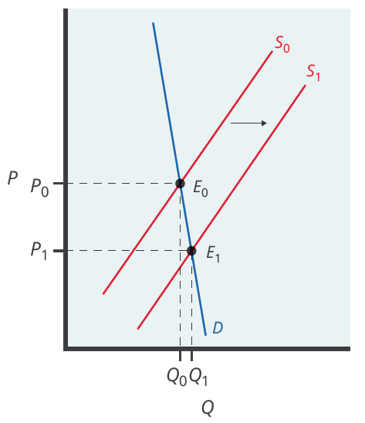
Maximizing Profits₂
In a technological breakthrough, firms are able to produce at a cheaper and more efficient rate, causing the supply curve to shift right.
If the produced good has a highly inelastic demand curve, the rightward shift in supply will lead to a substantially lower price for the product with relatively little increase in the quantity sold.
Notes:
In a technological breakthrough, firms are able to produce at a cheaper and efficient rate, causing the supply curve to shift right. If the produced good has a highly inelastic demand curve, the rightward shift in supply will lead to a substantially lower price for the product with relatively little increase in the quantity sold.

Slide 10
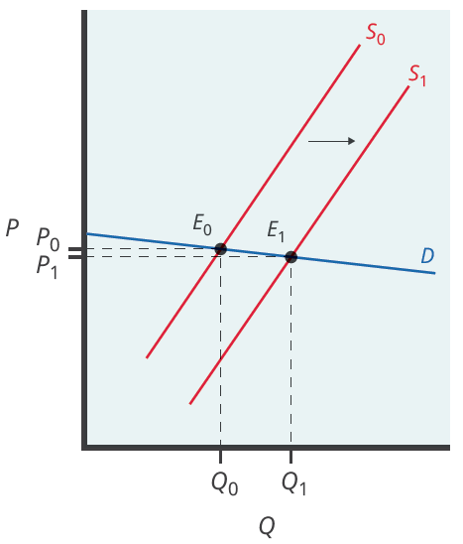
Maximizing Profits₃
On the other hand, if the produced good has a highly elastic demand curve, the rightward shift in supply will lead to a substantially higher quantity sold with relatively little decrease in the price.
Notes:
On the other hand, if the produced good has a highly elastic demand curve, the rightward shift in supply will lead to a substantially higher quantity sold with relatively little decrease in the price.

Slide 11
Can Businesses Pass Costs on to Consumers?
Elasticity also reveals whether firms can pass higher costs that they incur on to consumers.
Addictive substances with highly inelastic demand, like cigarettes, are products for which producers can pass higher costs on to consumers.
Economic research suggests that increasing cigarette prices by 10% leads to about a 3% reduction in the quantity of cigarettes purchased.
Higher taxes on cigarettes will raise tax revenue for the government, but they will not affect the quantity of smoking very much.
Notes:
Elasticity also reveals whether firms can pass higher costs that they incur on to consumers. Addictive substances with highly inelastic demand, like cigarettes, are products for which producers can pass higher costs on to consumers. Economic research suggests that increasing cigarette prices by 10% leads to about a 3% reduction in the quantity of cigarettes purchased. Higher taxes on cigarettes will raise tax revenue for the government, but they will not affect the quantity of smoking very much.

Slide 12
Elasticity and Tax Incidence₁
The example of cigarette taxes demonstrated that because demand is inelastic, taxes are not effective at reducing the quantity of smoking.
Cigarette taxes mainly affect consumers in the form of higher prices.
The analysis, or manner, of how a tax burden is divided between consumers and producers is called tax incidence.
Typically, the tax incidence, or burden, falls both on the consumers and producers of the taxed good.
If one wants to predict which group will bear most of the burden, all one needs to do is examine the elasticity of demand and supply.
Notes:
The example of cigarette taxes demonstrated that because demand is inelastic, taxes are not effective at reducing the equilibrium quantity of smoking, and they mainly pass along to consumers in the form of higher prices. The analysis, or manner, of how a tax burden is divided between consumers and producers is called tax incidence. Typically, the tax incidence, or burden, falls both on the consumers and producers of the taxed good. However, if one wants to predict which group will bear most of the burden, all one needs to do is examine the elasticity of demand and supply.

Slide 13
Elasticity and Tax Incidence₂
If demand is relatively inelastic, and
If demand is relatively elastic, and
supply is relatively elastic,
supply is relatively inelastic,
consumers bear a majority of the tax burden
suppliers bear a majority of the tax burden
Notes:
If demand is relatively inelastic, and supply is relatively elastic, consumers bear a majority of the tax burden.
If demand is relatively elastic, and supply is relatively inelastic, suppliers bear a majority of the tax burden.

Slide 14
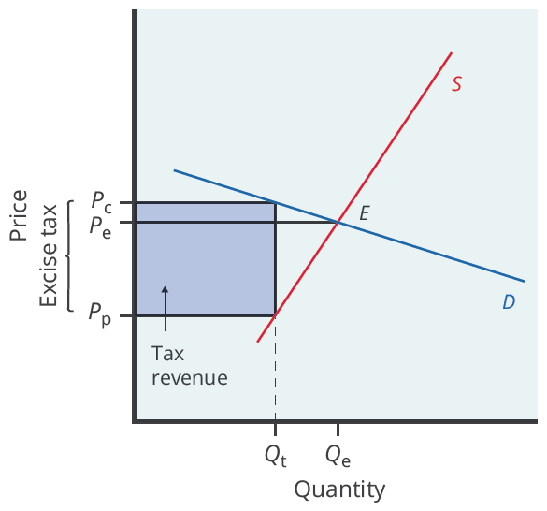
Elastic Demand, Inelastic Supply
An excise tax introduces a wedge between the price paid by consumers (P_{c}) and the price received by producers (P_{p}). When the supply curve is inelastic and demand is elastic, the burden is passed on to producers, and taxes do not greatly affect the equilibrium quantity.
Notes:
When the supply curve is inelastic and demand is elastic, the burden is passed on to producers and taxes do not greatly affect the equilibrium quantity. The graph displays the disproportionate tax burden on producers.

Slide 15
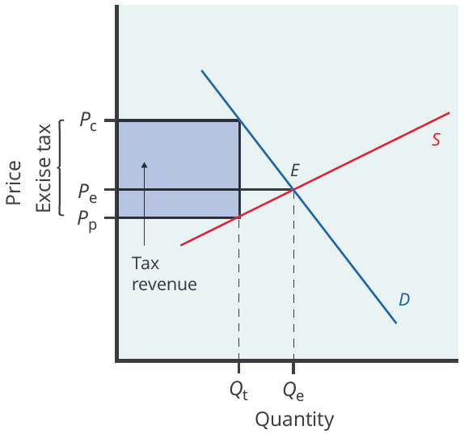
Elastic Supply, Inelastic Demand
When the supply is more elastic than demand, the tax incidence on consumers is larger than the tax incidence on producers. The more elastic the demand and supply curves, the lower the tax revenue.
Notes:
Similarly, when the demand curve is inelastic, consumers are not very responsive to price changes, and the quantity demanded reduces only modestly when the tax is introduced. Producers can then pass the tax burden along to consumers in the form of higher prices without much of a decline in the equilibrium quantity. The graphs display the disproportionate tax burden on consumers.

Slide 16
Long-Run vs. Short-Run Impact₁
Elasticities are often lower (more inelastic) in the short run than in the long run.
On the demand side of the market, it can sometimes be difficult to change quantity demanded in the short run but easier in the long run.
For example, in the short run, it is not easy for a person to make substantial changes in energy consumption, like gas usage.
However, in the long run, perhaps you can purchase a car that gets more miles to the gallon or choose a job that is closer to where you live.
Notes:
Elasticities are often lower (more inelastic) in the short run than in the long run. On the demand side of the market, it can sometimes be difficult to change quantity demanded in the short run but easier in the long run. For example, in the short run, it is not easy for a person to make substantial changes in energy consumption, like gas usage. However, in the long run, perhaps you can purchase a car that gets more miles to the gallon or choose a job that is closer to where you live.

Slide 17
Long-Run vs. Short-Run Impact₂
On the supply side of the market, producers of goods and services typically find it easier to expand production in the long term of several years rather than in the short run of a few months.
For example, in the short run, it can be costly or difficult to build a new factory, hire many new workers, or open new stores. However, over a few years, these changes are possible.
In most markets for goods and services, prices fluctuate more than quantities in the short run, but quantities often adjust more than prices in the long run.
Notes:
On the supply side of the market, producers of goods and services typically find it easier to expand production in the long term of several years rather than in the short run of a few months. For example, in the short run, it can be costly or difficult to build a new factory, hire many new workers, or open new stores. However, over a few years, these changes are possible. In most markets for goods and services, prices fluctuate more than quantities in the short run, but quantities often adjust more than prices in the long run.

Slide 18
Summary
In the market for goods and services, quantity supplied and quantity demanded are often relatively slow to react to changes in price in the short run but react more substantially in the long run, indicating that that demand and supply often (but not always) tend to be relatively inelastic in the short run and relatively elastic in the long run.
The tax incidence depends on the relative price elasticity of supply and demand: when supply is more elastic than demand, buyers bear most of the tax burden, and when demand is more elastic than supply, producers bear most of the cost of the tax.
Tax revenue is larger the more inelastic the demand and supply are.
Notes:
In the market for goods and services, quantity supplied and quantity demanded are often relatively slow to react to changes in price in the short run but react more substantially in the long run, indicating that that demand and supply often (but not always) tend to be relatively inelastic in the short run and relatively elastic in the long run.
The tax incidence depends on the relative price elasticity of supply and demand: when supply is more elastic than demand, buyers bear most of the tax burden, and when demand is more elastic than supply, producers bear most of the cost of the tax.
Tax revenue is larger the more inelastic the demand and supply are.

Slide 19




HAWKES LEARNING

