Slide 1
Price Elasticity of Demand and Price Elasticity of Supply
HAWKES LEARNING
Notes:
By the end of this lesson, you will be able to calculate the price elasticity of demand and the price elasticity of supply.

Slide 2
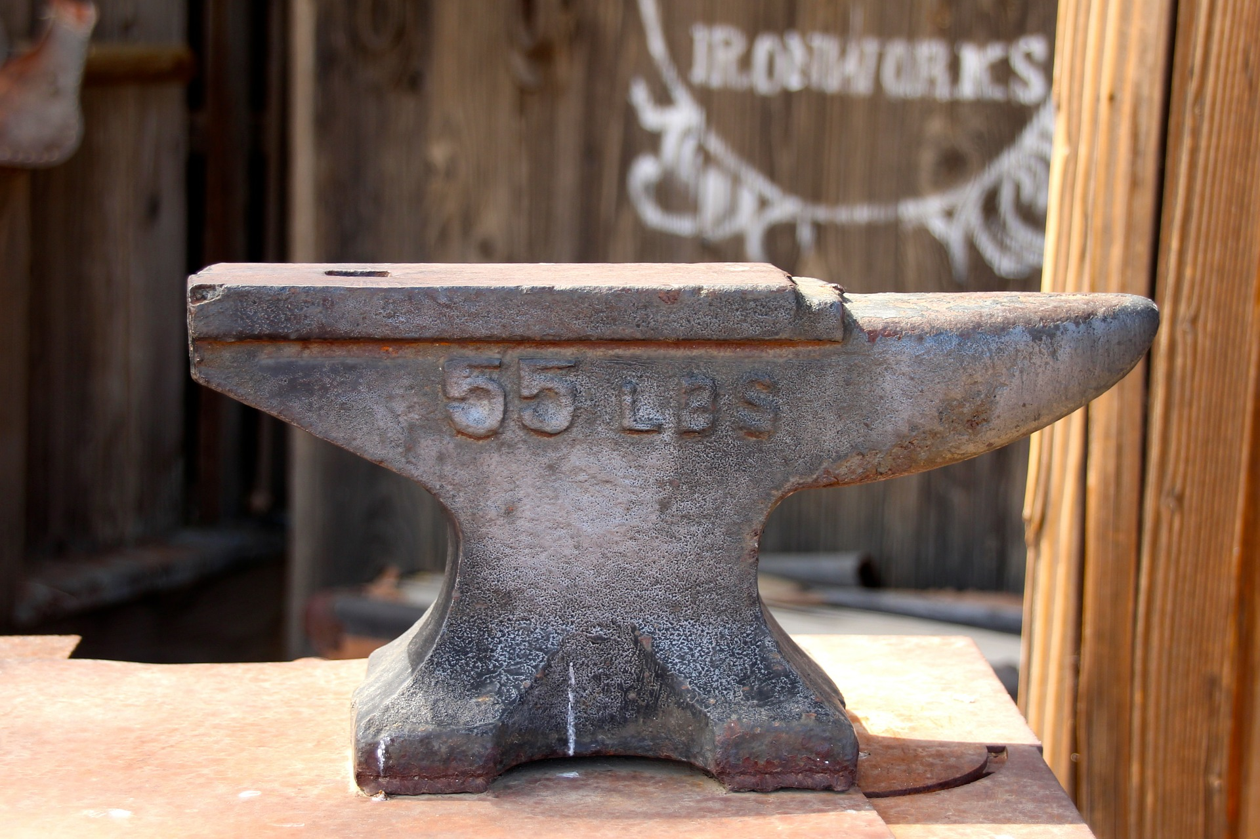

Elasticity₁
Elasticity is an economics concept that measures responsiveness of one variable to changes in another variable. Suppose you drop two items from a rooftop. The first item is an anvil. The second item is a tennis ball. Which will bounce higher? Obviously, the tennis ball. We would say that the tennis ball has greater elasticity.
Notes:
Economics is ultimately concerned with how individuals and society choose to allocate resources. Why is it that not everyone can have everything that they want or need?

Slide 3
Introduction to Elasticity
The law of demand states that a higher price will lead to a lower quantity demanded.
Similarly, the law of supply states that a higher price will lead to a higher quantity supplied.
What is unknown is exactly how much quantity demanded or quantity supplied will change following a change in price.
Elasticity is an economics concept that measures responsiveness of one variable to changes in another variable.
Notes:
The law of demand states that a higher price will lead to a lower quantity demanded. Similarly, the law of supply states that a higher price will lead to a higher quantity supplied. What is unknown is exactly how much quantity demanded or quantity supplied will change following a change in price. Elasticity is an economics concept that measures responsiveness of one variable to changes in another variable.

Slide 4

Price Elasticity
Price Elasticity of Demand
Price Elasticity of Supply
Notes:
Both the demand and supply curve show the relationship between price and the number of units demanded or supplied. Price elasticity is the ratio between the percentage change in the quantity demanded or supplied and the corresponding percent change in price.

Slide 5
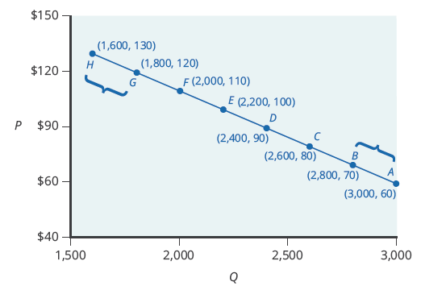

Price Elasticity of Demand
Notes:
The price elasticity of demand is the absolute value of the percentage change in the quantity demanded of a good or service divided by the percentage change in the price.

Slide 6
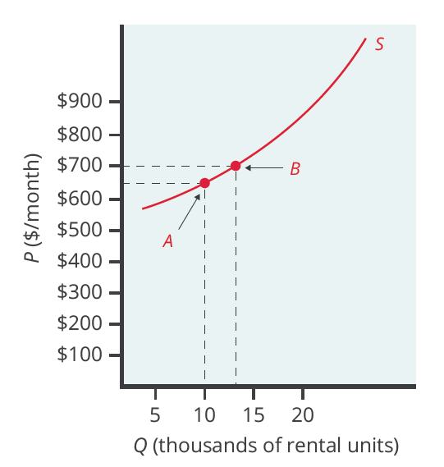

Price Elasticity of Supply
Notes:
The price elasticity of supply is absolute value of the percentage change in quantity supplied divided by the percentage change in price.

Slide 7
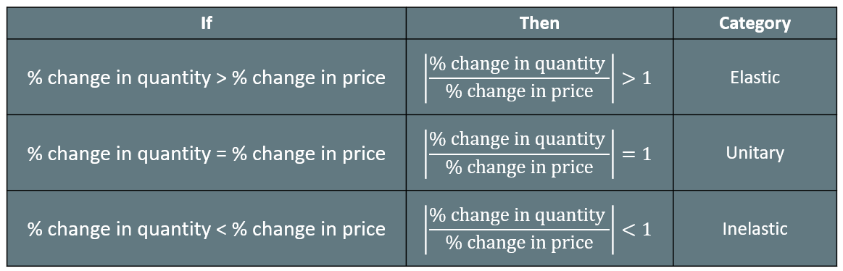
Elasticity₂
Notes:
We can usefully divide elasticities into three broad categories: elastic, inelastic, and unitary. An elastic demand or elastic supply is a curve in which the elasticity is greater than one, indicating a high responsiveness to price changes. An inelastic demand or inelastic supply is a curve in which the elasticity less than one, indicating a low responsiveness to price changes. Unitary elasticity is equal to one and indicates proportional responsiveness of either demand or supply.

Slide 8
On Your Own₁
The price elasticity of demand for a product is 2.60. Given that the percentage change in price is 15%, what is the percentage change in quantity demanded?
Notes:
Suppose you have a budget of $468. If you spend it all on ice cream, you can buy 120 pints. If the price of a glass of lemonade is 3 times less than the price of ice cream, how much lemonade can you buy if you decide to spend all your money on it?

Slide 9



On Your Own₂
The elasticity formula is:
Rearrange the formula to solve for percentage change in quantity demanded:
2. Plug the given values into the equation:
3. Solve the equation:

Slide 10


Midpoint Method
To calculate elasticity along a demand or supply curve, economists use the average percent change in both quantity and price. This is called the midpoint method for elasticity and is represented in the following equations:
Notes:
To calculate elasticity along a demand or supply curve, economists use the average percent change in both quantity and price. This is called the midpoint method for elasticity and is represented in the following equations.
Q1 is the quantity of Good 1, Q2 is the quantity of Good 2; P1 is the price of Good 1, and P2 is the price of Good 2.

Slide 11
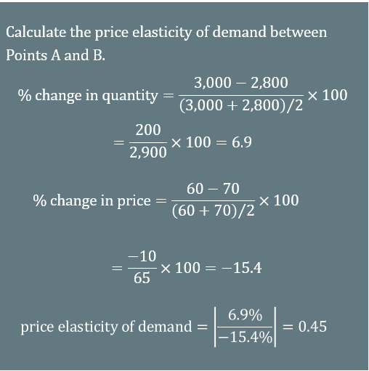
Price Elasticity of Demand Calculation
Notes:
Using the Midpoint Method, we calculate the price elasticity of demand between Points A and B as 0.45, an amount smaller than one, showing that the demand is inelastic in this interval. Price elasticities of demand are always negative since price and quantity demanded always move in opposite directions on the demand curve. Elasticities are given as positive numbers; that is why it is important to take the absolute value of all elasticity calculations.

Slide 12
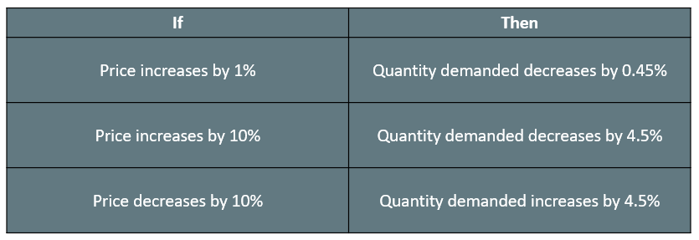

Price Elasticity of Demand Interpretation
$$price elasticity of demand=0.45$$
Notes:
A change in the price will result in a smaller percentage change in the quantity demanded. If the price increases by 1%, the quantity demanded will decrease by 0.45%. If the price increases by 10%, the quantity demanded will decrease by 4.5%. If the price decreases by 10%, the quantity demanded will increase by 4.5%.

Slide 13
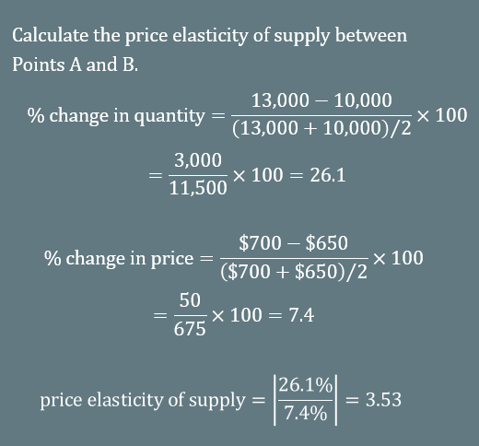
Price Elasticity of Supply Calculation
Notes:
Using the Midpoint Method, we calculate price elasticity of supply between Points A and B as 3.53, an amount greater than one, showing that the demand is elastic in this interval. Price elasticities of supply are always positive since price and quantity supplied move in the same direction on the supply curve.

Slide 14
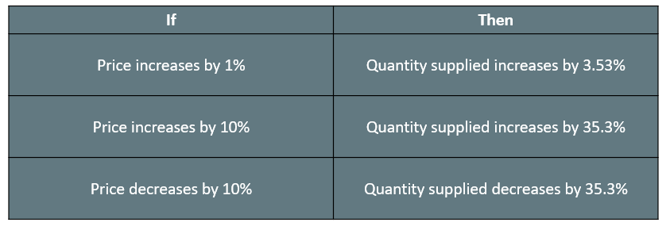

Price Elasticity of Supply Interpretation
$$price elasticity of supply=3.53$$
Notes:
In this case, if the price increases by 1%, the quantity supplied will increase by 3.53%. If the price increases by 10%, the quantity supplied will increase by 35.3%. If the price decreases by 10%, the quantity supplied will decrease by 35.3%.

Slide 15


Real-World Discussion₁
The price elasticity of demand for gasoline is usually inelastic, while the price elasticity of demand for hotel rooms is usually elastic. Can you think of other goods whose price elasticity of demand is likely to be inelastic or elastic?
Notes:
The price elasticity of demand for gasoline is usually inelastic, while the price elasticity of demand for hotel rooms is usually elastic. Can you think of other goods whose price elasticity of demand is likely to be inelastic or elastic?

Slide 16
Real-World Discussion₂
The price elasticities of demand for medicine and gasoline are inelastic, while the price elasticities of demand for restaurant meals and hotel rooms in resorts are usually elastic. Can you think of other
goods whose price elasticities of demand are likely to be inelastic or elastic?
The price elasticity of demand for goods that are necessities is usually inelastic. Examples of these goods include medicine, cigarettes for smokers, electricity, and required textbooks. The price elasticity of demand for goods that are luxuries is usually elastic. Examples of these goods include restaurant meals, concert tickets, and jewelry.
Notes:
The price elasticity of demand for goods that are necessities is usually inelastic. Examples of these goods include medicine, cigarettes for smokers, electricity, and required textbooks. The price elasticity of demand for goods that are luxuries is usually elastic. Examples of these goods include restaurant meals, concert tickets, and jewelry.

Slide 17
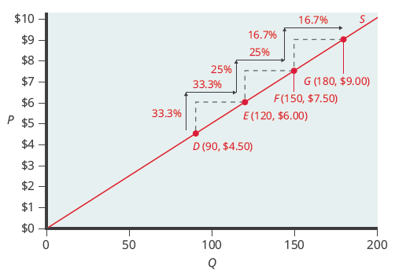
Elasticity, Not Slope
The slope is the rate of change in units along the curve, or the rise over run: the change in y over the change in x.
Elasticity is the percentage change, which is a different calculation from the slope and has a different meaning.
Notes:
It is important to note that elasticity is not slope. The slope is the rate of change in units along the curve, or the rise over run: the change in y over the change in x. The price elasticity, however, changes along the curve. Elasticity is the percentage change, which is a different calculation from the slope and has a different meaning. Now, you can calculate the price elasticity of demand, price elasticity of supply, and you can differentiate between price elasticity and slope.

Slide 18
Summary
Price elasticity measures the responsiveness of the quantity demanded or supplied of a good to a change in its price.
Elasticity is computed as the absolute value of the percentage change in quantity demanded (or supplied) divided by the percentage change in price.
Elastic demand or supply curves indicate that quantity demanded or supplied respond to price changes in a greater-than-proportional manner (the percentage change in quantity outweighs the percentage change in price).
An inelastic demand or supply curve is one in which a given percentage change in price will cause a smaller percentage change in quantity demanded or supplied.
A unitary elasticity means that a given percentage change in price leads to an equal percentage change in quantity demanded or supplied.

Slide 19




HAWKES LEARNING

