Slide 1
The Market System as an Efficient Mechanism for Information
HAWKES LEARNING
Notes:
By the end of this lesson, you will be able to apply demand and supply models to analyze prices and quantities and explain the effects of price controls on the equilibrium of prices and quantities.

Slide 2
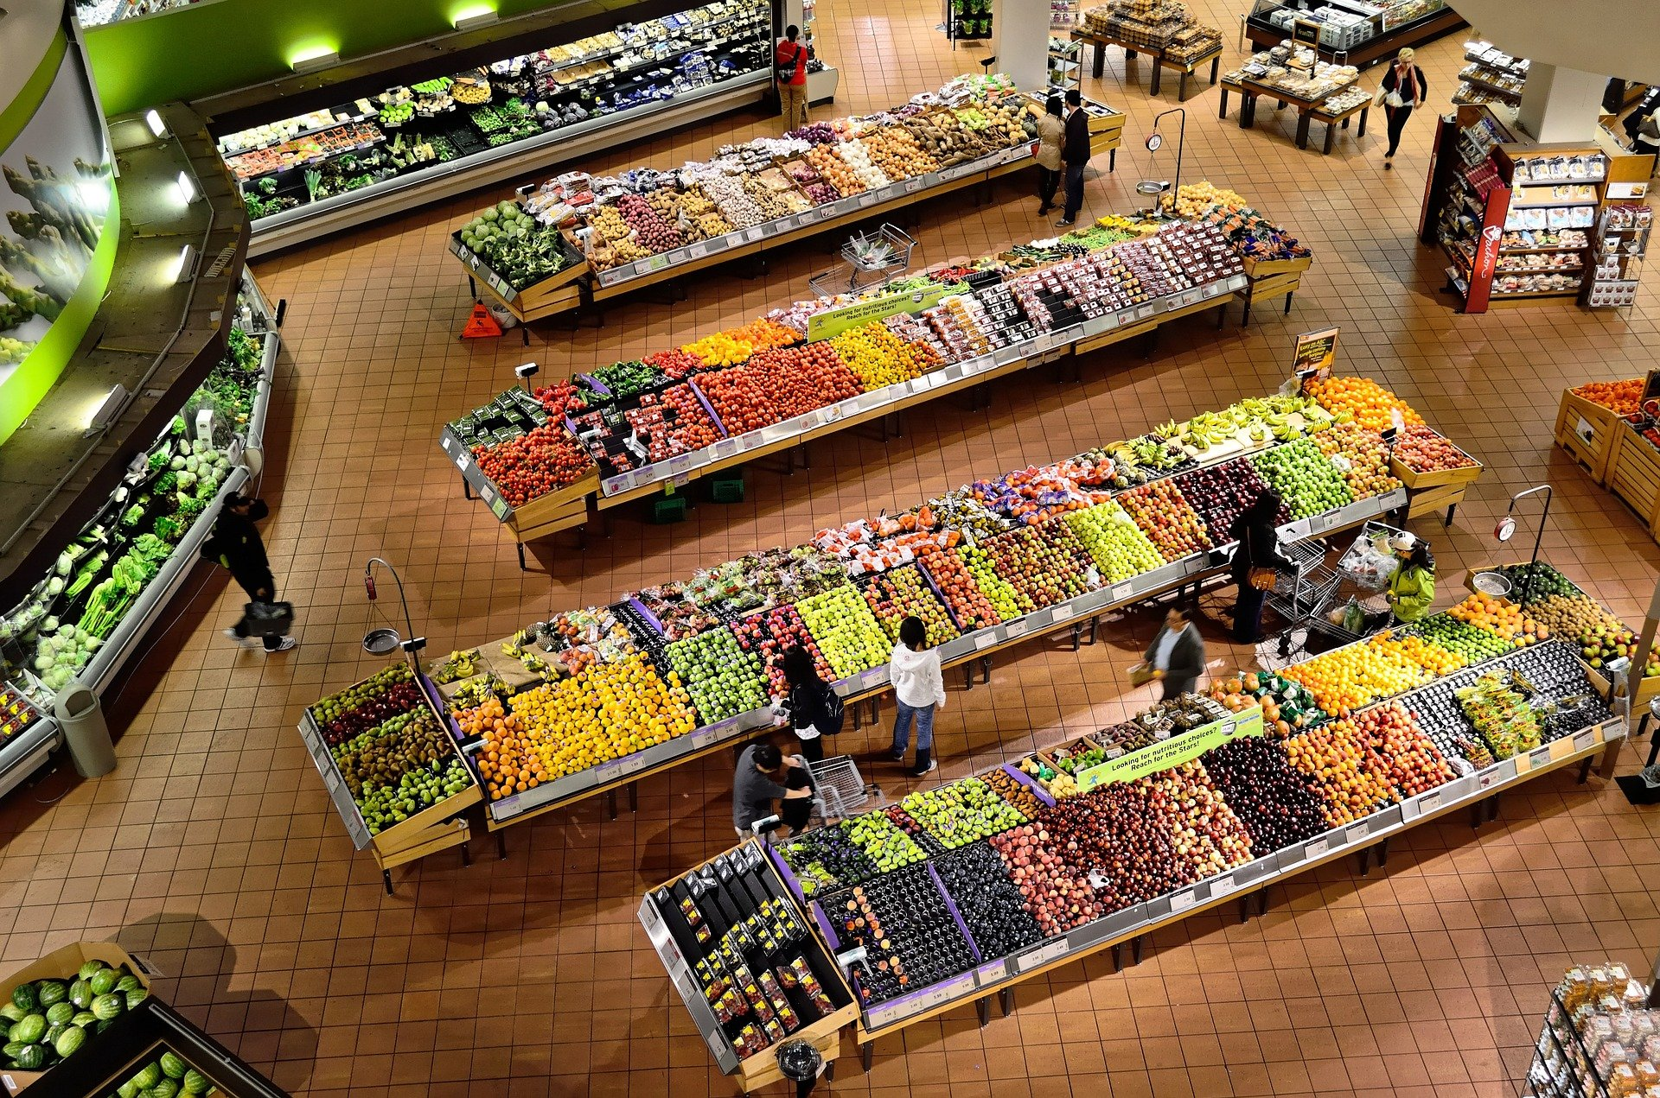
Price as a Social Mechanism₁
Think of the prices of goods you see at the store. What do these prices represent, beyond how expensive the goods are? What would a dramatic increase or decrease in the price of a good indicate to you as a shopper?

Slide 3
Price as a Social Mechanism₂
Prices exist in markets for goods and services, for labor, and for financial capital.
Prices serve as a social mechanism for collecting, combining, and transmitting information that is relevant to the market.
Prices are imperative to showing the relationship between demand and supply.
In a market-oriented economy, no government agency oversees the set of responses and interconnections that result from price changes.
Notes:
Prices exist in markets for goods and services, for labor, and for financial capital. In all of these markets, prices serve as a remarkable social mechanism for collecting, combining, and transmitting information that is relevant to the market—namely, the relationship between demand and supply—and then serving as messengers to convey that information to buyers and sellers. In a market-oriented economy, no government agency or guiding intelligence oversees the set of responses and interconnections that result from a change in price.

Slide 4
On Your Own₁
Suppose you are buying a new Jeep Wrangler, and the market is currently in equilibrium. If there is an increase in the price of fiberglass, which is used to produce Jeeps, what is likely to happen? Select the best answer.
  A. The demand for Jeep Wranglers will likely decrease.
  B. The supply of Jeep Wranglers will likely decrease.
  C. There is not enough information to know the impact in the market.
Notes:
Suppose you are buying a new Jeep Wrangler, and the market is currently in equilibrium. If there is an increase in the price of fiberglass, which is used to produce Jeeps, what is likely to happen? Select the best answer.

Slide 5
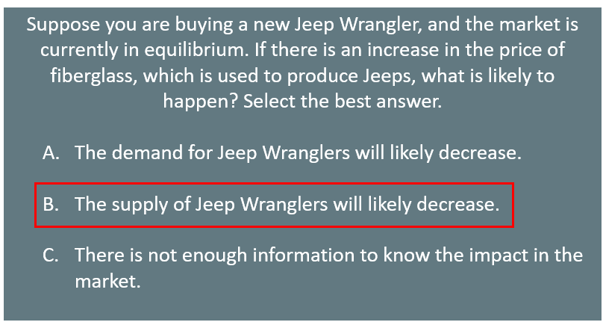
On Your Own₂
Notes:
An increase in the price of an input decreases the supply because it makes it more expensive to produce the good.

Slide 6

Impact of Price
An increase in the price of a product signals to consumers that there is a shortage, often incentivizing them to economize on buying the product.
For example, if you want to take a flight, but the ticket is currently expensive, you may wait until the ticket is cheaper.
The high price may be due to a holiday season, the cost of jet fuel, or the airline simply raising the price to see how consumers react.
You do not need to analyze the underlying factors of the price change, just the ticket price to decide when and if you purchase a flight.
Notes:
An increase in the price of a product signals consumers that there is a shortage, often incentivizing them to economize on the product. For example, if you want to take a flight, but the ticket is currently expensive, you may wait until the ticket is cheaper. The high price may be due to holiday season, the cost of jet fuel, or the airline simply raising the price to see how consumers react. You do not need to analyze the underlying factors of the price change, just the ticket price to decide when and if you purchase a flight.

Slide 7
Price Controls₁
The actions of consumers and producers as they react to prices overlap and interlock in markets for goods, labor, and financial capital.
A change in any single market is transmitted through these multiple interconnections to other markets.
Price controls are government laws that serve to regulate prices rather than allow the various markets to determine prices.
Those who seek price controls are trying to stifle the message that prices are bringing about the equilibrium level of price and quantity.
However, price controls do nothing to affect the underlying forces of demand and supply, and this can have serious repercussions.
Notes:
The actions of consumers and producers as they react to prices overlap and interlock in markets for goods, labor, and financial capital. A change in any single market is transmitted through these multiple interconnections to other markets. Price controls are government laws that serve to regulate prices rather than allow the various markets to determine prices. Those who seek price controls are trying to stifle the message that prices are bringing about the equilibrium level of price and quantity.

Slide 8
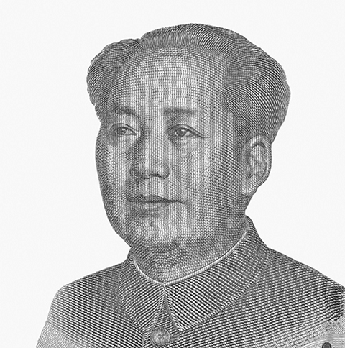
Price Controls₂
During China's "Great Leap Forward" in the late 1950s, the government kept food prices artificially low, causing 30 to 40 million people to die of starvation because the low prices depressed farm production. This was communist party leader Mao Zedong's social and economic campaign to rapidly transform the country from an agrarian economy to a socialist society through rapid industrialization and collectivization.
Notes:
During China's "Great Leap Forward" in the late 1950s, the government kept food prices artificially low, causing 30 to 40 million people to die of starvation because the low prices depressed farm production. This was communist party leader Mao Zedong's social and economic campaign to rapidly transform the country from an agrarian economy to a socialist society through rapid industrialization and collectivization.

Slide 9
Summary
The market price system provides a highly efficient mechanism for disseminating information about relative scarcities of goods, services, labor, and financial capital.
Market participants do not need to know why prices have changed, only that the changes require them to revisit previous decisions they made about supply and demand.
Price controls hide information about the true scarcity of products and thereby cause misallocation of resources.

Slide 10




HAWKES LEARNING

