Slide 1
Demand, Supply, and Equilibrium in Markets for Goods and Services
HAWKES LEARNING

Slide 2

Real-World Discussion
Suppose that your university’s football team is playing in the conference championship. Your school has sold out of tickets. There are 5,000 students who want to go to the game and are willing and able to buy a ticket but don’t have a ticket. What will happen in the market for tickets?
Notes:
Suppose that your university’s football team is playing in the conference championship. Your school has sold out of tickets. There are 5,000 students who want to go to the game and are willing and able to buy a ticket but don’t have a ticket. What will happen in the market for tickets?

Slide 3
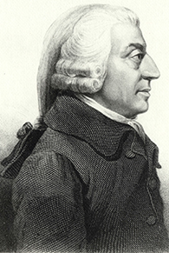
The Invisible Hand₁
Adam Smith's invisible hand theory states that the market works as if guided by an invisible hand.
Smith wrote that markets, if left alone, are the best and most efficient way of allocating scarce resources.
The interaction of buyers and sellers in a market, each pursuing their own self-interest, leads to the most efficient market outcome.
Notes:
Adam Smith's invisible hand theory states that the market works as if guided by an invisible hand. In 1776, Adam Smith wrote that markets, if left alone, are the best and most efficient way of allocating scarce resources. A market is guided by two principles: prices and self-interest. Buyers and sellers, each pursuing their own self-interests, lead to the most efficient market outcome.

Slide 4
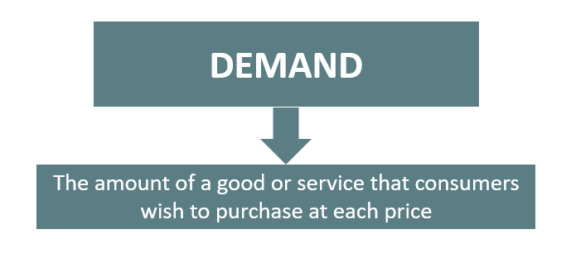
Demand
Notes:
Economists use the term demand to refer to the amount of some good or service that consumers are willing and able to purchase at each price. Demand is based on needs and wants and on your income, as well as other factors.

Slide 5
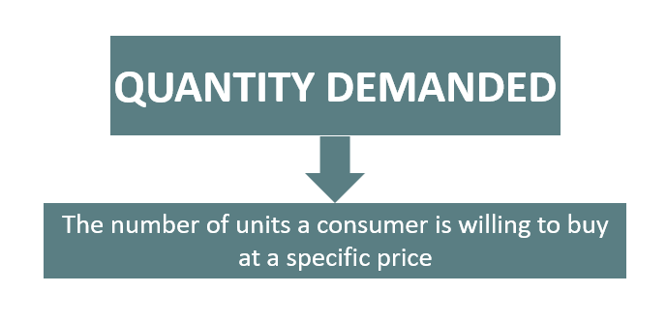
Quantity Demanded
Notes:
What a buyer pays for a unit of the specific good or service is called price. The total number of units that consumers are willing and able to purchase at a given price is called the quantity demanded.

Slide 6
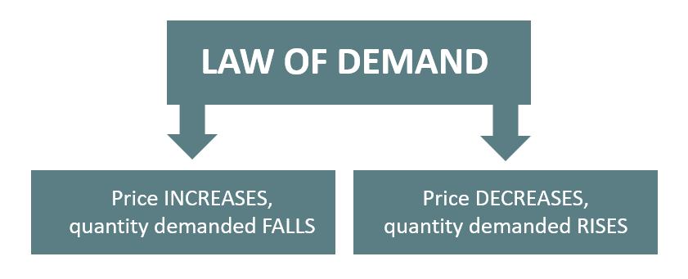
Law of Demand
Notes:
The law of demand states that, all other things constant, an increase in the price of a good will decrease the quantity demanded. Likewise, a fall in the price of a good will increase the quantity demanded.

Slide 7
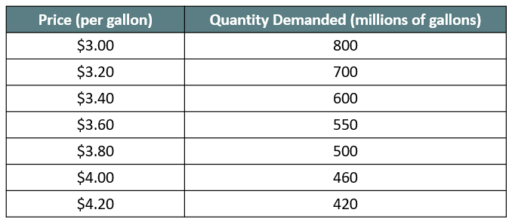
Demand Schedule
As price increases, quantity demanded decreases.
Notes:
Let’s consider the market for gasoline. Economists call a table that shows the quantity demanded at each price a demand schedule. We are measuring price in dollars per gallon of gasoline and quantity demanded in millions of gallons over some time period, like a day or a year, and over some geographic area, like a city or a state. As price increases, quantity demanded decreases, and vice versa.

Slide 8
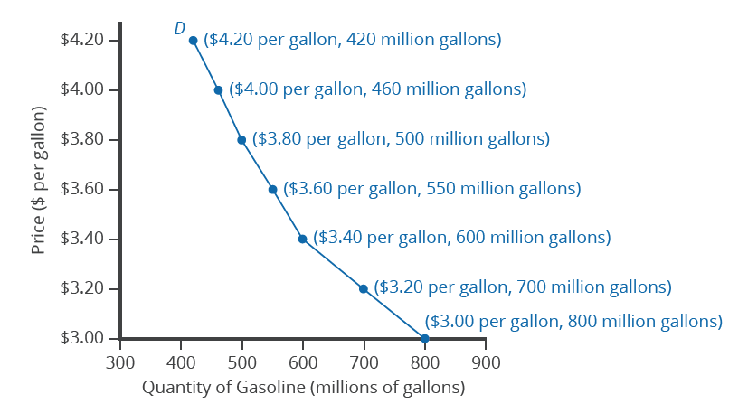
Demand Curve
A demand curve shows the relationship between price and quantity demanded.
Demand curves differ in shape but always show the inverse relationship between price and quantity demanded.
Notes:
We can graph this relationship. The result is a demand curve, showing the relationship between price and quantity demanded. Demand curves are different for each product, steeper or flatter, linear or curved, but all demand curves show the inverse relationship between price and quantity demanded (the law of demand). Note that “demand” refers to the curve itself, while “quantity demanded” refers to a point on the curve.

Slide 9
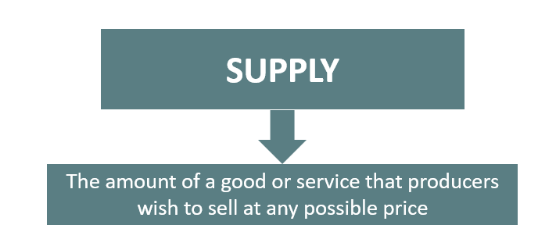
Supply
Notes:
When economists talk about supply, they mean the amount of some good or service a producer is willing to supply at each price.

Slide 10
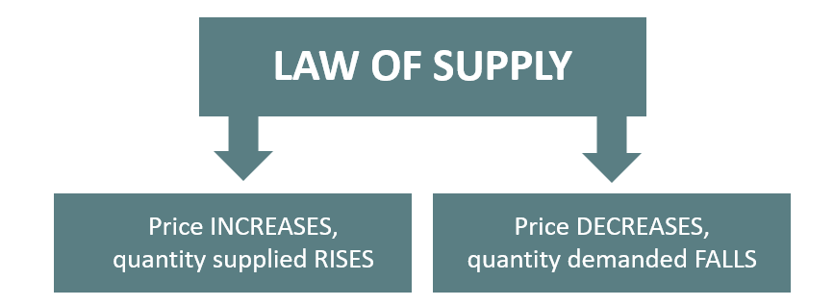
Law of Supply
Notes:
A rise in price generally leads to an increase in the quantity supplied of that good or service, while a fall in price will decrease the quantity supplied. This is sometimes called the law of supply. When the price of gasoline rises, for example, it encourages profit-seeking firms to take action, such as opening more gas stations or keeping existing gas stations open for longer hours.

Slide 11
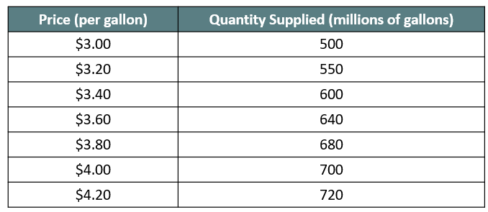
Supply Schedule
As price increases, quantity supplied increases.
Notes:
A supply schedule is a table that shows the quantity supplied at a range of different prices.

Slide 12
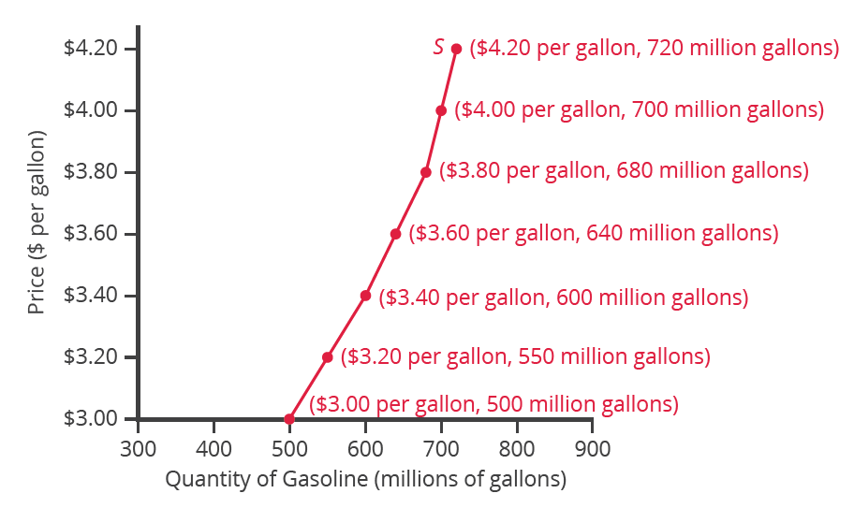
Supply Curve
A supply curve shows the relationship between price and quantity supplied.
The upward slope of the supply curve illustrates the law of supply—that a higher price leads to a higher quantity supplied, and vice versa.
Notes:
If we graph this relationship, we have a supply curve. “Supply” refers to the curve itself, while “quantity supplied” refers to a point on the curve. The upward slope of the supply curve illustrates the law of supply—that a higher price leads to a higher quantity supplied, and vice versa. Together, demand and supply determine the price and the quantity that will be bought and sold in a market.

Slide 13
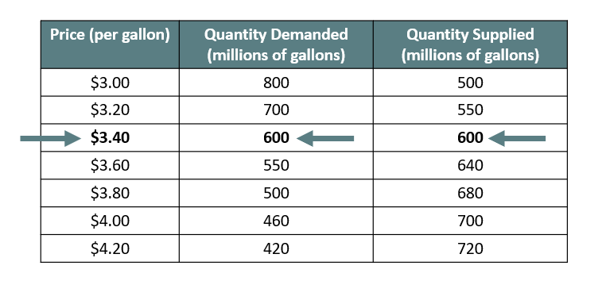
Demand and Supply₁
Notes:
If we put supply and demand together, we can see what price and quantity combination will correspond with the interests of both buyers and sellers. If you look at the table, you can see that the quantity demanded of buyers is equal to the quantity supplied of sellers at a price of $3.40. At this point, 600 million gallons of gasoline are bought and sold.

Slide 14
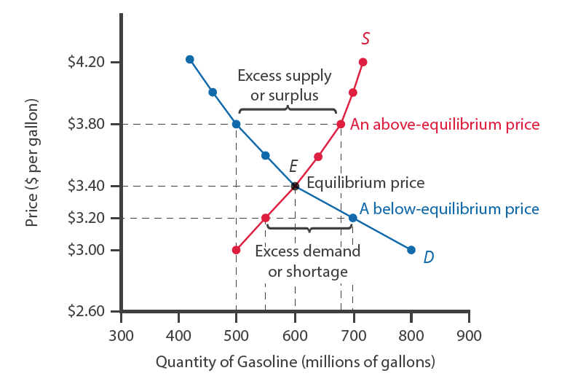
Demand and Supply₂
The equilibrium price and quantity occurs at the point where the demand and supply curves cross.
Notes:
The demand and supply curves intersect at a price of $3.40 and a quantity of 600. This is the equilibrium price and quantity. At any other price, the quantity demanded does not equal the quantity supplied, so the market is not in equilibrium at that price. The word equilibrium means “balance.” If a market is at its equilibrium price and quantity, it has no reason to move away from that point.

Slide 15
On Your Own₁
The demand curve in the market for milk is described by the equation Q _{d} = 360 − 30P, and the supply curve is described by the equation Q _{s} = 168 + 18P, where P is the price in dollars and Q is the number of gallons of milk.
Calculate the equilibrium price in this market.
Notes:
The demand curve in the market for milk is described by the equation Qd=360−30P, and the supply curve is described by the equation Qs=168+18P, where P is the price and Q is the number of gallons. Calculate the equilibrium price in this market.

Slide 16
On Your Own₂
To calculate equilibrium price, set the supply and demand equations equal to one another and solve for P:
360 − 30P = 168 + 18P
360 = 168 + 48P
192 = 48P
P = 4
Notes:
To calculate equilibrium price, set the supply and demand equations equal to one another and solve for P. The equilibrium price in the market for milk is 4 dollars.

Slide 17
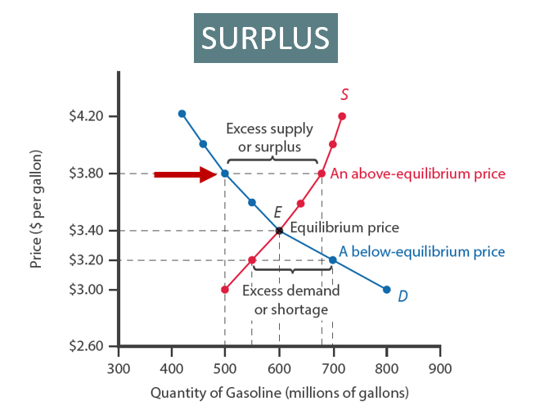
Demand and Supply₃
Notes:
Imagine, for example, that the price of a gallon of gasoline was $3.80 per gallon. At this higher price, the quantity demanded drops from 600 to 500. This decline in quantity reflects how consumers react to the higher price by finding ways to use less gasoline. The quantity of gasoline supplied rises from the 600 to 680 as the higher price makes it more profitable for gasoline producers to expand their output. There is now a surplus of gasoline because the quantity supplied exceeds the quantity demanded.

Slide 18
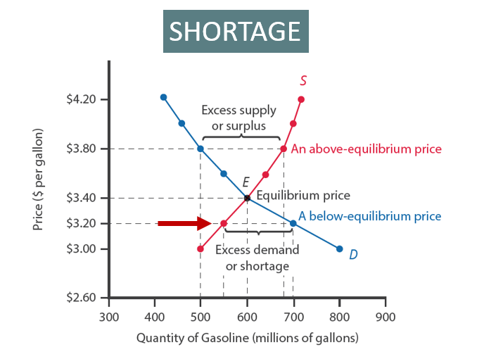
Demand and Supply₄
Notes:
Now, suppose that the price is below equilibrium, at $3.20 per gallon. Now, the quantity demanded is greater than the quantity supplied, so there is a shortage, or excess demand. Consumers who cannot get the product at this price will bid up the price, and higher prices will in turn cause the quantity supplied to increase, again moving the market to equilibrium.

Slide 19
The Invisible Hand₂
The Invisible Hand takes the market back to equilibrium!
Notes:
All of this adjustment takes place without government intervention, through the invisible hand of the marketplace.

Slide 20
Summary
A demand/supply schedule is a table that shows the quantity demanded/quantity supplied at different prices in the market.
A demand/supply curve shows the relationship between quantity demanded/quantity supplied and price in a given market on a graph.
The equilibrium price and equilibrium quantity occur where the supply and demand curves cross and quantity demanded equals quantity supplied.
When quantity supplied exceeds quantity demanded, a surplus occurs, and when quantity demanded exceeds quantity supplied, a shortage occurs.
Economic pressures, or the "invisible hand," will push the price toward the equilibrium level when an economic imbalance occurs.
Notes:
A demand/supply schedule is a table that shows the quantity demanded/quantity supplied at different prices in the market.
A demand/supply curve shows the relationship between quantity demanded/quantity supplied and price in a given market on a graph.
The equilibrium price and equilibrium quantity occur where the supply and demand curves cross and quantity demanded equals quantity supplied.
When quantity supplied exceeds quantity demanded, a surplus occurs, and when quantity demanded exceeds quantity supplied, a shortage occurs.
Economic pressures, or the ‘invisible hand’, will push the price toward the equilibrium level when an economic imbalance occurs.

Slide 21




HAWKES LEARNING

