Slide 1
Protectionism:
An Indirect Subsidy from Consumers to Producers
HAWKES LEARNING
Notes:
By the end of this lesson, you will be able to explain and analyze protectionism and calculate the effects of trade barriers.

Slide 2
Introduction₁
The world has become more connected on multiple levels, especially economically.
In 1970, imports and exports made up 11% of U.S. GDP, while they made up about 24% in 2020.
This chapter explores trade policy: the laws and strategies a country uses to regulate international trade.
Notes:
The world has become more connected on multiple levels, especially economically. In 1970, imports and exports made up 11% of U.S. GDP, while they made up about 24% in 2020. This chapter explores trade policy: the laws and strategies a country uses to regulate international trade.

Slide 3

Introduction₂
As the world has become more globally connected, firms and workers in high-income countries (like the United States, Japan, or the nations of the European Union) perceive a competitive threat from firms in medium-income countries (like Mexico, China, or South Africa) that have lower costs of living and therefore pay lower wages.
Notes:
As the world has become more globally connected, firms and workers in high-income countries like the United States, Japan, or the nations of the European Union perceive a competitive threat from firms in medium-income countries like Mexico, China, or South Africa that have lower costs of living and therefore pay lower wages.

Slide 4
Protectionism₁
When a government legislates policies to reduce or block international trade, it is engaging in protectionism.
Protectionist policies often seek to shield domestic producers and domestic workers from foreign competition.
Protectionism takes three main forms:
Tariffs
Import quotas
Nontariff barriers
Notes:
When a government legislates policies to reduce or block international trade, it is engaging in protectionism. Protectionist policies often seek to shield domestic producers and domestic workers from foreign competition. Protectionism takes three main forms: tariffs, import quotas, and nontariff barriers.

Slide 5
Tariffs
Tariffs are taxes that governments impose on imported goods and services.
This makes imports more expensive for consumers, discouraging imports.
For example, in recent years large, flat-screen televisions imported to the U.S. from China have faced a 5% tariff rate.
Notes:
Tariffs are taxes that governments impose on imported goods and services. This makes imports more expensive for consumers, discouraging imports. For example, in recent years large, flat-screen televisions imported to the U.S. from China have faced a 5% tariff rate.

Slide 6

Import Quotas
Import quotas are numerical limitations on the quantity of products that a country can import.
For example, sugar imports to the U.S. are still governed by quotas.
Notes:
Import quotas are numerical limitations on the quantity of products that a country can import. For example, sugar imports into the U.S. are still governed by quotas.

Slide 7
Nontariff Barriers
Nontariff barriers are all the other ways that a nation can draw up rules and regulations to make it more difficult to import products.
A rule requiring certain safety standards can limit imports just as effectively as high tariffs or low import quotas, for instance.
Notes:
Nontariff barriers are all the other ways that a nation can draw up rules and regulations to make it more difficult to import products. A rule requiring certain safety standards can limit imports just as effectively as high tariffs or low import quotas, for instance.

Slide 8
Trade Barriers
When the United States eliminates trade barriers in one area, consumers spend the money they save on that product elsewhere in the economy. Thus, while eliminating trade barriers in one sector of the economy will likely result in some job loss in that sector, consumers will spend the resulting savings in other sectors of the economy and hence increase the number of jobs in those other sectors.
Eliminate trade barriers
Job loss in sector that had the trade barrier
Consumer spending increases in other sectors of the economy
Job increase in other sectors
Notes:
When the United States eliminates trade barriers in one area, consumers spend the money they save on that product elsewhere in the economy. Thus, while eliminating trade barriers in one sector of the economy will likely result in some job loss in that sector, consumers will spend the resulting savings in other sectors of the economy and hence increase the number of jobs in those other sectors.

Slide 9
Demand and Supply Analysis of Protectionism
Restricting imports may appear to be nothing more than taking sales from foreign producers and giving them to domestic producers.
Other factors are at work, however, because firms do not operate in a vacuum.
Instead, firms sell their products either to consumers or to other firms, who are also affected by the trade barriers.
A demand and supply analysis of protectionism shows that it is a policy that imposes substantial domestic costs.
Notes:
Restricting imports may appear to be nothing more than taking sales from foreign producers and giving them to domestic producers. Other factors are at work, however, because firms do not operate in a vacuum. Instead, firms sell their products either to consumers or to other firms, who are also affected by the trade barriers. A demand and supply analysis of protectionism shows that it is a policy that imposes substantial domestic costs.

Slide 10
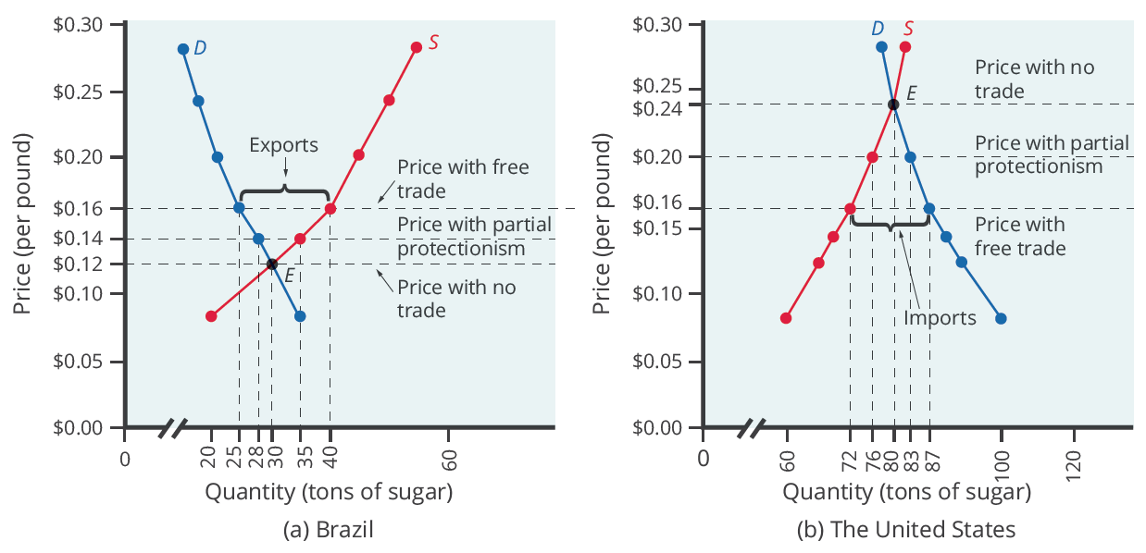
Demand & Supply
Before trade, the equilibrium price of sugar in Brazil is $0.12 a pound, and it is $0.24 per pound in the United States. When trade is allowed, businesses will buy cheap sugar in Brazil and sell it in the United States. This will result in higher prices in Brazil and lower prices in the United States.
Notes:
Before trade, the equilibrium price of sugar in Brazil is $0.12 a pound, and it is $0.24 per pound in the United States. When trade is allowed, businesses will buy cheap sugar in Brazil and sell it in the United States. This will result in higher prices in Brazil and lower prices in the United States.

Slide 11
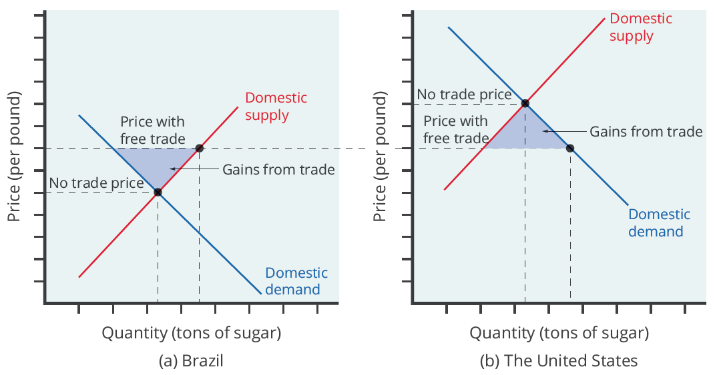
Gains from Trade
Free trade results in gains from trade. Total surplus increases in both countries, as the two shaded areas show. However, there are clear income distribution effects. Producers gain in the exporting country, while consumers lose; in the importing country, consumers gain and producers lose.
Notes:
Free trade results in gains from trade. Total surplus increases in both countries, as the two shaded areas show. However, there are clear income distribution effects. Producers gain in the exporting country, while consumers lose; in the importing country, consumers gain and producers lose.

Slide 12



Gains from Trade: U.S. Farmers
U.S. sugar farmers are likely to argue that if they could only be protected from sugar imported from Brazil, the United States would have higher domestic sugar production, more jobs in the sugar industry, and American sugar farmers would receive a higher price.
sugar
Notes:
U.S. sugar farmers are likely to argue that, if only they could be protected from sugar imported from Brazil, the United States would have higher domestic sugar production, more jobs in the sugar industry, and American sugar farmers would receive a higher price.

Slide 13


Gains from Trade: Tariffs
If the government sets a high-enough tariff on imported sugar, or sets an import quota at zero, the result will be that the quantity of sugar traded between countries could be reduced to zero, and the prices in each country will return to the levels before trade was allowed.
Notes:
If the government sets a high-enough tariff on imported sugar, or sets an import quota at zero, the result will be that the quantity of sugar traded between countries could be reduced to zero, and the prices in each country will return to the levels before trade was allowed.

Slide 14

Foreign Impact
The effect of protectionism on producers and consumers in the foreign country is complex. When a government uses an import quota to impose partial protectionism, Brazilian sugar producers receive a lower price for the sugar they sell in Brazil, but a higher price for the sugar they are allowed to export to the United States.
Notes:
The effect of protectionism on producers and consumers in the foreign country is complex. When a government uses an import quota to impose partial protectionism, Brazilian sugar producers receive a lower price for the sugar they sell in Brazil, but a higher price for the sugar they are allowed to export to the United States.

Slide 15
Who Benefits and Who Pays?
For protected producers, like U.S. sugar farmers, restricting imports is clearly positive.
Without a need to face imported products, these producers are able to sell more at a higher price.
For consumers in the country with the protected good, in this case U.S. sugar consumers, restricting imports is clearly negative.
They end up buying a lower quantity of the good and paying a higher price for what they do buy compared to the equilibrium with trade.
Notes:
For protected producers, like U.S. sugar farmers, restricting imports is clearly positive. Without a need to face imported products, these producers are able to sell more at a higher price. For consumers in the country with the protected good, in this case U.S. sugar consumers, restricting imports is clearly negative. They end up buying a lower quantity of the good and paying a higher price for what they do buy compared to the equilibrium with trade.

Slide 16

Protectionism₂
The results of protectionism on producers and consumers are complex. It can limit the choices of domestic consumers and lower the revenue of foreign producers.
Notes:
The results of protectionism on producers and consumers are complex. It can limit the choices of domestic consumers and lower the revenue of foreign producers.

Slide 17
Summary
There are three tools for restricting the flow of trade: tariffs, import quotas, and nontariff barriers.
When a country places limitations on imports from abroad—regardless of whether it uses tariffs, quotas, or nontariff barriers—it is said to be practicing protectionism.
Protectionism will raise the price of the protected good in the domestic market, which causes domestic consumers to pay more but domestic producers to earn more.

Slide 18




HAWKES LEARNING

