Slide 1
Absolute and Comparative Advantage
HAWKES LEARNING
Notes:
Absolute and Comparative Advantage. By the end of this video, you will be able to define absolute advantage, comparative advantage, and opportunity costs. You will also be able to explain the gains of trade created when a country specializes.

Slide 2

Introduction
While the iPhone is readily recognized as an Apple product, 26% of its component costs come from elements made by Samsung, a competitor. In international trade, there are often examples like this as each country or company focuses on what it does best.
Notes:
While the iPhone is readily recognized as an Apple product, 26% of its component costs come from elements made by Samsung, a competitor. In international trade, there are often examples like this as each country or company focuses on what it does best.

Slide 3
Trade
We live in a global marketplace.
For example, the food on your table might include fresh fruit from Chile, cheese from France, and bottled water from Scotland.
We are all linked by international trade, and the volume of that trade has grown dramatically in the last few decades.
Notes:
We live in a global marketplace. For example, the food on your table might include fresh fruit from Chile, cheese from France, and bottled water from Scotland. We are all linked by international trade, and the volume of that trade has grown dramatically in the last few decades.

Slide 4
Mercantilism
Adam Smith, known as the father of economics, was a Scottish philosopher who grew up in an era known now as "mercantilism."
Mercantilism was a belief that countries developed wealth by hoarding gold.
Adam Smith wrote a book, The Wealth of Nations, to speak out against this mercantilist system.
Smith believed a nation became wealthy not by hoarding gold but by specialization and trade.
Smith famously said, “Man is an animal that makes bargains: no other animal does this—no dog exchanges bones with another.”
Notes:
Adam Smith, known as the father of economics, was a Scottish philosopher who grew up in an era known now as "mercantilism.“ Mercantilism was a belief that countries developed wealth by hoarding gold. Adam Smith wrote a book, The Wealth of Nations, to speak out against this mercantilist system. Smith believed a nation became wealthy not by hoarding gold but by specialization and trade. Smith famously said, “Man is an animal that makes bargains: no other animal does this—no dog exchanges bones with another.”

Slide 5
Absolute Advantage₁
A country has an absolute advantage over another country in producing a good if it uses fewer resources to produce that good.
Absolute advantage can be the result of a country's natural endowment.
For example, Guatemala and Colombia have climates especially suited for growing coffee.
As some have argued, "geography is destiny."
Notes:
A country has an absolute advantage over another country in producing a good if it uses fewer resources to produce that good. Absolute advantage can be the result of a country's natural endowment. For example, Guatemala and Colombia have climates especially suited for growing coffee. As some have argued, "geography is destiny."

Slide 6
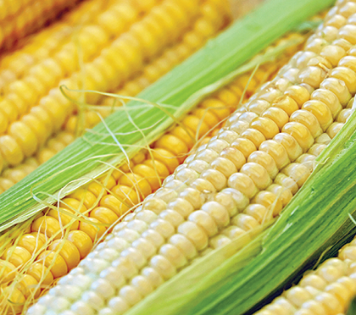
Absolute Advantage₂
If the U.S. is able to produce corn faster and with fewer resources than Brazil, the U.S. has the absolute advantage in corn.
Notes:
If the U.S. is able to produce corn faster and with fewer resources than Brazil, the U.S. has the absolute advantage in corn.

Slide 7
Comparative Advantage
A country has a comparative advantage when it can produce a good at a lower cost in terms of other goods.
The question each country or company should be asking when it trades is this: "What do we give up to produce this good?"
The concept of comparative advantage is based on this idea of opportunity cost.
For example, if Zambia focuses its resources on producing copper, it cannot use its land, labor, and finances to produce other goods.
Notes:
A country has a comparative advantage when it can produce a good at a lower cost in terms of other goods. The question each country or company should be asking when it trades is this: "What do we give up to produce this good?“ The concept of comparative advantage is based on this idea of opportunity cost. For example, if Zambia focuses its resources on producing copper, it cannot use its land, labor, and finances to produce other goods.

Slide 8
On Your Own₁
Suppose you and your roommate have a business selling sandwiches and cookies in your dorm. If you make only cookies, you can make 75 per day. If you make only sandwiches, you can make 15 per day. Your roommate can make 90 cookies or 30 sandwiches per day. Does it make sense for the two of you to specialize to increase your output? Why or why not?
Notes:
Suppose you and your roommate have a business selling sandwiches and cookies in your dorm. If you make only cookies, you can make 75 per day. If you make only sandwiches, you can make 15 per day. Your roommate can make 90 cookies or 30 sandwiches per day. Does it make sense for the two of you to specialize to increase your output? Why or why not?

Slide 9
On Your Own₂
Suppose you and your roommate have a business selling sandwiches and cookies in your dorm. If you make only cookies, you can make 75 per day. If you make only sandwiches, you can make 15 per day. Your roommate can make 90 cookies or 30 sandwiches per day. Does it make sense for the two of you to specialize to increase your output? Why or why not?
Your opportunity cost of making a sandwich is 75/15 = 5 cookies.
Your opportunity cost of making a cookie is 15/75 = 1/5 of a sandwich.
Your roommate’s opportunity cost of making a sandwich is 90/30 = 3 cookies.
Your roommate’s opportunity cost of making a cookie is 30/90 = 1/3 of a sandwich.
You should specialize in cookies because your opportunity cost is lower. Your roommate should specialize in sandwiches because the opportunity cost is lower.
Notes:
Suppose you and your roommate have a business selling sandwiches and cookies in your dorm. If you make only cookies, you can make 75 per day. If you make only sandwiches, you can make 15 per day. Your roommate can make 90 cookies or 30 sandwiches per day. Does it make sense for the two of you to specialize to increase your output? Why or why not?
Your opportunity cost of making a sandwich is 75/15 = 5 cookies.
Your opportunity cost of making a cookie is 15/75 = 1/5 of a sandwich.
Your roommate’s opportunity cost of making a sandwich is 90/30 = 3 cookies.
Your roommate’s opportunity cost of making a cookie is 30/90 = 1/3 of a sandwich.
You should specialize in cookies because your opportunity cost is lower. Your roommate should specialize in sandwiches because the opportunity cost is lower.

Slide 10
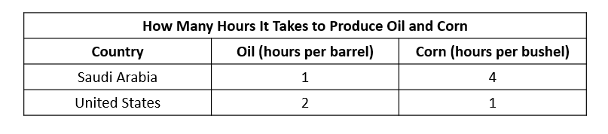
A Numerical Example of Absolute and Comparative Advantage₁
Consider a hypothetical world with two countries—Saudi Arabia and the United States—and two products: oil and corn.
Saudi Arabia has an absolute advantage in producing oil because it only takes an hour to produce a barrel of oil, compared to two hours in the United States. The United States has an absolute advantage in producing corn.
Notes:
Consider a hypothetical world with two countries—Saudi Arabia and the United States—and two products: oil and corn. Saudi Arabia has an absolute advantage in producing oil because it only takes an hour to produce a barrel of oil, compared to two hours in the United States. The United States has an absolute advantage in producing corn.

Slide 11
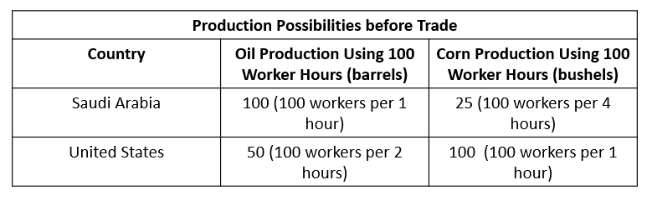
A Numerical Example of Absolute and Comparative Advantage₂
Now, let's determine which country produces which good (oil or corn) more cheaply. To simplify, let's say that Saudi Arabia and the United States each have 100 worker hours.
Notes:
Now, let's determine which country produces which good (oil or corn) more cheaply. To simplify, let's say that Saudi Arabia and the United States each have 100 worker hours.

Slide 12
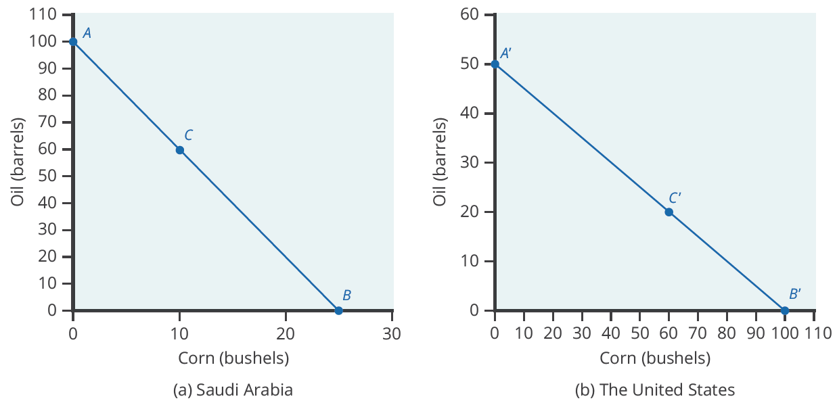
Production Possibilities Frontier₁
Notes:
If Saudi Arabia produces only oil, it can produce, at most, 100 barrels and no corn (Point A). At the other extreme, it can produce a maximum of 25 bushels of corn and no oil (Point B). It can also produce other combinations of oil and corn if it wants to consume both goods, such as at Point C. (b) If the United States produces only oil, it can produce, at most, 50 barrels and no corn (Point A'). At the other extreme, it can produce a maximum of 100 bushels of corn and no oil (Point B'). Other combinations of both oil and corn are possible, such as Point C'. All points above the frontiers are impossible to produce given the current level of resources and technology.

Slide 13
Production Possibilities Frontier₂
The slope of the production possibility frontier illustrates the opportunity cost of producing oil in terms of corn.
The U.S. can produce 50 barrels of oil or 100 bushels of corn.
The opportunity cost of one barrel of oil is two bushels of corn, or the slope is −1/2.
In the U.S. production possibility frontier graph, every increase in oil production of one barrel implies a decrease of two bushels of corn.
Notes:
The slope of the production possibility frontier illustrates the opportunity cost of producing oil in terms of corn. The U.S. can produce 50 barrels of oil or 100 bushels of corn. The opportunity cost of one barrel of oil is two bushels of corn, or the slope is −1/2. In the U.S. production possibility frontier graph, every increase in oil production of one barrel implies a decrease of two bushels of corn.

Slide 14
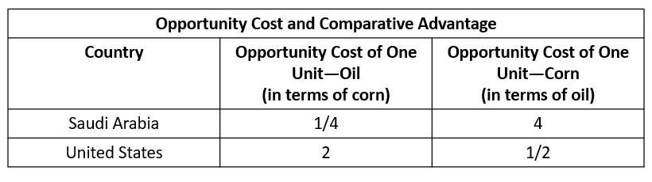
Opportunity Cost and Comparative Advantage
Again, recall that we defined comparative advantage as the opportunity cost of producing goods. Since Saudi Arabia gives up the least to produce a barrel of oil, (1/4 < 2 ) it has a comparative advantage in oil production. The United States gives up the least to produce a bushel of corn, so it has a comparative advantage in corn production.
Notes:
Again, recall that we defined comparative advantage as the opportunity cost of producing goods. Since Saudi Arabia gives up the least to produce a barrel of oil, (1/4<2 ) it has a comparative advantage in oil production. The United States gives up the least to produce a bushel of corn, so it has a comparative advantage in corn production.

Slide 15
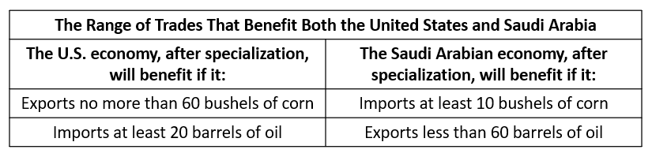
Gains from Trade
If Saudi Arabia can trade an amount of oil less than 60 barrels and receive in exchange an amount of corn greater than 10 bushels, it will have more of both goods than it did before specialization and trade. The table illustrates the range of trades that would benefit both sides.
Notes:
If Saudi Arabia can trade an amount of oil less than 60 barrels and receive in exchange an amount of corn greater than 10 bushels, it will have more of both goods than it did before specialization and trade. The table illustrates the range of trades that would benefit both sides.

Slide 16
Summary
A country has an absolute advantage in those products in which it has a productivity edge over other countries; it takes fewer resources to produce a product.
A country has a comparative advantage when it can produce a good at a lower cost in terms of other goods.
Countries that specialize based on comparative advantage gain from trade.

Slide 17




Hawkes Learning
HAWKES LEARNING
Notes:
Now you are able to define absolute advantage, comparative advantage, and opportunity costs. You are also able to explain the gains of trade created when a country specializes.

