Slide 1
The Production Possibilities Frontier and Social Choices
HAWKES LEARNING

Slide 2

Social Choice
How does a society decide to allocate its resources? Consider a scenario where society is forced to decide how many resources it will put toward health care (a) and education (b).
Notes:
How does a society decide to allocate its resources? Consider a scenario where society is forced to decide how many resources it will put toward health care (a) and education (b).

Slide 3



Social Choices
Like individuals, society is unable to fulfill its unlimited wants with the limited resources that are available.
There are more similarities than differences between the constraints that both individuals and society face.
Resources like labor, land, capital, and raw materials are not infinite, limiting the quantity of goods and services a society can produce.
Notes:
Like individual consumers, society is unable to fulfill its unlimited wants with the limited resources it has available. While the constraints that an individual and society face vary, there are more similarities than differences between the two. Depending on the availability of time and money, individuals are limited in the amount of goods and services they can consume. Depending on the availability of labor, land, capital, and raw materials, society is limited in the amount of goods and services it can produce.

Slide 4
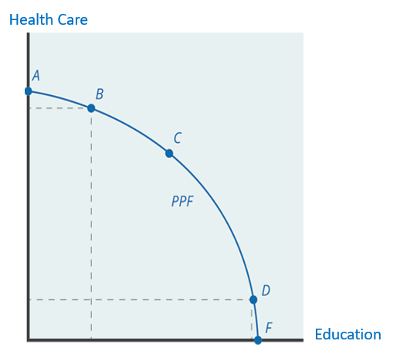
Production Possibilities Frontier
The production possibilities frontier is a diagram that shows the combinations of two products that an economy can produce given the resources it has available.
This production possibilities frontier shows a tradeoff between devoting social resources to either health care or education and all possible combinations of the two.
Notes:
The production possibilities frontier is a diagram that shows the combinations of two products that an economy can produce given the resources it has available. In this case, a society can either choose health care or education. The PPF shows the tradeoff between devoting social resources to either Good A or Good B. It also represents all possible combinations of the two goods that society can produce.

Slide 5
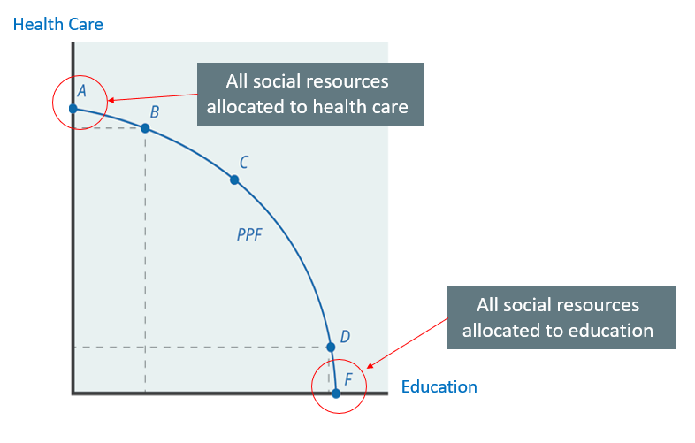
Points on Axis
Notes:
Point A shows the output of a society if all social resources were to be allocated towards health care. Notice that there would be no social resources spent towards education. In contrast, if the society were to put all resources toward education, the society would be producing at Point F. Both scenarios are unlikely, as society would not function well without any health care or any education.

Slide 6
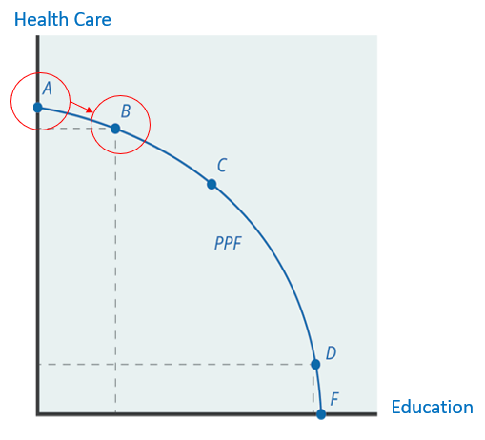
Why Is a PPF curved?
While the consumption budget constraint is based on the relative prices of two goods and, therefore, a straight line, the production possibilities frontier is a curved line.
Moving from Point A to Point B produces more gains to education than losses to health care due to the law of diminishing returns.
Notes:
While the consumption budget constraint is based on the relative prices of two goods and, therefore, a straight line, the production possibilities frontier is a curved line. Moving from Point A to Point B produces more gains to education than losses to health care due to the law of diminishing returns.

Slide 7
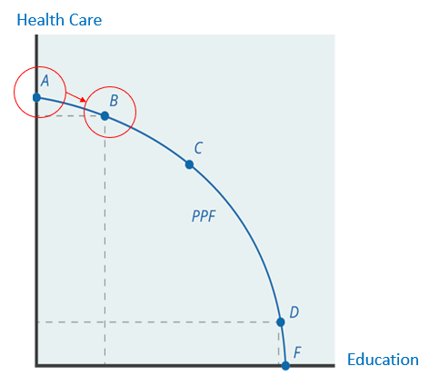
Law of Diminishing Returns
Diverting some resources away from A to B causes little reduction in health because the last few dollars going into health care services are not producing much additional gain in health.
Putting those marginal dollars into education, which is completely without resources at Point A, can produce relatively large gains.
Notes:
The law of diminishing returns explains that if additional quantities of resources are added to a certain point, the marginal benefit of that resource will eventually decline. In this way, the law of diminishing returns produces the outward-bending shape of the production possibilities frontier. The PPF curve does not directly tell a society what the best mix of goods or resources is but instead points out some choices that are clearly better than others. Diverting some resources away from A to B causes relatively little reduction in health because the last few marginal dollars going into health care services are not producing much additional gain in health. However, putting those marginal dollars into education, which is completely without resources at Point A, can produce relatively large gains. For this reason, the shape of the PPF from A to B is relatively flat, representing a relatively small drop-off in health and a relatively large gain in education.

Slide 8

Efficiency
Efficiency refers to lack of waste.
An efficient machine operates at low cost because it is not wasting energy or materials.
The production possibilities curve illustrates two kinds of efficiency: productive efficiency and allocative efficiency.
Notes:
Efficiency refers to lack of waste. When a society is efficient, every resource is optimally assigned to benefit society in the best way while ultimately eliminating waste. The production possibilities curve illustrates two kinds of efficiency: productive efficiency and allocative efficiency.

Slide 9
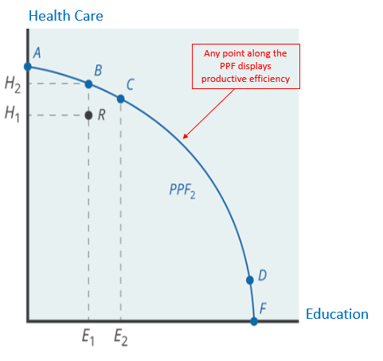
Productive Efficiency
Productive efficiency means it is impossible to produce more of one good without decreasing the output of another good.
All points along the PPF display productive efficiency, but points outside of the PPF, like point R, do not.
Notes:
Productive efficiency means it is impossible to produce more of one good without decreasing the output of another good. All points along the PPF display productive efficiency, but points outside the PPF, like point R, do not.

Slide 10
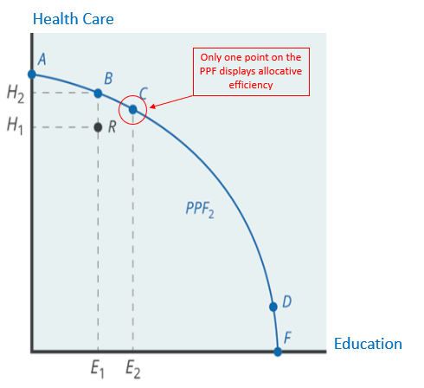
Allocative Efficiency
Allocative efficiency refers to a point on the PPF that represents the combination that society most desires.
Only one point on the PPF can represent a point where producers supply the exact quantity of goods that consumers demand.
Notes:
Allocative efficiency refers to a point on the PPF that represents the combination that society most desires. Only one point on the PPF can represent allocative efficiency, as there is only one point representing where producers supply the exact quantity of goods that consumers demand.

Slide 11
What Should a Country Produce?
Countries do not need to produce every single good they consume.
Often, how much of a good a country produces depends on how expensive it is to produce it versus buying it from a different country.
Countries have different opportunity costs of producing a specific good, either because of climate, geography, technology, or skills.
When a country can produce a good at a lower opportunity cost than another country, it has a comparative advantage in that good.
Notes:
Countries do not need to produce every single good they consume. Often, how much of a good a country decides to produce depends on how expensive it is to produce rather than buying it from a different country. Countries have different opportunity costs of producing a specific good, either because of climate, geography, technology, or skills, which allows them to produce certain goods for less than another country. When a country can produce a good at a lower opportunity cost than another country, it has comparative advantage in that good.

Slide 12
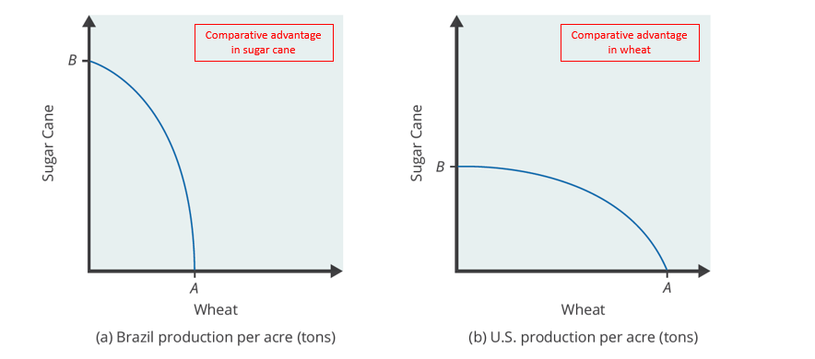
The PPF and Comparative Advantage
Steep Slope: Opportunity cost of trading off the good on the y-axis is greater than the good on the x-axis.
Flat Slope: Opportunity cost of trading off the good on the x-axis is greater than the good on the y-axis.
Notes:
The slope of a PPF curve shows the opportunity cost of choosing one good over another. Consider the PPFs showing wheat and sugar cane production in Brazil and the U.S. The U.S. PPF is flatter than the Brazil PPF, implying that the opportunity cost of wheat in terms of sugar cane is lower in the U.S. than in Brazil. Conversely, the opportunity cost of sugar cane is lower in Brazil. The U.S. has comparative advantage in wheat, and Brazil has comparative advantage in sugar cane.

Slide 13
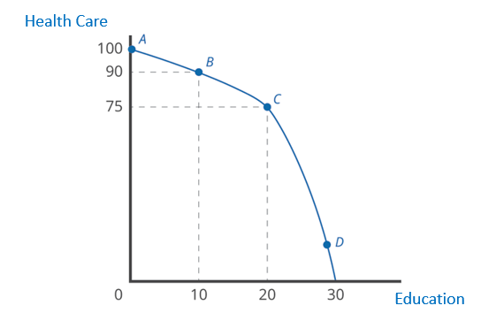
On Your Own₁
In the following figure, the tradeoff of moving down the PPF from Point A to Point D is demonstrated. What is the opportunity cost of moving from Point A to Point B? What is the opportunity cost of moving from Point B to C? Explain why the opportunity cost is changing.
Notes:
In the figure below, the tradeoff of moving down the PPF from Point A to Point D is demonstrated. What is the opportunity cost of moving from Point A to Point B? What is the opportunity cost of moving from Point B to C? Explain why the opportunity cost is changing.

Slide 14
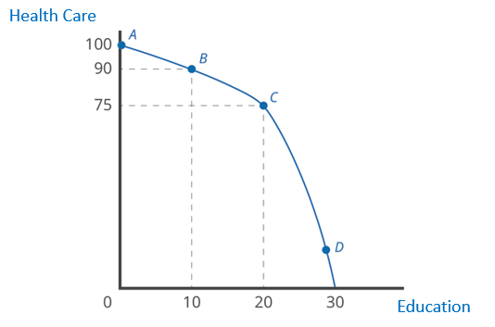
On Your Own₂
The opportunity cost of moving from Point A to Point B is 10 units of health care for the first 10 units of education. The opportunity cost of moving from Point B to C is 15 units of health care for the next 10 units of education. The opportunity cost increases as additional units of health care are given up for education, and vice versa, representing the law of diminishing returns.
Notes:
In the figure below, the tradeoff of moving down the PPF from Point A to Point D is demonstrated. What is the opportunity cost of moving from Point A to Point B? What is the opportunity cost of moving from Point B to C? Explain why the opportunity cost is changing.

Slide 15
Summary
The production possibilities frontier is a diagram that shows the combinations of two products that an economy can produce given the resources it has available.
The shape of the PPF is generally curved because of the law of diminishing returns, which states that as increments of additional resources are devoted to producing something, the marginal increase in the output will become increasingly smaller.
Productive efficiency means it is impossible to produce more of one good without decreasing the output of another good.
Allocative efficiency refers to a point on the PPF that represents the combination that society most desires.
The curvature of the PPF differs by country, which results in different countries having a comparative advantage in different goods.
Notes:
The production possibilities frontier is a diagram that shows the combinations of two products that an economy can produce given the resources it has available.
The shape of the PPF is generally curved because of the law of diminishing returns, which states that as increments of additional resources are devoted to producing something, the marginal increase in the output will become increasingly smaller.
Productive efficiency means it is impossible to produce more of one good without decreasing the output of another good.
Allocative efficiency refers to a point on the PPF that represents the combination that society most desires.
The curvature of the PPF differs by country, which results in different countries having a comparative advantage in different goods.

Slide 16




HAWKES LEARNING

