Slide 1
How Businesses Raise Financial Capital
HAWKES LEARNING
Notes:
How businesses raise financial capital. By the end of this lesson, you will be able to describe financial capital and how it relates to profits; discuss the purpose and process of borrowing, bonds, and corporate stock; and explain how firms choose between sources of financial capital.

Slide 2

How Businesses Raise Financial Capital₁
Many people choose to purchase their homes rather than rent. This chapter explores how the global financial crisis has influenced home ownership.
Notes:
Many people choose to purchase their homes rather than rent. This chapter explores how the global financial crisis has influenced home ownership.

Slide 3
Introduction
When a firm needs to buy new equipment or build a new facility, it often must go to the financial market to raise funds.
Usually, firms will add capacity during an economic expansion when profits are on the rise and consumer demand is high.
Business investment is one of the critical ingredients needed to sustain economic growth.
Notes:
When a firm needs to buy new equipment or build a new facility, it often must go to the financial market to raise funds. Usually, firms will add capacity during an economic expansion when profits are on the rise and consumer demand is high. Business investment is one of the critical ingredients needed to sustain economic growth.

Slide 4
Financial Capital Markets₁
Many firms, from huge companies to startup firms, do not have the financial resources to make all the desired investments.
Firms may need financial capital from outside investors, and they are willing to pay interest for the opportunity to obtain a rate of return on the investment for financial capital.
Financial capital suppliers, like households, wish to use their savings in a way that will provide a return.
Financial capital markets take the inflow of funds from financial capital suppliers and transform it into the funds that demanders desire.
Notes:
Many firms, from huge companies to startup firms, do not have the financial resources to make all the desired investments. Firms may need financial capital from outside investors, and they are willing to pay interest. Financial capital suppliers, like households, wish to use their savings in a way that will provide a return. Financial capital markets take the inflow of funds from financial capital suppliers and transform it into the funds that demanders desire.

Slide 5
Financial Capital Markets₂
These financial markets include the following:
Stocks
Bank loans
Bonds
Other financial investments
Notes:
These financial markets include the following: stocks, bonds, bank loans, and other financial investments.

Slide 6
How Businesses Raise Financial Capital₂
Firms often make decisions that involve spending money in the present and expecting to earn profits in the future. Firms can raise the financial capital they need to pay for such projects in four main ways:
From early-stage investors
By reinvesting profits
By borrowing through banks or bonds
By selling stock
Notes:
Firms often make decisions that involve spending money in the present and expecting to earn profits in the future. Firms can raise the financial capital they need to pay for such projects in four main ways: from early-stage investors, by borrowing through banks or bonds, by reinvesting profits, and by selling stock.

Slide 7
Early-Stage Financial Capital
New firms often have an idea or prototype for a product or service to sell but have few or no customers and thus are not earning profits.
For many small businesses, the original source of money is the business owner.
Many cities have a network of well-to-do individuals, known as "angel investors," who will put their own money into small new companies.
Angel investors end up owning a small portion of the firm for their investment.
Notes:
Firms that are just beginning often have an idea or prototype for a product or service to sell but have few or no customers, and thus are not earning profits. Such firms face a difficult problem when it comes to raising financial capital: how can a firm that has not yet demonstrated any ability to earn profits pay a rate of return to financial investors? For many small businesses, the original source of money is the business owner. Alternatively, many cities have a network of well-to-do individuals, known as "angel investors," who will put their own money into small new companies at an early development stage in exchange for owning some portion of the firm. Angel investors end up owning a small portion of the firm for their investment.

Slide 8
Venture Capital₁
Venture capital firms make financial investments in new companies that are still relatively small in size but have potential to grow substantially. These firms gather money from a variety of individual or institutional investors. These investors come from a number of places:
Banks
Institutions, like college endowments
Insurance companies that hold financial reserves
Corporate pension funds
Notes:
Venture capital firms make financial investments in new companies that are still relatively small in size but have potential to grow substantially. These firms gather money from a variety of individual or institutional investors. These investors come from a number of places: banks, insurance companies that hold financial reserves, institutions like college endowments, and corporate pension funds.

Slide 9

Venture Capital₂
Venture capital firms invest in young, emerging firms that have promising growth potential.
Notes:
Venture capital firms invest in young, emerging firms that have promising growth potential.

Slide 10
Profits as a Source of Financial Capital
If firms are earning profits, they can choose to reinvest some of these profits in equipment, structures, and research and development.
For many established companies, reinvesting their own profits is one primary source of financial capital.
Companies and firms just getting started may have numerous attractive investment opportunities but not enough profits to invest.
Firms often need to find financial capital sources other than profits.
Notes:
If firms are earning profits, they can choose to reinvest some of these profits in equipment, structures, and research and development. For many established companies, reinvesting their own profits is one primary source of financial capital. Companies and firms just getting started may have numerous attractive investment opportunities but not enough profits to invest. Firms often need to find financial capital sources other than profits.

Slide 11

Real World Example
Suppose that you and your roommate have plans to open a startup business that delivers groceries to college students. What source of financial capital would you likely use? Explain why you would choose this source.
Notes:
Suppose that you and your roommate have plans to open a startup business that delivers groceries to college students. What source of financial capital would you likely use? Explain why you would choose this source.

Slide 12
Borrowing: Banks and Bonds
When a firm has a record of earning profits, the firm can make a credible promise to pay interest, so the firm can borrow money.
Firms have two main borrowing methods: banks and bonds.
A bank loan for a firm works in much the same way as a loan for an individual who is buying a car or a house.
A bond is a financial contract: a borrower agrees to repay the amount that it borrowed and also an interest rate in the future.
Notes:
When a firm has a record of earning profits, the firm can make a credible promise to pay interest, so the firm can borrow money. Firms have two main borrowing methods: banks and bonds. A bank loan for a firm works in much the same way as a loan for an individual who is buying a car or a house. A bond is a financial contract: a borrower agrees to repay the amount that it borrowed and also an interest rate in the future.

Slide 13
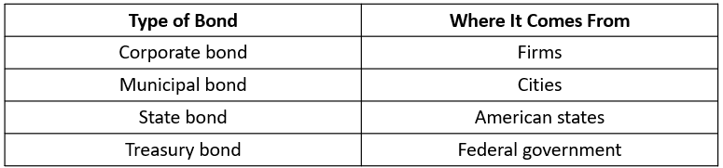
Bonds
Notes:
Different types of bonds come from different places

Slide 14
Corporate Stock and Public Firms₁
A corporation is a business owned by shareholders that have limited liability for the company's debt but share in its profits (and losses).
Those who buy the stock become the firm's owners, or shareholders.
Stock represents firm ownership; that is, a person who owns 100% of a company's stock, by definition, owns the entire company.
The company's stock is divided into shares.
Notes:
A corporation is a business owned by shareholders that have limited liability for the company's debt but share in its profits (and losses). Those who buy the stock become the firm's owners, or shareholders. Stock represents firm ownership; that is, a person who owns 100% of a company's stock, by definition, owns the entire company. The company's stock is divided into shares.

Slide 15

Corporate Stock and Public Firms₂
Since shareholders have diverse interests, they vote for a board of directors that will ensure the company acts in their best interests.
Notes:
Since shareholders have diverse interests, they vote for a board of directors that will ensure the company acts in their best interests.

Slide 16
Corporate Stock and Public Firms₃
We call a firm's first stock sale to the public an initial public offering (IPO).
A firm can make a direct payment to its shareholders, called a dividend.
The increase in the stock value (or of any asset) between when it is bought and sold is called a capital gain.
Notes:
We call a firm's first stock sale to the public an initial public offering (IPO). A firm can make a direct payment to its shareholders, called a dividend. The increase in the stock value (or of any asset) between when it is bought and sold is called a capital gain.

Slide 17
Private Company
A private company is owned by the people who run it on a day-to-day basis.
We call it a sole proprietorship if the business is unincorporated and there is one owner who is legally liable for anything done by the business.
We call it a partnership if it is unincorporated and owned by two or more people who are jointly liable for anything done by the business.
A private company can also be a corporation, but with no publicly issued stock.
Notes:
A private company is owned by the people who run it on a day-to-day basis. We call it a sole proprietorship if the business is unincorporated and only one owner is legally liable for anything done by the business. We call it a partnership if it is unincorporated and owned by two or more people who are jointly liable for anything done by the business. A private company can also be a corporation, but with no publicly issued stock.

Slide 18
Public Company
When a firm decides to sell stock, which financial investors can buy and sell, we call it a public company.
Shareholders own a public company.
The shareholders vote for a board of directors, who in turn hire top executives to run the firm on a day-to-day basis.
The more stock a shareholder owns, the more votes that shareholder is entitled to cast for the company's board of directors.
Notes:
When a firm decides to sell stock, which financial investors can buy and sell, we call it a public company. Shareholders own a public company. The shareholders vote for a board of directors, who in turn hire top executives to run the firm on a day-to-day basis. The more stock a shareholder owns, the more votes that shareholder is entitled to cast for the company's board of directors.

Slide 19
Corporate Governance
Corporate governance is the name economists give to the institutions that are supposed to watch over top executives.
Accurate information is sometimes not available because corporate governance fails.
For example, in the case of Lehman Brothers, corporate governance failed to provide investors with accurate financial information about the firm’s operations.
Notes:
Corporate governance is the name economists give to the institutions that are supposed to watch over top executives. Accurate information is sometimes not available because corporate governance fails. For example, in the case of Lehman Brothers, corporate governance failed to provide investors with accurate financial information about the firm’s operations.

Slide 20
On Your Own₁
1. New startup firms usually raise financial capital by:
A. Using the owner’s savings or investment from an angel investor or venture
capital firm
B. Issuing bonds
C. Getting a bank loan
D. Selling stock
2. The two forms of borrowing that firms can use to obtain financial capital are:
A. Stocks and bonds
B. Venture capital and angel investment
C. Bank loans and bonds
D. Selling stock and bank loans
3. The two forms of income from stock are:
A. Interest and dividends
B. Dividends and capital gains
C. Interest and capital gains
D. Profits and interest

Slide 21
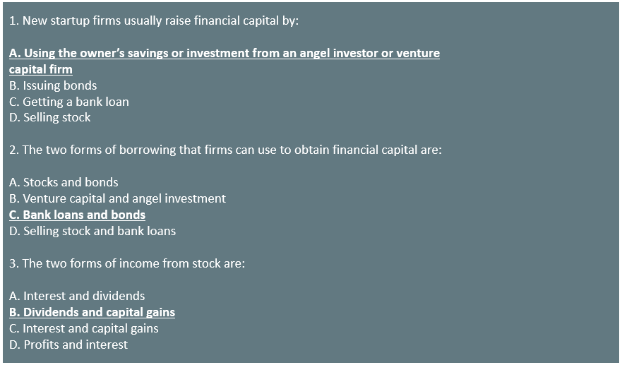
On Your Own₂

Slide 22
Summary
Companies can raise early-stage financial capital in several ways: from their owners' or managers' personal savings and credit cards or from private investors, like angel investors and venture capital firms.
A bond is a financial contract through which a borrower agrees to repay the amount that it borrowed.
Stock represents firm ownership and a company's stock is divided into shares.
A private company is usually owned by the people who run it on a day-to-day basis, although hired managers can run it.
When a firm decides to sell stock that financial investors can buy and sell, the firm is owned by its shareholders, who in turn elect a board of directors to hire top day-to-day management. We call this a public company.

Slide 23




HAWKES LEARNING

