Slide 1
The Poverty Trap
HAWKES LEARNING
Notes:
Economists have identified a problem known as the poverty trap.

Slide 2

The Poverty Trap₁
Consider a program to fight poverty: the government provides assistance to the poor, but as the poor earn income to support themselves, the government reduces the level of assistance it provides. With such a program, every time a poor person earns $100, the person loses $100 in government support. As a result, the person experiences no net gain for working. Economists call this problem the poverty trap.
Notes:
Consider a program to fight poverty: the government provides assistance to the poor, but as the poor earn income to support themselves, the government reduces the level of assistance it provides. With such a program, every time a poor person earns $100, the person loses $100 in government support. As a result, the person experiences no net gain for working. Economists call this problem the poverty trap.

Slide 3
The Poverty Trap: Scenario₁
Graphically, consider the situation a single mother (earning $8 an hour) with two children faces.
On the horizontal axis, put hours of leisure (or time spent with family responsibilities), increasing in quantity from left to right.
Also on the horizontal axis, put the number of hours of paid work, from 0 hours on the right to the maximum of 2,500 hours on the left.
On the vertical axis, put the amount of income per year, rising from low to higher amounts of income.
Suppose a government antipoverty program guarantees every family with a single mother and two children $18,000 in income.
Notes:
Graphically, consider the situation a single mother (earning $8 an hour) with two children faces. On the horizontal axis, put hours of leisure (or time spent with family responsibilities), increasing in quantity from left to right. Also on the horizontal axis, put the number of hours of paid work, from 0 hours on the right to the maximum of 2,500 hours on the left. On the vertical axis, put the amount of income per year, rising from low to higher amounts of income. Suppose a government antipoverty program guarantees every family with a single mother and two children $18,000 in income.

Slide 4
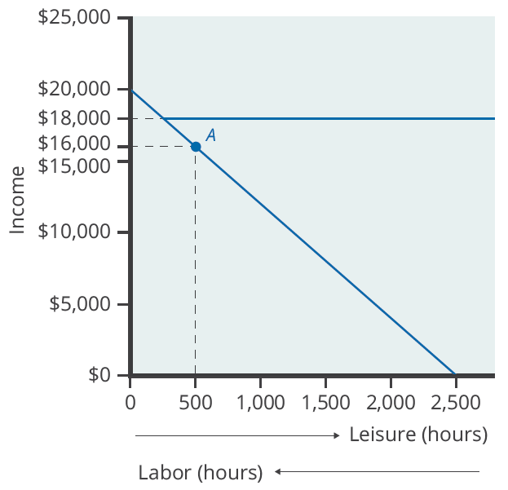
The Poverty Trap: Scenario₂
The original choice is 500 hours of leisure, 2,000 hours of work at Point A, and income of $16,000. With a guaranteed income of $18,000, this family would receive $18,000 whether it provides zero hours of work or 2,000 hours of work. Only if the family provides, say, 2,300 hours of work does its income rise above the guaranteed level of $18,000—and even then, the marginal gain to income from working many hours is small.
Notes:
The original choice is 500 hours of leisure, 2,000 hours of work at Point A, and income of $16,000. With a guaranteed income of $18,000, this family would receive $18,000 whether it provides zero hours of work or 2,000 hours of work. Only if the family provides, say, 2,300 hours of work does its income rise above the guaranteed level of $18,000—and even then, the marginal gain to income from working many hours is small.

Slide 5
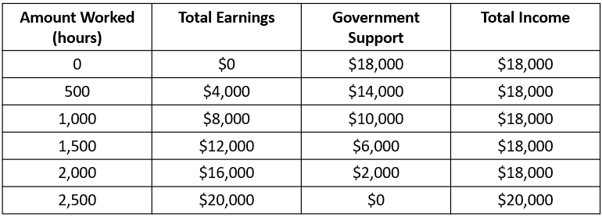
The Poverty Trap: Scenario₃
Total Income at Various Combinations of Work and Support
With this program, each time the mother earns $1,000, the government will deduct $1,000 of its support. The table shows what will happen at each combination of work and government support.
Notes:
With this program, each time the mother earns $1,000, the government will deduct $1,000 of its support. The table shows what will happen at each combination of work and government support.

Slide 6
The Poverty Trap: Scenario₄
If the mother works full time, giving up 40 hours per week with her children, she still ends up with $18,000 at the end of the year.
Only if she works 2,300 hours in the year—an average of 44 hours per week for 50 weeks a year—does household income rise to $18,400.
All of her year's work means that household income rises by only $400 over the income she would receive if she did not work at all.
She would need to work 50 hours a week to reach $20,000.
Notes:
If the mother works full time, giving up 40 hours per week with her children, she still ends up with $18,000 at the end of the year. Only if she works 2,300 hours in the year—an average of 44 hours per week for 50 weeks a year—does household income rise to $18,400. All of her year's work means that household income rises by only $400 over the income she would receive if she did not work at all. She would need to work 50 hours a week to reach $20,000.

Slide 7
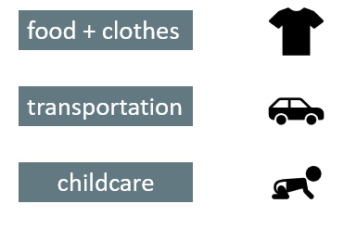
Considerations
While the previous example simplifies this struggle, consider that a single parent also has to consider the added time and costs for things like food, clothes, transportation, and childcare.
Notes:
While the previous example simplifies this struggle, consider that a single parent also has to consider the added time and costs for things like food, clothes, transportation, and child care.

Slide 8

Possible Government Modifications
Instead of reducing government payments by $1 for every $1 earned, the government could reduce payments by a smaller amount instead.
Imposing work requirements and setting a time limit on benefits can also reduce the harshness of the poverty trap.
It may be preferable in the long run to spend more money on a program that retains a greater incentive to work rather than spending less money on a program that nearly eliminates any gains from working.
Notes:
Instead of reducing government payments by $1 for every $1 earned, the government could reduce payments by a smaller amount instead. Imposing work requirements and setting a time limit on benefits can also reduce the harshness of the poverty trap. It may be preferable in the long run to spend more money on a program that retains a greater incentive to work rather than spending less money on a program that nearly eliminates any gains from working.

Slide 9
Summary
A poverty trap occurs when government-support payments for the poor decline as the poor earn more income.
As a result, the poor do not end up with much more income when they work because the loss of government support largely or completely offsets any income that one earns by working.
Phasing out government benefits more slowly, as well as imposing requirements for work as a condition of receiving benefits and a time limit on benefits, can reduce the harshness of the poverty trap.

Slide 10




HAWKES LEARNING

