Slide 1
Wages and Employment in an Imperfectly Competitive Labor Market
HAWKES LEARNING
Notes:
Today we are going to discuss wages and employment in an imperfectly competitive labor market.

Slide 2

Wages and Employment in an Imperfectly Competitive Labor Market₁
Regulations can help reduce the imbalance of power between parties in the labor market.
Notes:
Regulations can help reduce the imbalance of power between parties in the labor market.

Slide 3
Labor Market Regulations₁
To give workers more power, the U.S. government has passed, in response to years of labor protests, several laws to create a more equal balance of power between workers and employers. These laws include some of the following:
Setting minimum hourly wages
Setting maximum hours of work (at least before employers pay overtime rates)
Prohibiting child labor
Regulating health and safety conditions in the workplace
Requiring employers to provide family leave
Preventing discrimination on the basis of race, ethnicity, gender, sexual orientation, and age
Requiring employers to give advance notice of layoffs
Covering workers with unemployment insurance
Setting a limit on the number of immigrant workers from other countries
Notes:
To give workers more power, the U.S. government has passed, in response to years of labor protests, several laws to create a more equal balance of power between workers and employers. These laws include some of the following: setting minimum hourly wages, setting maximum hours of work (before overtime), prohibiting child labor, preventing discrimination on the basis of race, ethnicity, gender, sexual orientation, and age, regulating health and safety conditions in the workplace, requiring employers to provide family leave, covering workers with unemployment insurance, and setting a limit on the number of immigrant workers that are allowed into the United States from other countries.

Slide 4
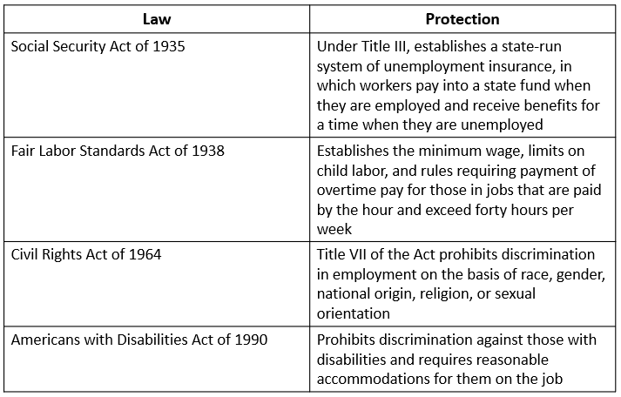
Labor Market Regulations₂
Notes:
The table lists some prominent U.S. workplace protection laws. Some of the laws listed in the table were only the start of labor market regulations in these areas and have been followed, over time, by other related laws, regulations, and court rulings.

Slide 5
Labor Market Regulations₃
There are two sources of imperfect competition in labor markets. This section primarily focuses on the demand side.
Demand-side sources:
Labor market power by employers
Supply-side sources:
Labor market power by employees
Notes:
There are two sources of imperfect competition in labor markets. This section primarily focuses on the demand side.
Demand-side sources: Labor market power by employers
Supply-side sources: Labor market power by employees

Slide 6
Monopsony₁
A competitive labor market is one where there are many potential employers for a given type of worker.
If there is only one employer in a labor market, they can offer lower wages than would exist in a competitive market.
If a lone employer is exploiting its market power, the firm is called a monopsony.
Notes:
A competitive labor market is one where there are many potential employers for a given type of worker. If there is only one employer in a labor market, they can offer lower wages than would exist in a competitive market. If a lone employer is exploiting its market power, the firm is called a monopsony.

Slide 7

Monopsony₂
The classical example of monopsony is the sole coal company in a West Virginia town. If coal miners want to work, they must accept what the coal company is paying.
Notes:
The classical example of monopsony is the sole coal company in a West Virginia town. If coal miners want to work, they must accept what the coal company is paying.

Slide 8
Marginal Cost of Labor
Because the monopsonist is the sole employer in a labor market, it can offer any wage it wishes.
However, because it faces the market supply curve for labor, if it wants to hire more workers, it must raise the wage it pays.
The marginal cost of labor is the cost to the firm of hiring one more worker.
Notes:
Because the monopsonist is the sole employer in a labor market, it can offer any wage it wishes. However, because it faces the market supply curve for labor, if it wants to hire more workers, it must raise the wage it pays. The marginal cost of labor is the cost to the firm of hiring one more worker.

Slide 9
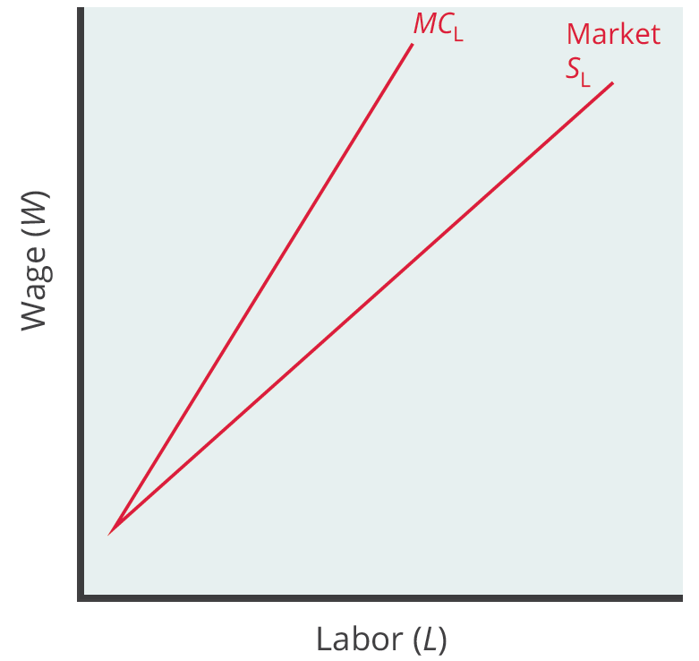
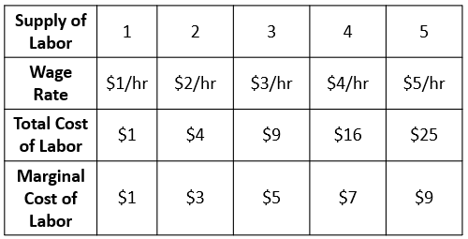
Monopsonist Labor Market Graph₁
In order to increase employment, monopsonists must raise the wage they pay, not just for new workers but for all the existing workers. As a result, the marginal cost of hiring additional labor is greater than the wage.
Notes:
Since monopsonies are the sole demander for labor, they face the market supply curve for labor. In order to increase employment, they must raise the wage they pay, not just for new workers but for all the existing workers. As a result, the marginal cost of hiring additional labor is greater than the wage. Thus, for any level of employment (above the first worker), MCL is above the market supply of labor.

Slide 10
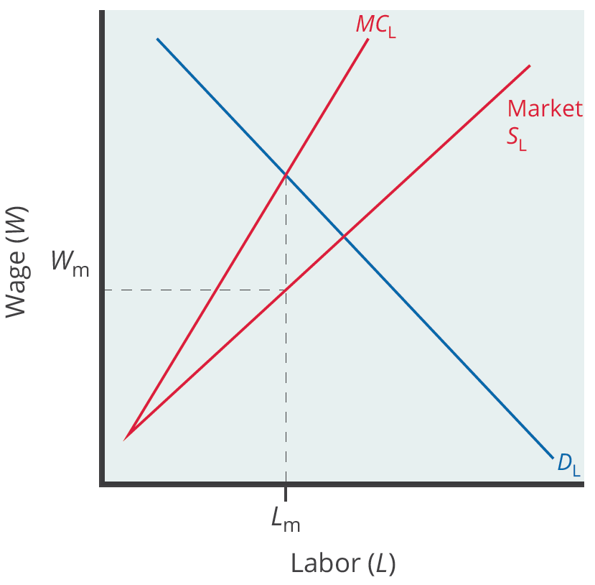
Monopsonist Labor Market Graph₂
A monopsony will hire workers up to the point L _{m}, where its demand for labor equals the marginal cost of additional labor, paying the wage W _{m} given by the supply curve of labor necessary to obtain L _{m} workers.
Notes:
A monopsony will hire workers up to the point where its demand for labor equals the marginal cost of additional labor, paying the wage given by the supply curve of labor necessary to obtain that many workers.

Slide 11
On Your Own₁
What are the similarities between a monopoly and a monopsony?
Notes:
What are the similarities between a monopoly and a monopsony?

Slide 12
On Your Own₂
What are the similarities between a monopoly and a monopsony?
The situations of monopoly and monopsony are very similar. A monopolist is a sole seller and a monopsony is a sole buyer (of labor). For a monopolist to sell more of its output, it must lower price. Similarly, for a monopsony to hire more labor, it must raise the wage rate.
Notes:
What are the similarities between a monopoly and a monopsony?
The situations of monopoly and monopsony are very similar. A monopolist is a sole seller and a monopsony is a sole buyer (of labor). For a monopolist to sell more of its output, it must lower price. Similarly, for a monopsony to hire more labor, it must raise the wage rate.

Slide 13
Summary
A monopsony is the sole employer in a labor market.
The monopsony can pay any wage it chooses, subject to the market supply of labor.
If the monopsony offers too low a wage, it may not find enough workers willing to work.
Since it must offer a higher wage to obtain more workers, the marginal cost of additional labor is greater than the wage.
To maximize profits, a monopsonist will hire workers up to the point where the marginal cost of labor equals the demand for labor.

Slide 14




HAWKES LEARNING

