Slide 1
Why the Private Sector Underinvests in Innovation
HAWKES LEARNING

Slide 2

Introduction
Launched by NASA on September 5, 1977, Voyager I's primary mission was to provide detailed images of Jupiter, Saturn, and their moons. It took this photograph of Jupiter on its journey. In August of 2012, Voyager I entered interstellar space (the first human-made object to do so), and it is expected to send data and images back to Earth until 2025. Such a technological feat entails many economic principles.
Notes:
Launched by NASA on September 5, 1977, Voyager I's primary mission was to provide detailed images of Jupiter, Saturn, and their moons. It took this photograph of Jupiter on its journey. In August of 2012, Voyager I entered interstellar space (the first human-made object to do so), and it is expected to send data and images back to earth until 2025. Such a technological feat entails many economic principles.

Slide 3
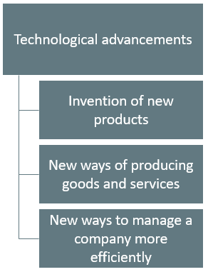

Technology
Technological breakthroughs have revolutionized consumer products.
Examples:
GPS Tracking Devices
Hybrid Cars
Internet and Search Engines
Social Networking - Facebook
Notes:
When we speak of innovation, we really are referring to new technologies. Technological breakthroughs have revolutionized consumer products. Some examples of this include GPS tracking devices, hybrid cars, the internet and search engines and social networking, like Facebook and Twitter. Technological investments include invention of new products, new ways of producing goods and services, and new ways to manage a company more efficiently.

Slide 4
Why the Private Sector Underinvests in Innovation₁
Market competition can provide an incentive for discovering new technology.
A firm earns higher profits by finding a way to produce products more cheaply or create products with characteristics consumers want.
In certain cases, however, competition discourages new technology, especially when other firms can quickly copy a new idea.
Many inventors over the years have discovered that their inventions brought them less profit than they might have reasonably expected.
Notes:
Market competition can provide an incentive for discovering new technology. A firm earns higher profits by finding a way to produce products more cheaply or to create products with characteristics consumers want. In certain cases, however, competition can discourage new technology, especially when other firms can quickly copy a new idea. Many inventors over the years have discovered that their inventions brought them less profit than they might have reasonably expected.

Slide 5

Example
Eli Whitney (1765–1825) invented the cotton gin, but then Southern cotton planters built their own seed-separating devices with a few minor changes in Whitney's design. When Whitney sued, he found that the courts in Southern states would not uphold his patent rights.
Notes:
Eli Whitney (1765–1825) invented the cotton gin, but then Southern cotton planters built their own seed-separating devices with a few minor changes in Whitney's design. When Whitney sued, he found that the courts in Southern states would not uphold his patent rights.

Slide 6


Externalities
An externality is the external benefit or harm from an action not experienced by the firm or person taking the action.
An example of a positive externality is innovation.
An example of a negative externality is pollution.
Notes:
An externality is the external benefit or harm from an action not experienced by the firm or person taking the action. An example of a positive externality is innovation. An example of a negative externality is pollution.

Slide 7
Private vs. Social Benefits of Innovation
If a firm builds a factory or buys a piece of equipment, the firm receives all the economic benefits that result from the investments.
When a firm invests in new technology, the private benefits, or profits, the firm receives are only a portion of the overall social benefits.
The social benefits of an innovation account for the value of all the positive externalities of the new idea or product.
The positive externalities are beneficial spillovers to a third party or parties.
Notes:
If a firm builds a factory or buys a piece of equipment, the firm receives all the economic benefits that result from the investments. When a firm invests in new technology, the private benefits, or profits, the firm receives are only a portion of overall social benefits. The social benefits of an innovation account for the value of all the positive externalities of the new idea or product. The positive externalities are beneficial spillovers to a third party or parties.

Slide 8

Positive Externality
The invention of new technology does not only benefit the individual company but others as well.
Notes:
The invention of new technology does not only benefit the individual company but others as well.

Slide 9
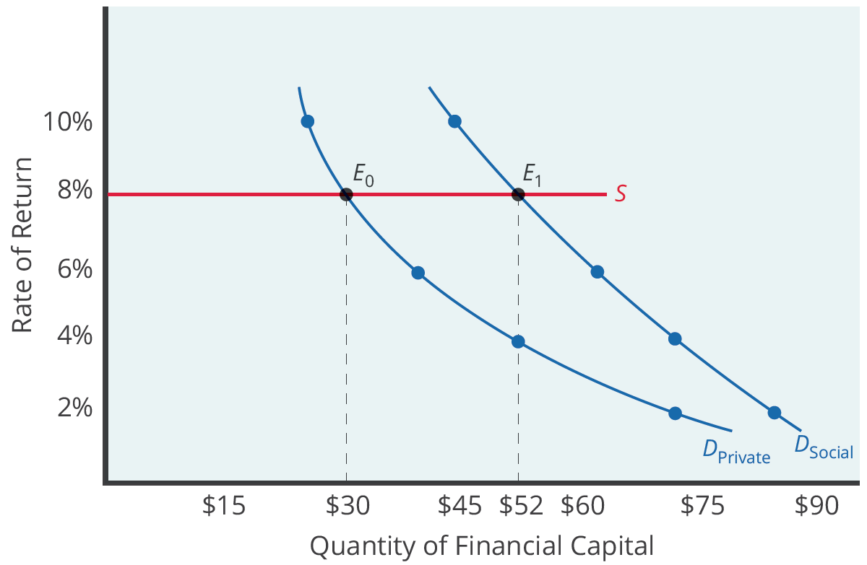
Underinvestment in Innovation: Drug Company₁
Assume a drug company faces a cost of borrowing of 8%.
If the firm receives only the private benefits of investing in R&D, its demand curve for financial capital is shown by D _{Private}.
If the firm could keep the social benefits of its investment for itself, its demand curve is shown by D _{Social}.
Notes:
Assume a drug company faces a cost of borrowing of 8%. If the firm receives only the private benefits of investing in R&D, its demand curve for financial capital is shown by Dprivate. If the firm could keep the social benefits of its investment for itself, its demand curve is shown by Dsocial.

Slide 10
Underinvestment in Innovation: Drug Company₂
If the drug company only receives the private benefits, it will under-invest.
If the drug company receives the social benefits, it will invest more.
Notes:
If the drug company only receives the private benefits, it would under-invest. If the drug company received the social benefits, it would invest more.

Slide 11
Why Invest in Human Capital?
The investment in anything, such as a new power plant, usually requires a certain upfront cost with an uncertain future benefit.
The investment in education, or human capital, is no different.
The idea is that higher levels of educational attainment will eventually increase the student's future productivity and subsequent ability to earn.
Once the student crunches the numbers, does this investment pay off?
Notes:
The investment in anything, such as a new power plant, usually requires a certain upfront cost with an uncertain future benefit. The investment in education, or human capital, is no different. The idea is that higher levels of educational attainment will eventually increase the student's future productivity and subsequent ability to earn. Once the student crunches the numbers, does this investment pay off?

Slide 12
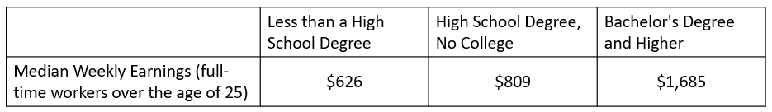
Private Rates of Return to Education
Usual Weekly Earnings of Wage and Salary Workers, 2021
(Source: Bureau of Labor Statistics [hawkes.biz/wkearnings])
Almost universally, economists have found that education does indeed pay off as an investment.
The estimated returns to education go primarily to the individual worker, so these returns are private rates of return to education.
Notes:
Almost universally, economists have found that education does indeed pay off as an investment. The estimated returns to education go primarily to the individual worker, so these returns are private rates of return to education.

Slide 13
Private vs. Social Returns to Education
There are also social returns to education, which justify government support for education.
The social returns are the positive externalities from education:
    Better health outcomes
    Lower levels of crime
    Cleaner environment
    More stable, democratic government
Notes:
There are also social returns to education, which justify government support for education. The social returns are the positive externality from education. These external benefits from education include better health outcomes, lower levels of crime, a cleaner environment and a more stable, democratic government.

Slide 14

Other Positive Externalities
Getting vaccinated
Washing your hands
Planting a garden
Notes:
The focus of this chapter was on innovation, but there are other examples of positive externalities that tend to be under-delivered by private markets. These include getting vaccinated, washing your hands and planting a garden.

Slide 15
Real-World Example
Innovation in technology creates a positive externality of beneficial spillovers to third parties. Think about a new technology or an improved technology. What are some of the positive externalities of this technology change? Who is affected by it? What other innovations came as a result? How did this affect you in your everyday life?
Notes:
Innovation in technology creates a positive externality of beneficial spillovers to third parties. Think about a new technology or an improved technology. What are some of the positive externalities of this technology change? Who is affected by it? What other innovations came as a result? How did this affect you in your everyday life?

Slide 16
Summary
Competition creates pressure to innovate.
If one can easily copy new inventions, the original inventor loses the incentive to invest further in research and development.
New technology often has positive externalities; that is, there are often spillovers from the invention of new technology that benefit firms other than the innovator.
The social benefit of an invention, once the firm accounts for these spillovers, typically exceeds the private benefit to the inventor.
If inventors could receive a greater share of the broader social benefits for their work, they would have a greater incentive to seek out new inventions.

Slide 17




HAWKES LEARNING

