Slide 1
The Tradeoff between Economic Output and Environmental Protection
HAWKES LEARNING
Notes:
In this lesson, “The Tradeoff Between Economic Output and Environmental Protection,” we’ll look at how decisions involving the two are analyzed.

Slide 2
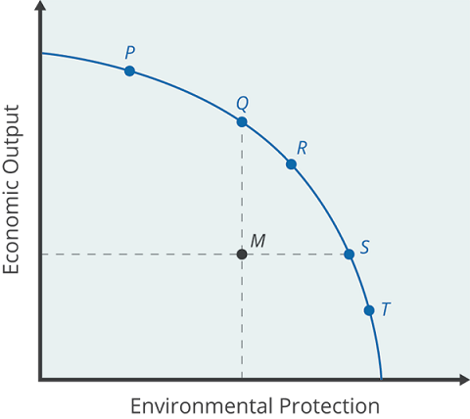
Production Possibility Frontier
An increase in environmental protection involves an opportunity cost of less economic output.
No matter what their preferences, all societies should wish to avoid choices not on the PPF, which are productively inefficient.
Efficiency requires that the choice be on the production possibility frontier.
Notes:
An increase in environmental protection involves an opportunity cost of less economic output. No matter what their preferences, all societies should wish to avoid choices not on the PPF, which are productively inefficient. Efficiency requires that the choice be on the production possibility frontier.

Slide 3
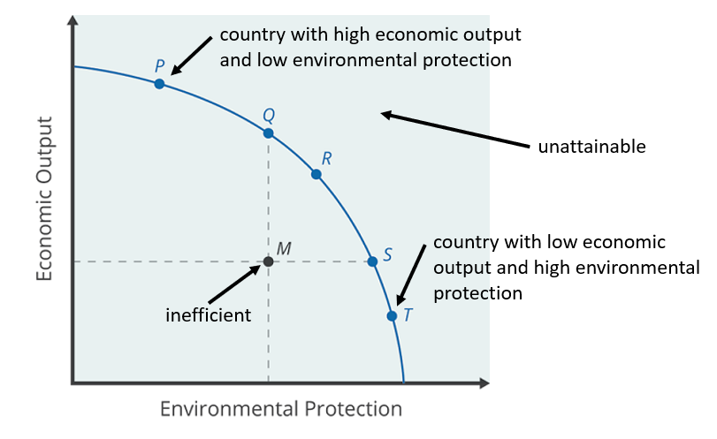
Spectrum of the PPF
Notes:
Each society has to use its own values to decide where they want to fall on the PPF. At one extreme, a country with a low per capita GDP may value economic output higher in order to produce nutrition, health and shelter for their people. Others may fall on the other extreme, placing importance on environmental protection rather than economic output. For economists, it doesn’t matter where a country falls on the PPF. However, falling below the PPF is inefficient and undesirable. Falling outside the PPF is unattainable.

Slide 4
GDP vs. Environmental Protection
Countries with low per capita gross domestic product (GDP), place a greater emphasis on economic output.
Placing emphasis on GDP helps to produce nutrition, shelter, health, education, and desirable consumer goods.
Countries with higher income levels may be willing to place a relatively greater emphasis on environmental protection since a greater share of people have access to the basic necessities of life.
Notes:
Countries with low per capita gross domestic product (GDP), place a greater emphasis on economic output. Placing emphasis on GDP helps to produce nutrition, shelter, health, education, and desirable consumer goods. Countries with higher income levels may be willing to place a relatively greater emphasis on environmental protection since a greater share of people have access to the basic necessities of life.

Slide 5
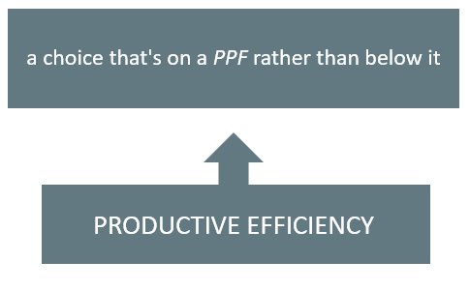
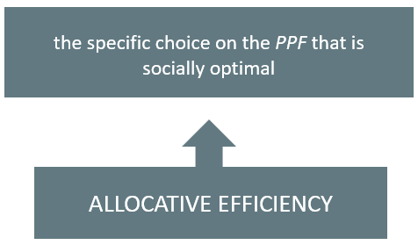
Efficiency
The goal should be productive efficiency, where your country falls on the PPF, instead of below it. However, each country will have to decide their own allocative efficiency, or the choice of where they will fall on the PPF between economic output and environmental protection.
Notes:
The goal should be productive efficiency, where your country falls on the PPF, instead of below it. However, each country will have to decide their own allocative efficiency, or the choice of where they will fall on the PPF between economic output and environmental protection.

Slide 6
Real-World Example
Economists know that choices inside a PPF are inefficient, yet some countries looking at the tradeoff between economic output and environmental protection might operate at such a point. What types of countries are more likely to operate inside the PPF?
Notes:
Economists know that choices inside a PPF are inefficient, yet some countries looking at the tradeoff between economic output and environmental protection might operate at such a point. What types of countries are more likely to operate inside the PPF?

Slide 7
Summary
Depending on their different income levels and political preferences, countries are likely to make different choices about allocative efficiency: the choice between economic output and environmental protection along the production possibility frontier that is socially optimal.
All countries should prefer to make a choice that shows productive efficiency: the choice somewhere on the production possibility frontier rather than inside it.

Slide 8




HAWKES LEARNING

