Slide 1
The Benefits and Costs of U.S. Environmental Laws
HAWKES LEARNING
Notes:
Today, we are going to discuss the benefits and costs of U.S. environmental laws.

Slide 2

Benefits of a Cleaner Environment
People may stay healthier and live longer.
Industries that rely on clean air and water may benefit.
Property values may increase.
People may simply enjoy the cleaner environment.
Notes:
What are the benefits of a cleaner environment? There are four main benefits. One, people may stay healthier and live longer. Two, industries that rely on clean air and water may benefit. Three, property values may increase. Four, people may simply enjoy the cleaner environment.

Slide 3



Regulation Costs and Benefits₁
One study by the EPA estimated the costs and benefits of the Clean Air Act from 1990 to 2020.
Total Cost = $380 billion
Total Benefits = $12 trillion
A recent EPA study estimated that the environmental benefits to Americans from the Clean Air Act will exceed their costs by a margin of four to one.
Notes:
What are costs and benefits of regulations that serve to clean the environment, like those made by the Environmental Protection Agency, also known as the EPA? Well, one study by the EPA estimated the costs and benefits to the Clean Air Act from 1990 to 2020. The costs totaled 380 billion, but the benefits were 12 trillion, which far outweighed the costs. A recent EPA study estimated that the environmental benefits to Americans from the Clean Air Act will exceed their costs by a margin of four to one.

Slide 4
Regulation Costs and Benefits₂
Is Every Regulation Good?
Some environmental regulations generate costs that are greater than benefits.
Notes:
There are some environmental regulations that generate costs that are greater than benefits, so each new regulation must be considered individually to determine if it will generate a net benefit to society.

Slide 5
Ecotourism
Ecotourism is tourism for the purpose of appreciating the ecology of the destination.
Many low-income countries have an economic interest in maintaining local ecosystems to promote ecotourism.
Ecotourism needs careful management so that eager tourists and local entrepreneurs do not destroy what the visitors are coming to see.
Notes:
Ecotourism is tourism for the purpose of appreciating the ecology of the destination. Many low-income countries have an economic interest in maintaining local ecosystems to promote ecotourism. Ecotourism needs careful management so that eager tourists and local entrepreneurs do not destroy what the visitors are coming to see.

Slide 6
Top Ecotourist Destinations
Costa Rica and Panama in Central America
The Caribbean
Malaysia
New Zealand
The Serengeti in Tanzania
The Amazon rain forests
The Galapagos Islands
Notes:
Here are the top ecotourist destinations in the world: Costa Rica and Panama in Central America, the Caribbean, Malaysia and other South Pacific destinations, New Zealand, the Serengeti and Tanzania, the Amazon Rainforest, and the Galapagos Islands.

Slide 7

Benefits of Ecotourism to Low-Income Countries
The value of ecotourism has led residents of low-income countries to preserve wildlife habitats.
South Africa, Namibia, and Zimbabwe have all experienced increases in rhinoceros and elephant populations due to the economic interest locals have in protecting them for ecotourism.
Notes:
Ecotourism has generated benefits for low-income countries. The value of ecotourism has led residents of low-income countries to preserve wildlife habitats, so ecotourism has also led to environmental benefits. As an example, South Africa, Namibia, and Zimbabwe have all experienced increases in rhinoceros and elephant populations due to the economic interests locals have in protecting them for ecotourism.

Slide 8
Real-World Discussion
Suppose you are a resident of a low-income country that has magnificent wildlife. In what ways does ecotourism change your incentives to protect the wildlife?
Notes:
Suppose you are a resident of a low-income country that has magnificent wildlife. In what ways does ecotourism change your incentives to protect the wildlife?

Slide 9
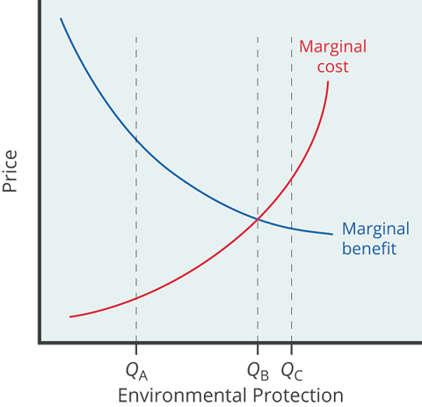
Marginal Costs & Marginal Benefits
The marginal costs of reducing pollution are generally increasing because one can make the least expensive and easiest reductions and leave the more expensive methods for later.
The marginal benefits of reducing pollution are generally declining because one can take the steps that provide the greatest benefit first, and steps that provide less benefit can wait until later.
Notes:
Reducing pollution is costly; one must sacrifice resources. The marginal costs of reducing pollution are generally increasing because one can make the least expensive and easiest reductions and leave the more expensive methods for later. The marginal benefits of reducing pollution are generally declining because one can take the steps that provide the greatest benefit first, and steps that provide less benefit can wait until later.

Slide 10
Clear It Up: What’s a life worth?
The National Center for Environmental Economics (NCEE) values a statistical human life at $7.4 million ($10.9 million in 2022 U.S. dollars).
This estimate is based on studies looking at tradeoffs people are willing to make.
People are willing to take jobs that have a higher probability of death in exchange for more money.
When the U.S. Department of Transportation makes decisions about what safety systems should be required in cars or airplanes, it will approve rules only where the estimated cost per life saved is $3 million or less.
Notes:
One final topic that must be considered when discussing the costs and benefits of environmental regulations is the value of human life. The National Center for Environmental Economics values a statistical human life at $7.4 million ($10.9 million in 2022 U.S. dollars). This estimate is based on tradeoffs that people are willing to make. In particular, people are willing to take jobs that have a higher probability of death in exchange for more money. An example of this would be the wage of a janitor that washes windows on the inside of buildings, compared to the wage of workers washing windows on the outside of buildings, where the risk of falling to one's death is substantially higher. Based on the probability of dying and the higher wage workers must be paid to accept that risk, economists can estimate the value of life. Government regulators use estimates such as these when deciding what proposed regulations are "reasonable," which means deciding which proposals have high enough benefits to justify their cost. For example, when the U.S. Department of Transportation makes decisions about what safety systems should be required in cars or airplanes, it will approve rules only where the estimated cost per life saved is $3 million or less.

Slide 11
Summary
We can make a strong case, taken as a whole, that the benefits of U.S. environmental regulation have outweighed the costs.
As the extent of environment regulation increases, additional expenditures on environmental protection will probably have increasing marginal costs and decreasing marginal benefits.
This pattern suggests that the flexibility and cost savings of market-oriented environmental policies will become more important.

Slide 12




HAWKES LEARNING

