Slide 1
The Great Deregulation Experiment
HAWKES LEARNING
Notes:
Across the United States, governments at all levels have regulated prices in a wide range of industries. In some industries with characteristics of a natural monopoly, like water and electricity, economic theory allows for regulation. However, once politicians are given a basis to intervene in markets and choose prices and quantities, it’s hard to know where to stop.

Slide 2
The Great Deregulation Experiment₁
Governments at all levels across the United States have regulated prices in a wide range of industries.
In some industries, like water and electricity, that have natural monopoly characteristics, economic theory allows for regulation.
However, once politicians are given a basis to intervene in markets and choose prices and quantities, it is hard to know where to stop.
Notes:
Governments at all levels across the United States have regulated prices in a wide range of industries. In some industries, like water and electricity, that have natural monopoly characteristics, economic theory allows for regulation. However, once politicians are given a basis to intervene in markets and choose prices and quantities, it is hard to know where to stop.

Slide 3
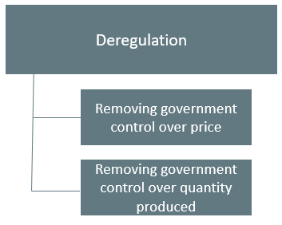
Doubts about Regulation of Prices and Quantities
Beginning in the 1970s, it became clear to policy makers of all political leanings that the existing price regulation was not working well.
The U.S. carried out a great policy experiment of deregulation, removing government controls across many industries.
Notes:
Beginning in the 1970s, it became clear to policymakers of all political leanings that the existing price regulation was not working well. The U.S. carried out a great policy experiment of deregulation, removing government controls across many industries. Deregulation includes removing government control over price and quantity produced.

Slide 4
Regulatory Capture₁
One difficulty with government price regulation is what economists call regulatory capture.
This occurs when firms that are supposedly regulated end up playing a large role in setting the regulations that they will follow.
Notes:
One difficulty with government price regulation is what economists call regulatory capture. Occurs when firms that are supposedly regulated end up playing a large role in setting the regulations that they will follow.

Slide 5

Regulatory Capture₂
When the airline industry was regulated, for example, it suggested appointees to the regulatory board, sent lobbyists to argue with the board, provided most of the information on which the board made decisions, and offered well-paid jobs to at least some of the people leaving the board.
Notes:
When the airline industry was regulated, for example, it suggested appointees to the regulatory board, sent lobbyists to argue with the board, provided most of the information on which the board made decisions, and offered well-paid jobs to at least some of the people leaving the board.

Slide 6
Regulatory Capture: Results
It is easy for regulators to poorly represent consumers.
The result of regulatory capture is that government price regulation can often become a way for existing competitors to work together.
Competitors may reduce output, keep prices high, and limit competition.
Notes:
It is easy for regulators to poorly represent consumers. The result of regulatory capture is that government price regulation can often become a way for existing competitors to work together. Competitors may reduce output, keep prices high, and limit competition.

Slide 7
The Effects of Deregulation
Deregulation, both of airlines and of other industries, has its negatives.
The greater pressure of competition leads to entry and exit.
When firms go bankrupt or contract substantially in size, they lay off workers who must find other jobs.
Notes:
Deregulation, both of airlines and of other industries, has its negatives. The greater pressure of competition leads to entry and exit. When firms go bankrupt or contract substantially in size, they lay off workers who must find other jobs.

Slide 8
Sarbanes-Oxley Act
Major accounting scandals involving prominent corporations such as Enron and Tyco International led to the Sarbanes-Oxley Act in 2002.
The government designed Sarbanes-Oxley to increase confidence in financial information provided by public corporations to protect investors from accounting fraud.
Notes:
Major accounting scandals involving prominent corporations such as Enron and Tyco International led to the Sarbanes-Oxley Act in 2002. The government designed Sarbanes-Oxley to increase confidence in financial information provided by public corporations to protect investors from accounting fraud.

Slide 9
The Great Recession
The Great Recession, which began in late 2007, was caused at least in part by a global financial crisis, which began in the United States.
The key component of the crisis was the creation and subsequent failure of several types of financial assets, like CMOs and CDSs.
Collateralized mortgage obligations (CMOs) are a type of mortgage-backed security.
Credit default swaps (CDSs) are insurance contracts on assets like CMOs that provide payoff even if the holder does not own the CMO.
Notes:
The Great Recession, which began in late 2007, was caused at least in part by a global financial crisis, which began in the United States. The key component of the crisis was the creation and subsequent failure of several types of financial assets, like CMOs and CDSs. Collateralized mortgage obligations (CMOs) are a type of mortgage-backed security. Credit default swaps (CDSs) are insurance contracts on assets like CMOs that provide payoff even if the holder does not own the CMO.

Slide 10
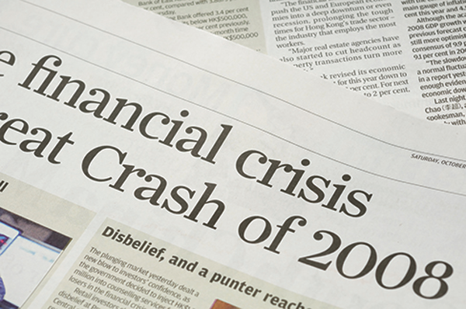
Dodd-Frank Act
One response to the financial crisis was the Dodd-Frank Act, which majorly attempted to reform the financial system.
The legislation’s purpose:
  To promote the financial stability of the United States by improving accountability and transparency in the financial system, to end "too big to fail," to protect the American taxpayer by ending bailouts, [and] to protect consumers from abusive financial services practices.
Notes:
One response to the financial crisis was the Dodd-Frank Act, which majorly attempted to reform the financial system. As noted on dodd-frant.com: To promote the financial stability of the United States by improving accountability and transparency in the financial system, to end "too big to fail," to protect the American taxpayer by ending bailouts, [and] to protect consumers from abusive financial services practices.

Slide 11
Sarbanes-Oxley and Dodd-Frank Acts
The Sarbanes-Oxley Act was designed to increase confidence in financial information provided by public corporations.
The Dodd-Frank Act was designed to improve accountability and transparency in the financial system.
Notes:
The Sarbanes-Oxley Act was designed to increase confidence in financial information provide by public corporations. The Dodd-Frank Act was designed to improve accountability and transparency in the financial system.

Slide 12
On Your Own₁
Choose the answer for each of the following questions.
The deregulation of industry has its drawbacks, including the increased competition leading to:
☐ Entry and exit
☐ Layoffs in the industry
☐ Bankruptcies of some companies
☐ All of the above
The Sarbanes-Oxley Act of 2002 was created because of:
☐ Accounting scandals
☐ The Great Recession
☐ Financial instability in the economy
☐ None of the above

Slide 13
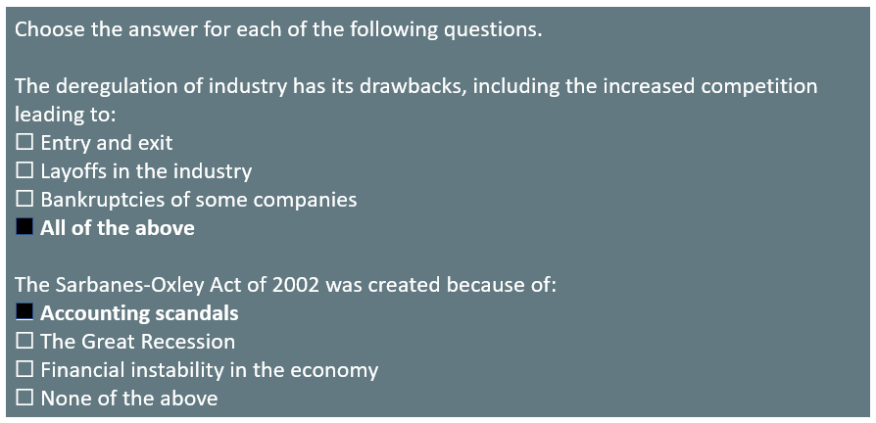
On Your Own₂

Slide 14
Summary
The U.S. economy experienced a wave of deregulation in the late 1970s and early 1980s when the government eliminated regulations that had set prices and quantities produced in a number of industries.
Major accounting scandals in the early 2000s, and more recently, the Great Recession, have spurred new regulation to prevent similar occurrences in the future.
Regulatory capture occurs when the regulated industries end up having a strong influence over what regulations exist.

Slide 15




HAWKES LEARNING

