Slide 1
Regulating Natural Monopolies
HAWKES LEARNING

Slide 2
Natural Monopolies₁
Most true monopolies today in the U.S. are regulated, natural monopolies.
A natural monopoly arises when average costs are declining over the range of production that satisfies market demand.
This typically happens when fixed costs are large relative to variable costs.
As a result, one firm is able to supply the total quantity demanded in the market at a lower cost than two or more firms could.
Splitting up the natural monopoly would raise the average cost of production and force customers to pay more.
Notes:
Most true monopolies today in the U.S. are regulated, natural monopolies. A natural monopoly poses a difficult challenge for competition policy because the structure of costs and demand makes competition unlikely or costly. A natural monopoly arises when average costs are declining over the range of production that satisfies market demand. This typically happens when fixed costs are large relative to variable costs. As a result, one firm is able to supply the total quantity demanded in the market at a lower cost than two or more firms could, so splitting up the natural monopoly would raise the average cost of production and force customers to pay more.

Slide 3
Real-World Example₁
Think about your local water company. Why is there only one water company providing water services in your community instead of having multiple water companies from which to choose for your service?
Notes:
Think about your local water company. Why is there only one water company providing water services in your community instead of having multiple water companies from which to choose for your service?

Slide 4
Real-World Example₂
Think about your local water company. Why is there only one water company providing water services in your community instead of having multiple water companies from which to choose for your service?
Water is an example of a public utility that is a natural monopoly. There is a large up-front infrastructure (fixed) cost. Once the infrastructure is in place, the marginal cost of adding a customer to the water service is relatively low. However, due to the high set up (infrastructure) costs, the more customers the water company has, the more it can spread out that cost. As such, the average costs decline as more and more output is produced for the added customers. This means that it will be hard to have competition. Moreover, having multiple water companies compete would mean an unnecessary
duplication of resources exists as each company would run its own set of pipes in the same community to supply water. This is inefficient. As a result, it is rational to have a single firm for this public utility.
Notes:
Think about your local water company. Why is there only one water company providing water services in your community instead of having multiple water companies from which to choose for your service? Water is an example of a public utility that is a natural monopoly. There is a large up-front infrastructure (fixed) cost. Once the infrastructure is in place, the marginal cost of adding a customer to the water service is relatively low. However, due to the high set up (infrastructure) costs, the more customers the water company has, the more it can spread out that cost. As such, the average costs decline as more and more output is produced for the added customers. This means that it will be hard to have competition. Moreover, having multiple water companies compete would mean an unnecessary
duplication of resources exists as each company would run its own set of pipes in the same community to supply water. This is inefficient. As a result, it is rational to have a single firm for this public utility.

Slide 5
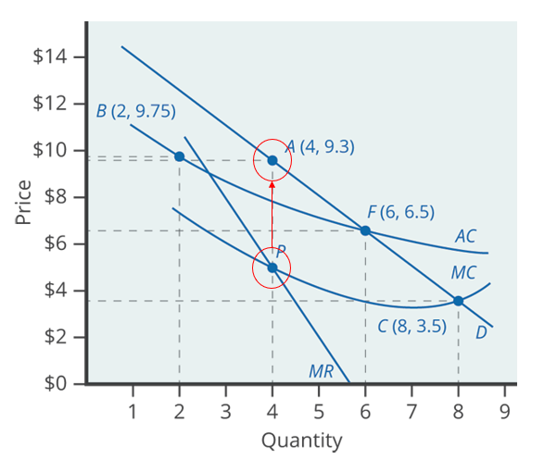
Natural Monopolies₂
A natural monopoly has a market demand curve that cuts through the downward-sloping portion of the average cost curve.
A natural monopoly will maximize profits by producing at the quantity where MR = MC and by then looking to the market demand curve to see what price to charge.
Notes:
A natural monopoly has a market demand curve that cuts through the downward-sloping portion of the average cost curve. A natural monopoly will maximize profits by producing at the quantity where MR=MC and by then looking to the market demand curve to see what price to charge.

Slide 6
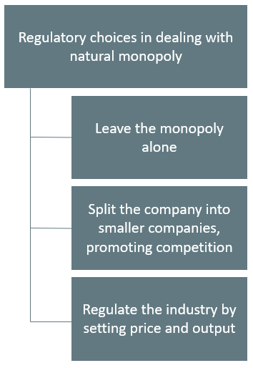
The Choices in Regulating a Natural Monopoly
Notes:
There are several ways to regulate a natural monopoly: leave the monopoly alone, split the company into smaller companies, promoting competition, and regulate the industry by setting price and output.

Slide 7
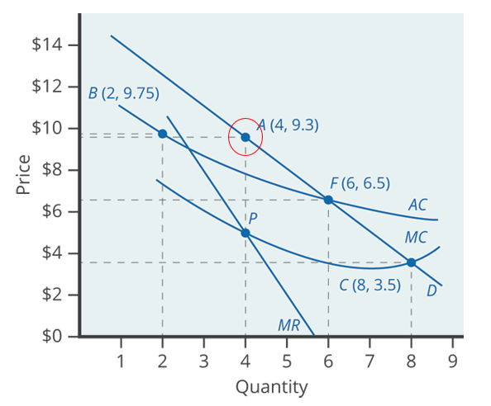
1. Leave the Monopoly Alone
If left alone, the monopoly will follow its normal approach to maximizing profits.
Since the price is above the average cost curve, the natural monopoly would earn economic profits.
Notes:
If the monopoly is left alone, it will follow its normal approach to maximizing profits. Since the price the monopoly chooses is above the average cost curve, the natural monopoly will earn economic profits.

Slide 8
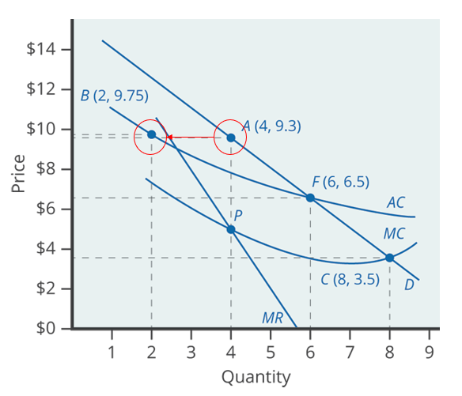
2. Split the Monopoly₁
A second outcome arises if antitrust authorities decide to divide the company so new firms can compete.
Assume a company is split in half, so instead of one large firm producing a quantity of 4, two half-size firms each produce a quantity of 2.
Notes:
If the monopoly is left alone, it will follow its normal approach to maximizing profits. Since the price a monopoly chooses is above the average cost curve, the natural monopoly will earn economic profits.

Slide 9
2. Split the Monopoly₂
With a downward-sloping average cost curve, two smaller firms will always have higher average costs of production than one larger firm.
If one firm grows larger than another, it will have lower average costs and may be able to drive its competitor out of the market.
Alternatively, two firms in a market may discover subtle ways of coordinating their behavior and keeping prices high.
Notes:
A second outcome arises if antitrust authorities decide to divide the company so that the new firms can compete. With a downward-sloping average cost curve, two smaller firms will always have higher average costs of production than one larger firm. If one firm grows larger than another, it will have lower average costs and may be able to drive its competitor out of the market. Alternatively, two firms in a market may discover subtle ways of coordinating their behavior and keeping prices high.

Slide 10
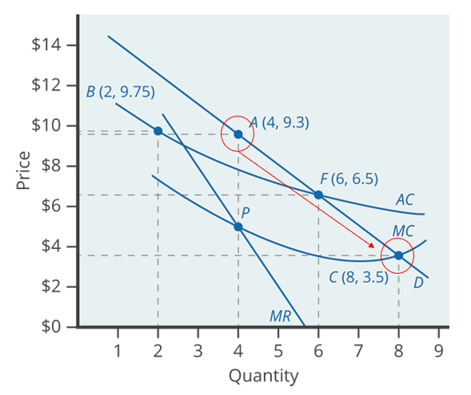
3. Setting Price and Output₁
A third alternative is that regulators may decide to set prices and quantities produced for this industry.
An example would be if the regulator requires that the firm produce the quantity of output where marginal cost crosses the demand curve.
This requires price to be set equal to MC, which is what would occur in a perfectly competitive market.
Notes:
A third alternative is that regulators may decide to set prices and quantities produced for this industry. An example would be if the regulator requires that the firm produce the quantity of output where marginal cost crosses the demand curve. This requires price to be set equal to MC, which is what would occur in a perfectly competitive market.

Slide 11
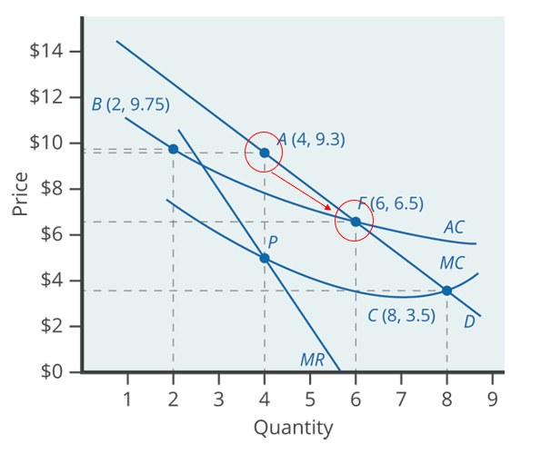
3. Setting Price and Output₂
A more plausible option for the regulator would be to set the price where AC crosses the demand curve.
This lets the monopoly charge enough to cover its average costs and earn a normal rate of profit so that it can continue operating.
It also prevents the firm from raising prices and earning abnormally high monopoly profits.
Notes:
A more plausible option for the regulator would be to set the price where AC crosses the demand curve. This lets the monopoly charge enough to cover its average costs and earn a normal rate of profit so that it can continue operating. It also prevents the firm from raising prices and earning abnormally high monopoly profits.

Slide 12
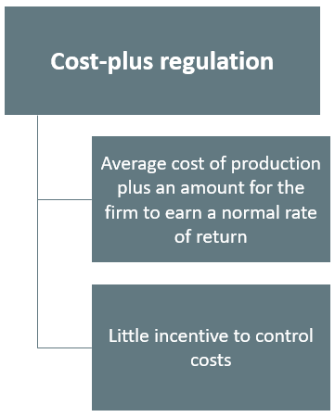
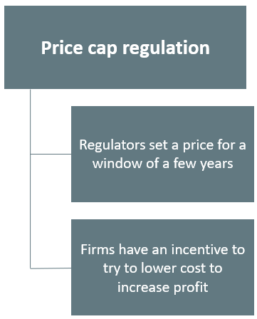
Cost-Plus vs. Price Cap Regulation
Notes:
Cost-plus regulation refers to when regulators permit a regulated firm to cover its costs and to make a normal level of profit. Firms have little incentive to control costs. Price cap regulation refers to when the regulator sets a price that a firm cannot exceed over the next few years. Firms have an incentive to try to lower cost to increase profit.

Slide 13
Summary
In the case of a natural monopoly, market competition will not work well, so rather than allowing an unregulated monopoly to raise price and reduce output, the government may wish to regulate price and/or output.
Natural monopolies can be regulated through splitting the natural monopoly into multiple companies or requiring a certain level of output and price.
Cost-plus regulation refers to government regulation in which the price that a firm can charge is set over a period of time by looking at the firm's accounting costs and then adding a margin so that the firm can earn a normal rate of profit.
Price cap regulation refers to government regulation of a firm where the government sets a price level several years in advance.

Slide 14




HAWKES LEARNING

