Slide 1
Regulating Anticompetitive Behavior
HAWKES LEARNING

Slide 2

Regulating Anticompetitive Behavior₁
Firms who receive patents are legally given the right to earn above-average profits for a time to reward and encourage innovation.
Notes:
Firms who receive patents are legally given the right to earn above-average profits for a time to reward and encourage innovation.

Slide 3
Antitrust Law
U.S. antitrust laws reach beyond blocking mergers that would reduce competition to include a wide array of anticompetitive practices.
For example, it is illegal for competitors to form a cartel to collude to make pricing and output decisions as if they were a monopoly firm.
Under U.S. antitrust laws, monopoly itself is not illegal.
For example, the law explicitly allows a firm to earn higher-than-normal profits for a time as a reward for innovation.
Notes:
U.S. antitrust laws reach beyond blocking mergers that would reduce competition to include a wide array of anticompetitive practices. For example, it is illegal for competitors to form a cartel to collude to make pricing and output decisions as if they were a monopoly firm. Under U.S. antitrust laws, monopoly itself is not illegal. For example, the law explicitly allows a firm to earn higher-than-normal profits for a time as a reward for innovation.

Slide 4
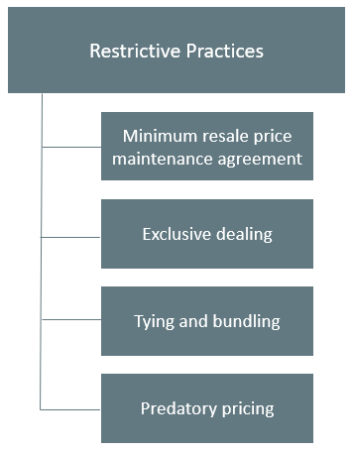
Restrictive Practices
Notes:
Antitrust law includes rules against restrictive practices—practices that do not involve outright agreements to raise price or to reduce the quantity produced but might have the effect of reducing competition. Antitrust cases involving restrictive practices are often controversial because they delve into specific contracts or agreements between firms that are allowed in some cases but not in others.

Slide 5
Minimum Resale Price Maintenance Agreements₁
Product manufacturers often sell to a group of dealers who then sell to the general public.
A minimum resale price maintenance agreement would require the dealers to sell for at least a certain minimum price.
A minimum price contract is illegal because it would restrict competition among dealers.
Notes:
Product manufacturers often sell to a group of dealers who then sell to the general public. A minimum resale price maintenance agreement would require the dealers to sell for at least a certain minimum price. A minimum price contract is illegal because it would restrict competition among dealers.

Slide 6

Minimum Resale Price Maintenance Agreements₂
A manufacturer is legally allowed to "suggest" minimum prices and to stop selling to dealers that undercut prices. This basically serves as a minimum resale price maintenance agreement but disguised as a legal suggestion.
Notes:
A manufacturer is legally allowed to "suggest" minimum prices and to stop selling to dealers that undercut prices. This basically serves as a minimum resale price maintenance agreement, but disguised as a legal suggestion.

Slide 7
Exclusive Dealing
An exclusive dealing agreement between a manufacturer and a dealer can be legal or illegal.
It is legal if the purpose of the contract is to encourage competition between dealers.
Exclusive deals may also limit competition.
If a retailer obtained exclusive rights to be the sole distributor of a good, this exclusive contract would have an anticompetitive effect.
Notes:
An exclusive dealing agreement between a manufacturer and a dealer can be legal or illegal. It is legal if the purpose of the contract is to encourage competition between dealers. Exclusive deals may also limit competition. If a retailer obtained exclusive rights to be the sole distributor of a good, this exclusive contract would have an anticompetitive effect.

Slide 8
Tying Sales
Tying sales happen when a customer is required to buy one product only if the customer also buys a second product.
Tying sales are controversial because they force consumers to purchase a product that they may not actually want or need.
For example, suppose that to purchase a popular at-home stereo, the store required that you also purchase a certain TV model.

Slide 9
Bundling₁
Bundling is where a firm sells two or more products as one.
Bundling can offer an advantage for consumers by allowing them to acquire multiple products or services for a better price.
For example, consider an internet, home phone, and cable package through a cable company.
Notes:
Bundling is where a firm sells two or more products as one. Bundling can offer an advantage for consumers by allowing them to acquire multiple products or services for a better price. For example, consider an internet, home phone, and cable package through a cable company.

Slide 10

Bundling₂
An example of bundling is if a store sold several household appliances together at a lower price than if all items were purchased individually.
Notes:
An example of bundling is if a store sold several household appliances together at a lower price than if all items were purchased individually.

Slide 11
Predatory Pricing
Predatory pricing occurs when the existing firm reacts to a new firm by dropping prices very low until the new firm is driven out of the market, at which point the existing firm raises prices again.
This pattern of pricing is aimed at deterring new firms from entering the market.
In practice, it can be hard to figure out when pricing is predatory or just market competition.
Notes:
Predatory pricing occurs when the existing firm reacts to a new firm by dropping prices very low until the new firm is driven out of the market, at which point the existing firm raises prices again. This pattern of pricing is aimed at deterring new firms from entering the market. In practice, it can be hard to figure out when pricing is predatory or just market competition.

Slide 12
On Your Own₁
What is it called when a customer is required to buy one product only if the customer buys a second product?
☐ Tying sales
☐ Bundling
☐ Resale price maintenance
☐ Exclusive dealing
What is it called when existing firms react to a new firm by drastically dropping prices?
☐ Resale price maintenance
☐ Tying sales
☐ Price discrimination
☐ Predatory pricing

Slide 13
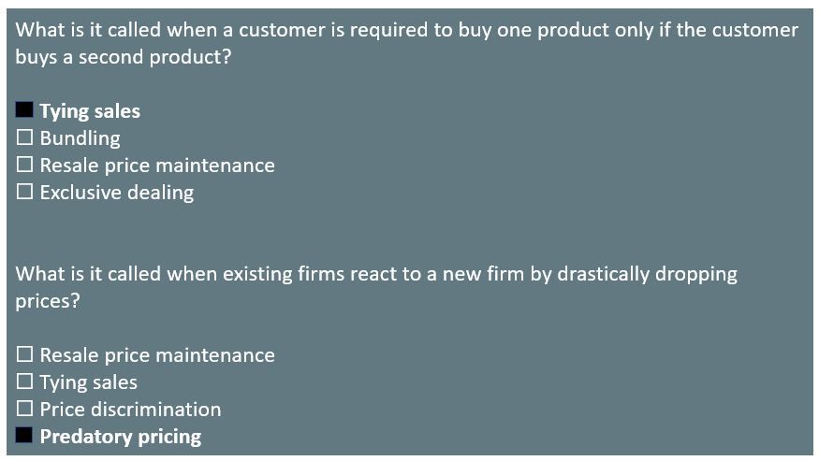
On Your Own₂

Slide 14
Restrictive Practice
The concept of restrictive practices is continually evolving as firms seek new ways to earn profits and government regulators define what is permissible.
A situation where the law is evolving and changing is always somewhat troublesome since laws are most useful and fair when firms know what they are in advance.
Since the law is open to interpretation, competitors who are losing out in the market can accuse successful firms of anticompetitive restrictive practices.
Officials at the FTC and the Department of Justice are aware of these issues, but there is no easy way to resolve them.
Notes:
The concept of restrictive practices is continually evolving as firms seek new ways to earn profits and government regulators define what’s permissible. Of course, laws are most useful and fair when firms know what they are in advance, but when it comes to restrictive practices, the law is always evolving. Additionally, since the law is open to interpretation, struggling firms could accuse successful firms of anticompetitive restrictive practices and try to win through government regulation what they’ve failed to accomplish in the market. Officials at the Federal Trade Commission and the Department of Justice are, of course, aware of these issues, but there is no easy way to resolve them.

Slide 15
Summary
Antitrust authorities block firms from openly colluding to form a cartel that will reduce output and raise prices.
Companies sometimes attempt to find other ways around these restrictions and, consequently, many antitrust cases involve restrictive practices that can reduce competition in certain circumstances, like tying sales, bundling, and predatory pricing.
The concept of restrictive practices is continually evolving as firms seek new ways to earn profits and regulators define what is allowed.

Slide 16




HAWKES LEARNING

