Slide 1
Corporate Mergers
HAWKES LEARNING
Notes:
By the end of this lesson, you will be able to explain antitrust laws, calculate concentration ratios, calculate the Herfindahl-Hirschman Index (HHI), and evaluate methods of antitrust regulation.

Slide 2
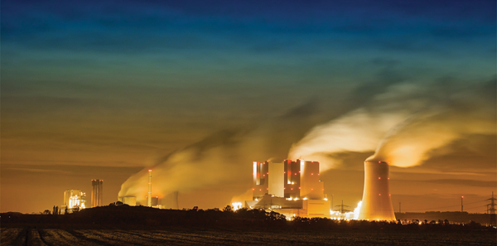
Corporate Mergers₁
Large corporations, such as the natural gas producer Kinder Morgan, can bring economies of scale to the marketplace. Will that benefit consumers, or is more competition better?
Notes:
Large corporations, such as the natural gas producer Kinder Morgan, can bring economies of scale to the marketplace. Will that benefit consumers, or is more competition better?

Slide 3
Theory of the Firm
Recall the three important lessons on the theory of the firm:
1. Competition is a good thing because it provides consumers with lower prices and a variety of innovative products.
2. Large-scale production can dramatically lower average costs.
3. Markets in the real world are rarely perfectly competitive.
Notes:
Recall the three important lessons on the theory of the firm:
1. Competition is a good thing because it provides consumers with lower prices and a variety of innovative products.
2. Large-scale production can dramatically lower average costs.
3. Markets in the real world are rarely perfectly competitive.

Slide 4
Mergers and Acquisitions
A corporate merger occurs when two separate firms combine to become a single firm.
An acquisition occurs when one firm purchases another.
An acquisition may not look like a merger since the newly purchased firm may continue to operate under its former company name.
Mergers can also be lateral, where two firms of similar sizes combine to become one.
Notes:
A corporate merger occurs when two separate firms combine to become a single firm. An acquisition occurs when one firm purchases another. An acquisition may not look like a merger since the newly purchased firm may continue to operate under its former company name. Mergers can also be lateral, where two firms of similar sizes combine to become one.

Slide 5
Regulations for Approving Mergers
Since a merger combines two firms into one, it can reduce the extent of competition between firms.
When two large U.S. firms announce a merger or acquisition, they must notify the U.S. Federal Trade Commission (FTC).
The laws that give government the power to block certain mergers or break up large firms into smaller ones are called antitrust laws.
Notes:
Since a merger combines two firms into one, it can reduce the extent of competition between firms. When two large U.S. firms announce a merger or acquisition, they must notify the U.S. Federal Trade Commission (FTC). The laws that give government the power to block certain mergers, and even in some cases to break up large firms into smaller ones, are called antitrust laws.

Slide 6
Freedom of Choice
The U.S. government approves most proposed mergers. In a market-oriented economy, firms have the freedom to make their own choices. Private firms generally have the freedom to:
Expand and reduce production
Set prices
Open and close facilities
Hire and fire workers
Sell old or new products
Acquire, be acquired, or merge with another firm
Notes:
The U.S. government approves most proposed mergers. In a market-oriented economy, firms have the freedom to make their own choices. Private firms generally have the freedom to: to expand or reduce production; set the price they choose; open new factories or sales facilities or close them; hire workers or to lay them off; and start selling new products or stop selling existing ones. If the owners want to acquire a firm, be acquired, or merge with another firm, this decision is just one of many that firms are free to make.

Slide 7
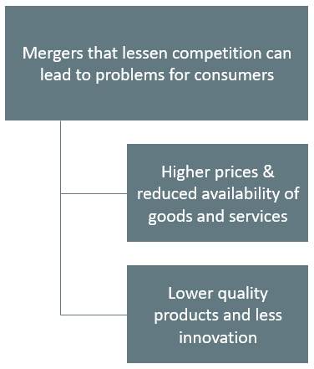
Merger Problems
Notes:
Mergers that lessen competition can lead to problems for consumers: Higher prices & reduced availability of goods and services. Lower quality products and less innovation

Slide 8
Concentration Ratio
Regulators have struggled for decades to measure the degree of monopoly power in an industry.
An early tool was the concentration ratio, which measures the combined market share of the top firms in an industry.
A firm’s market share is its proportion of total sales in a particular market.
Notes:
Regulators have struggled for decades to measure the degree of monopoly power in an industry. An early tool was the concentration ratio, which measures the combined market share of the top firms in an industry. A firm’s market share is its proportion of total sales in a particular market.

Slide 9
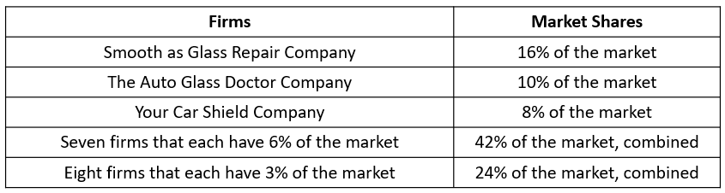
Four-Firm Concentration Ratio
The four-firm concentration ratio is calculated by adding the market shares of the four largest firms.
In the example market given in the table, the four-firm concentration ratio is 16 + 10 + 8 + 6 = 40.
This concentration ratio is not considered especially high because the largest four firms have less than half the market.
Notes:
The four-firm concentration ratio is calculated by adding the market shares of the four largest firms: in this case, 16+10+8+6=40. We do not consider this concentration ratio especially high because the largest four firms have less than half the market.

Slide 10
Herfindahl-Hirschman Index (HHI)₁
Another approach to measuring industry concentration is called the Herfindahl-Hirschman Index (HHI).
HHI is calculated by summing the squares of the market share of each firm in the industry.
Notes:
Another approach to measuring industry concentration is called the Herfindahl-Hirschman Index or HHI. We calculate HHI by summing the squares of the market share of each firm in the industry. In this case, the HHI is sixteen squared plus ten squared, plus eight squared, plus six squared times seven, plus three squared times eight, which equals 744.

Slide 11
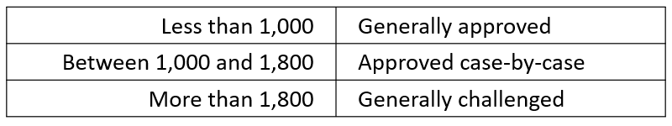
Herfindahl-Hirschman Index (HHI)₂
In the 1980s, the FTC approved or challenged mergers based on the HHI value the merger was expected to cause.
Notes:
if a merger would result in an HHI of less than 1,000, the FTC would probably approve it. If a merger would result in an HHI of more than 1,800, the FTC would probably challenge it. If a merger would result in an HHI between 1,000 and 1,800, the FTC would scrutinize the plan and make a case-by-case decision.

Slide 12
Problems with Concentration Ratio and HHI
Both the four-firm concentration ratio and the Herfindahl-Hirschman index share some weaknesses.
They assume the "market" under discussion is well-defined, and the only question is measuring how sales are divided in that market.
They assume a broad measure of concentration in the market is enough to make a decision about the effects of a merger.
In response to these two problems, the antitrust regulators have been changing their approach in recent decades.
Notes:
Both the four-firm concentration ratio and the Herfindahl-Hirschman index share some weaknesses. They assume the "market" under discussion is well-defined, and the only question is measuring how sales are divided in that market. They assume a broad measure of concentration in the market is enough to make a decision about the effects of a merger. In response to these two problems, the antitrust regulators have been changing their approach in recent decades.

Slide 13
New Directions for Antitrust
Globalization has changed the market boundaries.
The Federal Trade Commission has begun to look less at market share and more at the data on actual competition between businesses.
The new approach to antitrust regulation involves detailed analysis of specific markets and companies.
Now, statistical tools and real-world evidence estimate the demand and supply curves that the firms who are proposing a merger face.
Notes:
Globalization has changed the market boundaries. The Federal Trade Commission has begun to look less at market share and more at the data on actual competition between businesses. The new approach to antitrust regulation involves detailed analysis of specific markets and companies. Now, statistical tools and real-world evidence estimate the demand and supply curves that the firms who are proposing a merger face.

Slide 14
Summary
A corporate merger involves two private firms joining together.
An acquisition refers to one firm buying another firm.
Antitrust laws seek to ensure active competition in markets, sometimes by preventing large firms from forming through mergers and acquisitions, sometimes by regulating business practices that might restrict competition, and sometimes by breaking up large firms into smaller competitors.
A four-firm concentration ratio is calculated by adding the market shares—that is, the percentage of total sales—of the four largest firms in the market.
A Herfindahl-Hirschman Index (HHI) is calculated by taking the market shares of all firms in the market, squaring them, and summing the total.

Slide 15




HAWKES LEARNING

