Slide 1
Monopolistic Competition
HAWKES LEARNING
Notes:
By the end of this lesson, you will be able to explain the significance of differentiated products and how a monopolistic competitor chooses price, quantity, advertising and decides to enter or exit the market.

Slide 2
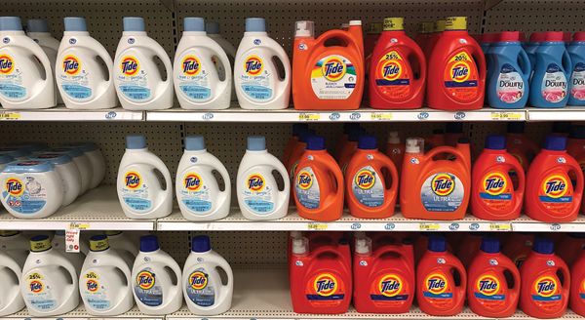
Entry and Exit Decisions
The laundry detergent market is characterized neither as perfect competition nor as monopoly.
Notes:
The laundry detergent market is characterized neither as perfect competition nor as monopoly.

Slide 3
Market Structure
Perfect competition and monopoly are at opposite ends of the competition spectrum.
The vast majority of real-world firms and organizations fall between these extremes and are referred to as imperfectly competitive.
There are two main types of imperfectly competitive market structures: monopolistic competition and oligopoly.
Notes:
Perfect competition and monopoly are at opposite ends of the competition spectrum. The vast majority of real-world firms and organizations fall between these extremes and are referred to as imperfectly competitive. There are two main types of imperfectly competitive market structures: monopolistic competition and oligopoly.

Slide 4
Monopolistic Competition₁
Monopolistic competition involves many firms competing against each other but selling products that are distinctive in some way.
When products are distinctive, each firm has a mini-monopoly on its particular style or flavor or brand name.
Firms producing such products must also compete with other styles and flavors and brand names.
The term "monopolistic competition" captures this mixture of mini-monopoly and tough competition.
Notes:
Monopolistic competition involves many firms competing against each other but selling products that are distinctive in some way. When products are distinctive, each firm has a mini-monopoly on its particular style or flavor or brand name. Firms producing such products must also compete with other styles and flavors and brand names. The term "monopolistic competition" captures this mixture of mini-monopoly and tough competition.

Slide 5
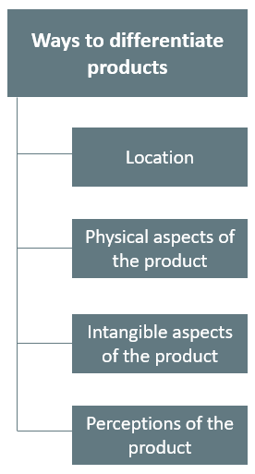
Differentiated Products
Notes:
A firm can try to make its products different from those of its competitors in several ways. We call products that are distinctive in one of these ways differentiated products. Products differ in their location, physical aspects, intangible aspects, and perceptions.

Slide 6
Perceived Demand for a Monopolistic Competitor
A monopolistically competitive firm perceives a demand for its goods that is an intermediate case between monopoly and competition.
The demand curve that a monopolistic competitor faces is not flat, but rather downward-sloping.
A monopolistic competitor can raise its price without losing all its customers or lower the price and gain more customers.
Notes:
A monopolistically competitive firm perceives a demand for its goods that is an intermediate case between monopoly and competition. The demand curve that a monopolistic competitor faces is not flat but rather downward-sloping. A monopolistic competitor can raise its price without losing all its customers or lower the price and gain more customers.

Slide 7
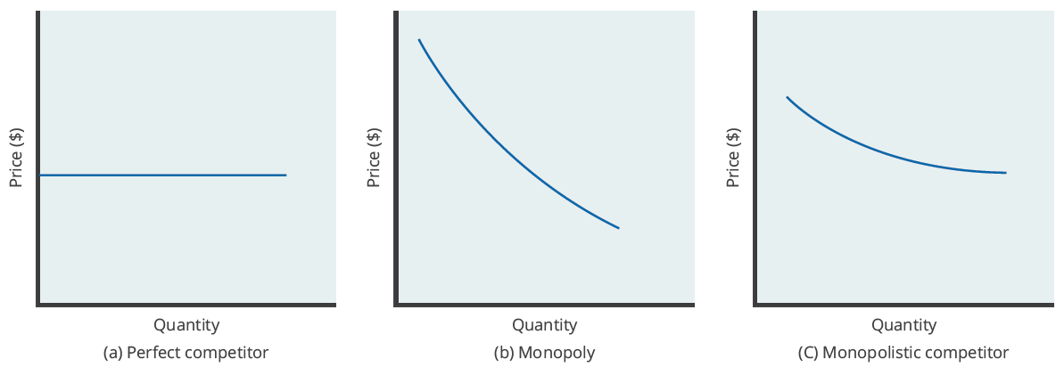
Perceived Demand Curves
The demand curve that a perfectly competitive firm faces is perfectly elastic, the demand curve that a monopoly faces is the market demand, and the demand curve that a monopolistically competitive firm faces falls between them.
Notes:
The demand curve that a perfectly competitive firm faces is perfectly elastic, the demand curve that a monopoly faces is the market demand, and the demand curve that a monopolistically competitive firm faces falls between them.

Slide 8
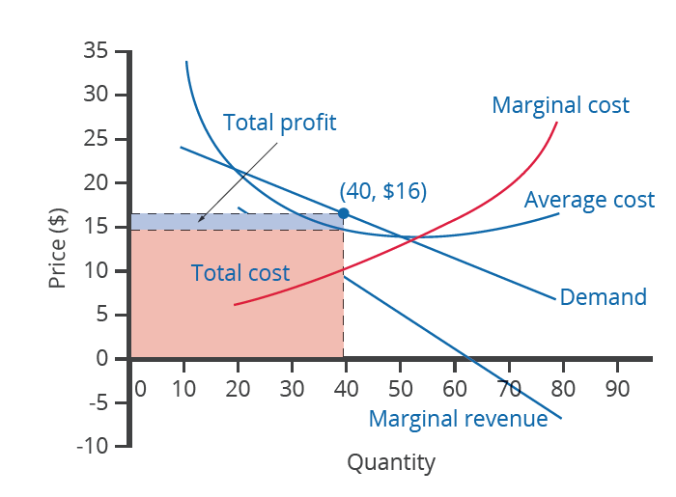
How a Monopolistic Competitor Chooses Price and Quantity
The monopolistically competitive firm decides on its profit-maximizing quantity and price in much the same way as a monopolist.
A monopolistic competitor faces a downward-sloping demand curve and will choose some combination of price and quantity along its perceived demand curve.
To maximize profits, the chosen quantity will be where MR = MC.
Notes:
The monopolistically competitive firm decides on its profit-maximizing quantity and price in much the same way as a monopolist. A monopolistic competitor faces a downward-sloping demand curve and will choose some combination of price and quantity along its perceived demand curve. To maximize profits, the chosen quantity will be where MR=MC.

Slide 9
Monopolistic Competitors and Entry₁
If one monopolistic competitor earns positive economic profits, other firms will be tempted to enter the market.
For example, a successful restaurant with a unique barbecue sauce must be concerned that competitors will try to copy the sauce.
The entry of other firms into the same general market shifts the demand curve that a monopolistically competitive firm faces.
As more firms enter the market, the quantity demanded at a given price for any particular firm will decline.
A decline in price means the firm's perceived demand curve and marginal revenue curve will shift to the left.
Notes:
If one monopolistic competitor earns positive economic profits, other firms will be tempted to enter the market. For example, a successful restaurant with a unique barbecue sauce must be concerned that competitors will try to copy the sauce. The entry of other firms into the same general market shifts the demand curve that a monopolistically competitive firm faces. As more firms enter the market, the quantity demanded at a given price for any particular firm will decline. A decline in price means the firm's perceived demand curve and marginal revenue curve will shift to the left.

Slide 10
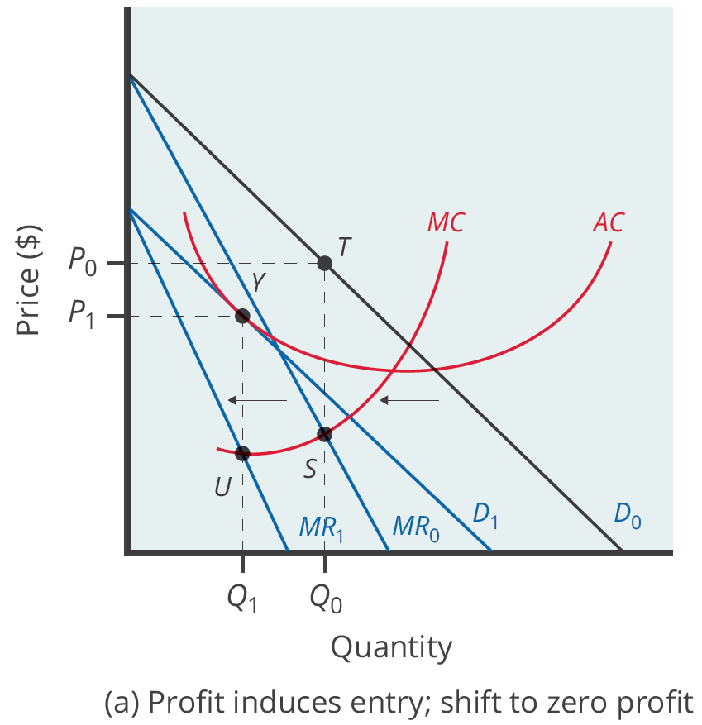
Monopolistic Competitors and Entry₂
Positive economic profits attract competing firms to the industry, driving the original firm's demand down.
At the new equilibrium quantity, the original firm earns no economic profit, and entry into the industry ceases.
Notes:
Positive economic profits attract competing firms to the industry, driving the original firm's demand down. At the new equilibrium quantity, the original firm is earning zero economic profits, and entry into the industry ceases.

Slide 11
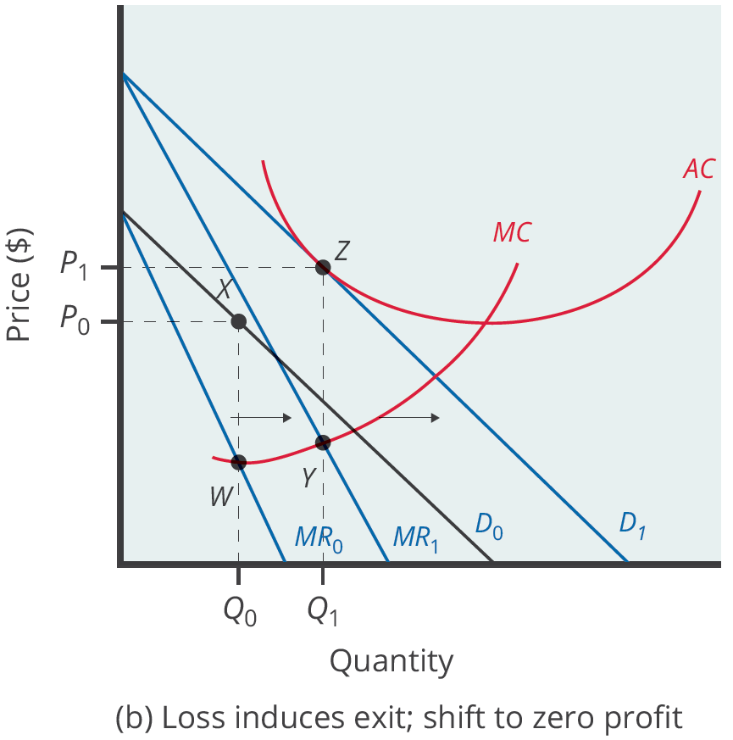
Monopolistic Competitors and Exit
Losses induce firms to leave the industry.
When they do, demand for the original firm increases, where the firm is earning zero economic profit once again.
Notes:
Losses induce firms to leave the industry. When they do, demand for the original firm increases, where the firm is earning zero economic profit once again.

Slide 12
Monopolistic Competition and Efficiency
The end result of entry and exit is that firms end up with a price that lies on the downward-sloping portion of the average cost curve.
The rule for maximizing profit is to set MR = MC, and price is higher than MR because the demand curve is downward-sloping.
A monopolistically competitive industry does not display productive or allocative efficiency in either the short run, when firms are making economic profits and losses, or in the long run, when firms are earning zero profits.
Notes:
The end result of entry and exit is that firms end up with a price that lies on the downward-sloping portion of the average cost curve. The rule for maximizing profit is to set MR=MC, and price is higher than MR because the demand curve is downward-sloping. A monopolistically competitive industry does not display productive or allocative efficiency in either the short run, when firms are making economic profits and losses, or in the long run, when firms are earning zero profits.

Slide 13
Summary
Monopolistic competition refers to a market where many firms sell differentiated products.
The perceived demand curve for a monopolistically competitive firm is downward-sloping, which shows that it is a price maker and chooses a combination of price and quantity.
A profit-maximizing monopolistic competitor will seek out the quantity where marginal revenue is equal to marginal cost.
If the firms in a monopolistically competitive industry are earning economic profits, the industry will attract entry until profits are driven down to zero in the long run.
A monopolistically competitive firm is not productively efficient because it does not produce at the minimum of its average cost curve.

Slide 14




HAWKES LEARNING

