Slide 1
How Monopolies Form: Barriers to Entry
HAWKES LEARNING
Notes:
By the end of this lesson, you’ll be able to distinguish between a natural monopoly and a legal monopoly; explain how economies of scale and the control of natural resources led to the necessary formation of legal monopolies; analyze the importance of trademarks and patents in promoting innovation; and identify examples of predatory pricing.

Slide 2
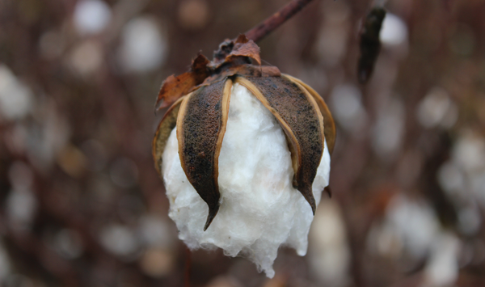
How Monopolies Form: Barriers to Entry₁
In the mid-nineteenth century, the United States, specifically the Southern states, had a near monopoly in the cotton that they supplied to Great Britain. These states attempted to leverage this economic power into political power—trying to sway Great Britain to formally recognize the Confederate States of America.
Notes:
In the mid-nineteenth century, the United States, specifically the Southern states, had a near monopoly in the cotton that they supplied to Great Britain. These states attempted to leverage this economic power into political power—trying to sway Great Britain to formally recognize the Confederate States of America.

Slide 3
Monopoly
If perfect competition is a market where firms simply respond to the market price, monopoly is a market with no competition at all.
In the case of monopoly, one firm produces all the output in a market.
Since a monopoly faces no significant competition, it can charge any price it wishes, subject to the demand curve.
In practice, people often use the term monopoly to describe a market in which one firm merely has a very high market share.
Notes:
If perfect competition is a market where firms have no market power and they simply respond to the market price, monopoly is a market with no competition at all, and firms have a great deal of market power. In the case of monopoly, one firm produces all the output in a market. Since a monopoly faces no significant competition, it can charge any price it wishes, subject to the demand curve. While a monopoly, by definition, refers to a single firm, in practice people often use the term to describe a market in which one firm merely has a very high market share.

Slide 4
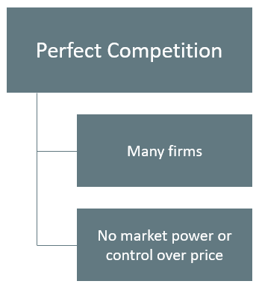
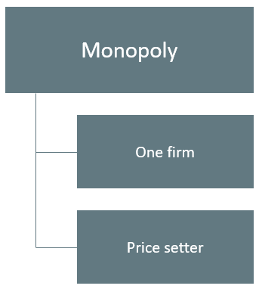
Perfect Competition vs. Monopoly
Notes:
With perfect competition, there are many firms that have no market power or control over price.
With a monopoly, there is one firm that is the price setter.

Slide 5
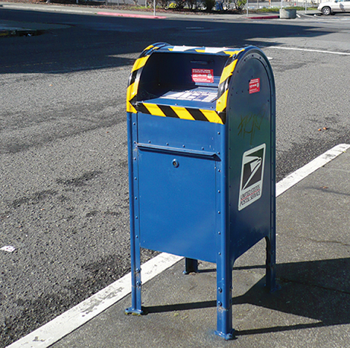
Monopoly Examples
Even though there are very few true monopolies in existence, we do deal with some of those few every day, often without realizing it.
The U.S. Postal Service and your electric and water companies are a few examples.
Notes:
Even though there are very few true monopolies in existence, we do deal with some of those few every day, often without realizing it. The U.S. Postal Service and your electric and water companies are a few examples.

Slide 6
How Monopolies Form: Barriers to Entry₂
Because of the lack of competition, monopolies tend to earn significant economic profits.
Profits should attract vigorous competition, and yet, because of one particular characteristic of monopoly, they do not.
Three main categories of barriers to entry exist.
Notes:
Because of the lack of competition, monopolies tend to earn significant economic profits. Profits should attract vigorous competition, and yet, because of one particular characteristic of monopoly, they do not. Three main categories of barriers to entry exist.

Slide 7
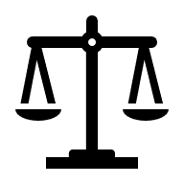


Barriers to Entry
Legal barriers to entry
Technological barriers to entry
Market barriers to entry
In some cases, barriers to entry may lead to monopoly, while in other cases, they may limit competition to a few firms.
Notes:
Barriers to entry are the legal, technological, or market forces that discourage or prevent potential competitors from entering a market. In some cases, barriers to entry may lead to monopoly, while in other cases, they may limit competition to a few firms.

Slide 8
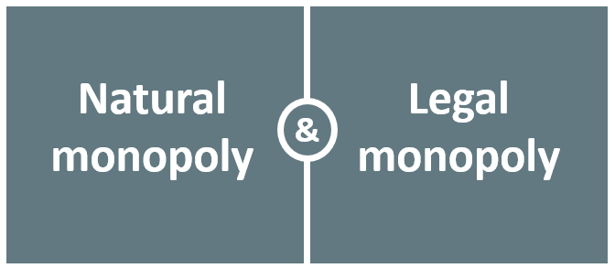
Types of Monopolies
Notes:
There are two types of monopoly, based on the types of barriers to entry they exploit. One is natural monopoly, where the barriers to entry are something other than legal prohibition. The other is legal monopoly, where laws prohibit (or severely limit) competition.

Slide 9
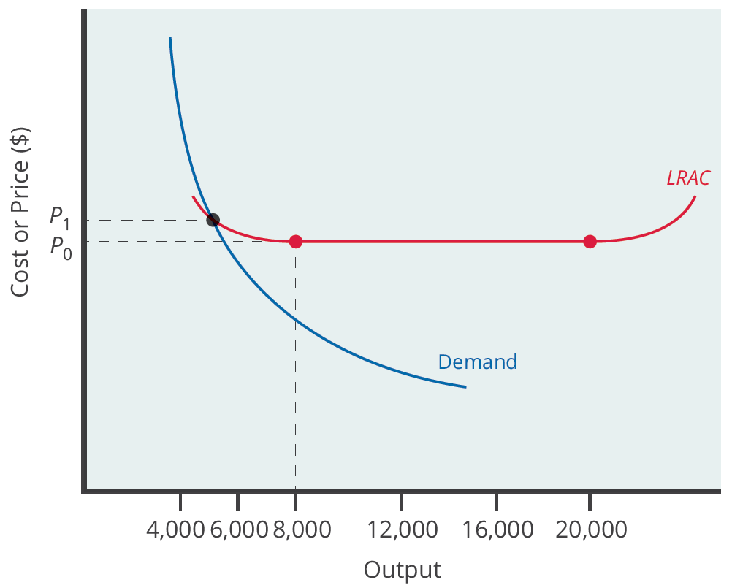
Natural Monopoly
Assume the market demand curve intersects the long-run average cost curve at a point that exhibits economies of scale (the downward sloping region).
If a second firm enters the market at a smaller size, its average costs will be higher than those of the existing firm, and it will be unable to compete.
If a second firm attempts to enter the market at a larger size, it could not sell all its output due to insufficient demand.
Notes:
Assume the market demand curve intersects the long-run average cost curve at a point that exhibits economies of scale (the downward sloping region). If a second firm enters the market at a smaller size, its average costs will be higher than those of the existing firm, and it will be unable to compete. If a second firm attempts to enter the market at a larger size, it could not sell all its output due to insufficient demand.

Slide 10
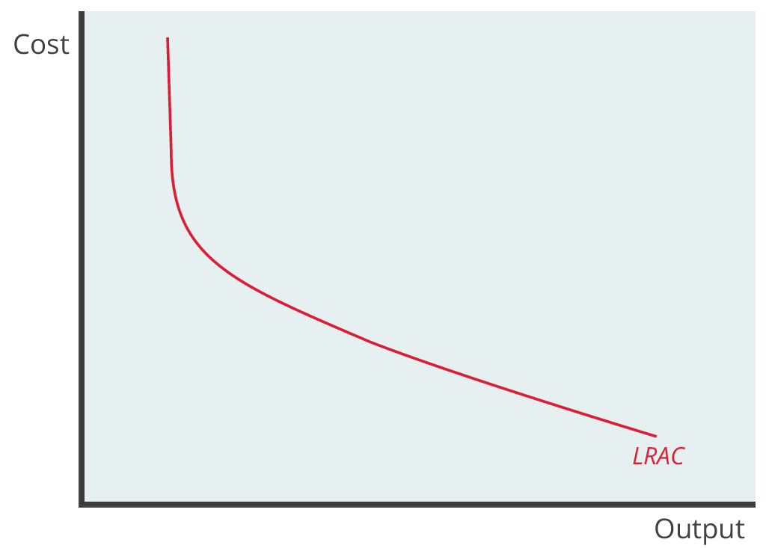
Natural Monopoly LRAC
A natural monopoly is typically shown as occurring when the LRAC continues to fall as output increases.
It becomes less costly for the lone firm in the industry to produce, on average, the higher level of output.
Notes:
A natural monopoly is typically shown as occurring when the LRAC continues to fall as output increases. It becomes less costly for the lone firm in the industry to produce, on average, the higher the level of output.

Slide 11
Economies of Scale
Economists call the situation where economies of scale are large relative to the quantity demanded in the market a natural monopoly.
Economies of scale are when average costs decline as output expands.
Natural monopolies often arise in industries where the marginal cost of adding an additional customer is very low once fixed costs are in place.
This results in situations where there are substantial economies of scale.
Notes:
Economists call the situation where economies of scale are large relative to the quantity demanded in the market a natural monopoly. Economies of scale are when average costs decline as output expands. Natural monopolies often arise in industries where the marginal cost of adding an additional customer is very low once fixed costs are in place. This results in situations where there are substantial economies of scale.

Slide 12

Control of a Physical Resource
Another type of natural monopoly occurs when a company has control of a scarce physical resource.
If a company has control of a scarce resource, it will obviously be a barrier to entry of another company wishing to utilize that resource.
In the 1930s, ALCOA controlled most of the supply of bauxite, a key mineral used in making aluminum. Other firms were simply unable to produce enough aluminum to compete.
Notes:
Another type of natural monopoly occurs when a company has control of a scarce physical resource. If a company has control of a scare resource, it will obviously be a barrier to entry of another company wishing to utilize that resource.
In the 1930s, ALCOA controlled most of the supply of bauxite, a key mineral used in making aluminum. Other firms were simply unable to produce enough aluminum to compete.

Slide 13
Legal Monopoly
For some products, the government erects barriers to entry by prohibiting or limiting competition.
Most legal monopolies are utilities—products necessary for everyday life—that are socially beneficial.
The government often sets regulations to ensure customers have access to an appropriate amount of products or services.
Additionally, legal monopolies are often subject to economies of scale, as in the case of utilities, so it makes sense to allow only one provider.
For example, under U.S. law, no organization but the U.S. Postal Service is legally allowed to deliver first-class mail.
Notes:
For some products, the government erects barriers to entry by prohibiting or limiting competition. Most legal monopolies are utilities—products necessary for everyday life—that are socially beneficial. The government often sets regulations to ensure customers have access to an appropriate amount of products or services. Additionally, legal monopolies are often subject to economies of scale, as in the case of utilities, so it makes sense to allow only one provider. For example, under U.S. law, no organization but the U.S. Postal Service is legally allowed to deliver first-class mail.

Slide 14
Promoting Innovation
Innovation takes time and resources to achieve.
Companies invest in research and development (R&D) to provide innovative goods and services.
Without legal protection, other companies could replicate these goods and services without incurring the costs of R&D.
Many firms would, therefore, choose not to invest in R&D, meaning the world would have less innovation.
The U.S. Patent and Trademark Office and the U.S. Copyright Office promote innovation through categories of intellectual property.
Notes:
Innovation takes time and resources to achieve. Companies invest in research and development to provide innovative goods and services.
Without legal protection, other companies could replicate these goods and services without research and development costs. Many firms would, therefore, choose not to invest in research and development, meaning the world would have less innovation. The U.S. Patent and Trademark Office and the U.S. Copyright Office promote innovation through categories of intellectual property.

Slide 15
Intellectual Property
Patent: An exclusive right to produce for twenty years
Trademark: An identifying symbol for a good that is protected legally
Copyright: Legal protection for original works lasting for seventy years beyond the life of the creator
Trade secrets: Protection of information not covered by a patent or trademark
Notes:
Patent- An exclusive right to produce for twenty years
Trademark- An identifying symbol for a good that is protected legally
Copyright- Legal protection for original works lasting for seventy years beyond the life of the creator
Trade secrets- Protection of information not covered by a patent or trademark

Slide 16
Deregulation
Government limitations on competition used to be more common in the United States.
For most of the twentieth century, only one phone company, AT&T, was legally allowed to provide local and long-distance service.
AT&T lost its monopoly when the technology for providing phone service changed from wires to microwave and satellite transmission.
Given an improvement in technology, the government no longer required AT&T to be the lone provider of certain services.
Deregulation refers to removing government controls over setting prices and quantities in certain industries.
Notes:
Government limitations on competition used to be more common in the United States. For most of the twentieth century, only one phone company, AT&T, was legally allowed to provide local and long-distance service. AT&T lost its monopoly when the technology for providing phone service changed from wires to microwave and satellite transmission. Given an improvement in technology, the government no longer required AT&T to be the lone provider of certain services. Deregulation refers to removing government controls over setting prices and quantities in certain industries.

Slide 17
Intimidating Potential Competition
Businesses have developed a number of schemes for creating barriers to entry by deterring potential competitors from entering the market.
One method is known as predatory pricing, in which a firm uses the threat of sharp price cuts to discourage competition.
Predatory pricing is a violation of U.S. antitrust law, but it is difficult to prove.
Notes:
Businesses have developed a number of schemes for creating barriers to entry by deterring potential competitors from entering the market. One method is known as predatory pricing, in which a firm uses the threat of sharp price cuts to discourage competition. Predatory pricing is a violation of U.S. antitrust law, but it is difficult to prove.

Slide 18
Real-World Discussion
Economies of scale is defined as a situation in which the long-run average costs of production decrease as production increases. In other words, for these firms bigger is better! That makes it difficult for the little guy to compete. Think about Walmart. Is Walmart practicing predatory pricing? Or are they able to offer lower prices to their customers because of efficiency and lower costs? Provide an example of a firm or an industry where economies of scale limits competition.
Notes:
Economies of scale is defined as a situation in which the long-run average costs of production decrease as production increases. In other words, for these firms bigger is better! That makes it difficult for the little guy to compete. Think about Walmart. Is Walmart practicing predatory pricing? Or are they able to offer lower prices to their customers because of efficiency and lower costs? Provide an example of a firm or an industry where economies of scale limits competition.

Slide 19
Summary
Barriers to entry prevent or discourage competitors from entering the market.
These barriers include economies of scale that lead to natural (or legal) monopoly; control of a physical resource; legal restrictions on competition; intellectual property protection; and practices to restrict competition like predatory pricing.
Intellectual property refers to legally guaranteed ownership of an idea rather than a physical item.
The laws that protect intellectual property include patents, copyrights, trademarks, and trade secrets.
A natural monopoly arises when economies of scale persist over a large enough range of output that if one firm supplies the entire market, no other firm can enter without facing a cost disadvantage.

Slide 20




HAWKES LEARNING

