Slide 1
Graphing
HAWKES LEARNING
Notes:
Graphing. By the end of this lesson, you will be able to identify different graphs and calculate slope. Graphs are pictures of numerical information. There are many different types of graphs, and each type is particularly well-suited to the display and clarification of certain types of information.

Slide 2
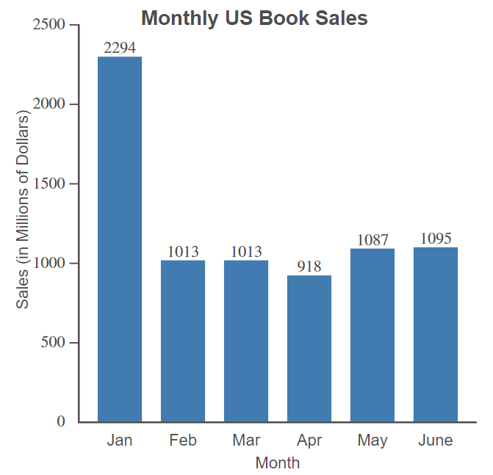
Bar Graphs
Notes:
Bar graphs emphasize comparative amounts. This bar graph shows monthly U.S. books sales. We can compare sales by month. A good bar graph has a title and labeled axis. We can see that January had the most sales of $ 2,294M, and April had the least sales with $918M.

Slide 3
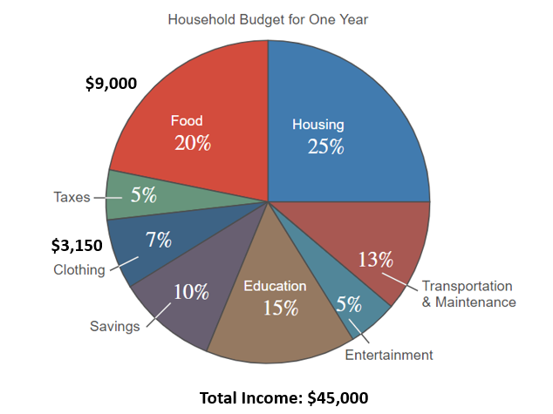
Circle Graphs
Notes:
Circle graphs, or pie charts, help in understanding percents or parts of a whole. This graph shows the percent of a household's annual income they plan to budget for various expenses. If the household’s total income is $45,000, we can find out how much they spend on various necessities. They spend 45,000 times 0.20, or $9,000, on food and $45,000 times 0.07, or $3,150, on clothing.

Slide 4
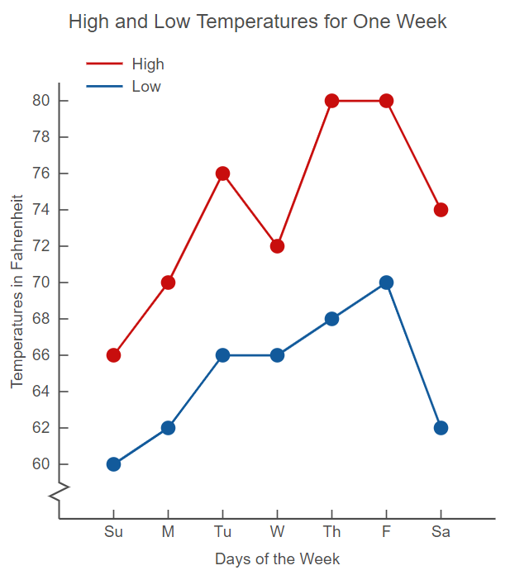
Line Graphs
Notes:
Line graphs indicate tendencies or trends over a period of time. This graph shows the relationships between daily high and low temperatures. We can tell that temperatures tended to rise during the week but fell sharply on Saturday, and the weather was hottest on Thursday and Friday and coolest on Sunday.

Slide 5
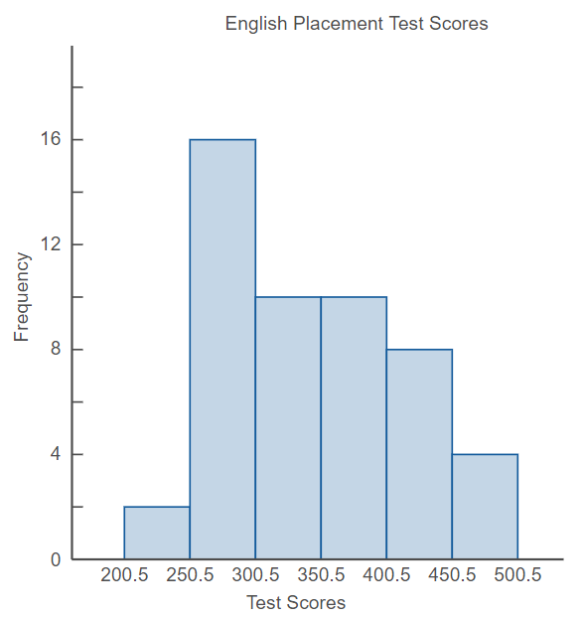
Histograms
Notes:
Histograms indicate data in classes, a range or interval of numbers. This histogram summarizes the scores of students on an English placement test. We can tell that 16 students scored in the second class, between 250.5 and 300.5.

Slide 6
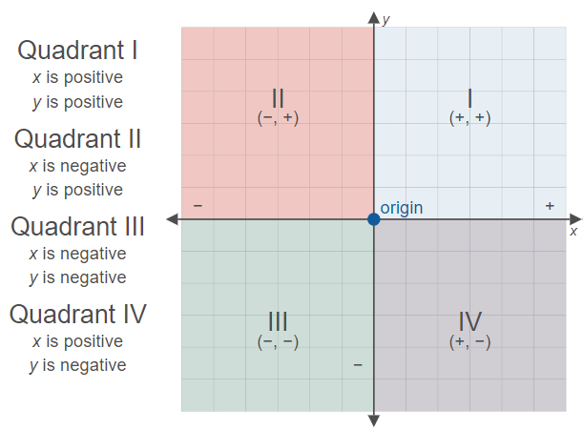
Quadrants
Notes:
When plotting points to create a graph, we must be aware of the quadrants and coordinates. In the first quadrant, x and y are both positive; in the second quadrant, x is negative, and y is positive; in the third quadrant, x and y are both negatives; and in the fourth quadrant, x is positive, and y is negative.

Slide 7
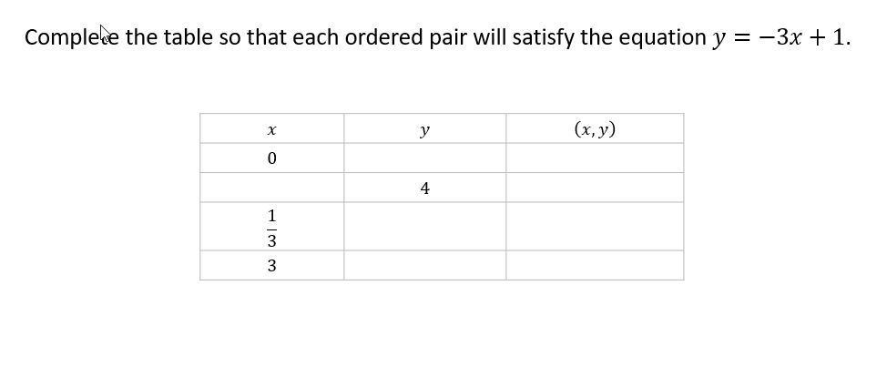
Ordered Pairs₁
Notes:
To complete the table with ordered pairs, we can plug in the given numbers into y = -3x + 1.

Slide 8
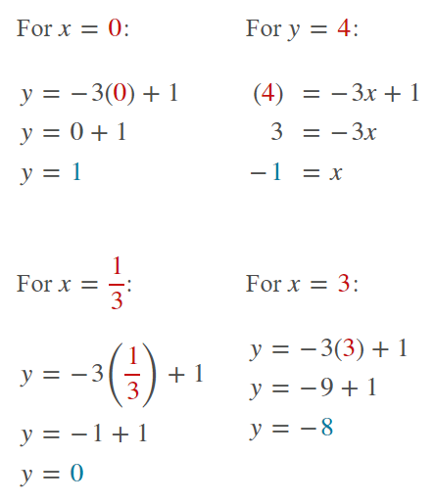
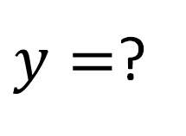
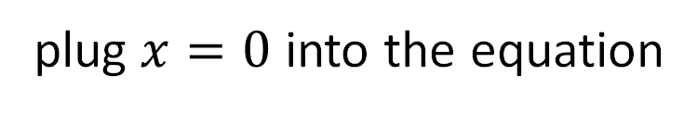
Ordered Pairs₂
$y=$?
plug $x=0$ into the equation
Notes:
For x= 0, we have that y= 1.

Slide 9
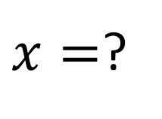
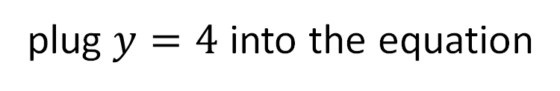
Ordered Pair₃
$x=$?
plug $y=4$ into the equation
Notes:
For y=4, we have that x=-1.

Slide 10
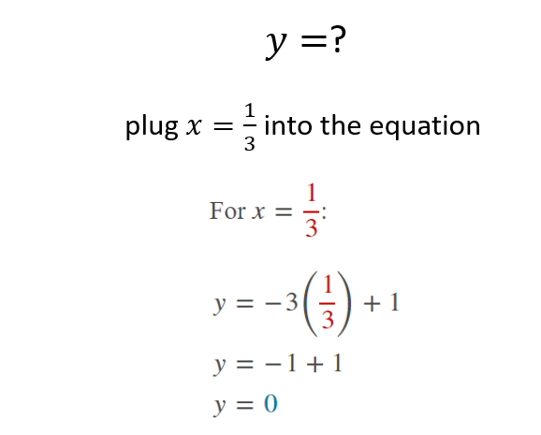
Ordered Pairs₄
Notes:
For x= 1/3, we have that y=0.

Slide 11
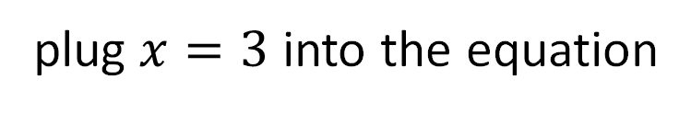
Ordered Pairs₅
$y=$?
plug $x=3$ into the equation
Notes:
and for x=3, we have that y =-8.

Slide 12
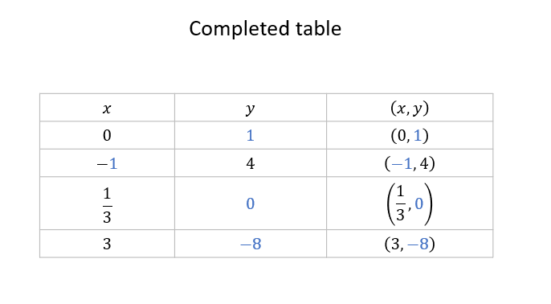
Ordered Pairs₆
Notes:
This is the completed table.

Slide 13
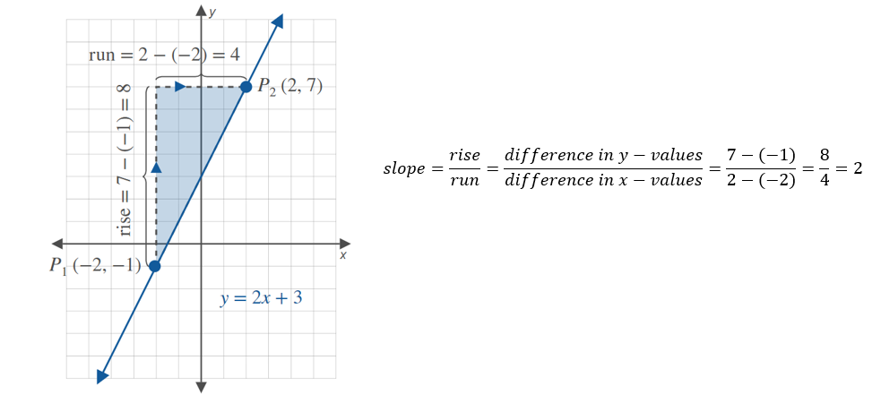
Slope
Notes:
To calculate the slope of the line y=2x + 3, we can calculate the rise over run using the coordinate points P₁ (-2,-1) and P₂ (2,7) to find that the slope of the line is 2.

Slide 14
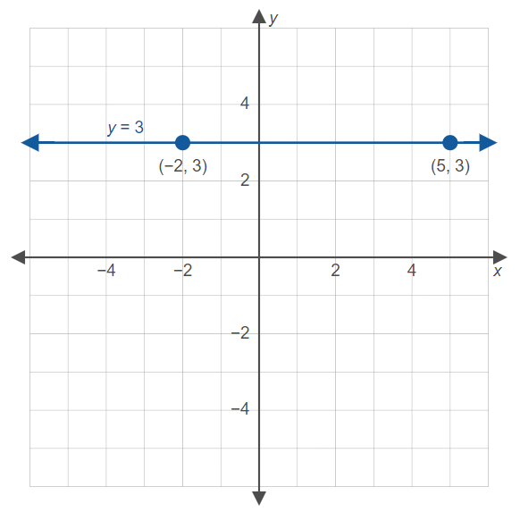
Horizontal Line Slope
Notes:
The slope of a horizontal line is zero, as rise is always zero; dividing zero by a number equals zero.

Slide 15
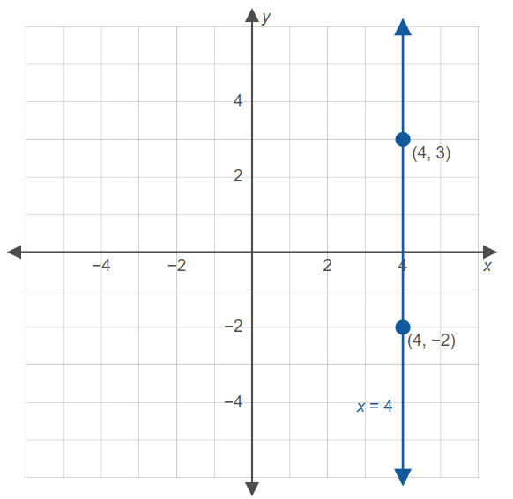
Vertical Line Slope
Notes:
The slope of a vertical line is undefined because dividing a number by zero results in an undefined value.

Slide 16
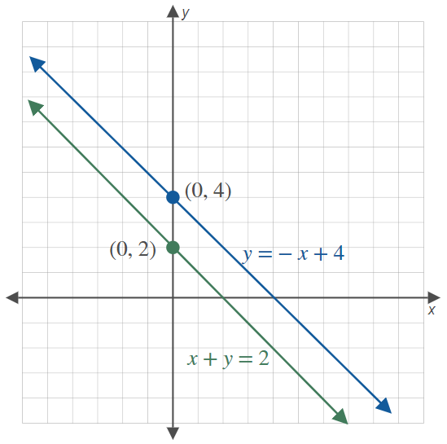
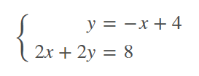
Systems: Parallel Lines
Notes:
When two lines have the same slope, they are parallel, and they never intersect. Thus, there is no solution for the system and the system is inconsistent.

Slide 17

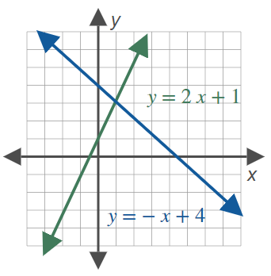
Systems: Intersecting Lines
Notes:
When two lines intersect, the system is consistent, and the equations are independent.

Slide 18

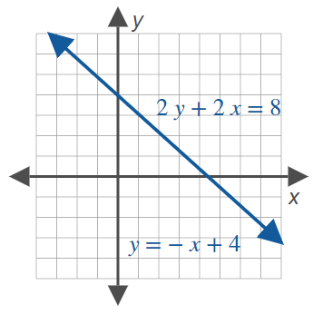
Systems: Overlapping Lines
Notes:
When two lines overlap, the system is consistent, and the equations are dependent. Now, you are able to identify different graphs, calculate slope, and evaluate line systems.

Slide 19




Hawkes Learning
HAWKES LEARNING

