Slide 1
Multiplication and Division
HAWKES LEARNING
Notes:
Today, we review multiplication and division.

Slide 2
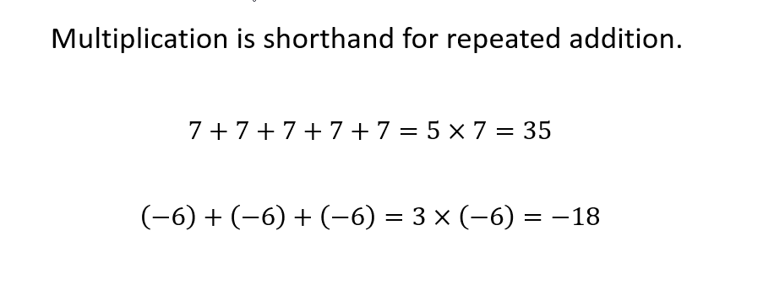
Multiplication
Notes:
Multiplication is shorthand for repeated addition. For instance, if we add together five 7s, we have 7 plus 7 plus 7 plus 7 plus 7, which is equal to 5 times 7, which is equal to 35. You also add together negative numbers, so three negative 6s is negative 6 plus negative 6 plus negative 6, which is simply 3 times negative 6, which is equal to negative 18.

Slide 3
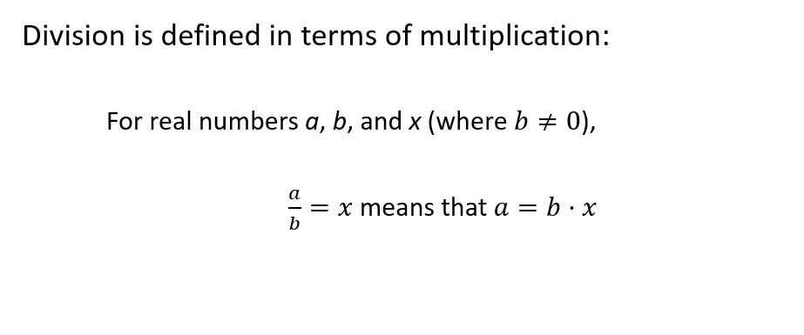
Division
Notes:
Division is defined in terms of multiplication. For real numbers a, b, and x, where b is not equal to zero, a divided by b equaling x means that a equals b times x.

Slide 4
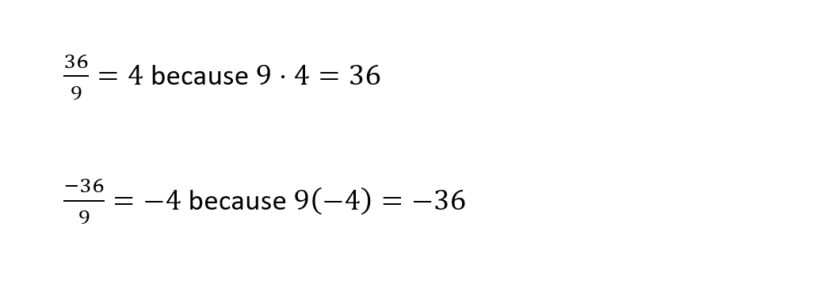
Division: Examples
Notes:
Let’s look at two simple examples that demonstrate how division works in terms of multiplication. In our first example, 36 divided by 9 equals 4 because 9 times 4 equals 36. In the second example, we have the same problem, only this time we are dividing negative 36 by 9. This is equal to negative 4 because 9 times negative 4 equals negative 36.

Slide 5
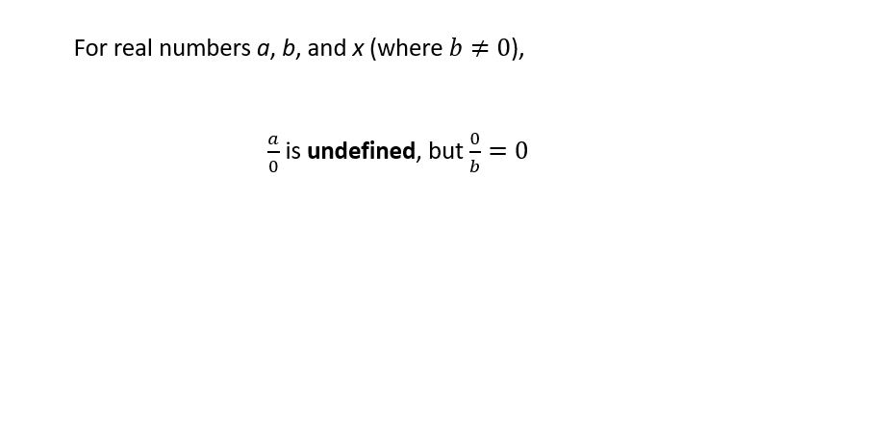
Division and Zero
Notes:
One special case to remember is how to deal with division of and by zero. If we have two real numbers, a and b, neither of which is zero, then a divided by 0 is undefined, but zero divided by b is just zero. So, you can try to divide things into zero, but you cannot divide by zero.

Slide 6
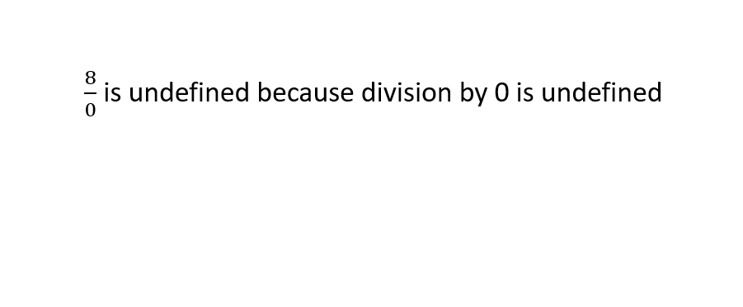
Division and Zero: Example
Notes:
In this example, 8 is divided by zero, but that is undefined. This example is a reminder that division by zero is undefined, so don’t attempt it!

Slide 7
Sign Rules
If two numbers being multiplied or divided have the same sign, both the product and the quotient will be positive.
If two numbers being multiplied or divided have different signs, both the product and the quotient will be negative.
Notes:
Now, let’s talk about some sign rules. There are two rules to remember. The first rules is that if the numbers you are working with have the same sign, both the product and the quotient of those two numbers will be a positive number. The second rule is that if the two numbers you are trying to multiply or divide have different signs, then both the product or the quotient will be negative.

Slide 8
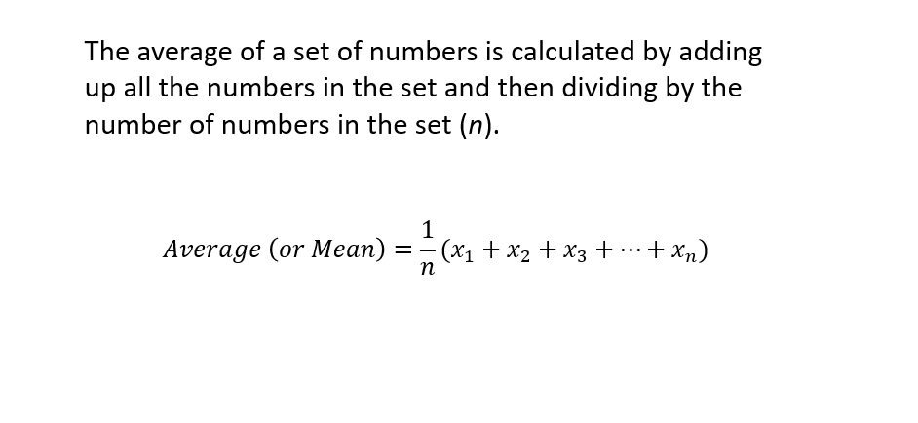
Calculating Averages
Notes:
Let’s close with an application. Here, we are going to calculate the average of a set of numbers. The average of a set of numbers is calculated by adding up all the numbers in the set and then dividing by the number of objects in the set, n. Here is the mathematical representation of that definition. The average (which is also sometimes called the mean) of a set of numbers is equal to 1 over n times the sum of the objects in the set. Notice that the objects are labeled x, with subscripts ranging from 1 to n.

Slide 9
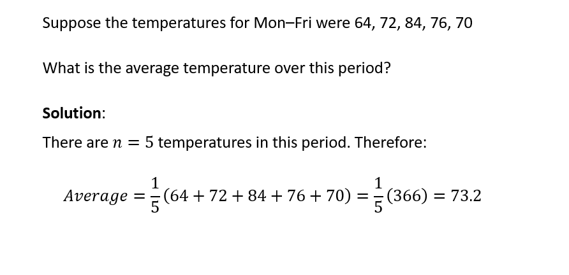
Calculating Averages: Example
Notes:
Here is a concrete example of calculating an average, in particular, an average temperature. You are given the temperatures for five days, Monday through Friday. Then, you are asked, “What is the average temperature over these five days?” The solution starts by noting that the number of objects in your set is n equals 5. Then, we fill in the values for the formula on the previous slide with the data from this slide. You can see x₁ was 64 degrees, x₂ was 72 degrees. and so on until we have x₅, which was 70 degrees. Adding those five temperatures together gives us 366, and when we divide 366 by 5, we get that the average temperature over this five-day period is 73.2 degrees.

Slide 10




HAWKES LEARNING

