Slide 1
Addition and Subtraction
HAWKES LEARNING

Slide 2
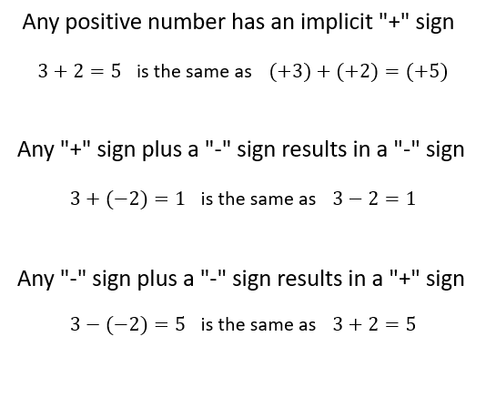
Conventions
Notes:
Today, we are going to review addition and subtraction. We will start by just noting some conventions about the positive and negative signs. First, whenever you see a positive number, it has an implicit plus sign in front of it. So, the equation “3 plus 2 equals 5” is the same as “positive 3 plus positive 2 equals positive five.” Second, any plus sign combined with a negative sign results in a negative sign. So, “3 plus negative 2 equals 1” is the same as “3 minus 2 equals 1.” Notice that the addition of a negative number, negative 2, changes the problem into a subtraction problem. Finally, any negative sign plus another negative sign results in a plus sign. Therefore, “3 minus negative 2 equals 5" is the same as “3 plus 2 equals 5.” You can think of the two negative signs as canceling each other out to become a positive sign.

Slide 3
Addition
3 Cases:
Adding 2 positive numbers
Adding 2 negative numbers
Adding one positive and one negative number
Notes:
Now, let’s talk about addition. We are going to consider three cases: adding two positive numbers, adding two negative numbers, and then adding one positive and one negative number.

Slide 4
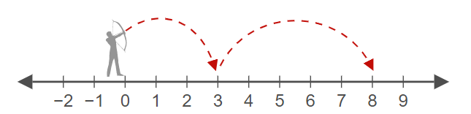
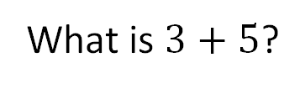
Addition: Case 1
Case 1: Adding two positive numbers
What is $3+5$?
Notes:
Case 1 is adding two positive numbers. What is 3 plus 5? This problem can be represented using a number line. In the diagram, there is a person standing on the number zero who shoots an arrow 3 units and then another arrow 5 units, and you can see that the two arrows end up landing on the number 8. So, 3 plus 5 equals 8. Notice that this can be represented as “positive 3 plus positive 5 equals 8” or more simply as “3 plus 5 equals 8.”

Slide 5
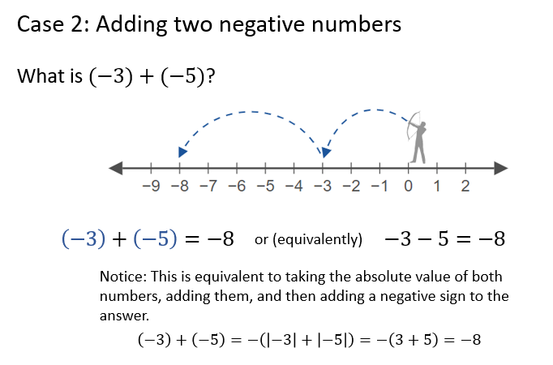
Addition: Case 2
Notes:
Case 2 is adding two negative numbers. What is negative 3 plus negative 5? Again, using a number line representation, the person standing on the number zero shoots two arrows in the negative direction, first for 3 units, then another for 5 additional units, with the final arrow landing on negative 8. Thus, negative 3 plus negative 5 is negative 8. Notice that you can equivalently notate this problem as “negative 3 plus negative 5 equals negative 8” or “3 minus 5 equals negative 8.” Also, notice that adding two negative numbers has another equivalent approach for its calculation. In this approach, you take the absolute value of both negative numbers and add them together. Then, you add a negative sign to that sum to get your final answer. You can see this approach in this next line, where we take the absolute value of negative 3 and negative 5; then, a negative sign is added to the sum of 3 plus 5, giving you negative 8.

Slide 6
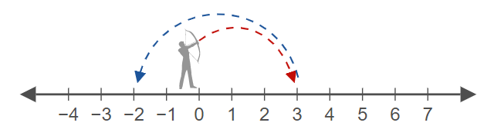
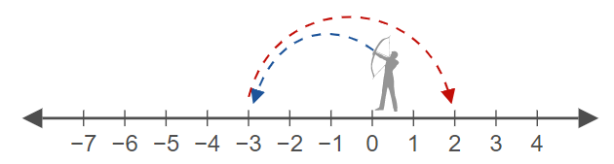
Addition: Case 3₁
Case 3: Adding one positive and one negative number
Notes:
Case 3 is adding one positive and one negative number. Let’s use the number line representation again, and we’ll first consider positive 3 plus negative 5. You can see the person standing on zero shoot one arrow in the positive direction for 3 units and then shoot another arrow in the negative direction for 5 units, landing on negative 2. In the second example, notice we have the same problem, but the signs are reversed on the 3 and 5. Now, the person with the arrow shoots in the negative direction for 3 units and then in the positive direction for 5 units, landing on positive 2.

Slide 7
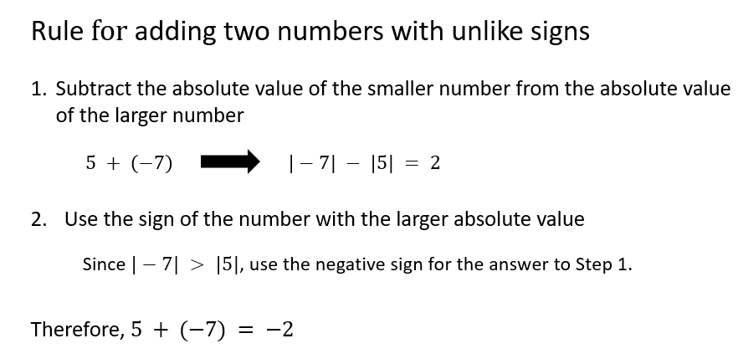
Addition: Case 3₂
Notes:
The rule for addition in this case--adding two numbers with unlike signs--has two steps. The first step is to subtract the absolute value of the smaller number from the absolute value of the bigger number. So, if the problem was to add 5 and negative 7, you would subtract the absolute value of 5, the smaller number, from the absolute value of negative 7. Then, in the second step, you would use the sign of the number with the larger absolute value for the final answer. In this example, since the absolute value of negative 7 is greater than the absolute value of 5, you would use the negative sign from the 7 for the answer from Step 1. Therefore, 5 plus negative 7 equals negative 2.

Slide 8
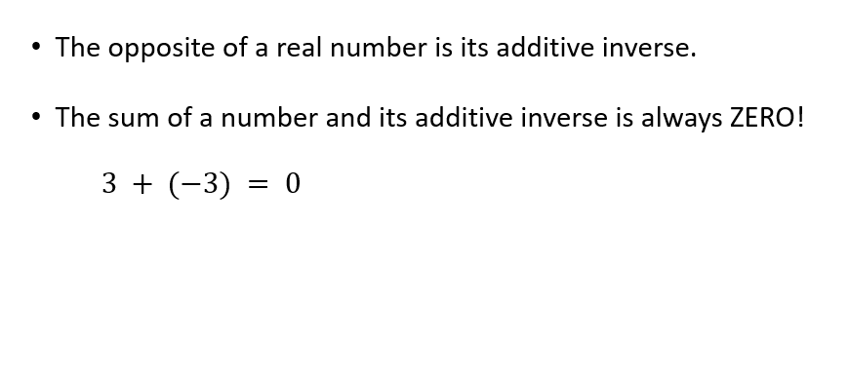
Additive Inverse
Notes:
The additive inverse is important in understanding subtraction. The opposite of a real number is called its additive inverse. Furthermore, the sum of a number plus its additive inverse is always zero. Therefore, 3 plus its additive inverse, negative 3, is equal to 0.

Slide 9
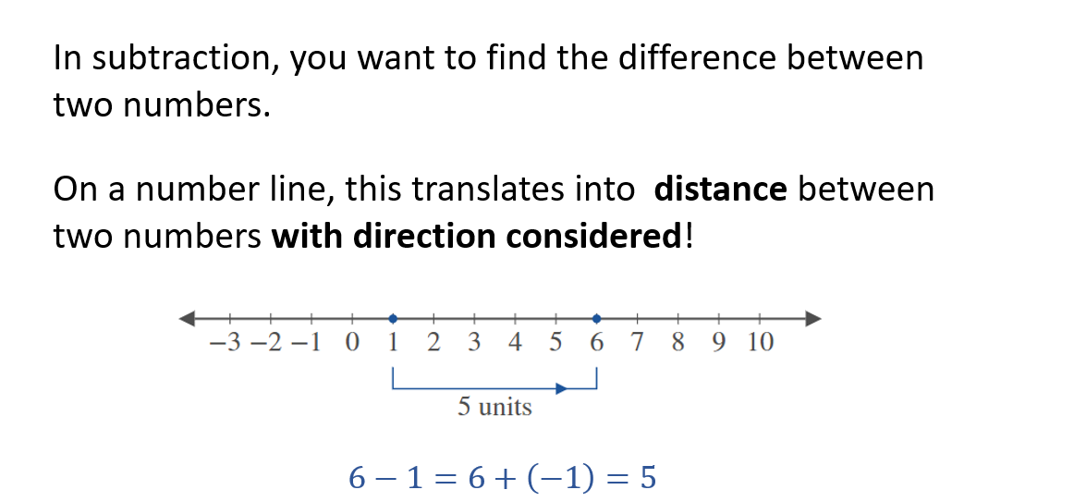
Subtraction₁
Notes:
Now, let’s talk about subtraction. In subtraction, you want to find the difference between two numbers. On a number line, this translates into the distance between two numbers with direction considered. This can easily be seen on a number. Here the problem “6 minus 1” is represented. You see that the distance between 1 and 6 is 5. You also see that the subtraction problem is really also an addition problem, with one positive and one negative number: 6 plus negative 1. Either way, “6 minus 1” or “6 plus negative 1” equals 5.

Slide 10
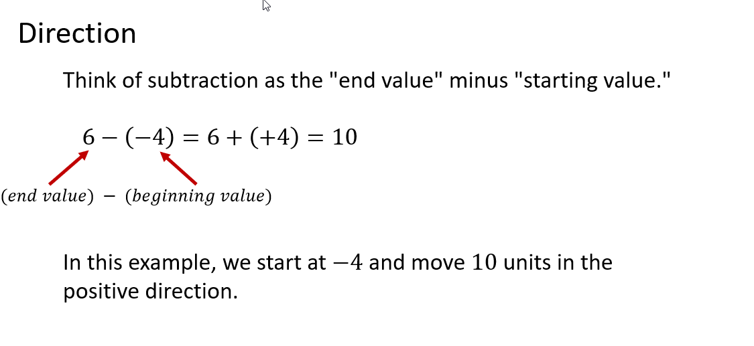
Subtraction₂
Notes:
To understand the direction aspect of the subtraction problem, you can think of subtraction as the end value minus the starting value. In the example of “6 minus negative 4,” you see that 6 is the end value, while negative 4 is the starting value. The difference is positive 10 because you move in the positive direction for 10 units to get to 6 if you are starting at negative 4.

Slide 11
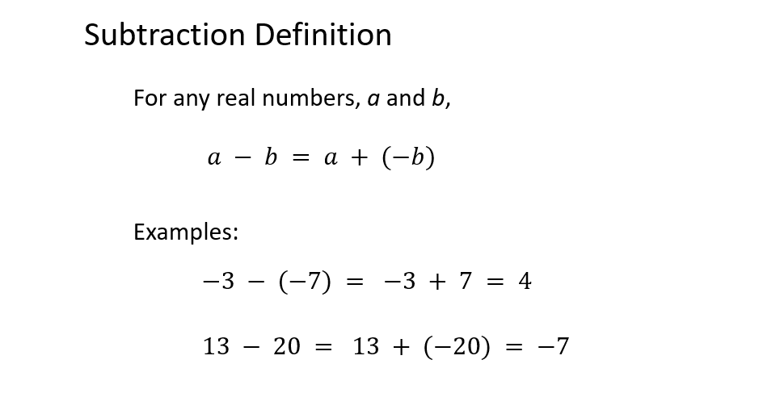
Subtraction₃
Notes:
That brings us to the official subtraction definition. For any real numbers a and b, a minus b is equal to a plus negative b. Here are two examples. “Negative 3 minus negative 7” is the same as “negative 3 plus 7,” and that equals 4. “13 minus 20” is the same as “13 plus negative 20,” and that equals negative 7.

Slide 12
Application: Change in Value₁
$$Change in Value = Final Value − Initial Value$$
Notes:
Let’s close this lesson by looking at an application of subtraction: a change in value. So, a change in value is simply equal to the final value minus the initial value.

Slide 13
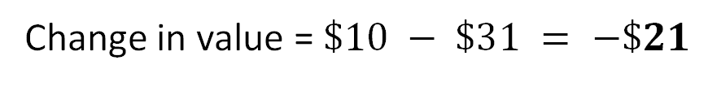
Application: Change in Value₂
Example
Suppose the price of one share of GE stock went from about $31 per share to $10 per share over three years. What is the change in value of GE's stock price?
Given: Initial Value = $31, Final Value = $10
Change in value = $\$10 − \$31 = −\$21$
Notes:
Here is an example. Suppose the price of one share of GE (or General Electric) stock went from about $31 per share to $10 per share over 3 years. What is the change in value of GE’s stock price? Let’s first write down the given information. The initial value is $31. The final value is $10. The change in value is therefore $10 minus $31, which is equal to negative $21. So, GE’s stock price lost $21 of value over 3 years.

Slide 14




Hawkes Learning
HAWKES LEARNING

