Slide 1
How Individuals Make Choices Based on Their Budget Constraint
HAWKES LEARNING

Slide 2

Choice in a World of Scarcity₁
Economics is ultimately concerned with how individuals and society choose to allocate resources. Why is it that not everyone can have everything they want or need?
Notes:
Economics is ultimately concerned with how individuals and society choose to allocate resources. Why is it that not everyone can have everything that they want or need?

Slide 3
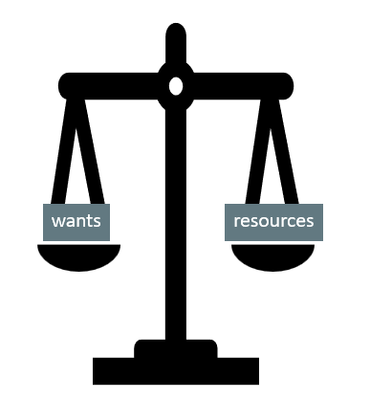
Choice in a World of Scarcity₂
We have unlimited wants and limited resources to fulfill them.
People live in a world of scarcity, meaning neither individuals nor societies can have all the time, money, possessions, and experiences they wish.
Notes:
The fundamental problem of economics is that we generally have unlimited wants and limited resources to fulfill our wants. In other words, we are faced with the problem of scarcity, meaning neither individuals nor societies can have all the time, money, possessions and experiences they wish.

Slide 4
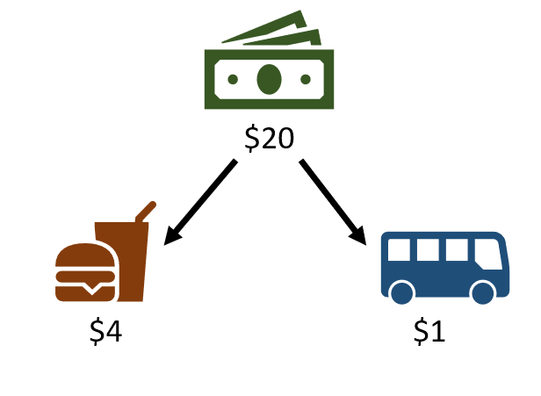
How Do Individuals Make Decisions?
Notes:
Suppose you have $20 of spending money each week that you can split up to buy burgers and bus tickets. Burgers cost $4 each, and bus tickets cost $1 each. What combinations of the two goods can you buy?

Slide 5
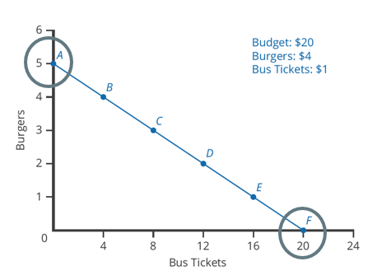
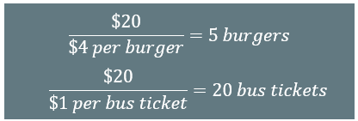
Axis Values
Notes:
Graphing burgers on the vertical axis, the maximum amount of burgers you could buy each week would be found by taking the amount you have to spend, or $20, divided by the price of burgers, which is $4. So, if you spent all your money on burgers, you could buy five burgers each week. Alternatively, if you spent all your money on bus tickets, you could purchase 20 tickets, which is found by dividing $20 by the cost of a bus ticket, which is $1.

Slide 6
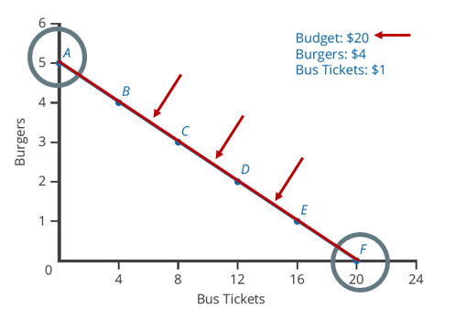
Budget Constraint: Burgers vs. Bus Tickets
A budget constraint shows the possible combinations of two goods that are affordable given an individual’s limited income.
Any point along the budget constraint represents an affordable combination of burgers and bus tickets given a $20 budget.
Notes:
Connecting these points gives the budget constraint. A budget constraint shows the possible combinations of two goods that are affordable given an individual’s limited income. Any point along the budget constraint represents a combination of burgers and bus tickets that you can purchase given the price of each good and a $20 budget. Any point outside of the budget constraint is unaffordable.

Slide 7
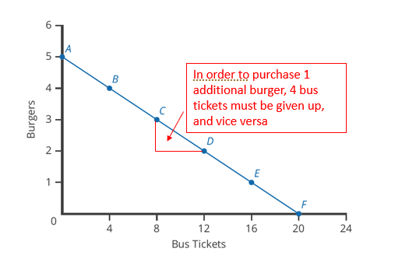
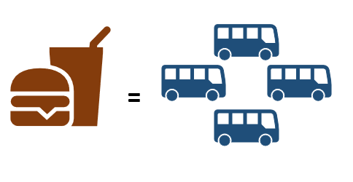
Slope of the Budget Constraint
The slope of a budget constraint gives opportunity cost, or what one must give up of the next best alternative to obtain what he or she desires.
The opportunity cost of a burger is the 4 bus tickets that must be given up, as the $4 spent on a burger could have bought 4 bus tickets.
Notes:
The relative prices of the two goods will determine the slope of your budget constraint. The slope represents the opportunity cost of trading off one good for the other. Opportunity cost represents what one must give up of the next best alternative to obtain what he or she desires. Moving to a different point on a budget constraint represents purchasing a different quantity of the goods represented. Purchasing more of one good means giving up the opportunity to purchase more of the other good. In this case, the opportunity cost of purchasing a $4 burger is the four $1 bus tickets that could have been purchased.

Slide 8
On Your Own₁
Suppose you have a budget of $468. If you spend it all on ice cream, you can buy 120 pints of ice cream. If the price of a glass of lemonade is 3 times less than the price of ice cream, how much lemonade can you buy if you decide to spend all your money on it?
Notes:
Suppose you have a budget of $468. If you spend it all on ice cream, you can buy 120 pints of ice cream. If the price of a glass of lemonade is 3 times less than the price of ice cream, how much lemonade can you buy if you decide to spend all your money on it?

Slide 9



On Your Own₂
1. Start by calculating the price of ice cream. If $468 can buy 120 pints, the price per pint can be calculated as follows:
2. Given that the price of a glass of lemonade is 3 times less than a pint of ice cream, the price per glass can be calculated as follows:
3. Finally, to calculate how many glasses of lemonade could be bought at a price of $1.30 per glass, divide the total budget by the price per glass:
Notes:
Start by calculating the price of ice cream. If $468 can buy 120 pints, the price per pint is $3.90. Then, given that the price of a glass of lemonade is 3 times less than a pint of ice cream, the price per glass is $1.30. Finally, to calculate how many glasses of lemonade could be bought at a price of $1.30 per glass, divide the total budget by the price per glass. This gives you 360 glasses of lemonade.

Slide 10
Opportunity Cost
Opportunity cost is often expressed as the price of something, but price may not always accurately capture the true opportunity cost.
Opportunity cost includes all lost opportunity to do or consume something else.
Opportunity cost encompasses many things, including monetary cost, time lost, and experiences that one could have had.
For example, attending college includes not only tuition costs, but also the foregone opportunity to do something else, like work a paying job.
Notes:
Opportunity cost is often expressed as the price of something, but price may not always accurately capture the true opportunity cost. Opportunity cost encompasses all lost opportunity to do or consume something else. For example, attending college not only costs money, but you are also foregoing the opportunity to do something else like work a paying job. In economics, we consider the cost of time and other factors, too.

Slide 11
Real-World Discussion
Think about how you make decisions given scarcity.
There are only 24 hours in a day. You get to choose how you want to use those hours. You choose how many hours you want to spend sleeping, how many hours you want to spend studying, how many hours you want to hang out with friends, etc. There may be consequences for those choices, but ultimately, the decision is up to you.
Now, consider opportunity cost. What is the opportunity cost of choosing to spend one hour sleeping?
Notes:
Think about how you make decisions given scarcity. There are only 24 hours in a day. You get to choose how you want to use those hours. You choose how many hours you want to spend sleeping, how many hours you want to spend studying, how many hours you want to hang out with friends, etc. There may be consequences for those choices, but ultimately, the decision is up to you.
Now, consider opportunity cost. What is the opportunity cost of choosing to spend one hour sleeping?

Slide 12


Marginal Decision-Making and Diminishing Marginal Utility
Marginal analysis is the process of comparing the costs and benefits of choosing a little more or a little less of a good.
The optimal choice necessitates comparing how costs and benefits change from one option to another.
Notes:
When we consider the tradeoffs involved in making a choice to consume an additional bus ticket or burger, we are looking at the costs and benefits of that decision. This is known as marginal analysis, the process of comparing the costs and benefits of choosing a little more or a little less of a good. We often look at total costs and total benefits, when the optimal choice necessitates comparing how costs and benefits change from one option to another.

Slide 13
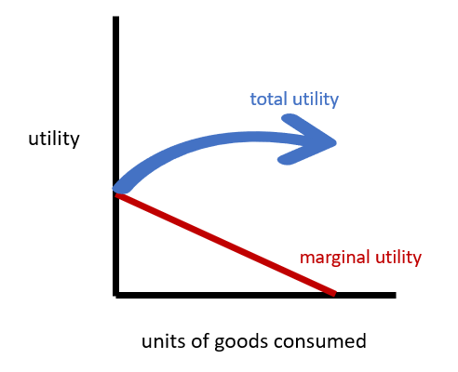
Utility
Utility refers to the satisfaction that a good or service provides.
The law of diminishing marginal utility states that as a person receives more of a good, the additional utility from each additional unit of the good declines.
Notes:
Satisfaction is referred to as utility in economics. Total utility usually increases at a decreasing rate. The law of diminishing marginal utility states that as a person receives more of a good, the additional utility from each additional unit of the good declines.

Slide 14
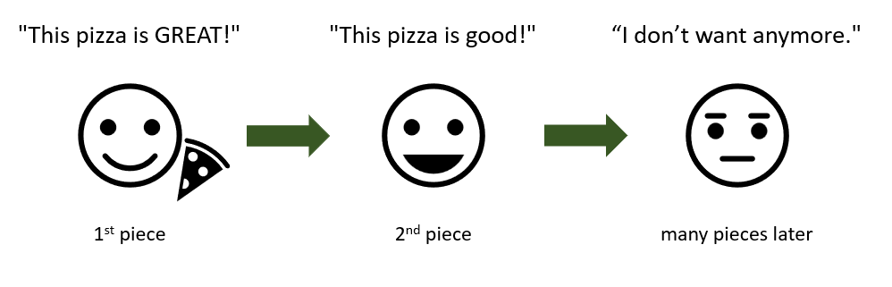
Diminishing Marginal Utility
Notes:
Think of ordering pizza by the slice. The first piece of pizza usually tastes the best, giving you the most utility. The second piece still tastes great, but it is usually not as wonderful as that first slice of pizza. After several more slices, your marginal utility declines quickly, as eating more pizza could cause you to feel worse. This is known as diminishing marginal utility.

Slide 15


Sunk Costs
Sunk costs are costs that were incurred in the past that cannot be recovered.
Dealing with failing sunk costs can be frustrating, as people and firms often don’t wish to admit an error in judgement.
Firms may find it hard to give up on a new product that is doing poorly because they spent so much money in creating the product.
The lesson of sunk costs is to ignore them and make decisions based on what may happen in the future.
Notes:
Sunk costs are costs that were incurred in the past and cannot be recovered. Dealing with failing sunk costs can be frustrating, as people and firms often don’t wish to admit an error in judgement. The lesson of sunk costs is to ignore them and make decisions based on what may happen in the future. Your decision-making about future consumption (or production) should not include sunk costs.

Slide 16
Summary
People live in a world of scarcity, meaning neither individuals nor societies can have all the time, money, possessions, and experiences they wish.
A budget constraint shows the possible combinations of two goods that are affordable given an individual’s limited income.
Opportunity cost is what one must give up of the next best alternative to obtain what he or she desires, also the slope of a budget constraint.
Utility refers to the satisfaction that a good or service provides, which diminishes as a person receives more of a good, known as diminishing marginal utility.
Sunk costs are costs that were incurred in the past that cannot be recovered.
Notes:
People live in a world of scarcity, meaning neither individuals nor societies can have all the time, money, possessions, and experiences they wish.
A budget constraint shows the possible combinations of two goods that are affordable given an individual’s limited income.
Opportunity cost is what one must give up of the next best alternative to obtain what he or she desires, also the slope of a budget constraint.
Utility refers to the satisfaction that a good or service provides, which diminishes as a person receives more of a good, known as diminishing marginal utility.
Sunk costs are costs that were incurred in the past that cannot be recovered.

Slide 17




HAWKES LEARNING

