Slide 1
Demand and Supply Shifts in Foreign Exchange Markets
HAWKES LEARNING

Slide 2
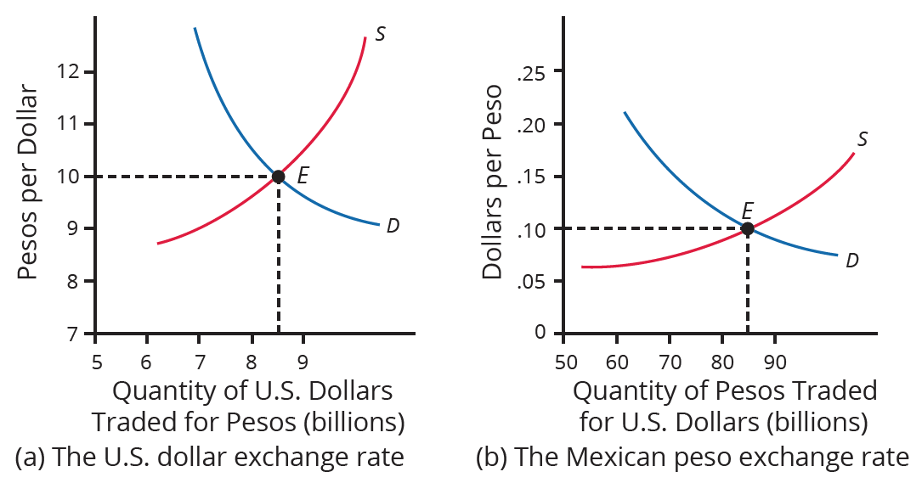
Introduction
The foreign exchange market involves firms, households, and investors coming together through banks and key foreign exchange dealers to demand and supply currencies. Consider an example of the exchange rate between the U.S. dollar (USD) and the Mexican peso (MXN):
Notes:
The foreign exchange market involves firms, households, and investors coming together through banks and key foreign exchange dealers to demand and supply currencies. Consider an example of the exchange rate between the U.S. dollar (USD) and the Mexican peso (MXN):

Slide 3
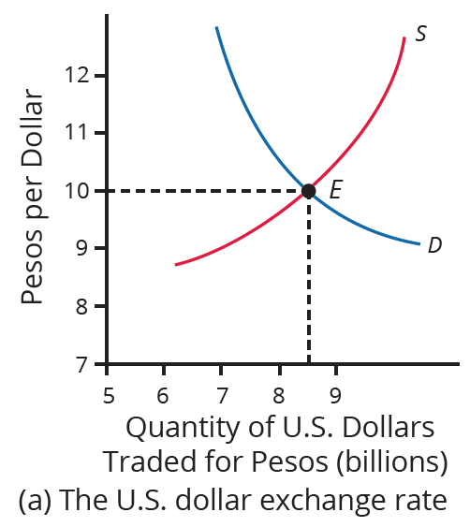
Dollar Exchange Rate
The vertical axis shows the exchange rate for U.S. dollars, measured in pesos.
The horizontal axis shows the quantity of U.S. dollars traded in the foreign exchange market for pesos.
The demand curve (D) for U.S. dollars intersects the supply curve (S) of U.S. dollars at the equilibrium point (E), which is an exchange rate of MXN 10 = USD 1 and a total volume of USD 8.5 billion.
Notes:
The vertical axis shows the exchange rate for U.S. dollars, measured in pesos. The horizontal axis shows the quantity of U.S. dollars traded in the foreign exchange market for pesos. The demand curve (D) for U.S. dollars intersects the supply curve (S) of U.S. dollars at the equilibrium point (E), which is an exchange rate of MXN10=USD1 and a total volume of USD8.5 billion.

Slide 4
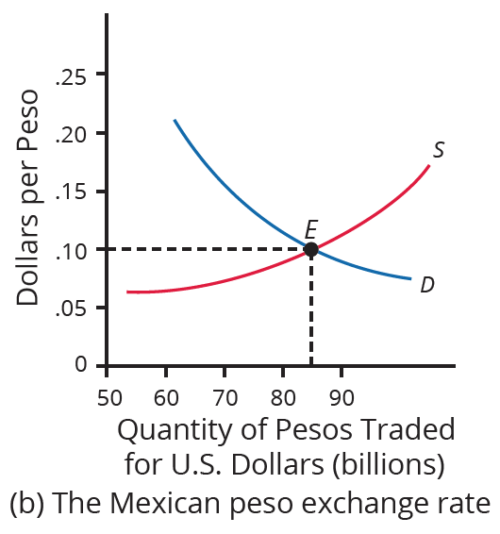
Peso Exchange Rate
The vertical axis shows the exchange rate for Mexican pesos, measured in U.S. dollars.
The horizontal axis shows the quantity of Mexican pesos traded in the foreign exchange market for dollars.
The demand curve (D) for Mexican pesos intersects the supply curve (S) of Mexican pesos at the equilibrium point (E), which is an exchange rate of USD 0.10 = MXN 1 and a total volume of MXN 85 billion.
Notes:
The vertical axis shows the exchange rate for Mexican pesos, measured in U.S. dollars. The horizontal axis shows the quantity of Mexican pesos traded in the foreign exchange market. The demand curve (D) for Mexican pesos intersects the supply curve (S) of Mexican pesos at the equilibrium point (E), which is an exchange rate of USD0.10=MXN1 and a total volume of MXN85 billion.

Slide 5
Dollars to Pesos
Note that the two exchange rates are inverses: MXN 10 = USD 1 is the same as USD 0.10 = MXN 1. In the actual foreign exchange market, almost all the trading of Mexican pesos is for U.S. dollars.
Notes:
Note that the two exchange rates are inverses: MXN10=USD1 is the same as USD0.10=MXN1. In the actual foreign exchange market, almost all the trading of Mexican pesos is for U.S. dollars.

Slide 6
Expectations about Future Exchange Rates
One reason to demand a currency on the foreign exchange market is the belief that the currency's value is about to increase.
One reason to supply (sell) a currency is the belief that the value is about to decrease.
In contrast to many other cases, supply and demand typically both move at the same time in the foreign exchange market.
Groups of participants in the foreign exchange market, like firms and investors, include some buyers and some sellers.
An expectation of a future shift in the exchange rate affects both buyers and sellers and, consequently, demand and supply.
Notes:
One reason to demand a currency on the foreign exchange market is the belief that the currency's value is about to increase. One reason to supply (sell) a currency is the belief that the value is about to decrease. In contrast to many other cases, supply and demand typically both move at the same time in the foreign exchange market. Groups of participants in the foreign exchange market, like firms and investors, include some buyers and some sellers. An expectation of a future shift in the exchange rate affects both buyers and sellers and, consequently, demand and supply.

Slide 7
Speed of Shifts in Exchange Rates
When investors expect a country's currency to strengthen, they buy the currency and cause it to appreciate immediately.
This can make other investors believe that future increases in value are likely, leading to even greater appreciation.
Similarly, the expectation that a currency might weaken quickly leads to actual weakening of the currency, reinforcing the belief.
Beliefs about the future path of exchange rates can be self-reinforcing, at least for a time, and a large share of the trading in foreign exchange markets involves dealers trying to outguess each other.
Notes:
When investors expect a country's currency to strengthen, they buy the currency and cause it to appreciate immediately. This can make other investors believe that future increases in value are likely, leading to even greater appreciation. Similarly, the expectation that a currency might weaken quickly leads to actual weakening of the currency, reinforcing the belief. Beliefs about the future path of exchange rates can be self-reinforcing, at least for a time, and a large share of the trading in foreign exchange markets involves dealers trying to outguess each other.

Slide 8
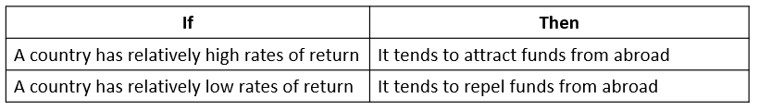
Differences in Rates of Return across Countries
The motivation for investment (domestic or foreign) is to earn a return.
When deciding where they will invest their funds, both businesses and countries consider the rate of returns in other countries.
Whether the exchange rate appears high or low will attract or repel foreign investment.
Notes:
The motivation for investment (domestic or foreign) is to earn a return. When deciding where they will invest their funds, both businesses and countries consider the rate of returns in other countries. Whether the exchange rate appears high or low will attract or repel foreign investment.

Slide 9
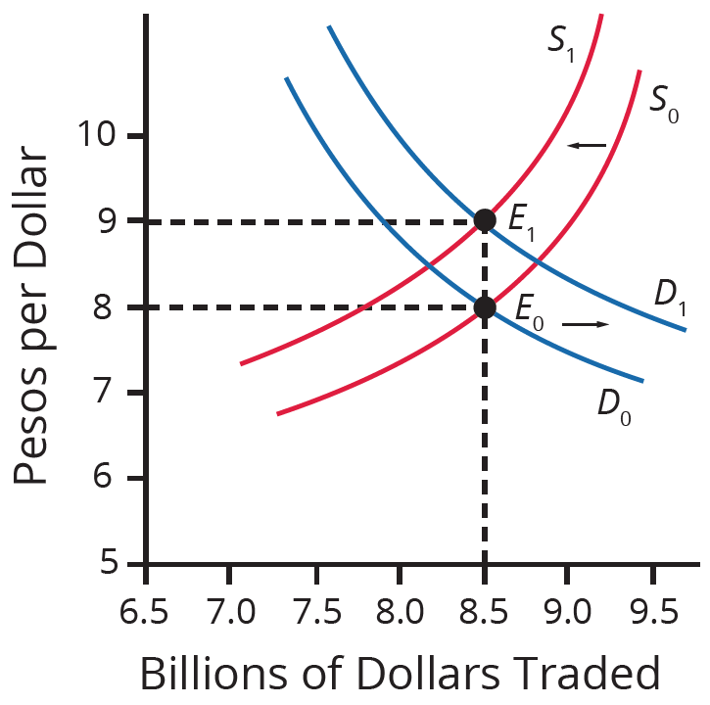
Higher Rate of Return
A higher rate of return for U.S. dollars makes holding dollars more attractive.
The demand for dollars in the foreign exchange market shifts right, from D₀ to D₁, while the supply of dollars shifts left, from S₀ to S₁.
The new equilibrium (E₁) has a stronger exchange rate than the original equilibrium (E₀), but in this example, the equilibrium quantity traded does not change.
Notes:
A higher rate of return for U.S. dollars makes holding dollars more attractive. The demand for dollars in the foreign exchange market shifts right, from D0 to D1, while the supply of dollars shifts left, from S0 to S1. The new equilibrium (E1) has a stronger exchange rate than the original equilibrium (E0), but in this example, the equilibrium quantity traded does not change.

Slide 10
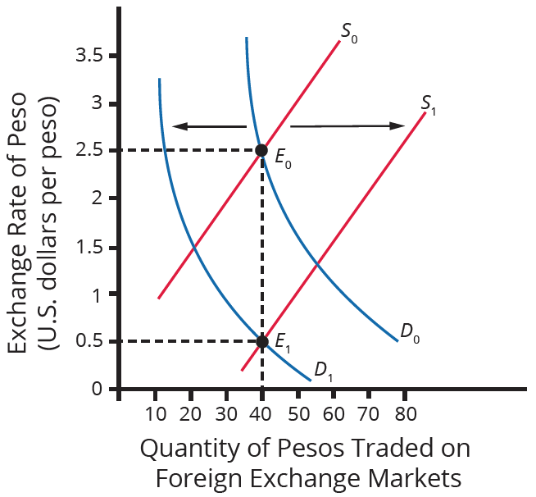
Relative Inflation
If a country experiences a relatively high inflation rate compared to other economies, the buying power of its currency is eroding.
This tends to discourage anyone from acquiring or holding the currency.
A rise in inflation for the Mexican peso caused demand to shift left from D₀ to D₁ and supply to shift right from S₀ to S₁.
Both movements caused the currency to depreciate.
Notes:
If a country experiences a relatively high inflation rate compared to other economies, the buying power of its currency is eroding. This tends to discourage anyone from acquiring or holding the currency. A rise in inflation for the Mexican peso caused demand to shift left from D0 to D1 and supply to shift right from S0 to S1. Both movements caused the currency to depreciate.

Slide 11
Purchasing Power Parity
Over the long term, exchange rates must bear some relationship to the currency's buying power in terms of internationally traded goods.
If the exchange rate in one country is cheaper than others, businesses will start buying in the cheaper country, sell to other countries, and pocket the profits.
The purchasing power parity (PPP) exchange rate equalizes the prices of internationally traded goods across countries.
Economists at the World Bank's International Comparison Program (ICP) have used studies of the prices and quantities of internationally tradable goods to calculate the PPP exchange rate for all countries.
Notes:
Over the long term, exchange rates must bear some relationship to the currency's buying power in terms of internationally traded goods. If the exchange rate in one country is cheaper than others, businesses will start buying in the cheaper country, sell to other countries, and pocket the profits. The purchasing power parity (PPP) exchange rate equalizes the prices of internationally traded goods across countries. Economists at the World Bank's International Comparison Program (ICP) have used studies of the prices and quantities of internationally tradable goods to calculate the PPP exchange rate for all countries.

Slide 12
Market Exchange Rates Versus Purchasing Power Parity
In October 2022, the exchange rate was JPY 148 = USD 1, but in December 2021, the exchange rate was JPY 113 = USD 1. For simplicity, say that Japan's GDP was JPY 500 trillion in both 2021 and 2022. If you use the market exchange rates, this would be Japan's GDP:
GDP in 2021 = $\frac{\text{JPY}\text{ 500 }\text{trillion}}{\text{JPY}\text{ 113}}$ = USD 4.42 trillion
GDP in 2022 = $\frac{\text{JPY}\text{ 500 }\text{trillion}}{\text{JPY}\text{ 148}}$ = USD 3.38 trillion
The misleading appearance of a changing Japanese economy occurs only because we used the market exchange rate, which often has short-run rises and falls. However, PPP exchange rates stay fairly constant and change minimally, if at all, from year to year.
Notes:
In October 2022, the exchange rate was JPY 148 = USD 1, but in December 2021, the exchange rate was JPY 113 = USD 1. For simplicity, say that Japan's GDP was JPY 500 trillion in both 2021 and 2022. If you use the market exchange rates, this would be Japan's GDP:
GDP in 2018 = "JPY 500 trillion" /"JPY 113" = USD 4.42 trillion
GDP in 2019 = "JPY 500 trillion" /"JPY 148" = USD 3.38 trillion
The misleading appearance of a changing Japanese economy occurs only because we used the market exchange rate, which often has short-run rises and falls. However, PPP exchange rates stay fairly constant and change minimally, if at all, from year to year.

Slide 13


On Your Own₁
Suppose that the current exchange rate for the Canadian dollar (CAD) is USD 0.75. The inflation rate in the U.S. is 3%, and the inflation rate in Canada is 1%. Explain what will happen to the exchange rate for Canadian dollars.
Notes:
Suppose that the current exchange rate for the Canadian dollar (CAD) is USD 0.75. The inflation rate in the U.S. is 3%, and the inflation rate in Canada is 1%. Explain what will happen to the exchange rate for Canadian dollars.

Slide 14
On Your Own₂
Suppose that the current exchange rate for the Canadian dollar (CAD) is USD 0.75. The inflation rate in the U.S. is 3%, and the inflation rate in Canada is 1%. Explain what will happen to the exchange rate for Canadian dollars.
Since the inflation rate is lower in Canada than in the U.S., Canadian dollars have more purchasing power. Investors will increase their demand for Canadian dollars and decrease the supply of Canadian dollars. As a result, the Canadian dollar will appreciate above CAD 1 = USD 0.75. This means that the U.S. dollar will depreciate.
Notes:
Suppose that the current exchange rate for the Canadian dollar (CAD) is USD 0.75. The inflation rate in the U.S. is 3%, and the inflation rate in Canada is 1%. Explain what will happen to the exchange rate for Canadian dollars. Since the inflation rate is lower in Canada than in the U.S., Canadian dollars have more purchasing power. Investors will increase their demand for Canadian dollars and decrease the supply of Canadian dollars. As a result, the Canadian dollar will appreciate above CAD 1 = USD 0.75. This means that the U.S. dollar will depreciate.

Slide 15
Summary
In the extreme short run, ranging from a few minutes to a few weeks, exchange rates are influenced by speculators who try to invest in currencies that will appreciate and sell currencies that will depreciate.
In the relatively short run, differences in rates of return influence exchange rate markets.
Countries with relatively high real rates of return (for example, high interest rates) tend to experience stronger currencies as they attract money from abroad, while countries with relatively low rates of return tend to experience weaker exchange rates as investors convert to other currencies.
In the medium run of a few months or a few years, inflation rates influence exchange rate markets.
Over long periods of many years, exchange rates tend to adjust toward the purchasing power parity (PPP) rate.

Slide 16




HAWKES LEARNING

