Slide 1
Section 4.6
Applications: Distance-Rate-Time, Interest, Average, and Cost

Slide 2
Example 1: Application: Solving Distance-Rate-Time Problems
A brother and sister leave a family reunion at the
same time and drive their cars in opposite directions. The brother’s speed is 50 mph and the sister’s speed
is 65 mph. When will they be 460 miles apart?
Solution
Let t = travel time.

Slide 3
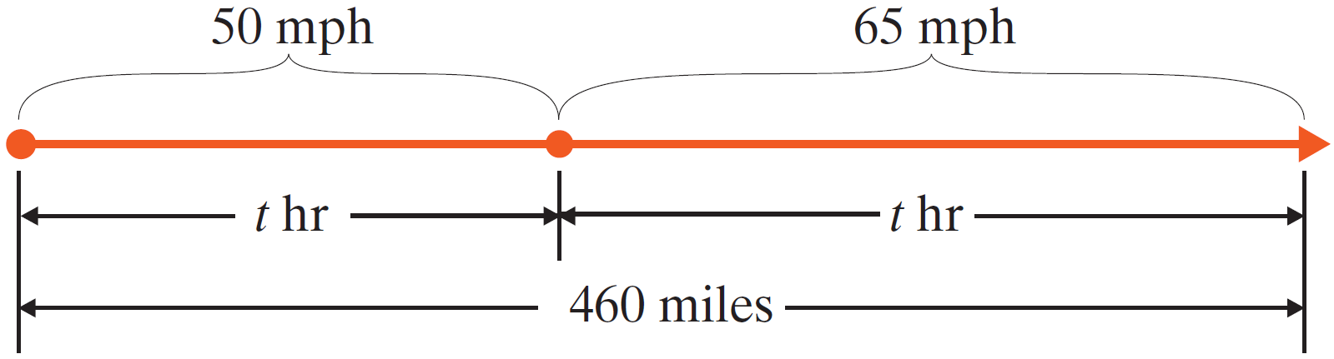
Example 1: Application: Solving Distance-Rate-Time Problems (cont.)
Rate • Time = Distance
Brother’s trip | 50 | ⋅ | t | = | 50t
Sister’s trip | 65 | ⋅ | t | = | 65t

Slide 4
Example 1: Application: Solving Distance-Rate-Time Problems (cont.)
The brother and sister will be 460 miles apart in 4 hours.

Slide 5
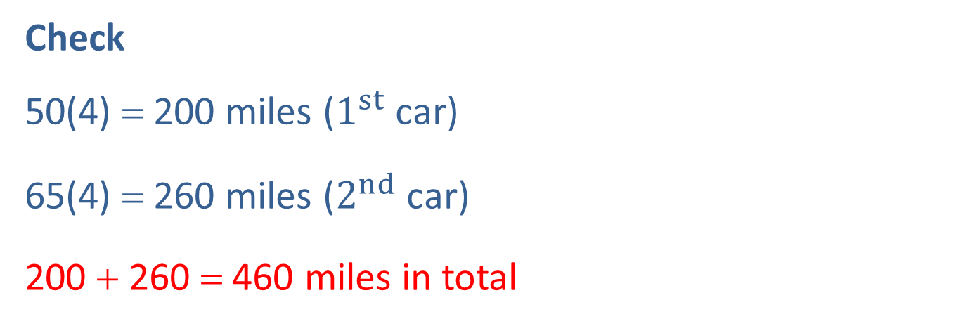
Example 1: Application: Solving Distance-Rate-Time Problems (cont.)
Check
50(4) = 200 miles ($1^{st}$ car)
65(4) = 260 miles ($2^{nd}$ car)
200 + 260 = 460 miles in total

Slide 6
Example 2: Application: Solving Distance-Rate-Time Problems
A motorist averaged 45 mph for the first part of a trip and 54 mph for the last part of the trip. If the total trip of 303 miles took 6 hours, what was the time for each part?
Solution
Total time minus time for 1st part of the trip is equal to the time for the 2nd part.

Slide 7
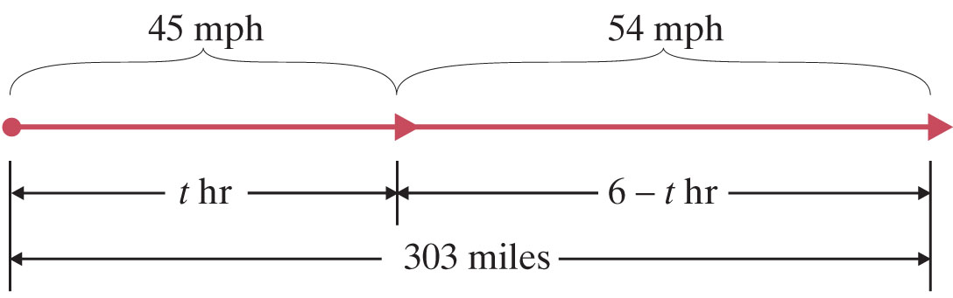
Example 2: Application: Solving Distance-Rate-Time Problems (cont.)
Let t = time for 1st part of trip
6 − t = time for 2nd part of trip
Rate • Time = Distance
1st Part | 45 | ⋅ | t | = | 45t
2nd Part | 54 | ⋅ | 6 − t | = | 54(6 – t)

Slide 8
Example 2: Application: Solving Distance-Rate-Time Problems (cont.)

Slide 9
Example 2: Application: Solving Distance-Rate-Time Problems (cont.)
The first part took
The second part took
Check
105 + 198 = 303 miles in total

Slide 10
Example 3: Application: Solving
Interest Problems
Kara has had $40,000 invested for one year, some in a savings account which paid 7% and the rest in a high-risk stock which yielded 12% for the year. If her interest income last year was $3550, how much did she have in the savings account and how much did she invest in the stock?

Slide 11
Example 3: Application: Solving
Interest Problems (cont.)
Solution
Let x = amount invested at 7%
40,000 − x = amount invested at 12%
Principal . Rate = Interest
Savings Account | x | . | 0.07 | = | 0.07(x)
Stock | 40,000 – x | . | 0.12 | = | 0.12(40,000 – x)

Slide 12
Example 3: Application: Solving
Interest Problems (cont.)

Slide 13
Example 3: Application: Solving
Interest Problems (cont.)
Kara had $25,000 in the savings account at 7% interest and $15,000 in the high-risk stock at 12% interest.
Check
25,000(0.07) = 1750 and 15,000(0.12) = 1800
and $1750 + $1800 = $3550

Slide 14
Example 4: Application: Finding The Average
(or Mean)
Suppose that you have scores of 85, 92, 82, and 88 on four exams in your English class. What score will you need on the fifth exam to have an average of 90?
Solution
Let x = your score on the fifth exam.
The sum of all the scores, including the unknown fifth exam, divided by 5 must equal 90.

Slide 15
Example 4: Application: Finding The Average
(or Mean) (cont.)
Assuming that each exam is worth 100 points, you cannot attain an average of 90 on the five exams.

Slide 16
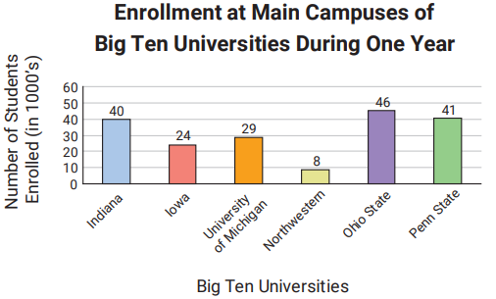
Example 5: Application: Using Bar Graphs
The bar graph shows the undergraduate enrollment at the main campuses at six Big Ten universities during a certain year. Use the graph to find the following. (Note that the units on the graph are in thousands.)

Slide 17
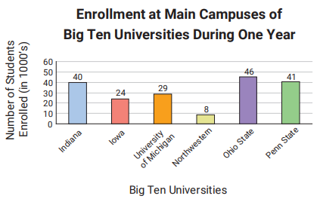
Example 5: Application: Using Bar Graphs (cont.)
Find the average
enrollment over the
six schools. (Round to
the nearest thousand.)
Which university had
the lowest enrollment?
Find the difference in
enrollment between
Ohio State and
Penn State.

Slide 18
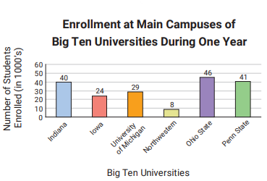
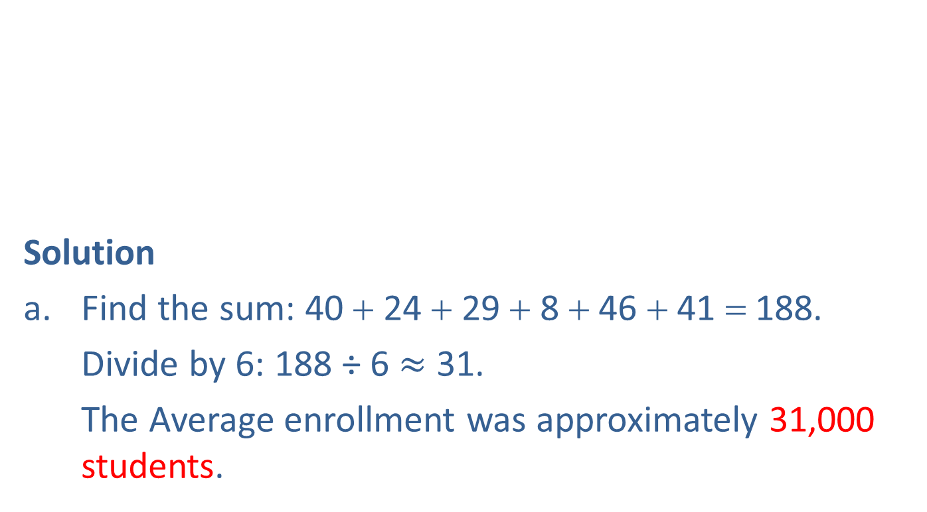
Example 5: Application: Using Bar Graphs (cont.)
Solution
a. Find the sum: 40 + 24 + 29 + 8 + 46 + 41 = 188.
Divide by 6: 188 ÷ 6 $≈$ 31.
The Average enrollment was approximately 31,000 students.

Slide 19
Example 5: Application: Using Bar Graphs (cont.)
b. Northwestern had the lowest enrollment with 8000
students.
The difference was
46,000 − 41,000 = 5000 students.

Slide 20
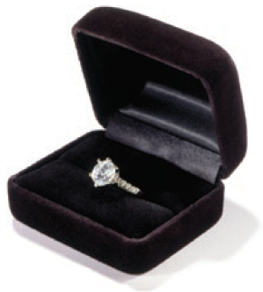
Example 6: Application: Calculating Cost
A jeweler paid $350 for a ring. He wants to price the ring for sale so that he can give a 30% discount on the marked selling price and still make a profit of 20% on his cost. What should be the marked selling price of the ring?
Solution
We make use of the relationship
S − C = P (Selling price − Cost = Profit).
Let x = marked selling price.
Then x − 0.30x = actual selling price and 350 = cost.

Slide 21
Example 6: Application: Calculating Cost (cont.)
The jeweler should set the selling price at $600.

Slide 22
Example 6: Application: Calculating Cost (cont.)
Check
-$350

Slide 23

Example 6: Application: Calculating Cost (cont.)
As a double check,
$\$350$
$×0.20$
$\$70$

