Slide 1
Section 2.4
Measures of Dispersion and Percentiles

Slide 2
Definition: Range
The range is the difference between the largest value and smallest value in a data set.

Slide 3
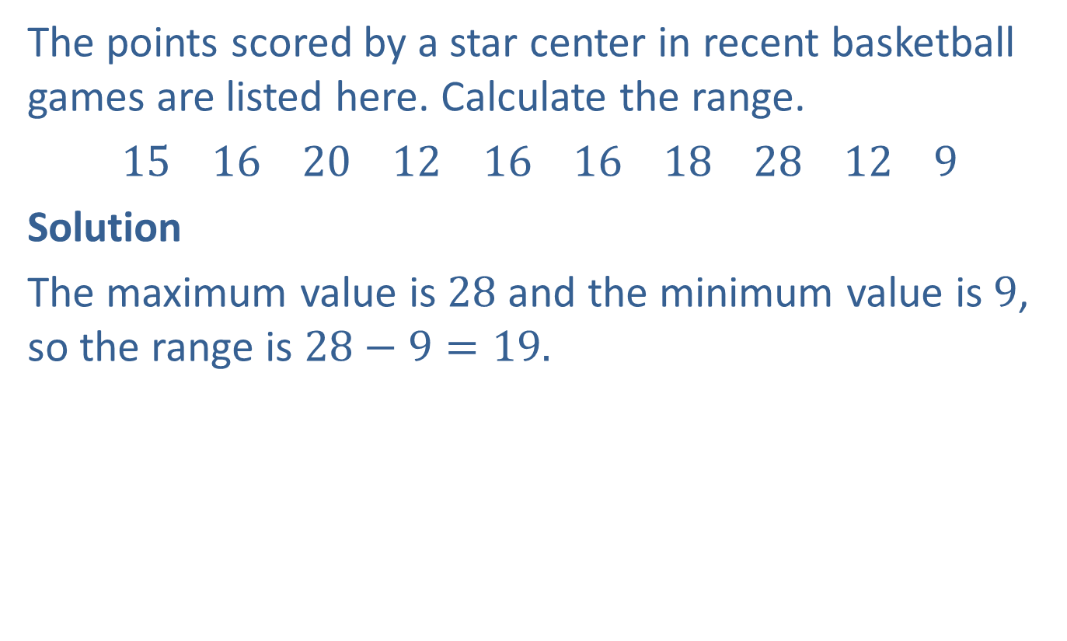
Example 1: Finding the Range
The points scored by a star center in recent basketball games are listed here. Calculate the range.
15 16 20 12 16 16 18 28 12 9
Solution
The maximum value is $28$ and the minimum value is $9$, so the range is $28−9=19.$

Slide 4
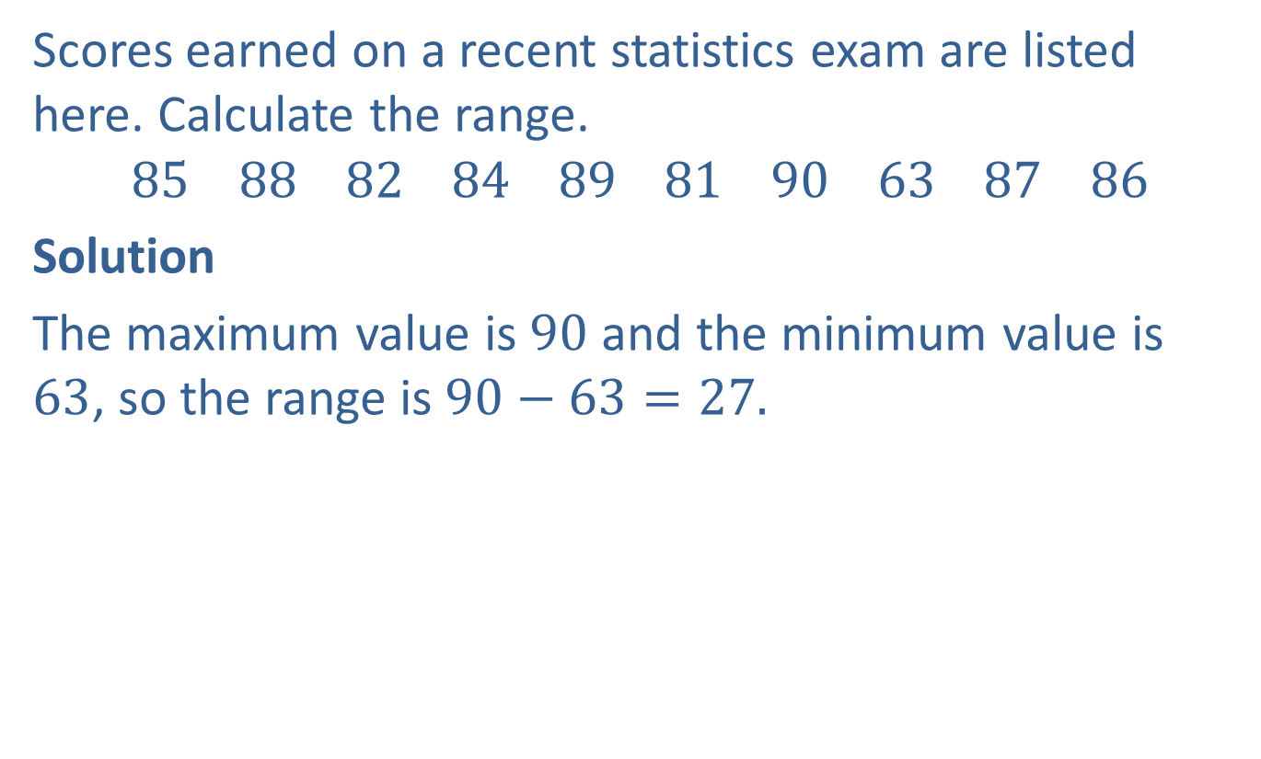
Example 2: Finding the Range
Scores earned on a recent statistics exam are listed here. Calculate the range.
$$85 88 82 84 89 81 90 63 87 86$$
Solution
The maximum value is $90$ and the minimum value is $63$, so the range is $90−63=27.$

Slide 5
Note
It is important to note that the formula for standard deviation differs for samples and populations. We will only consider samples here.

Slide 6
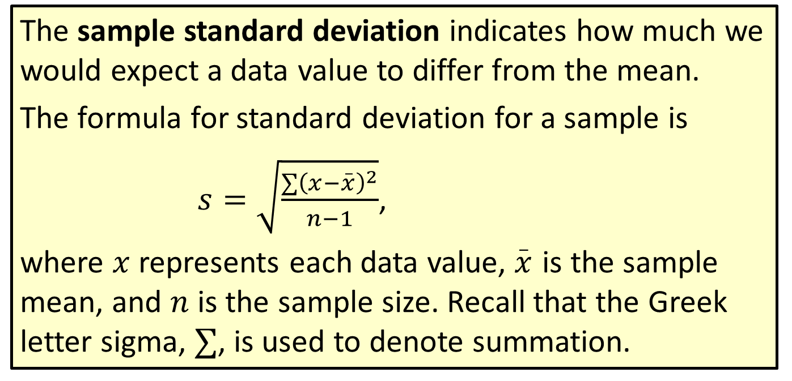
Formula: Sample Standard Deviation
The sample standard deviation indicates how much we would expect a data value to differ from the mean.
The formula for standard deviation for a sample is
$s=\sqrt{\frac{∑{\left(x−\overset{_}{x}\right)}^{2}}{n−1}}$,
where $x$ represents each data value, $\overset{_}{x}$ is the sample mean, and $n$ is the sample size. Recall that the Greek letter sigma, $∑$, is used to denote summation.

Slide 7
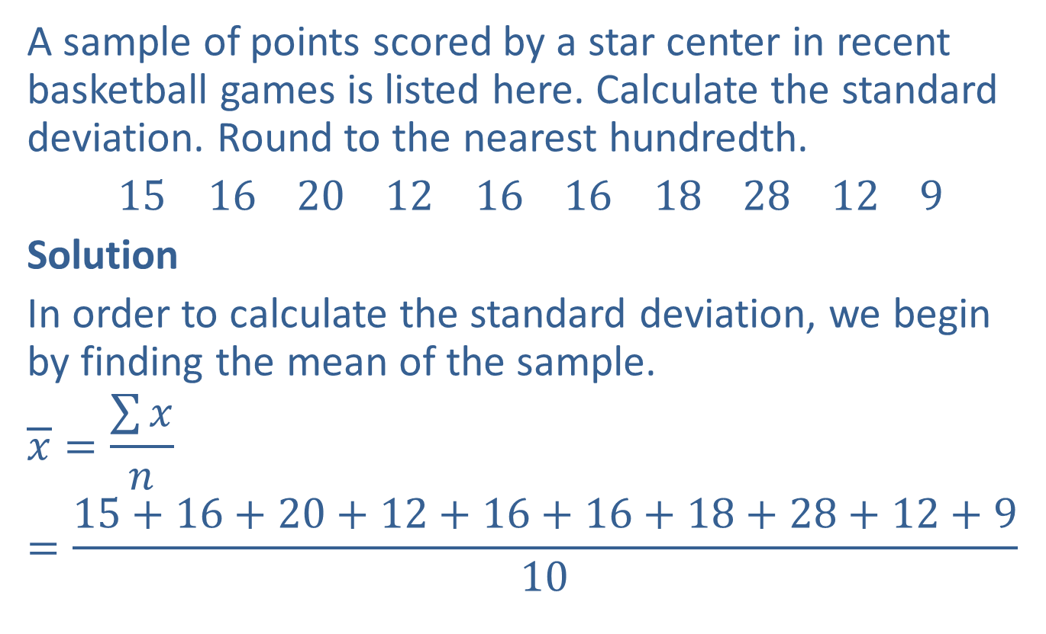
Example 3: Finding the Standard Deviation
A sample of points scored by a star center in recent basketball games is listed here. Calculate the standard deviation. Round to the nearest hundredth.
15 16 20 12 16 16 18 28 12 9
Solution
In order to calculate the standard deviation, we begin by finding the mean of the sample.
$$\overline{x}=\frac{\sum{x}}{n}=\frac{15+16+20+12+16+16+18+28+12+9}{10}$$

Slide 8
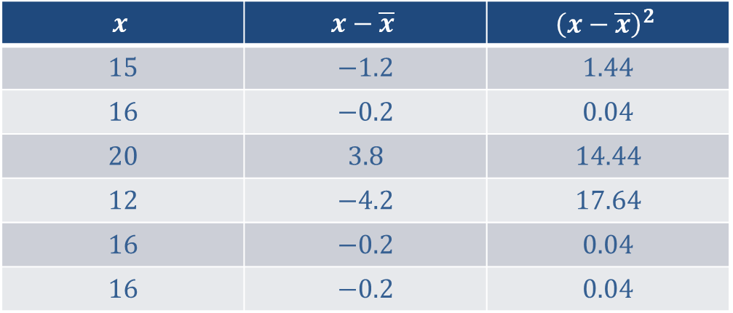

Example 3: Finding the Standard Deviation (cont.)
$$=\frac{162}{10}=16.2$$
The mean is $16.2.$
When calculating the standard deviation, it is helpful to use a table to keep the numbers organized.
$$x$$ | $$x−\overline{x}$$ | $${\left(x−\overline{x}\right)}^{2}$$
$$15$$ | $$−1.2$$ | $$1.44$$
$$16$$ | $$−0.2$$ | $$0.04$$
$$20$$ | $$3.8$$ | $$14.44$$
$$12$$ | $$−4.2$$ | $$17.64$$
$$16$$ | $$−0.2$$ | $$0.04$$
$$16$$ | $$−0.2$$ | $$0.04$$

Slide 9
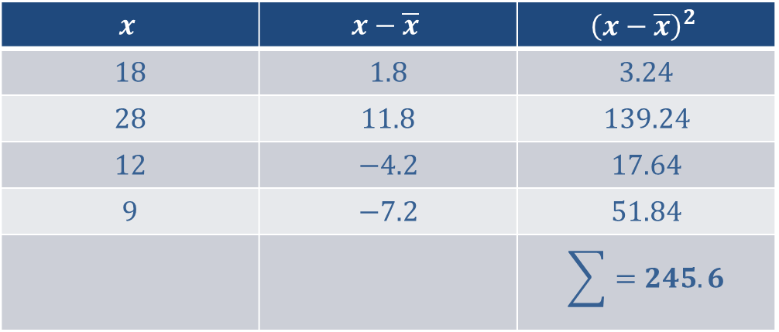

Example 3: Finding the Standard Deviation (cont.)
Now that the table is complete, we are ready to substitute values into the standard deviation formula.
$$s=\sqrt{\frac{\sum{{\left(x−\overline{x}\right)}^{2}}}{n−1}}$$
$$x$$ | $$x−\overline{x}$$ | $${\left(x−\overline{x}\right)}^{2}$$
$$18$$ | $$1.8$$ | $$3.24$$
$$28$$ | $$11.8$$ | $$139.24$$
$$12$$ | $$−4.2$$ | $$17.64$$
$$9$$ | $$−7.2$$ | $$51.84$$
 |  | $$\sum{=245.6}$$

Slide 10
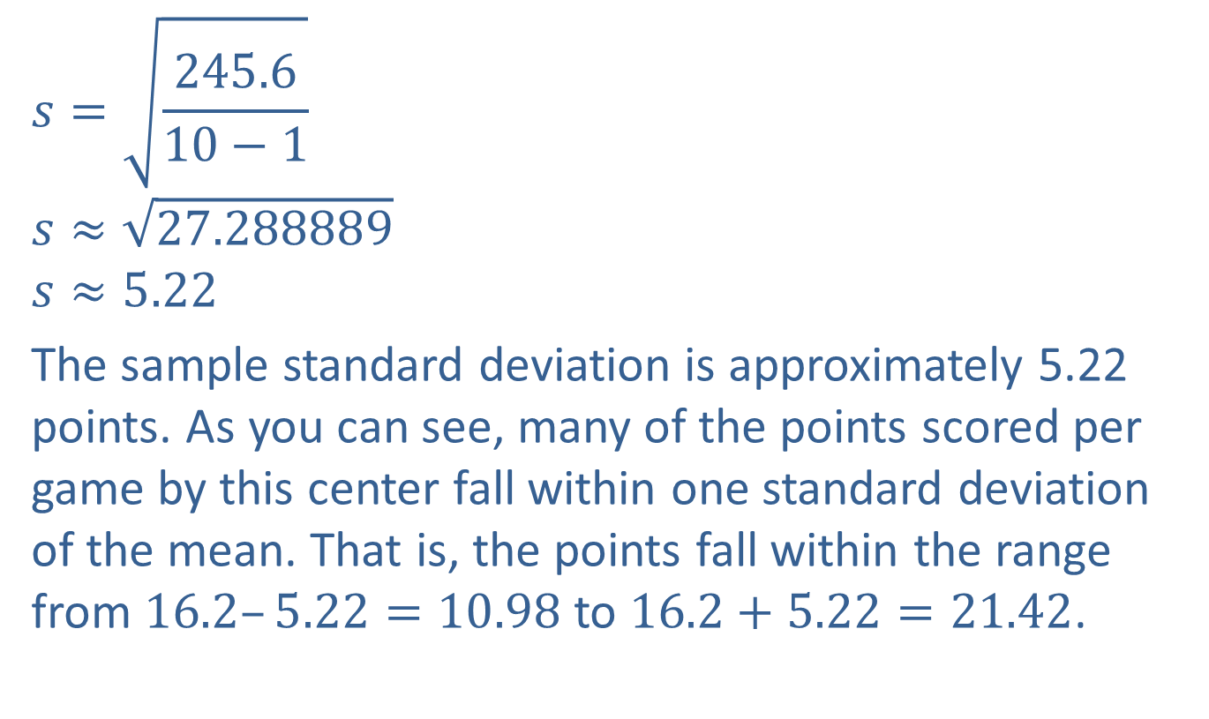
Example 3: Finding the Standard Deviation (cont.)
$$s=\sqrt{\frac{245.6}{10−1}}$$
$$s≈\sqrt{27.288889}$$
$$s≈5.22$$
The sample standard deviation is approximately 5.22 points. As you can see, many of the points scored per game by this center fall within one standard deviation of the mean. That is, the points fall within the range from $16.2–5.22=10.98$ to $16.2+5.22=21.42$.

Slide 11
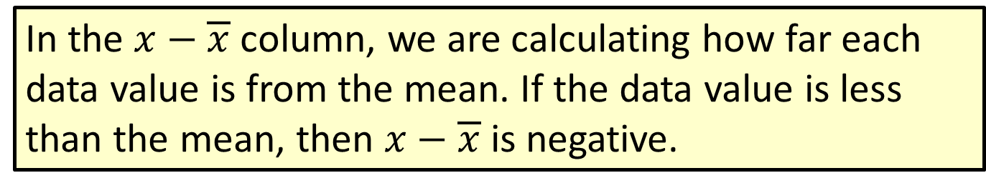
Note
In the $x−\overline{x}$ column, we are calculating how far each data value is from the mean. If the data value is less than the mean, then $x−\overline{x}$ is negative.

Slide 12
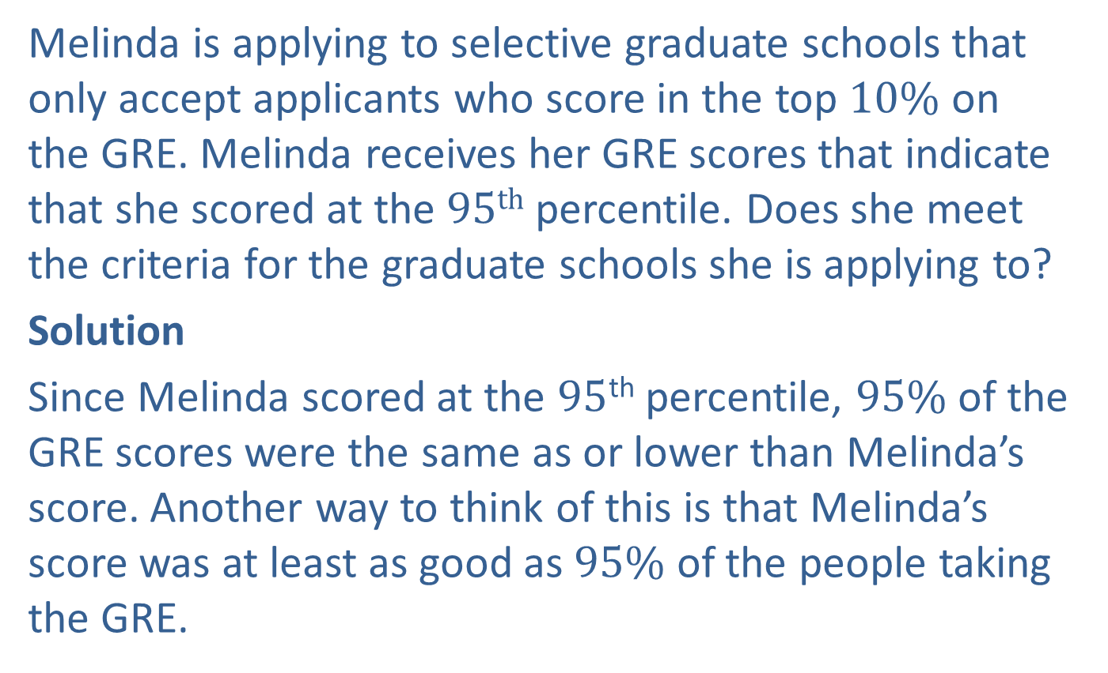
Example 4: Using Percentiles
Melinda is applying to selective graduate schools that only accept applicants who score in the top $10\%$ on the GRE. Melinda receives her GRE scores that indicate that she scored at the $95th$ percentile. Does she meet the criteria for the graduate schools she is applying to?
Solution
Since Melinda scored at the $95$^{th} percentile, $95\%$ of the GRE scores were the same as or lower than Melinda’s score. Another way to think of this is that Melinda’s score was at least as good as $95\%$ of the people taking the GRE.

Slide 13

Example 4: Using Percentiles (cont.)
This also means that only $5\%$ of the scores were better than Melinda’s score. As a result, her score is within the top $10\%$ and she meets the criteria for the graduate schools she is applying to.

Slide 14
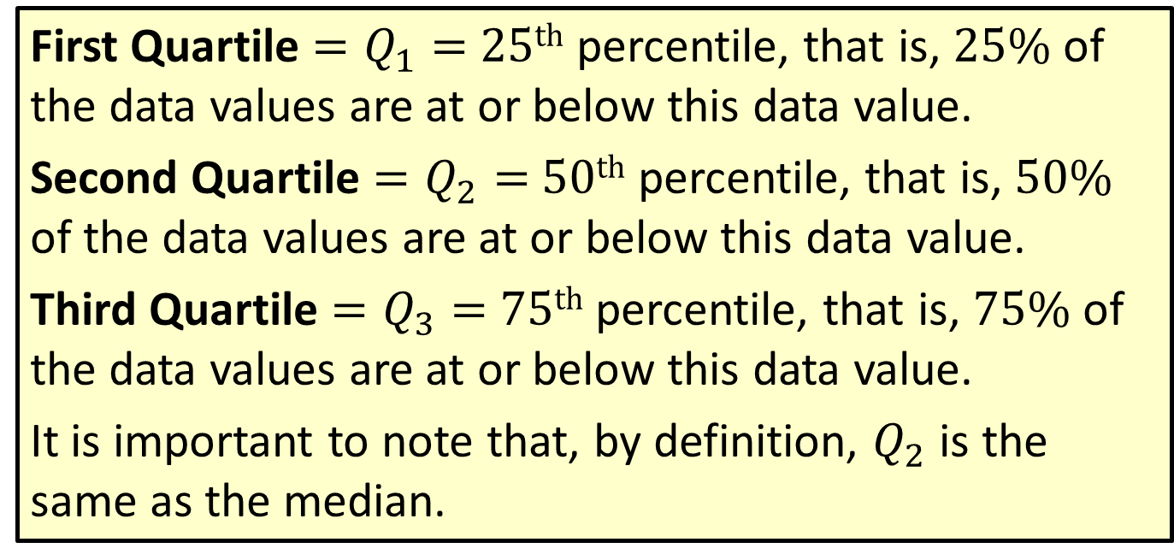
Definition: Quartiles
First Quartile $=Q_{1}=$ $25th$ percentile, that is, $25\%$ of the data values are at or below this data value.
Second Quartile $=Q_{2}=$ $50th$ percentile, that is, $50\%$ of the data values are at or below this data value.
Third Quartile $=Q_{3}=$ $75th$ percentile, that is, $75\%$ of the data values are at or below this data value.
It is important to note that, by definition, $Q_{2}$ is the same as the median.

Slide 15
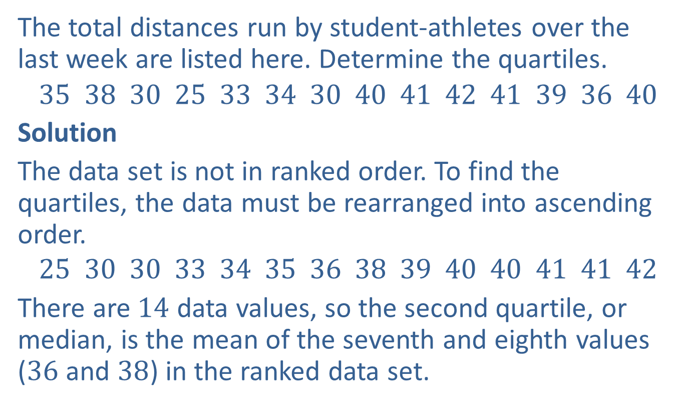
Example 5: Determining Quartiles
The total distances run by student-athletes over the last week are listed here. Determine the quartiles.
$$35 38 30 25 33 34 30 40 41 42 41 39 36 40$$
Solution
The data set is not in ranked order. To find the quartiles, the data must be rearranged into ascending order.
$$25 30 30 33 34 35 36 38 39 40 40 41 41 42$$
There are $14$ data values, so the second quartile, or median, is the mean of the seventh and eighth values ($36$ and $38$) in the ranked data set.

Slide 16
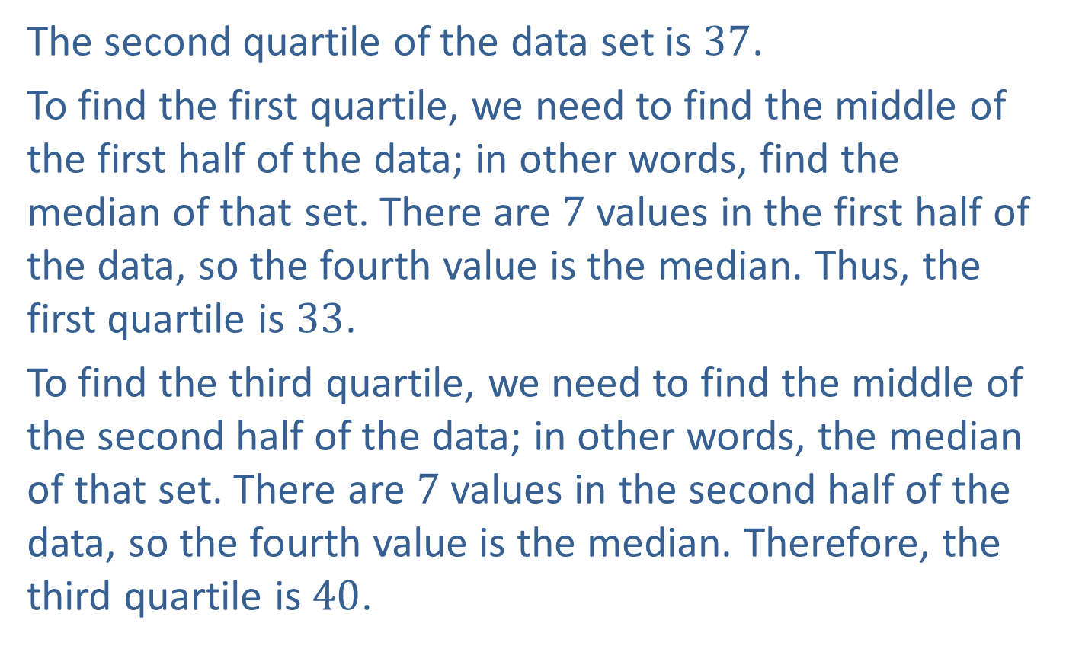
Example 5: Determining Quartiles (cont.)
The second quartile of the data set is $37$.
To find the first quartile, we need to find the middle of the first half of the data; in other words, find the median of that set. There are $7$ values in the first half of the data, so the fourth value is the median. Thus, the first quartile is $33$.
To find the third quartile, we need to find the middle of the second half of the data; in other words, the median of that set. There are $7$ values in the second half of the data, so the fourth value is the median. Therefore, the third quartile is $40$.

Slide 17




Example 5: Determining Quartiles (cont.)
$$25 30 30 33 34 35 36 38 39 40 40 41 41 42$$
First Quartile = $33$
Second Quartile (Median) $=37$
Third Quartile $=40$
$$Q1$$
$$Q2$$
$$Q3$$

