Slide 1
Section 2.3
Measures of Center

Slide 2
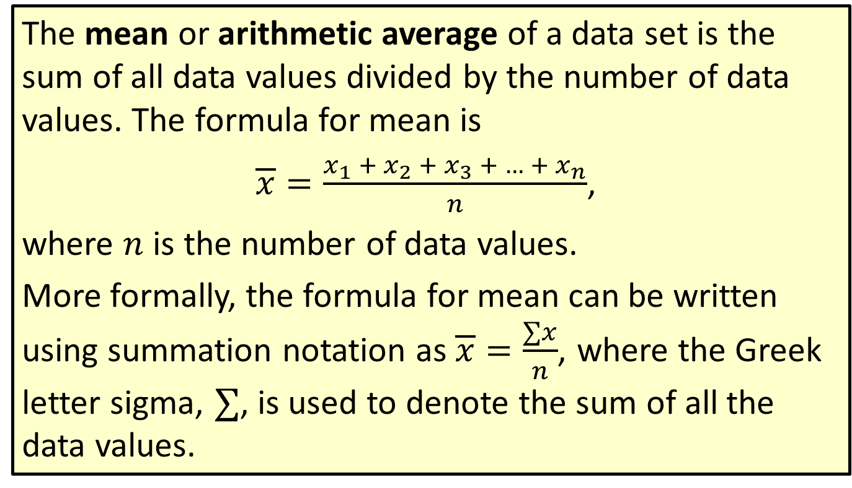
Definition: Mean
The mean or arithmetic average of a data set is the sum of all data values divided by the number of data values. The formula for mean is
$\overline{x}=\frac{x_{1} + x_{2} + x_{3} + … + x_{n}}{n}$,
where $n$ is the number of data values.
More formally, the formula for mean can be written using summation notation as $\overline{x}=\frac{∑x}{n}$, where the Greek letter sigma, $∑$, is used to denote the sum of all the data values.

Slide 3
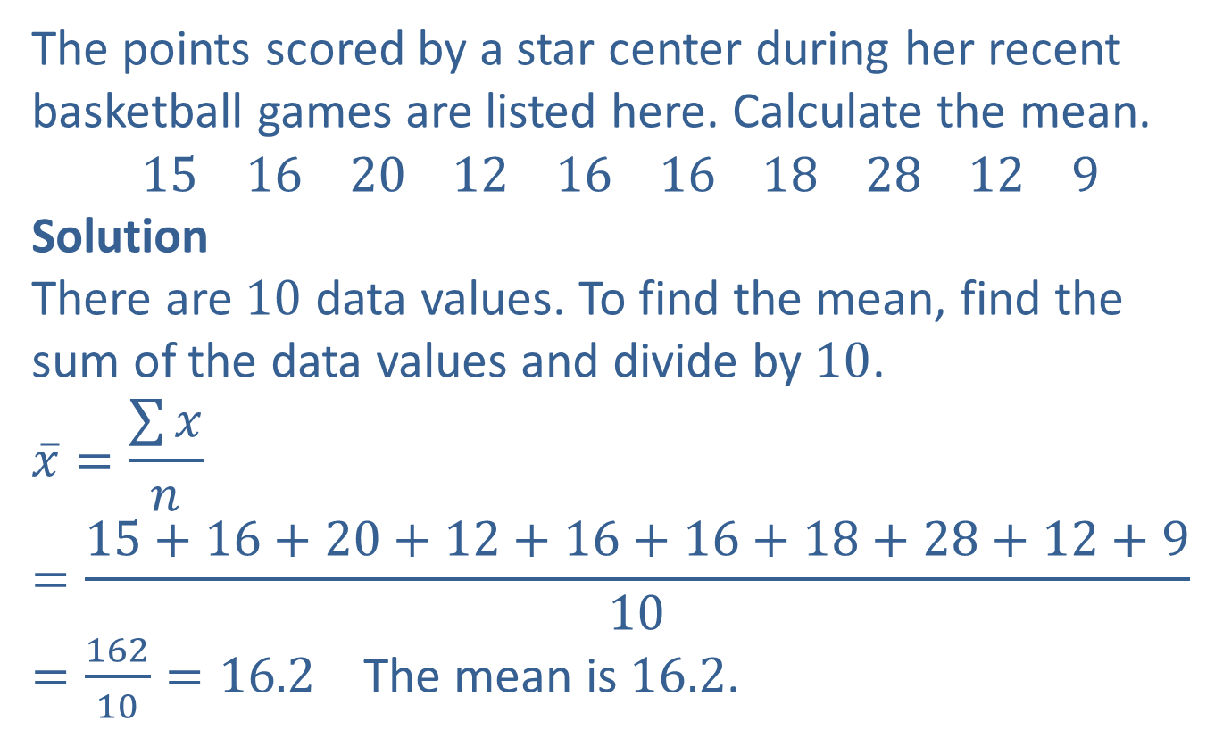
Example 1: Finding the Mean
The points scored by a star center during her recent basketball games are listed here. Calculate the mean.
$$15 16 20 12 16 16 18 28 12 9$$
Solution
There are $10$ data values. To find the mean, find the sum of the data values and divide by $10$.
$$\overline{x}=\frac{\sum{x}}{n}=\frac{15+16+20+12+16+16+18+28+12+9}{10}$$
$=\frac{162}{10}=16.2$ The mean is $16.2$.

Slide 4
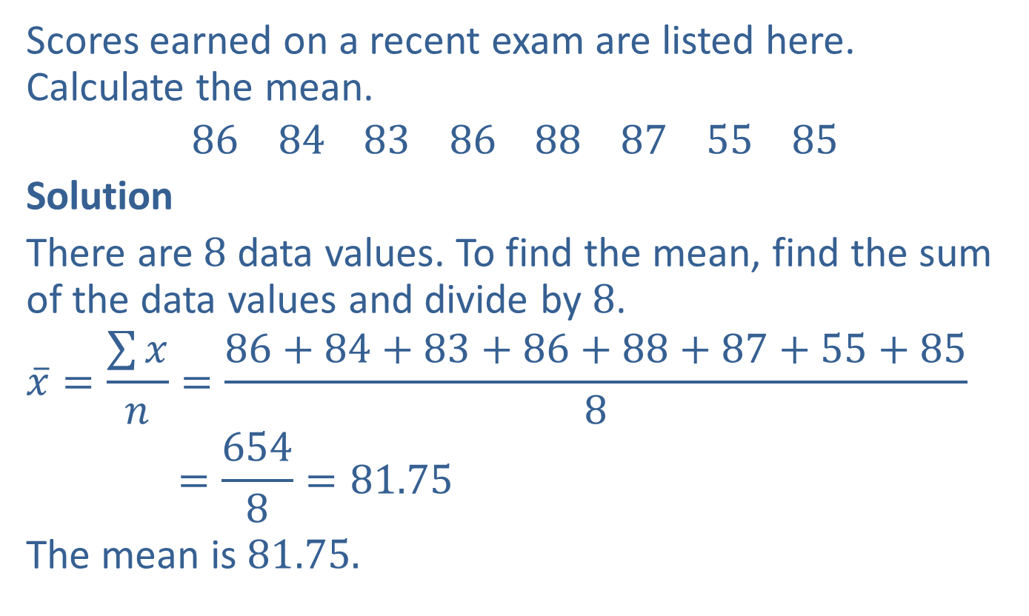
Example 2: Finding the Mean
Scores earned on a recent exam are listed here. Calculate the mean.
$$86 84 83 86 88 87 55 85$$
Solution
There are $8$ data values. To find the mean, find the sum of the data values and divide by $8$.
$$\overline{x}=\frac{\sum{x}}{n}=\frac{86+84+83+86+88+87+55+85}{8}$$
$$=\frac{654}{8}=81.75$$
The mean is $81.75$.

Slide 5
Procedure: Determining the Median
​Arrange the data in ranked (ascending or descending) order.
a. ​If there is an odd number of data values, the
median is the middle value.
​If there is an even number of data values, the median is the mean of the middle two data values.
Note: When there is an even number of data points in a set, unless the two middle data points are equal, the median will not be a value in the data set.

Slide 6
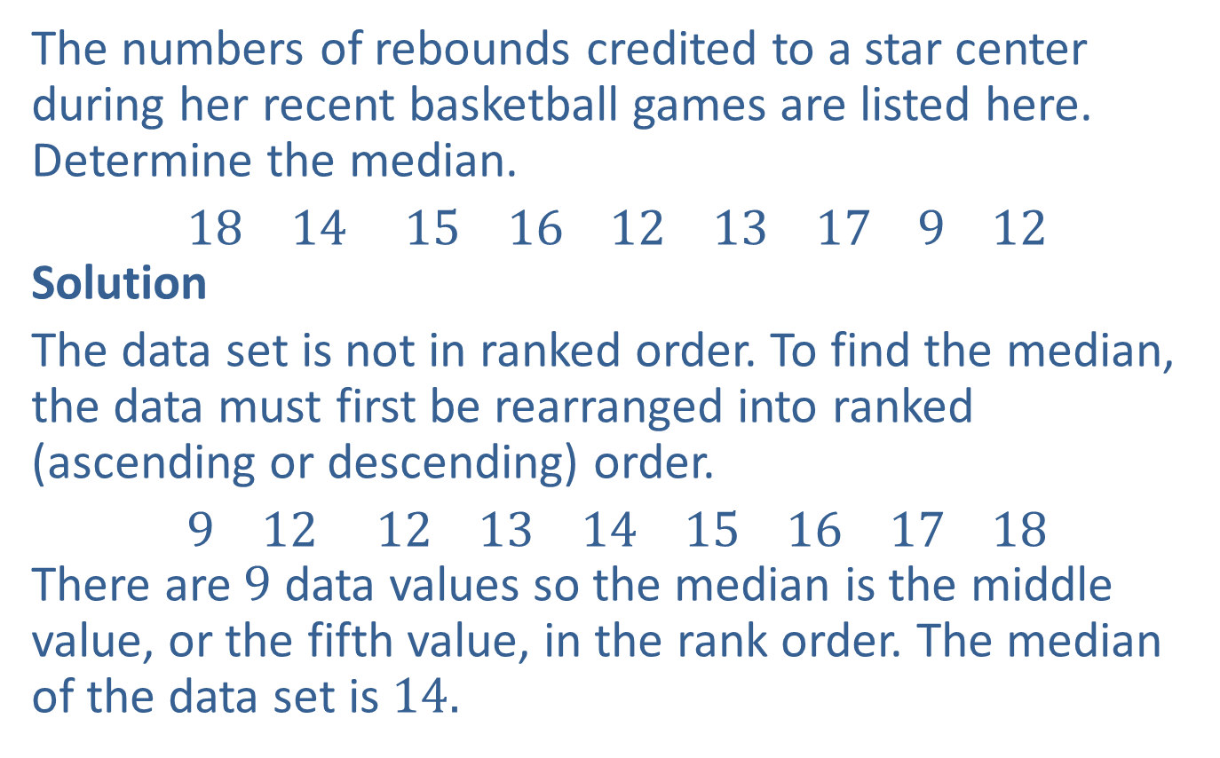
Example 3: Finding the Median
The numbers of rebounds credited to a star center during her recent basketball games are listed here. Determine the median.
$18 14 15 16 12 13 17 9 12$
Solution
The data set is not in ranked order. To find the median, the data must first be rearranged into ranked (ascending or descending) order.
$9 12 12 13 14 15 16 17 18$
There are $9$ data values so the median is the middle value, or the fifth value, in the rank order. The median of the data set is $14.$

Slide 7
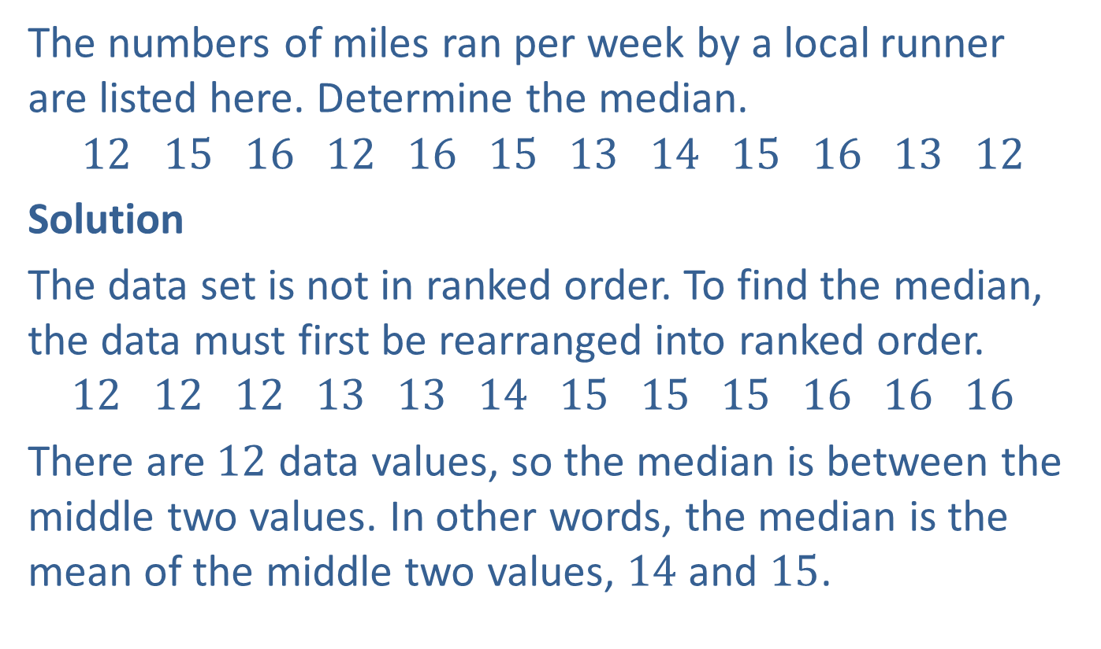
Example 4: Finding the Median
The numbers of miles ran per week by a local runner are listed here. Determine the median.
$$12 15 16 12 16 15 13 14 15 16 13 12$$
Solution
The data set is not in ranked order. To find the median, the data must first be rearranged into ranked order.
$$12 12 12 13 13 14 15 15 15 16 16 16$$
There are $12$ data values, so the median is between the middle two values. In other words, the median is the mean of the middle two values, $14$ and $15$.

Slide 8

Example 4: Finding the Median (cont.)
$$\overline{x}=\frac{14+15}{2}=\frac{29}{2}=14.5$$
The median of the data set is $14.5$. (Notice that $14.5$ is not a value in the data set.)

Slide 9
Definition: Mode
The mode of a data set is the data value that occurs most frequently. If all data values occur the same number of times, then there is no mode.
A data set is unimodal if there is only one data value that occurs most frequently.
A data set is bimodal if there are two data values that occur the same number of times and also occur more frequently than all other values.
If there are more than two data values that qualify to be the mode, then we say the data set is multimodal.

Slide 10
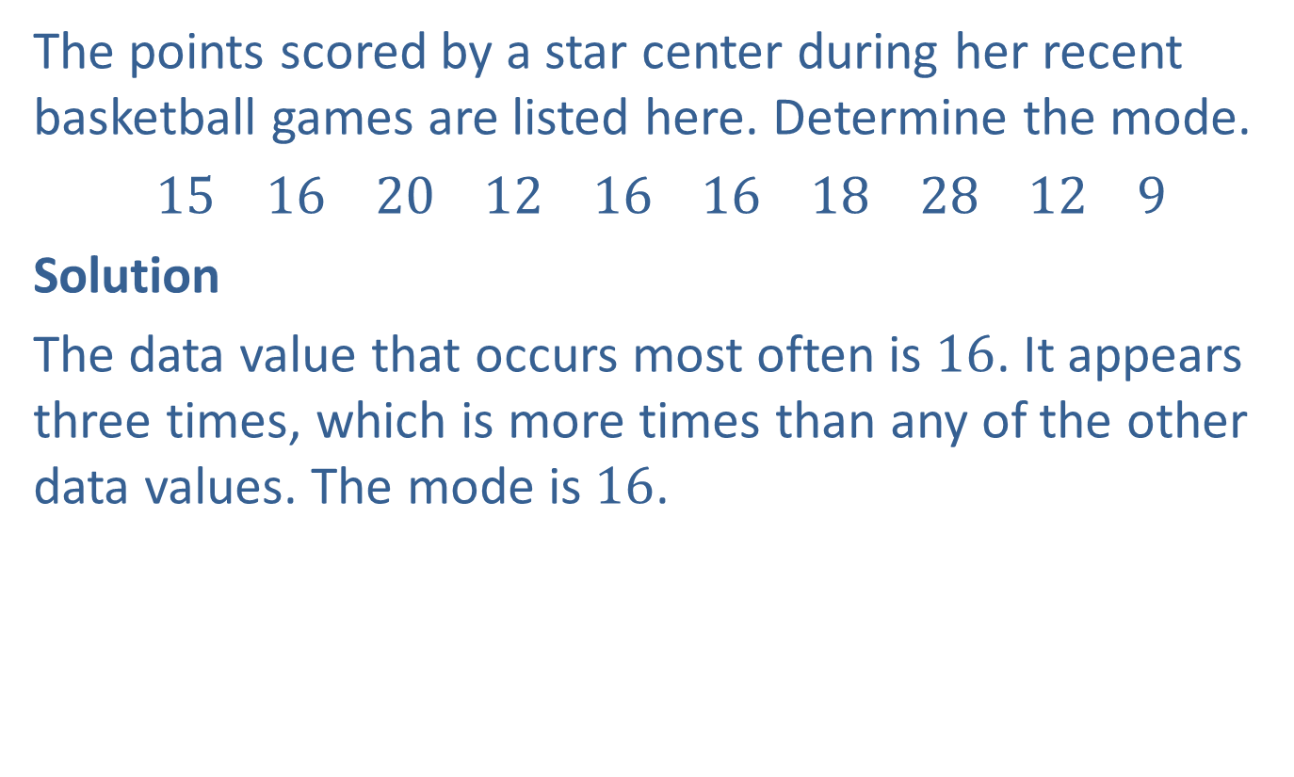
Example 5: Finding the Mode
The points scored by a star center during her recent basketball games are listed here. Determine the mode.
$15 16 20 12 16 16 18 28 12 9$
Solution
The data value that occurs most often is $16$. It appears three times, which is more times than any of the other data values. The mode is $16$.

Slide 11
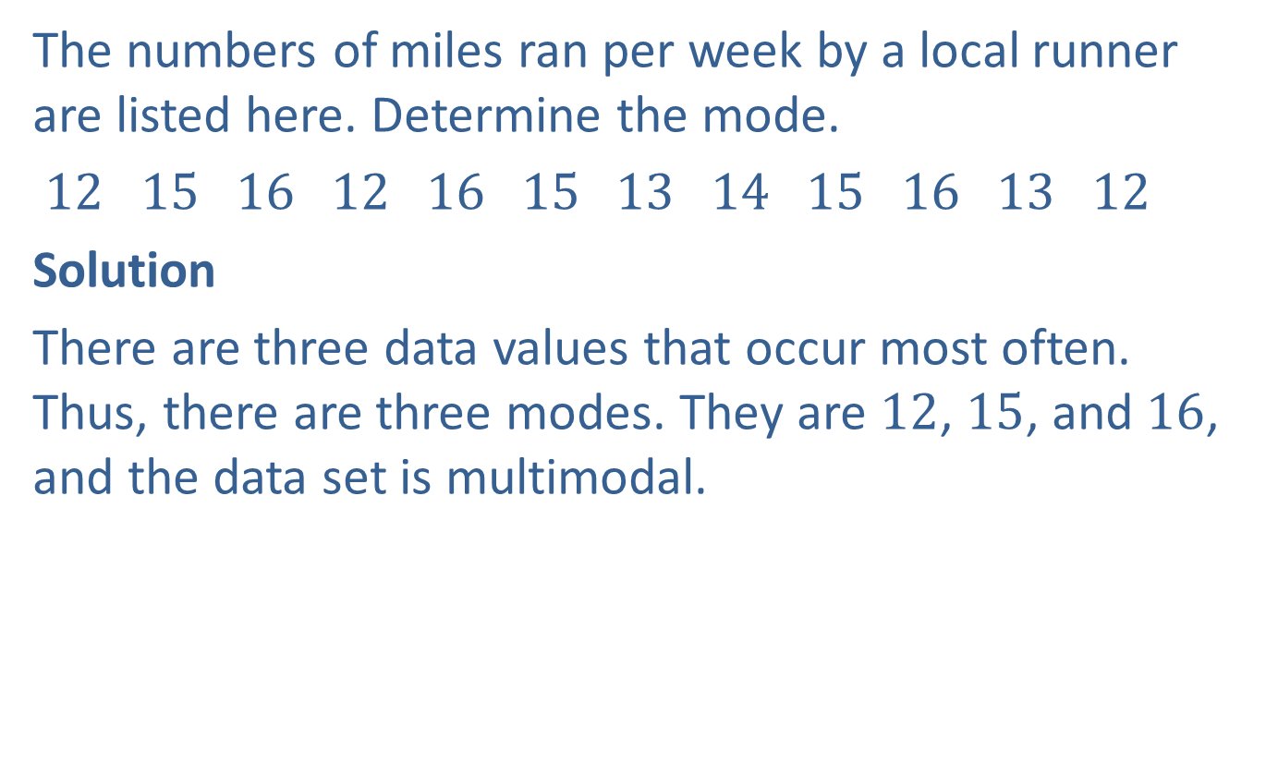
Example 6: Finding the Mode
The numbers of miles ran per week by a local runner are listed here. Determine the mode.
$12 15 16 12 16 15 13 14 15 16 13 12$
Solution
There are three data values that occur most often. Thus, there are three modes. They are $12$, $15$, and $16$, and the data set is multimodal.

Slide 12
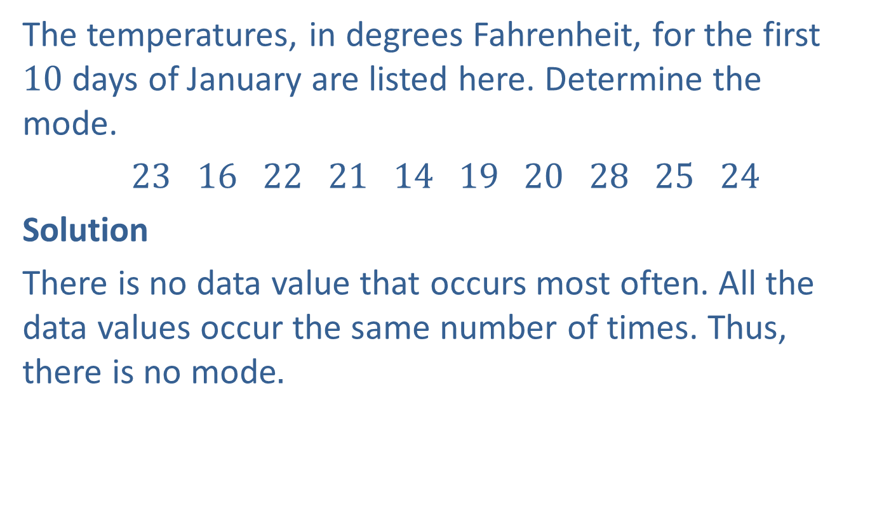
Example 7: Finding the Mode
The temperatures, in degrees Fahrenheit, for the first $10$ days of January are listed here. Determine the mode.
$23 16 22 21 14 19 20 28 25 24$
Solution
There is no data value that occurs most often. All the data values occur the same number of times. Thus, there is no mode.

Slide 13
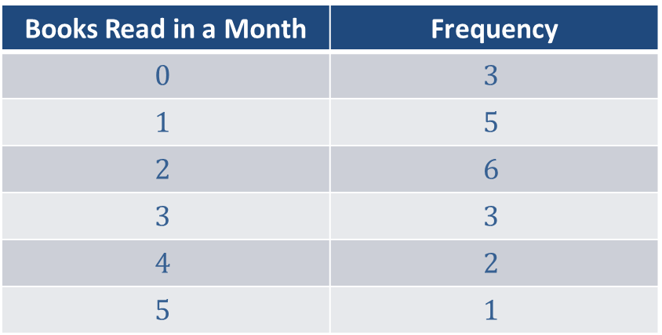
Example 8: Application: Finding Measures of Central Tendency from a Frequency Distribution
Use the following frequency distribution to determine a. the mean, b. the median, and c. the mode for the given data concerning the number of books read in August by book club members.
Number of Books read by Members of the Sweetwater Book Club in the month of August
Books Read in a Month | Frequency
$$0$$ | $$3$$
$$1$$ | $$5$$
$$2$$ | $$6$$
$$3$$ | $$3$$
$$4$$ | $$2$$
$$5$$ | $$1$$

Slide 14
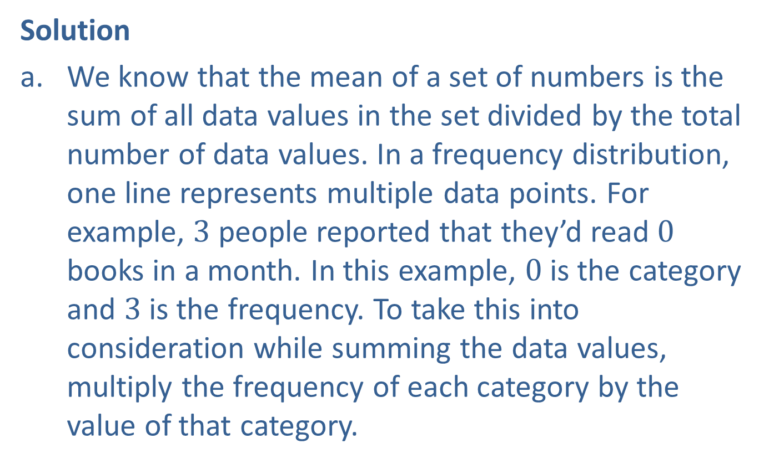
Example 8: Application: Finding Measures of Central Tendency from a Frequency Distribution (cont.)
Solution
We know that the mean of a set of numbers is the sum of all data values in the set divided by the total number of data values. In a frequency distribution, one line represents multiple data points. For example, $3$ people reported that they’d read $0$ books in a month. In this example, $0$ is the category and $3$ is the frequency. To take this into consideration while summing the data values, multiply the frequency of each category by the value of that category.

Slide 15
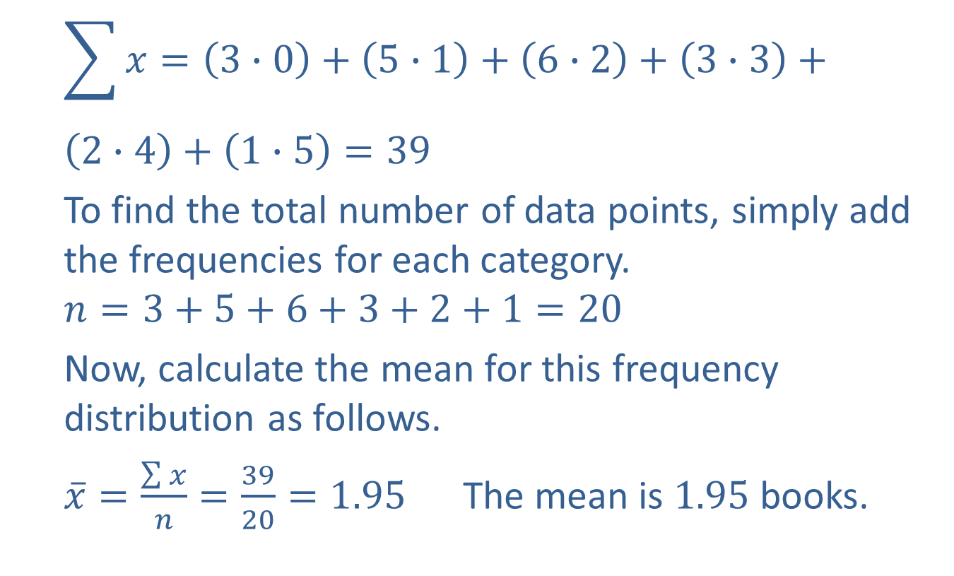
Example 8: Application: Finding Measures of Central Tendency from a Frequency Distribution (cont.)
$$\sum{x=\left(3∙0\right)+\left(5∙1\right)+\left(6∙2\right)+\left(3∙3\right)+}$$
$$\left(2∙4\right)+\left(1∙5\right)=39$$
To find the total number of data points, simply add the frequencies for each category.
$$n=3+5+6+3+2+1=20$$
Now, calculate the mean for this frequency distribution as follows.
$\overline{x}=\frac{\sum{x}}{n}=\frac{39}{20}=1.95$ The mean is $1.95$ books.

Slide 16
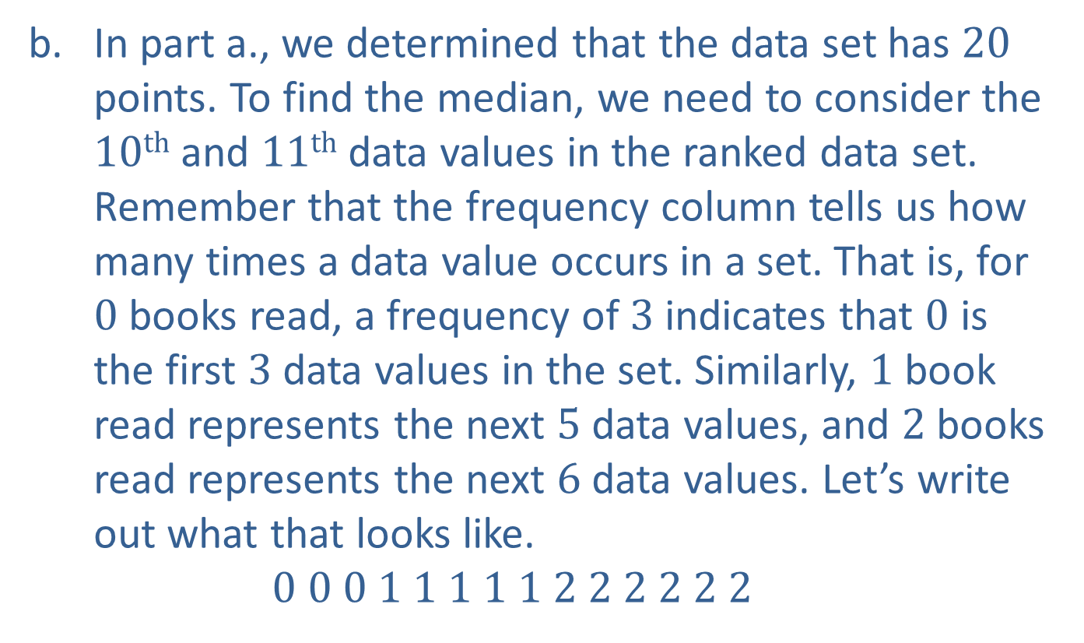
Example 8: Application: Finding Measures of Central Tendency from a Frequency Distribution (cont.)
In part a., we determined that the data set has $20$ points. To find the median, we need to consider the $10th$ and $11th$ data values in the ranked data set. Remember that the frequency column tells us how many times a data value occurs in a set. That is, for $0$ books read, a frequency of $3$ indicates that $0$ is the first $3$ data values in the set. Similarly, $1$ book read represents the next $5$ data values, and $2$ books read represents the next $6$ data values. Let’s write out what that looks like.
$$0 0 0 1 1 1 1 1 2 2 2 2 2 2$$

Slide 17
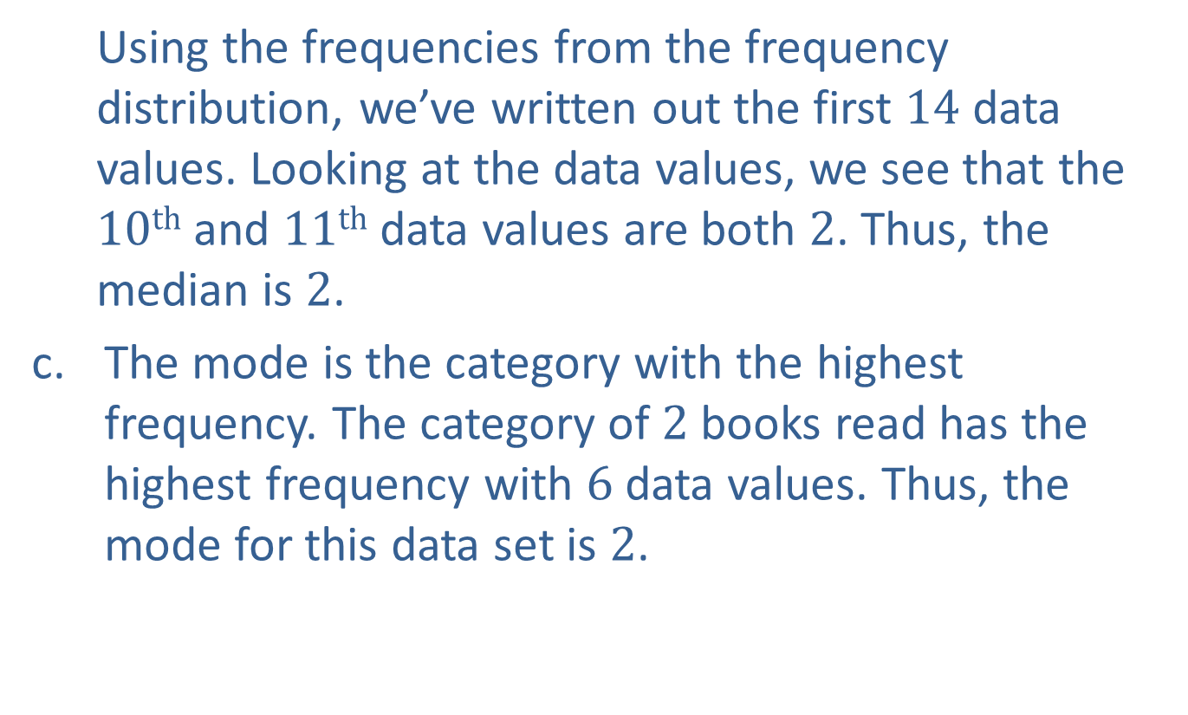
Example 8: Application: Finding Measures of Central Tendency from a Frequency Distribution (cont.)
Using the frequencies from the frequency distribution, we’ve written out the first $14$ data values. Looking at the data values, we see that the $10th$ and $11th$ data values are both $2$. Thus, the median is $2$.
The mode is the category with the highest frequency. The category of $2$ books read has the highest frequency with $6$ data values. Thus, the mode for this data set is $2$.

Slide 18
Procedure: Finding the Weighted Mean
The weighted mean is the mean of a data set where each data value in the set does not hold the same level of importance. The weighted mean is calculated as follows.
Multiply each data value by the weight assigned to that data value.
Calculate the sum of the products.
Calculate the sum of the weights.
Divide the sum of the products by the sum of the weights.

Slide 19
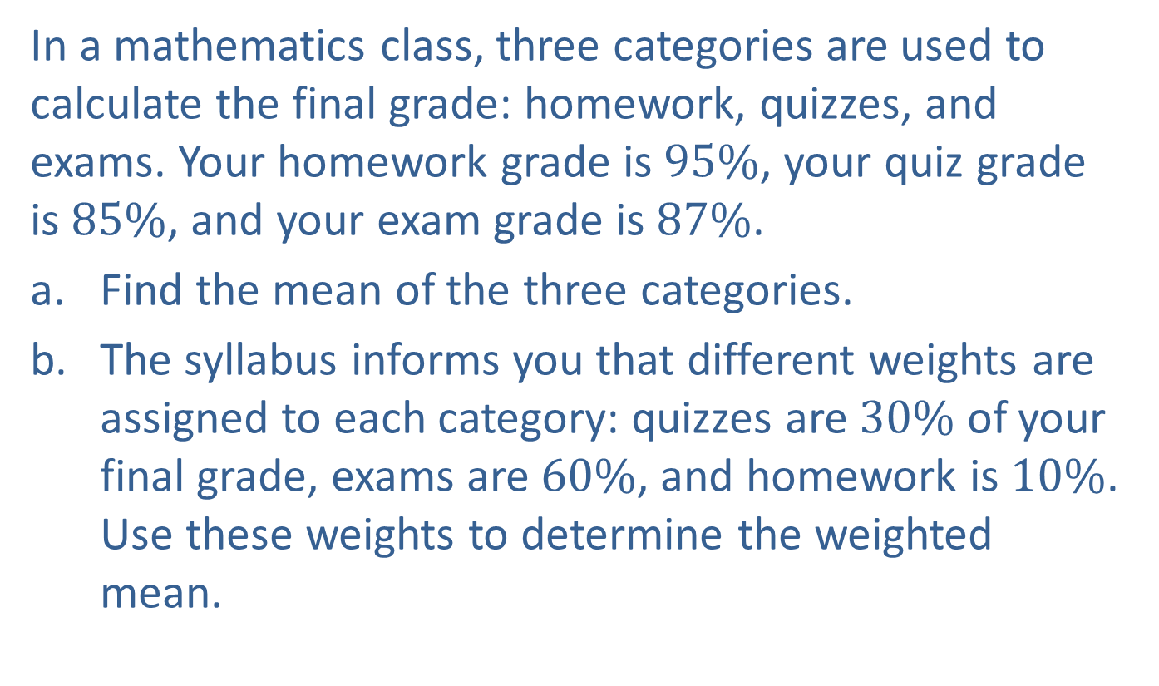
Example 9: Application: Finding the Weighted Mean
In a mathematics class, three categories are used to calculate the final grade: homework, quizzes, and exams. Your homework grade is $95\%$, your quiz grade is $85\%$, and your exam grade is $87\%$.
​Find the mean of the three categories.
​The syllabus informs you that different weights are assigned to each category: quizzes are $30\%$ of your final grade, exams are $60\%$, and homework is $10\%$. Use these weights to determine the weighted mean.

Slide 20
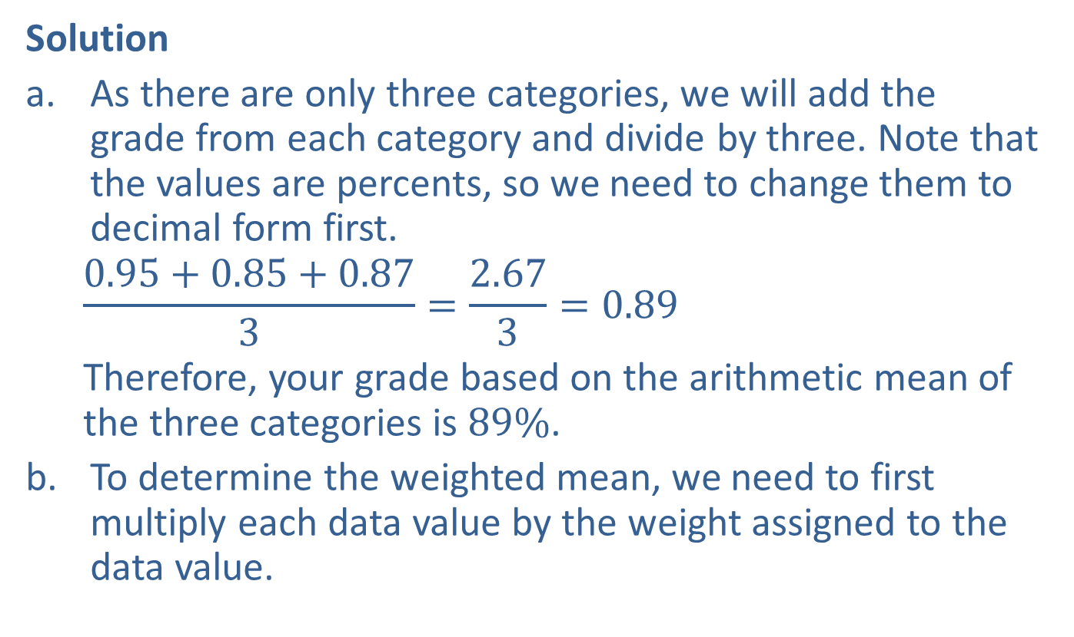
Example 9: Application: Finding the Weighted Mean (cont.)
Solution
As there are only three categories, we will add the grade from each category and divide by three. Note that the values are percents, so we need to change them to decimal form first.
$$\frac{0.95+0.85+0.87}{3}=\frac{2.67}{3}=0.89$$
Therefore, your grade based on the arithmetic mean of the three categories is $89\%$.
To determine the weighted mean, we need to first multiply each data value by the weight assigned to the data value.

Slide 21
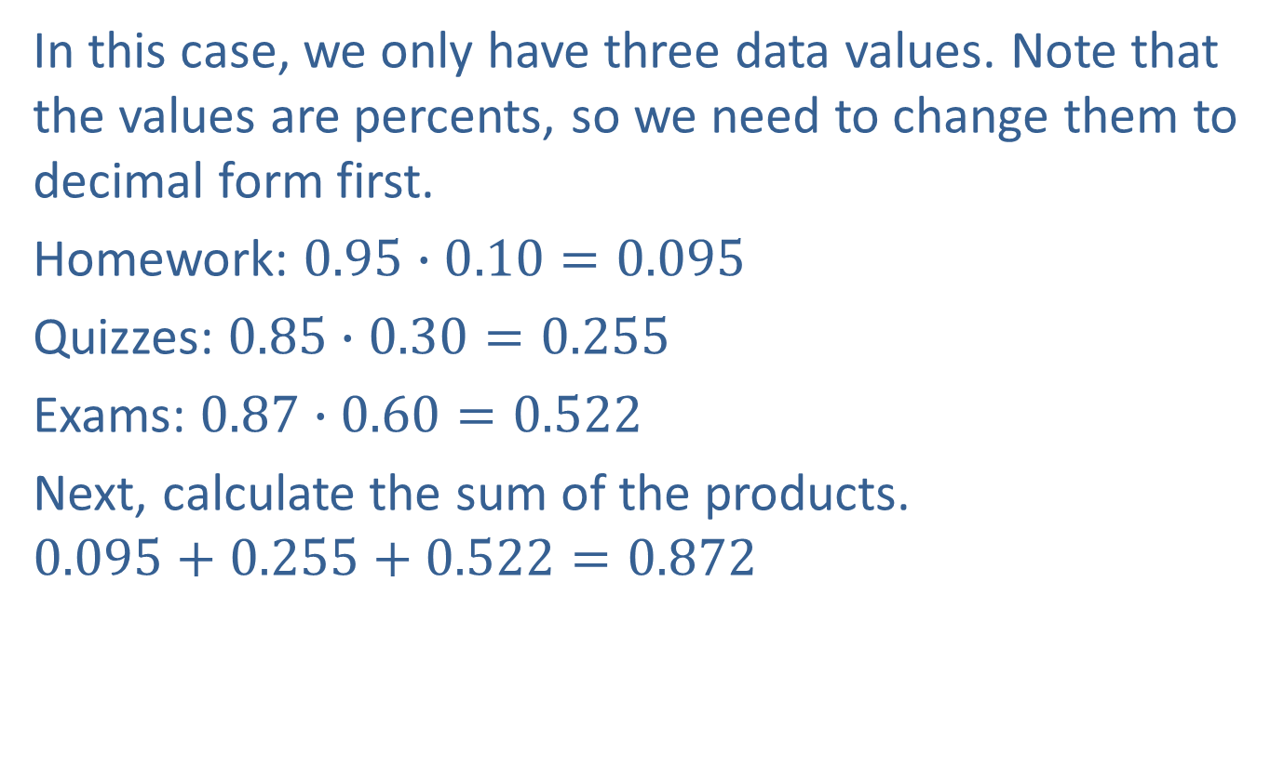
Example 9: Application: Finding the Weighted Mean (cont.)
In this case, we only have three data values. Note that the values are percents, so we need to change them to decimal form first.
Homework: $0.95∙0.10=0.095$
Quizzes: $0.85∙0.30=0.255$
Exams: $0.87∙0.60=0.522$
Next, calculate the sum of the products.
$$0.095+0.255+0.522=0.872$$

Slide 22
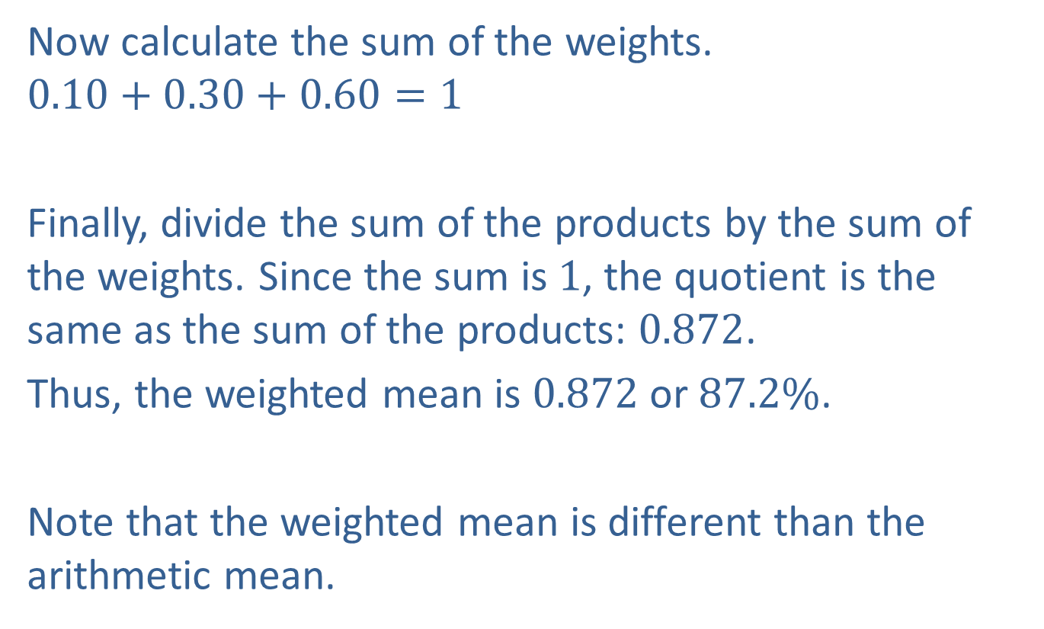
Example 9: Application: Finding the Weighted Mean (cont.)
Now calculate the sum of the weights.
$$0.10+0.30+0.60=1$$
Finally, divide the sum of the products by the sum of the weights. Since the sum is $1$, the quotient is the same as the sum of the products: $0.872$.
Thus, the weighted mean is $0.872$ or $87.2\%$.
Note that the weighted mean is different than the arithmetic mean.

