Slide 1

Section 11.5
Graphing Quadratic Functions and Applications

Slide 2
Definition: Quadratic Functions
A quadratic function is any function that can be written in the form
where a, b, and c are real numbers and a ≠ 0.

Slide 3
Example 1: Graphing Quadratic Functions
Graph each quadratic function, setting up a table of values for x and y as an aid. Choose values of x on each side of the line of symmetry.

Slide 4
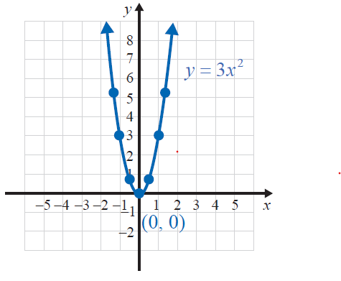
Example 1: Graphing Quadratic Functions (cont.)
Solution
a.
x | y
−1 | 3
0 | 0
1 | 3

Slide 5
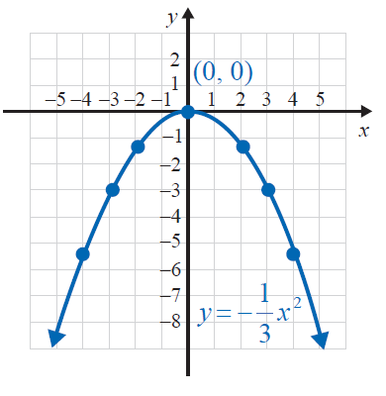
Example 1: Graphing Quadratic Functions (cont.)
x | Y
−4
−3 | −3
−2
0 | 0
2
3 | −3
4

Slide 6
Formula: Vertex Formula
The vertex of a quadratic function of the form
y = ax² + bx + c can be found by identifying the values of a and b then substituting them into the following formulas.
Notice that to find the y-coordinate, the value of the
x-coordinate is substituted back into the original function.

Slide 7
Example 2: Graphing Quadratic Functions of the Form y = ax² + bx + c
For find the line of symmetry, vertex,
x-intercepts, and y-intercept.
Solution
For we have a = −1, b = −4, and c = 2. If
then

Slide 8
Example 2: Graphing Quadratic Functions of the Form y = ax² + bx + c (cont.)
So the vertex is at (−2, 6) and the line of symmetry is
x = −2.
If x = 0, then y = −(0)² −4 ⋅ 0 + 2 = 2 and the y-intercept is at (0, 2).
If y = 0, then
Quadratic formula

Slide 9
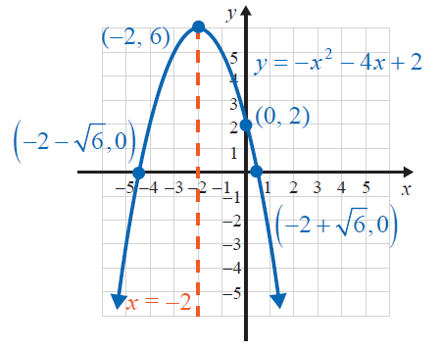
Example 2: Graphing Quadratic Functions of the Form y = ax² + bx + c (cont.)
The x-intercepts are at and
Summary:
line of symmetry is x = −2.
vertex: (−2, 6)
x-intercepts: and
y-intercept: (0, 2)

Slide 10
Example 3: Graphing Quadratic Functions of the Form y = ax² + bx + c
For find the line of symmetry, vertex,
x-intercepts, and y-intercept.
Solution
For we have a = 2, b = −6, and c = 5.
If then

Slide 11
Example 3: Graphing Quadratic Functions of the Form y = ax² + bx + c (cont.)
So we have the vertex at and the line of
symmetry is
If x = 0, then and the y-intercept is at (0, 5).
If y = 0, then
Quadratic formula

Slide 12
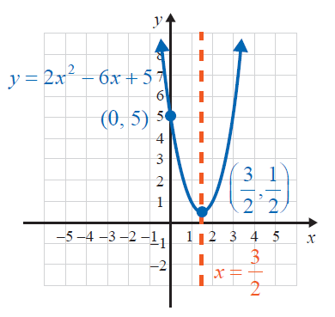
Example 3: Graphing Quadratic Functions of the Form y = ax² + bx + c (cont.)
There are no real zeros because the discriminant is negative. The graph will not cross the x-axis.
Summary:
vertex:
line of symmetry is
x-intercepts: none
y-intercept: (0, 5)

Slide 13
Definition: Minimum and Maximum Values
For
If a > 0, then the parabola opens upward and the vertex is the lowest point and the y-coordinate of the vertex is called the minimum value of the function.
If a < 0, then the parabola opens downward and vertex is the highest point and y-coordinate of the vertex is called the maximum value of the function.

Slide 14
Example 4: Application: Finding Minimum and Maximum Values
A ball is thrown vertically upward from the ground with an initial velocity of 64 ft per second. Using the function where h is the height of the object after time t, v₀ is the initial velocity, and h₀ is the initial height, determine how long it will take for the ball to reach its maximum height and what that height will be.
Solution
For this problem, we are told that v₀ = 64 ft per second and h₀ = 0 ft (ground level), so the quadratic function modeling the path of the ball is

Slide 15
Example 4: Application: Finding Minimum and Maximum Values (cont.)
For this function a = −16, b = 64, and the maximum
height occurs at the point where
For t = 2,
Thus, it will take the ball 2 seconds to reach its maximum height of 64 feet.

Slide 16
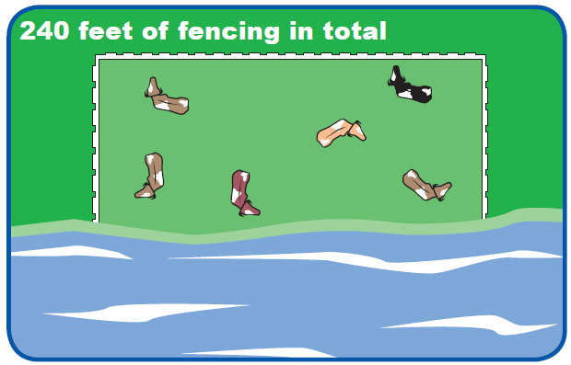
Example 5: Application: Finding Minimum and Maximum Values
A rancher is going to build three sides of a rectangular corral next to a river. He has 240 feet of fencing and wants to enclose the maximum area possible. What are the dimensions of the fencing that gives the corral its maximum area?

Slide 17
Example 5: Application: Finding Minimum and Maximum Values (cont.)
Solution
Let x represent the length of the two equal sides of the rectangular corral and 240 − 2x represent the length of the third side of the rectangular corral.
Since area equals length times width, the area A of the corral is represented by the quadratic function
The maximum area occurs at the point where

Slide 18
Example 5: Application: Finding Minimum and Maximum Values (cont.)
Two sides of the rectangle are 60 feet and the third side is 240 – 2(60) = 120 feet.
The maximum area possible is
60(120) = 7200 square feet.

Slide 19
Example 6: Graphing with a Calculator
Use a graphing calculator to graph the quadratic function y = 2x² − x − 15. Then use the TRACE key to estimate the location of three points on the graph.
Solution
Step 1: Press the Y= key.
Step 2: Enter the function to be graphed:
\Y1 = 2X² − X − 15.
Step 3: Press GRAPH in the upper right-hand corner of the keyboard.

Slide 20
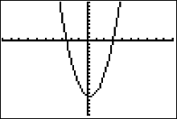
Example 6: Graphing with a Calculator (cont.)
Step 4: If using the standard window, the vertex of the parabola may not be visible. Press WINDOW and adjust the settings so that Xmin = −10 , Xmax = 10 , Ymin = −20 and Ymax = 10.
The graph of the parabola should appear on the display as shown here.

Slide 21
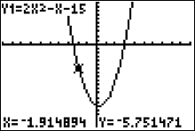
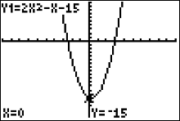
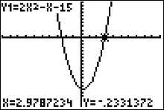
Example 6: Graphing with a Calculator (cont.)
Now, press the TRACE key and move the cursor around to estimate the location of points.
Three such locations are shown here.

