Slide 1
Section 10.5
Multiplication with Radicals

Slide 2
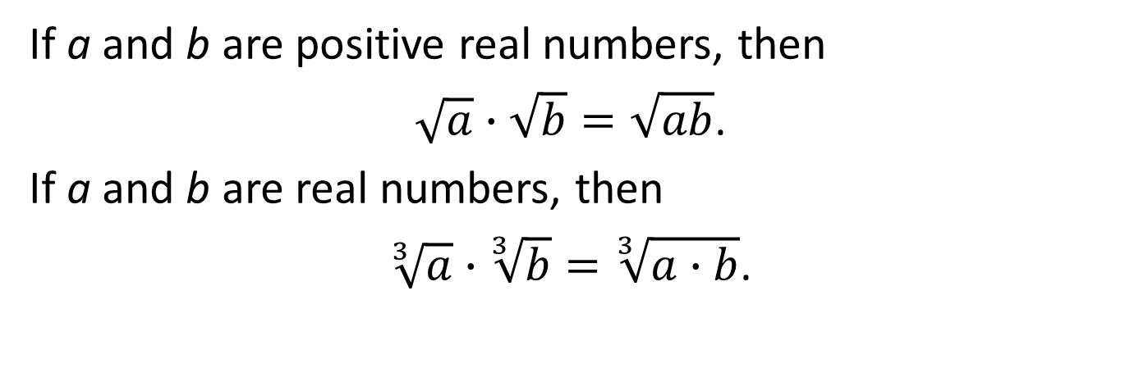
Properties: Multiplication Property of Radicals
If a and b are positive real numbers, then
$\sqrt{a}∙\sqrt{b}=\sqrt{ab}$.
If a and b are real numbers, then
$\sqrt[3]{a}∙\sqrt[3]{b}=\sqrt[3]{a∙b}$.

Slide 3
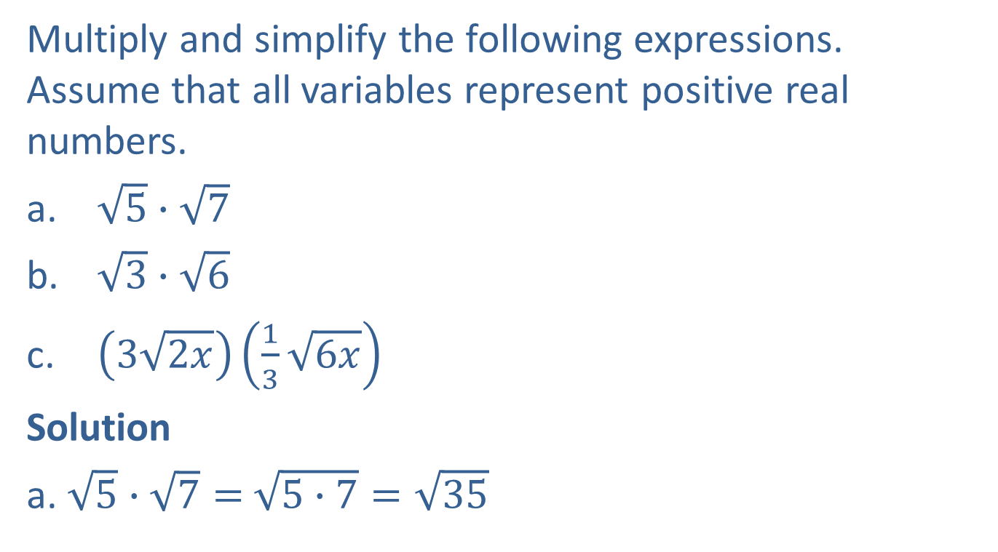
Example 1: Multiplying Radicals
Multiply and simplify the following expressions. Assume that all variables represent positive real numbers.
$\sqrt{5}∙\sqrt{7}$
$\sqrt{3}∙\sqrt{6}$
$\left(3\sqrt{2x}\right)\left(\frac{1}{3}\sqrt{6x}\right)$
Solution
a. $\sqrt{5}∙\sqrt{7}=$ $\sqrt{5∙7}=\sqrt{35}$

Slide 4
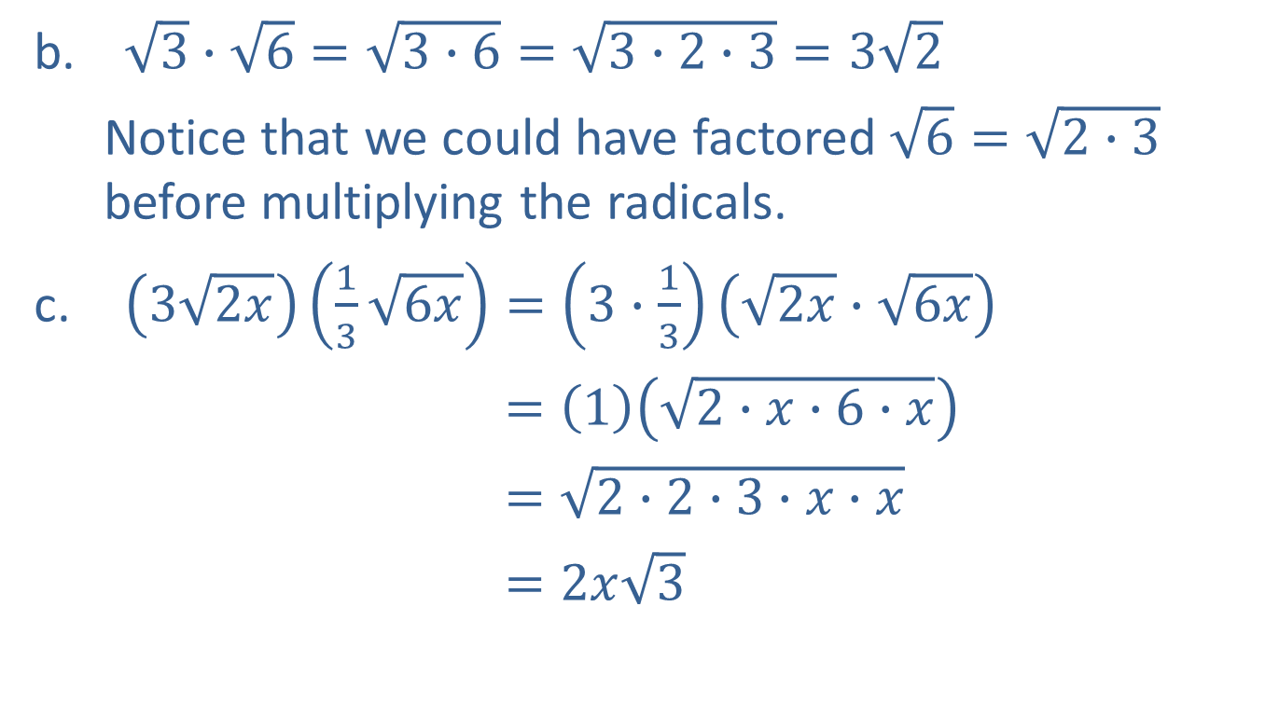
Example 1: Multiplying Radicals (cont.)
$\sqrt{3}∙\sqrt{6}=\sqrt{3∙6}=\sqrt{3∙2∙3}=3\sqrt{2}$
Notice that we could have factored $\sqrt{6}=\sqrt{2∙3}$ before multiplying the radicals.
$\left(3\sqrt{2x}\right)\left(\frac{1}{3}\sqrt{6x}\right)=\left(3∙\frac{1}{3}\right)\left(\sqrt{2x}∙\sqrt{6x}\right)$
$=\left(1\right)\left(\sqrt{2∙x∙6∙x}\right)$
$=\sqrt{2∙2∙3∙x∙x}$
$=2x\sqrt{3}$

Slide 5
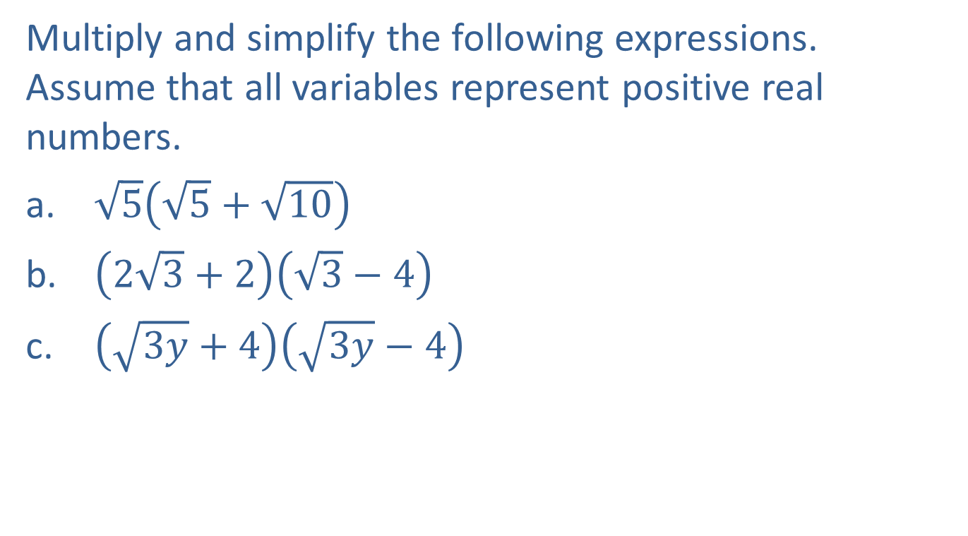
Example 2: Multiplying Radical Expressions
Multiply and simplify the following expressions. Assume that all variables represent positive real numbers.
$\sqrt{5}\left(\sqrt{5}+\sqrt{10}\right)$
$\left(2\sqrt{3}+2\right)\left(\sqrt{3}−4\right)$
$\left(\sqrt{3y}+4\right)\left(\sqrt{3y}−4\right)$

Slide 6

Example 2: Multiplying Radical Expressions (cont.)
Solution
$\sqrt{5}\left(\sqrt{5}+\sqrt{10}\right)=\sqrt{5}∙\sqrt{5}+\sqrt{5}∙\sqrt{10}$
$={\left(\sqrt{5}\right)}^{2}+\sqrt{5∙10}$
$=5+\sqrt{5∙2∙5}$
$=5+5\sqrt{2}$

Slide 7


Example 2: Multiplying Radical Expressions (cont.)
b. $\left(2\sqrt{3}+2\right)\left(\sqrt{3}−4\right)=2{\left(\sqrt{3}\right)}^{2}−4∙2∙\sqrt{3}+2\sqrt{3}−2∙4$
$=2\left(3\right)−8\sqrt{3}+2\sqrt{3}−8$
$=6−8+\left(−8+2\right)\sqrt{3}$
$=−2−6\sqrt{3}$
c. $\left(\sqrt{3y}+4\right)\left(\sqrt{3y}−4\right)={\left(\sqrt{3y}\right)}^{2}−{\left(4\right)}^{2}$
$=3y−16$
Difference of two squares:
$$\left(a+b\right)\left(a−b\right)=a^{2}−b^{2}$$

Slide 8
Completion Example 3: Multiplying with Radicals
Multiply and simplify the following expressions. Assume that all variables represent positive numbers.
Solution
a.
18

Slide 9
Completion Example 3: Multiplying with Radicals (cont.)
Solution
−4
−4
x
32

Slide 10
Example 4: Translating English Phrases into Algebraic Expressions
Translate the given English phrase into an algebraic expression.
the product of eight and the cube root of fifteen
twelve times the square root of two x minus three
twelve times the square root of a two x, minus three

Slide 11
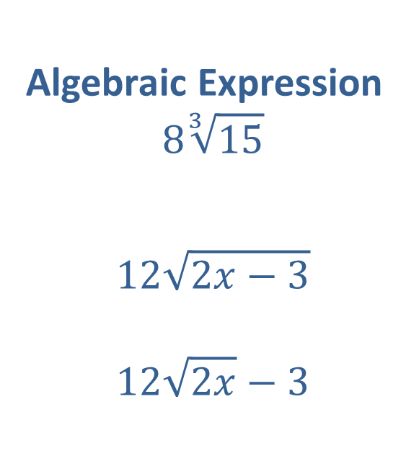
Example 4: Translating English Phrases into Algebraic Expressions (cont.)
Solution
English Phrase
the product of eight and the cube root of fifteen
twelve times the square root of two x minus three
twelve times the square root of a two x, minus three
Algebraic Expression
$$8\sqrt[3]{15}$$
$$12\sqrt{2x−3}$$
$$12\sqrt{2x}−3$$

Slide 12
Note
In Example 4b, notice that the minus three is included as part of the radicand. In Example 4c, the comma indicates a change in operation, so minus three is not
included as part of the radicand.

Slide 13
Example 5: Using a Calculator to Evaluate Radical Expressions
Use a TI-84 Plus graphing calculator to evaluate each expression. Round answers to the nearest ten-thousandth.

Slide 14
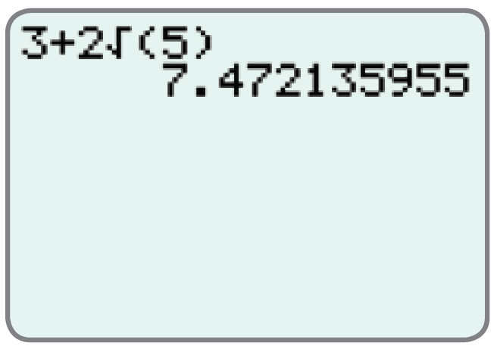
Example 5: Using a Calculator to Evaluate Radical Expressions (cont.)
Solution
The display should appear as follows.
Thus,
Rounded to the nearest ten-thousandth

Slide 15
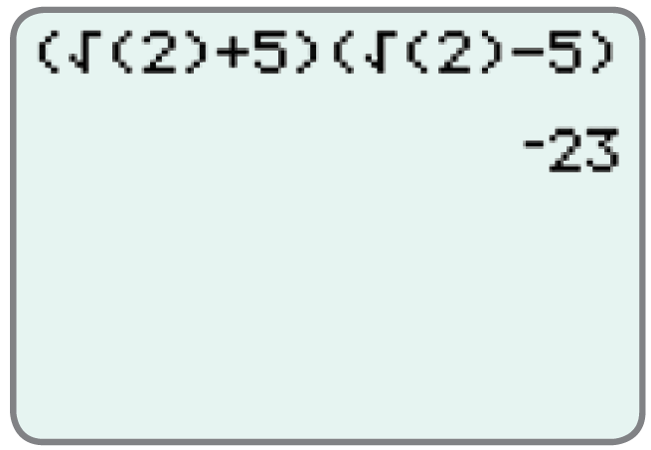
Example 5: Using a Calculator to Evaluate Radical Expressions (cont.)
b. The display should appear as follows.
Note: The right parenthesis on 2 must be
included. Otherwise, the calculator will
interpret the expression as
which is not intended.
Thus,

